Slide 1
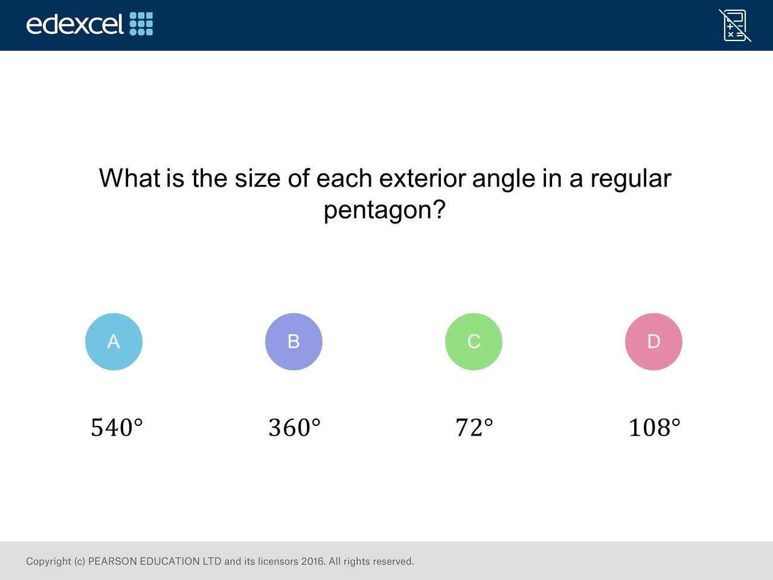
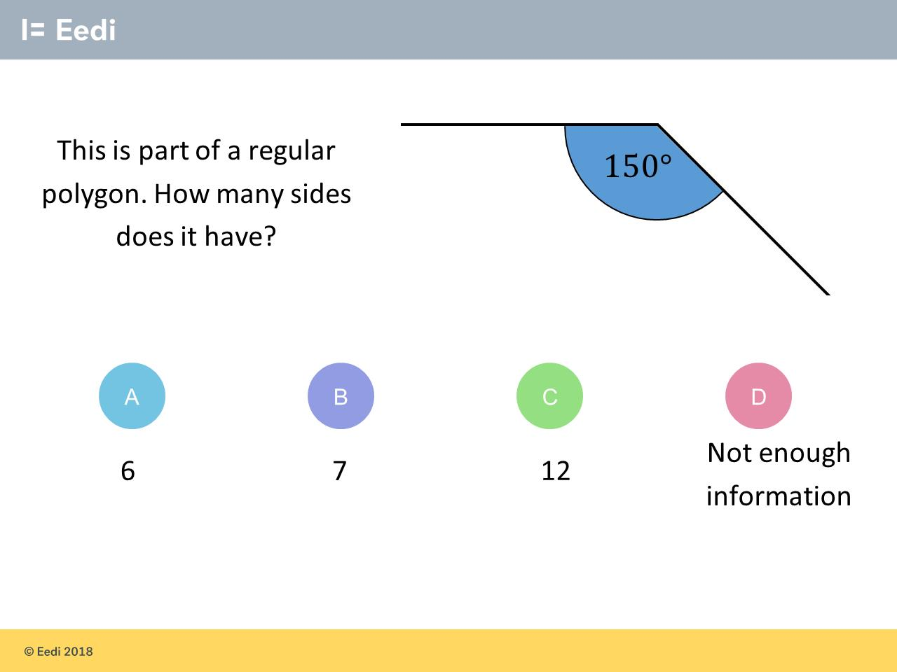
Worst answered question?
Most common wrong answer?

Slide 2
ANSWERS

Slide 3
Worst answered question?

Slide 4
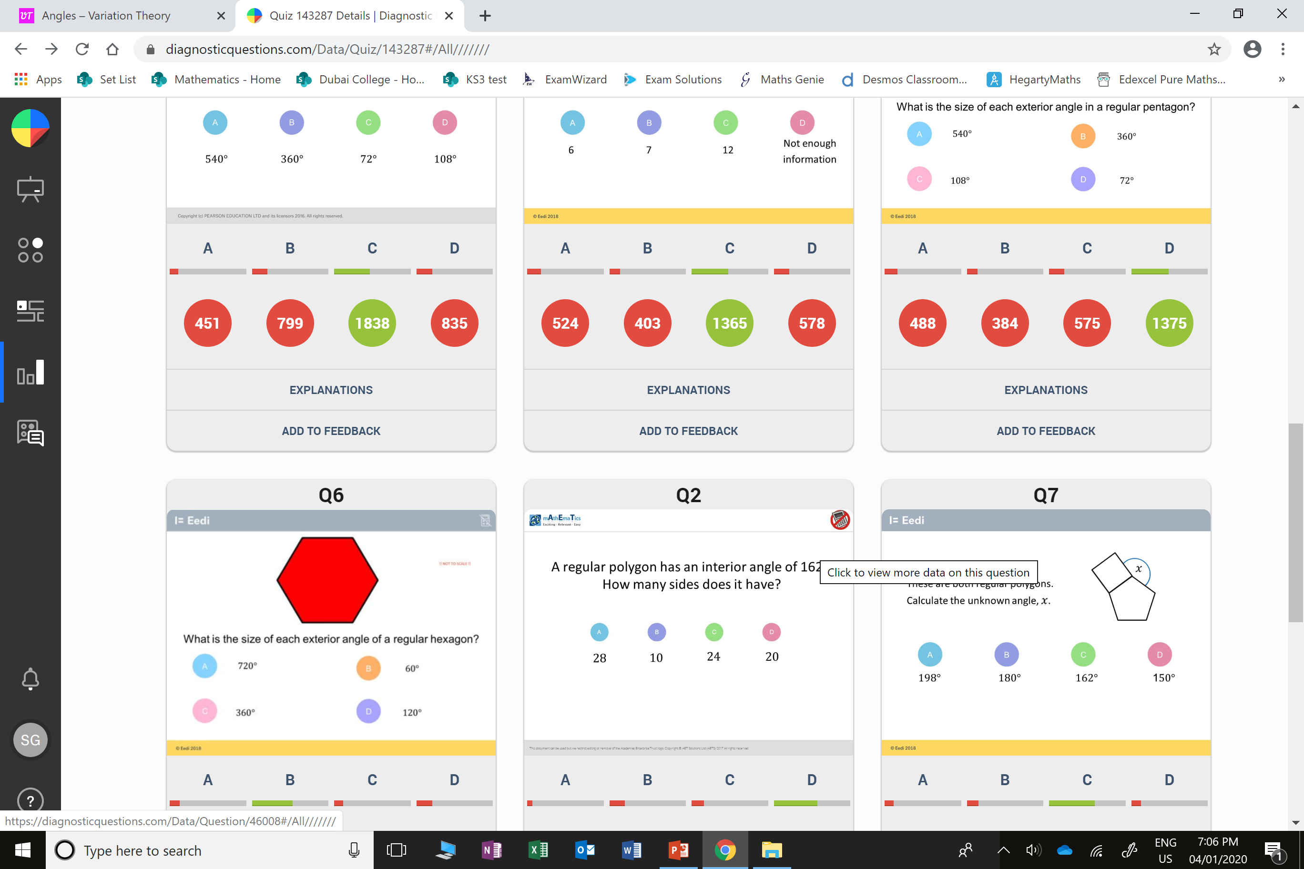
D
They gave the interior angle.

Slide 5
D
The don’t recognise they need to work out the exterior angle.

