Slide 1
Convert the decimals to a % and a fraction in its simplest form.
Decimal | % | Fraction
0.5
0.05
0.005
0.055
0.555
5
5.5
Decimal | % | Fraction
1.5
1.05
1.005
1.055
1.555
6
6.5

Slide 2
Convert the % to a decimal and a fraction in its simplest form.
% | Decimals | Fraction
0.2%
2%
2.2%
20%
22%
200%
2000%
% | Decimals | Fraction
100.2%
102%
102.2%
120%
122%
300%
2100%

Slide 3
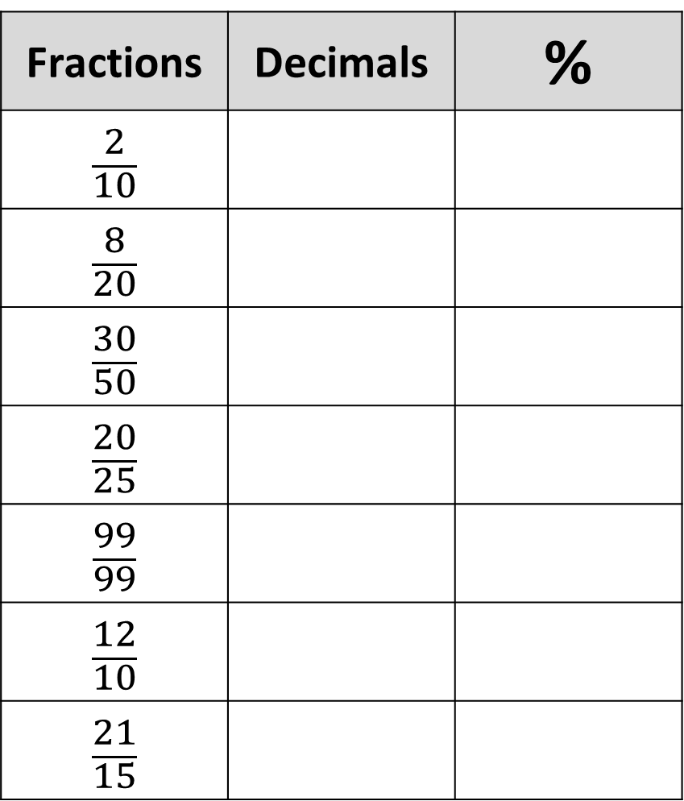
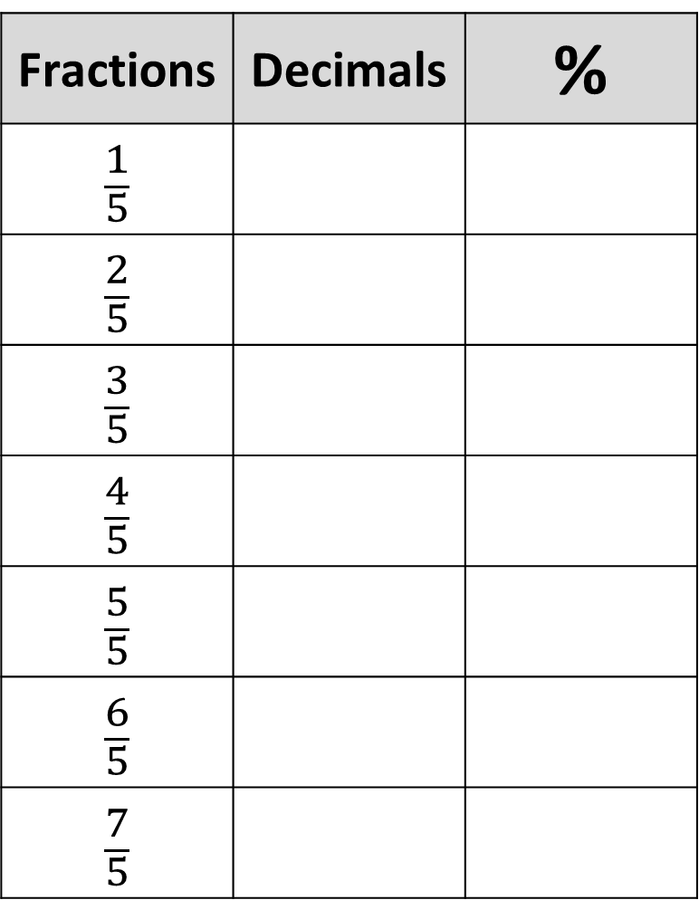
Convert the fraction to a decimal and a percentage.
Fractions | Decimals | %
$$\frac{1}{5}$$
$$\frac{2}{5}$$
$$\frac{3}{5}$$
$$\frac{4}{5}$$
$$\frac{5}{5}$$
$$\frac{6}{5}$$
$$\frac{7}{5}$$
Fractions | Decimals | %
$$\frac{2}{10}$$
$$\frac{8}{20}$$
$$\frac{30}{50}$$
$$\frac{20}{25}$$
$$\frac{99}{99}$$
$$\frac{12}{10}$$
$$\frac{21}{15}$$

Slide 4
ANSWERS

Slide 5
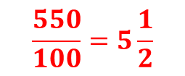
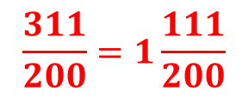
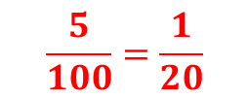
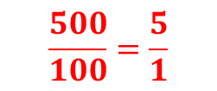
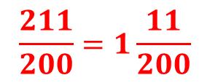
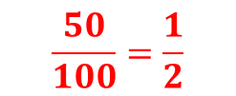
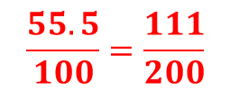
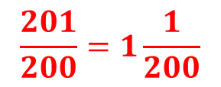
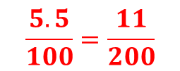
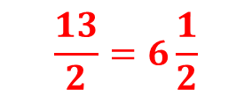
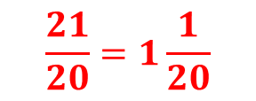
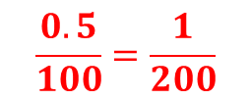
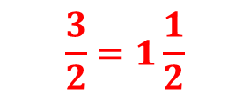

Convert the decimals to a % and a fraction in its simplest form.
Decimal | % | Fraction
0.5
0.05
0.005
0.055
0.555
5
5.5
Decimal | % | Fraction
1.5
1.05
1.005
1.055
1.555
6
6.5
50%
$$\frac{50}{100}=\frac{1}{2}$$
150%
$$\frac{3}{2}=1\frac{1}{2}$$
5%
$$\frac{5}{100}=\frac{1}{20}$$
105%
$$\frac{21}{20}=1\frac{1}{20}$$
0.5%
$$\frac{0.5}{100}=\frac{1}{200}$$
100.5%
$$\frac{201}{200}=1\frac{1}{200}$$
5.5%
$$\frac{5.5}{100}=\frac{11}{200}$$
105.5%
$$\frac{211}{200}=1\frac{11}{200}$$
55.5%
$$\frac{55.5}{100}=\frac{111}{200}$$
155.5%
$$\frac{311}{200}=1\frac{111}{200}$$
500%
$$\frac{500}{100}=\frac{5}{1}$$
600%
$$\frac{6}{1}$$
550%
$$\frac{550}{100}=5\frac{1}{2}$$
650%
$$\frac{13}{2}=6\frac{1}{2}$$

Slide 6
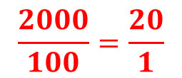
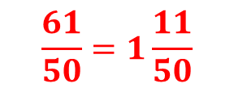
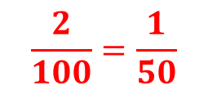
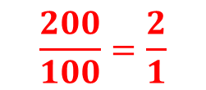
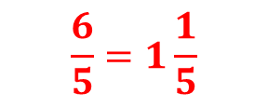
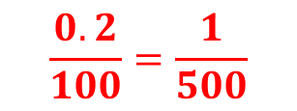
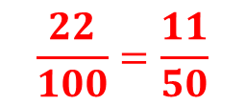
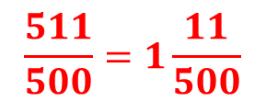
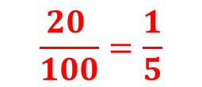

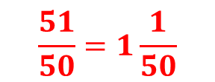
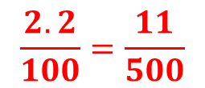


Convert the % to a decimal and a fraction in its simplest form.
% | Decimals | Fraction
0.2%
2%
2.2%
20%
22%
200%
2000%
% | Decimals | Fraction
100.2%
102%
102.2%
120%
122%
300%
2100%
0.002
$$\frac{0.2}{100}=\frac{1}{500}$$
1.002
$$\frac{501}{500}=1\frac{1}{500}$$
0.02
$$\frac{2}{100}=\frac{1}{50}$$
1.02
$$\frac{51}{50}=1\frac{1}{50}$$
0.022
$$\frac{2.2}{100}=\frac{11}{500}$$
1.022
$$\frac{511}{500}=1\frac{11}{500}$$
0.2
$$\frac{20 }{100}=\frac{1}{5}$$
1.2
$$\frac{6}{5}=1\frac{1}{5}$$
0.22
$$\frac{22}{100}=\frac{11}{50}$$
1.22
$$\frac{61}{50}=1\frac{11}{50}$$
2
$$\frac{200}{100}=\frac{2}{1}$$
3
$$\frac{3}{1}$$
20
$$\frac{2000}{100}=\frac{20}{1}$$
21
$$\frac{21}{1}$$

Slide 7
Convert the fraction to a decimal and a percentage.
Fractions | Decimals | %
$$\frac{1}{5}$$
$$\frac{2}{5}$$
$$\frac{3}{5}$$
$$\frac{4}{5}$$
$$\frac{5}{5}$$
$$\frac{6}{5}$$
$$\frac{7}{5}$$
Fractions | Decimals | %
$$\frac{2}{10}$$
$$\frac{8}{20}$$
$$\frac{30}{50}$$
$$\frac{20}{25}$$
$$\frac{99}{99}$$
$$\frac{12}{10}$$
$$\frac{21}{15}$$
0.2
20%
0.2
20%
0.4
40%
0.4
40%
0.6
60%
0.6
60%
0.8
80%
0.8
80%
1
100%
1
100%
1.2
120%
1.2
120%
1.4
140%
1.4
140%

