Slide 1
LO: Surface Area
of a Cylinder

Slide 2
What is the area of the circle?
Give you answer in terms of π
Area
= π x 5²
= 25π
10 cm

Slide 3
What is the circumference of the circle?
Give you answer in terms of π
Circumference
= π x 12
= 12π
6 cm

Slide 4
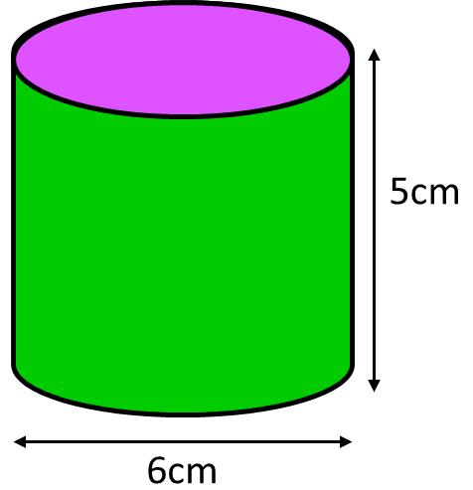
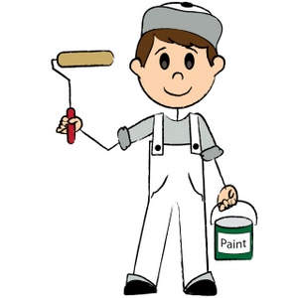
You have been given the job to
paint the following cylinder.
How much paint do you need?

Slide 5
What 2D shapes make up
a net of cylinder?
6cm
5cm
5cm
6cm
6cm

Slide 6
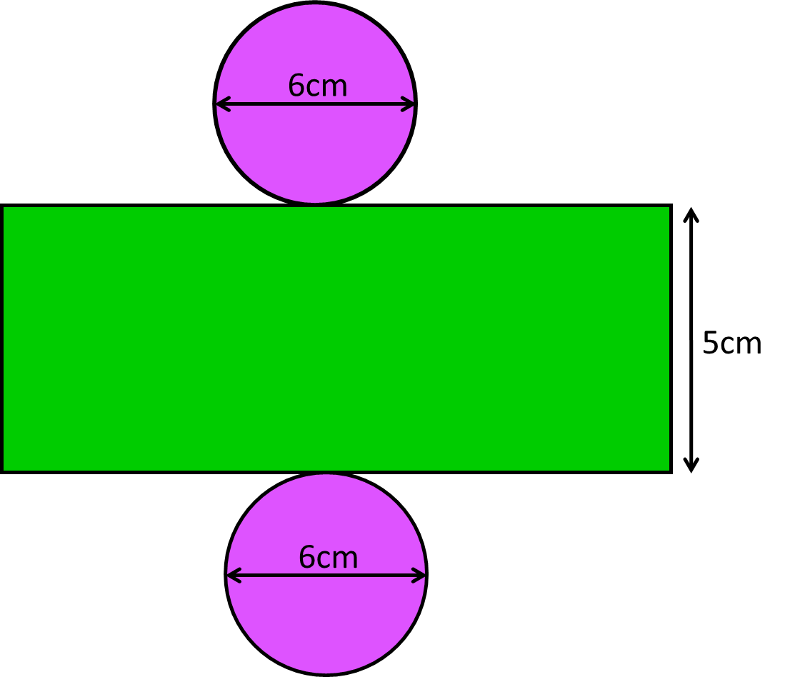
Area of the Circles
= π x 3²
= 9π
6cm
2 x 9π = 18π

Slide 7
Area of the
Rectangle
Circumference = 6π
5
5 x 6π = 30π

Slide 8
Total Surface Area of the Cylinder. Give answer in terms of π
9π
5cm
30π
6cm
9π
Total Surface Area
= 48π

Slide 9
Total Surface Area of the Cylinder. Give answer in terms of π
25π
8cm
80π
10cm
25π
Total Surface Area
= 130π

Slide 10


Volume (Cylinder) = π$r^{2}h$
h
r
Surface Area (Cylinder) = 2π$r^{2}$+ 2π$rh$

