Slide 1
LO: Volume of Prisms

Slide 2
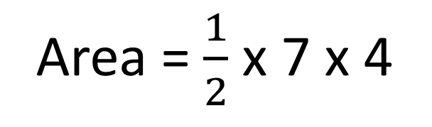
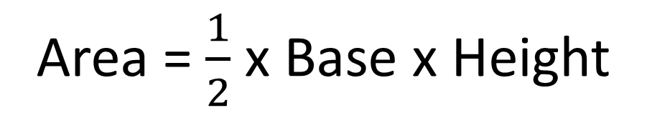
What is the area of the shape?
Area = $\frac{1}{2}$ x Base x Height
8cm
Area = $\frac{1}{2}$ x 7 x 4
4cm
Area = 14 cm²
7cm

Slide 3
What is the area of the shape?
Area = Base x Height
4cm
8cm
Area = 7 x 4
Area = 28 cm²
7cm

Slide 4
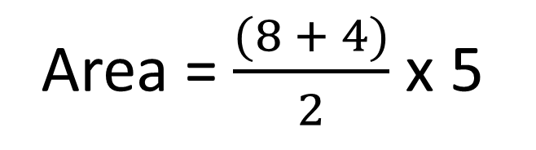
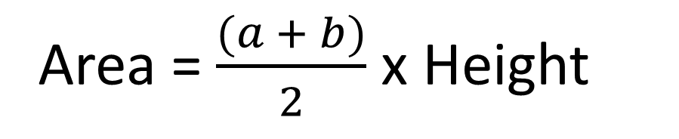
What is the area of the shape?
4cm
Area = $\frac{(a + b)}{2}$ x Height
Area = $\frac{(8 + 4)}{2}$ x 5
5cm
Area = 30 cm²
8cm

Slide 5

What is a prism?
A prism is a 3D shape that’s cross section is constant along its length.

Slide 6

Prism or Not?

Slide 7

Prism or Not?

Slide 8
Prism or Not?

Slide 9
Prism or Not?

Slide 10
Prism or Not?

Slide 11
Prism or Not?

Slide 12
Prism or Not?

Slide 13

What shape is the Cross Section?
Rectangle

Slide 14
What shape is the Cross Section?
Triangle
`

Slide 15
What shape is the Cross Section?
Hexagon

Slide 16
How can you use
cross section and length
to calculate volume of a prism?
Volume =
Area of the Cross Section x Length

Slide 17
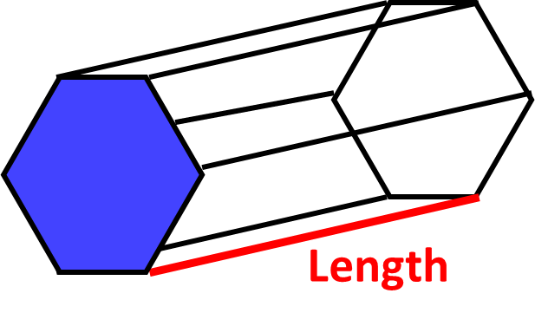
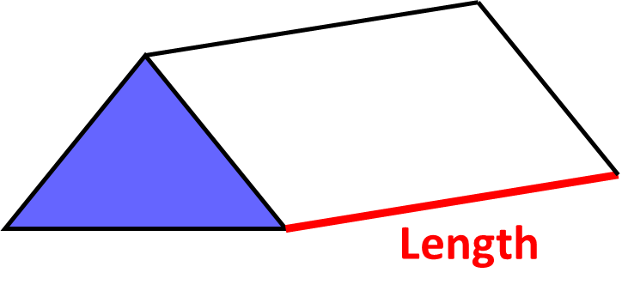
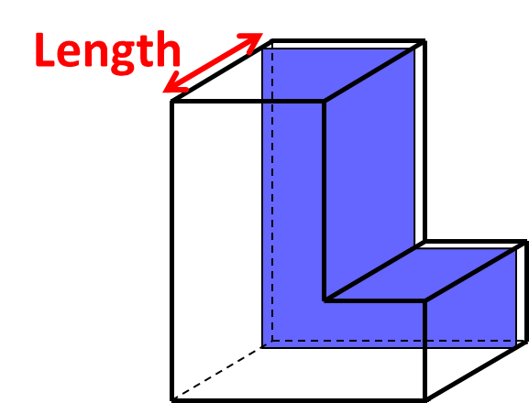
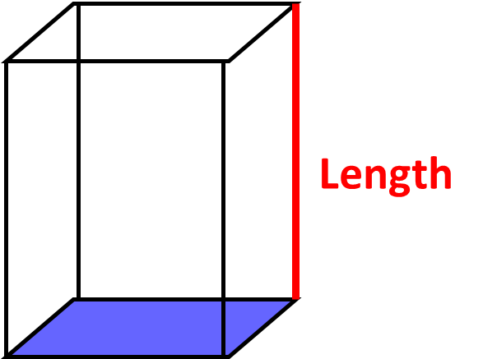
Volume = Cross Section x Length

Slide 18
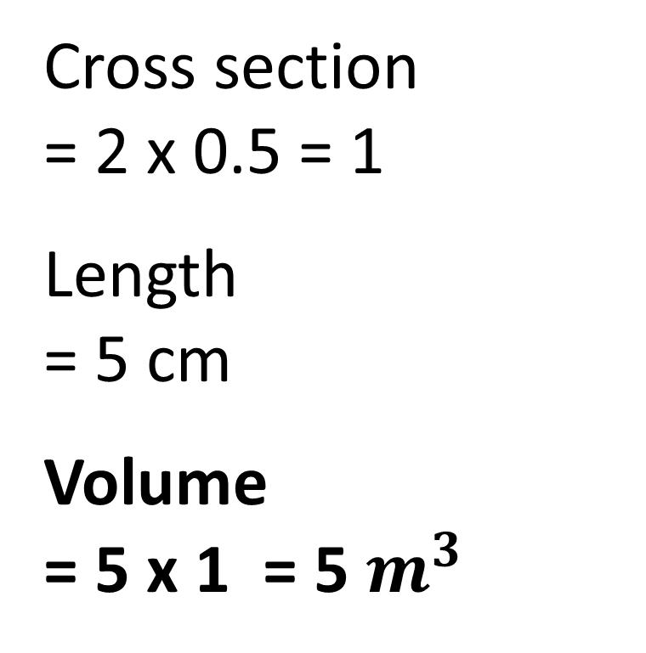
What is the volume?
Cross section
= 2 x 0.5 = 1
Length
= 5 cm
Volume
= 5 x 1 = 5 $m^{3}$
2m
0.5m
5m

Slide 19
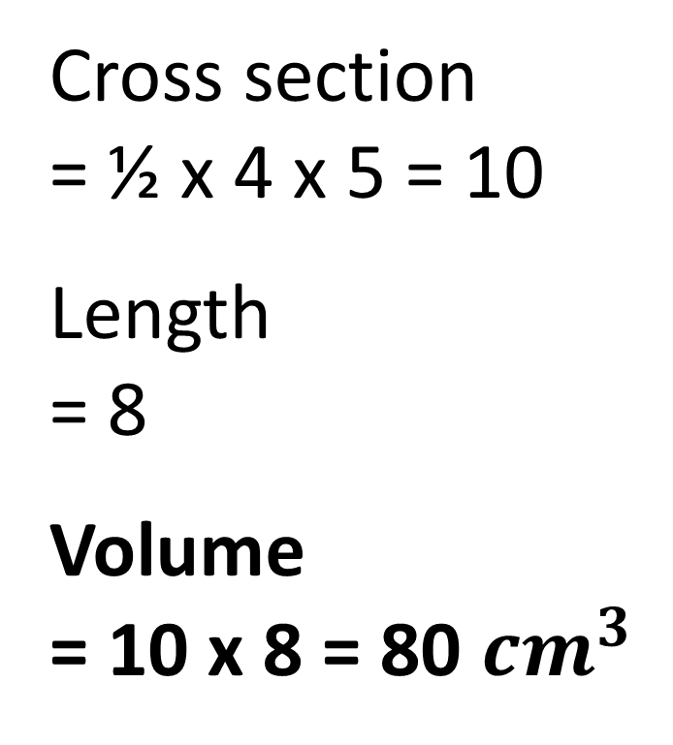
What is the volume?
Cross section
= ½ x 4 x 5 = 10
Length
= 8
Volume
= 10 x 8 = 80 ${cm}^{3}$
4cm
8cm
5cm

Slide 20
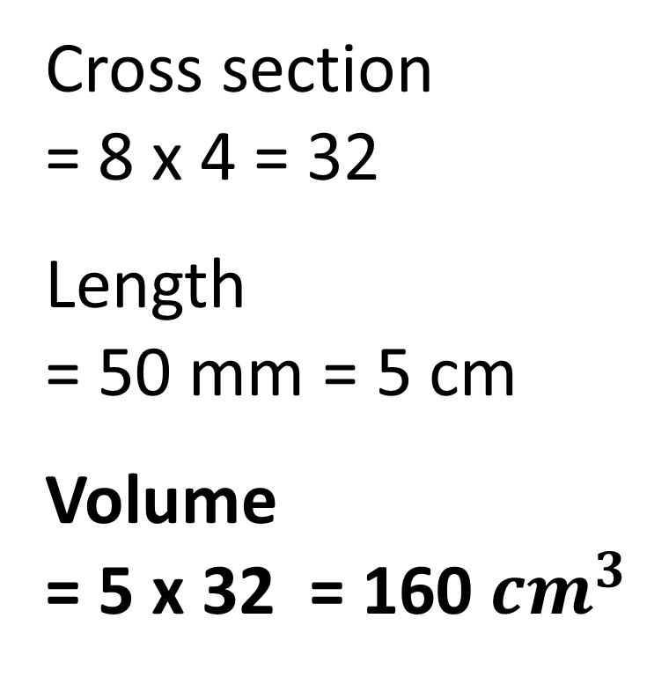
What is the volume?
Cross section
= 8 x 4 = 32
Length
= 50 mm = 5 cm
Volume
= 5 x 32 = 160 ${cm}^{3}$
8cm
4cm
50mm

Slide 21
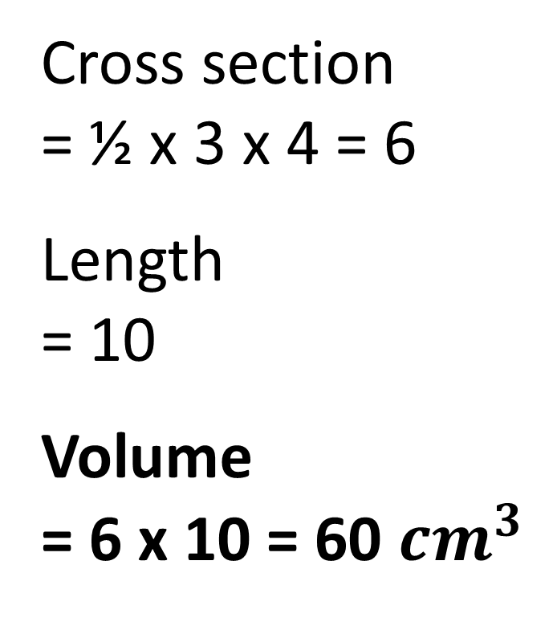
What is the volume?
Cross section
= ½ x 3 x 4 = 6
Length
= 10
Volume
= 6 x 10 = 60 ${cm}^{3}$
5cm
3cm
10cm
4cm

Slide 22
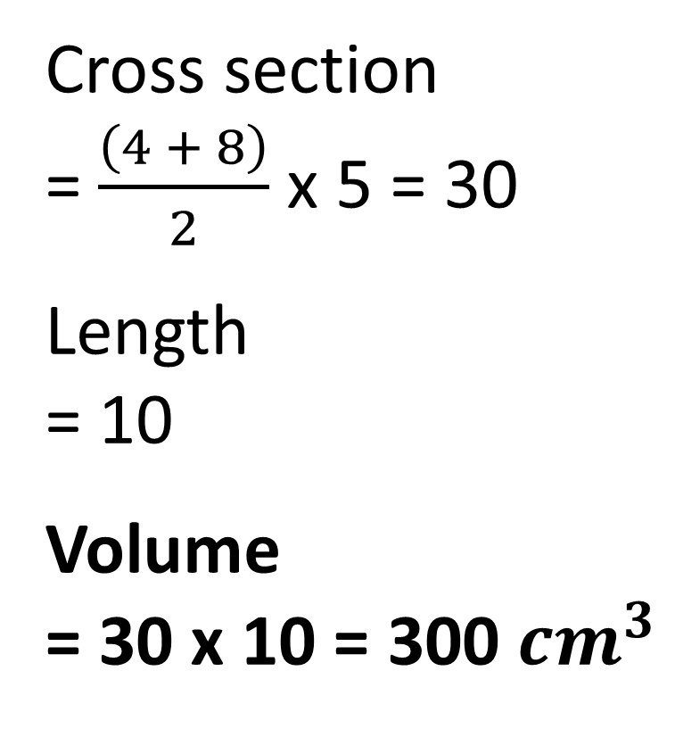
What is the volume?
Cross section
= $\frac{\left(4 + 8\right)}{2}$ x 5 = 30
Length
= 10
Volume
= 30 x 10 = 300 ${cm}^{3}$
4cm
5cm
10cm
8cm

Slide 23
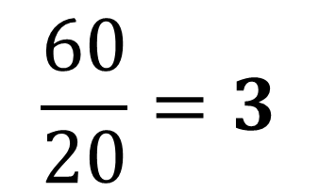
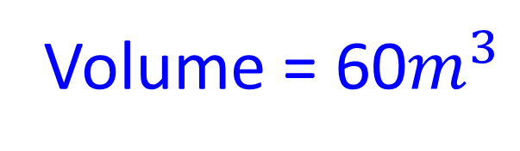
Find the value of x.
Cross Section Area
4 x 5 = 20
x
$$\frac{60}{20}=3$$
x =
4m
5m
Volume = 60$m^{3}$

Slide 24
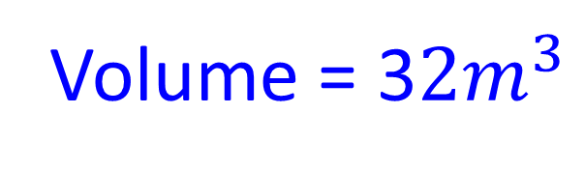
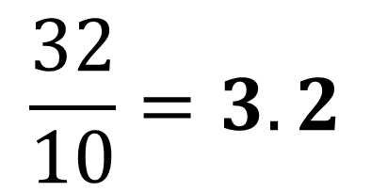
Find the value of x.
Volume = 3$2m^{3}$
Cross Section Area
0.5 x 4 x 5 = 10
$$\frac{32}{10}=3.2$$
x =
4cm
x
5cm

Slide 25
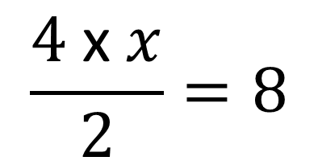
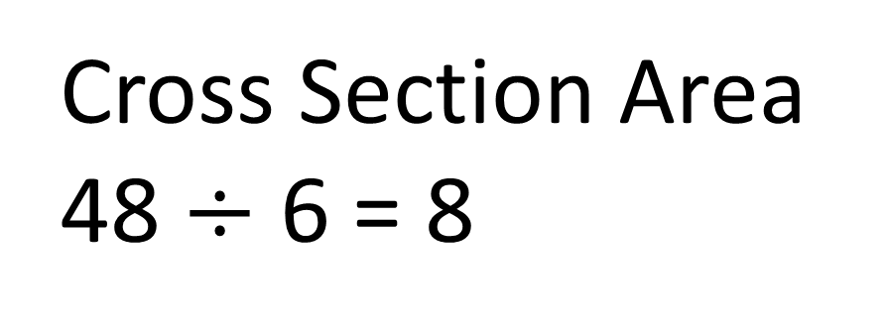
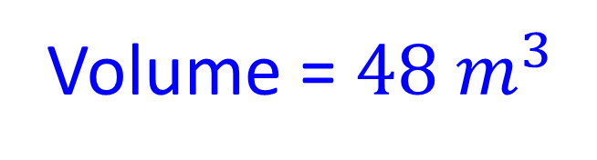
Find the value of x.
Volume = $48 m^{3}$
Cross Section Area
48 $÷$ 6 = 8
$$\frac{4 \text{x} x}{2}=8$$
4cm
6cm
x = 4
x

