Slide 1
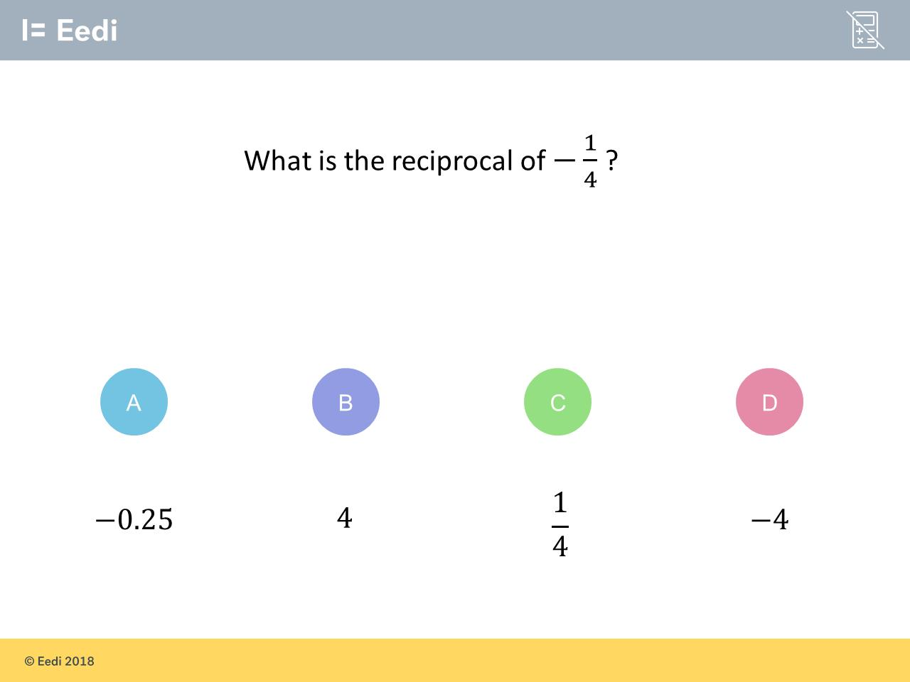
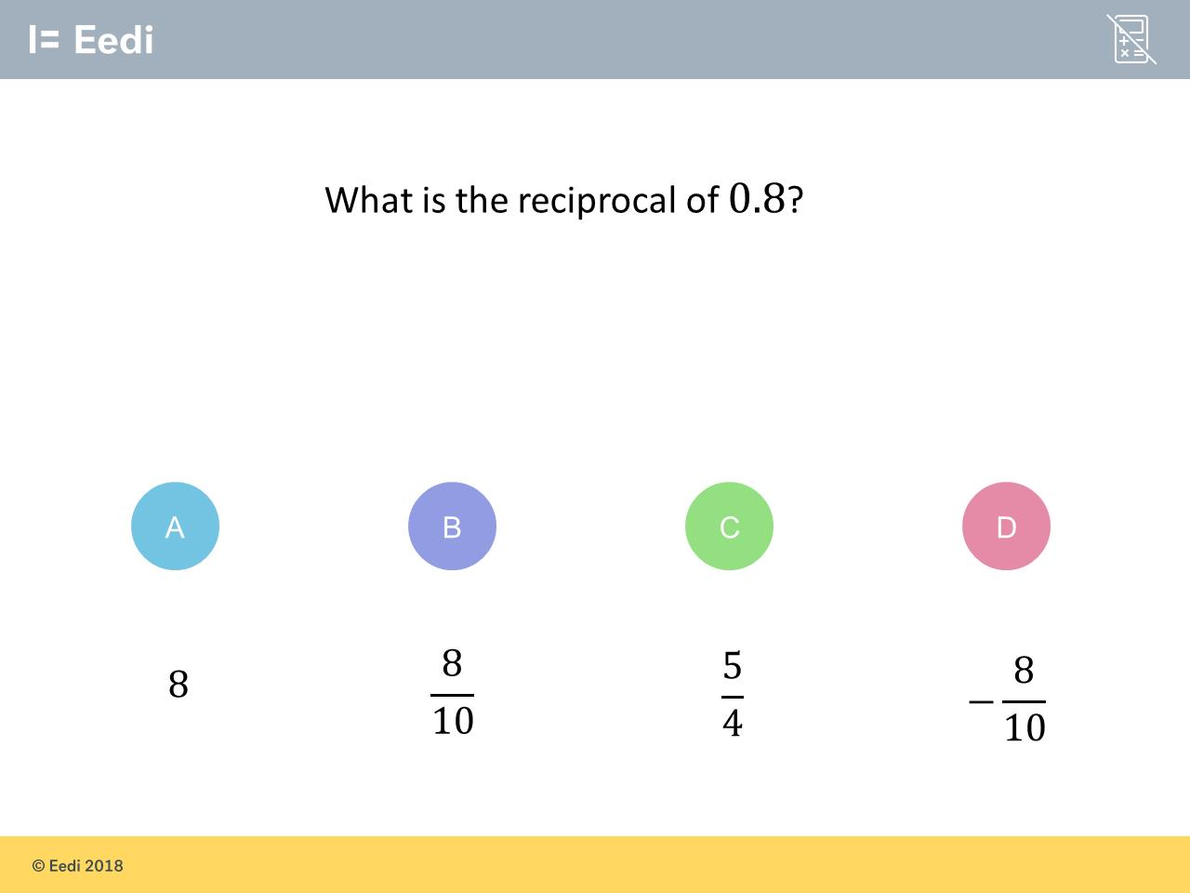
Worst answered question?
Most common wrong answer?

Slide 2
ANSWERS

Slide 3
Worst answered question?

Slide 4
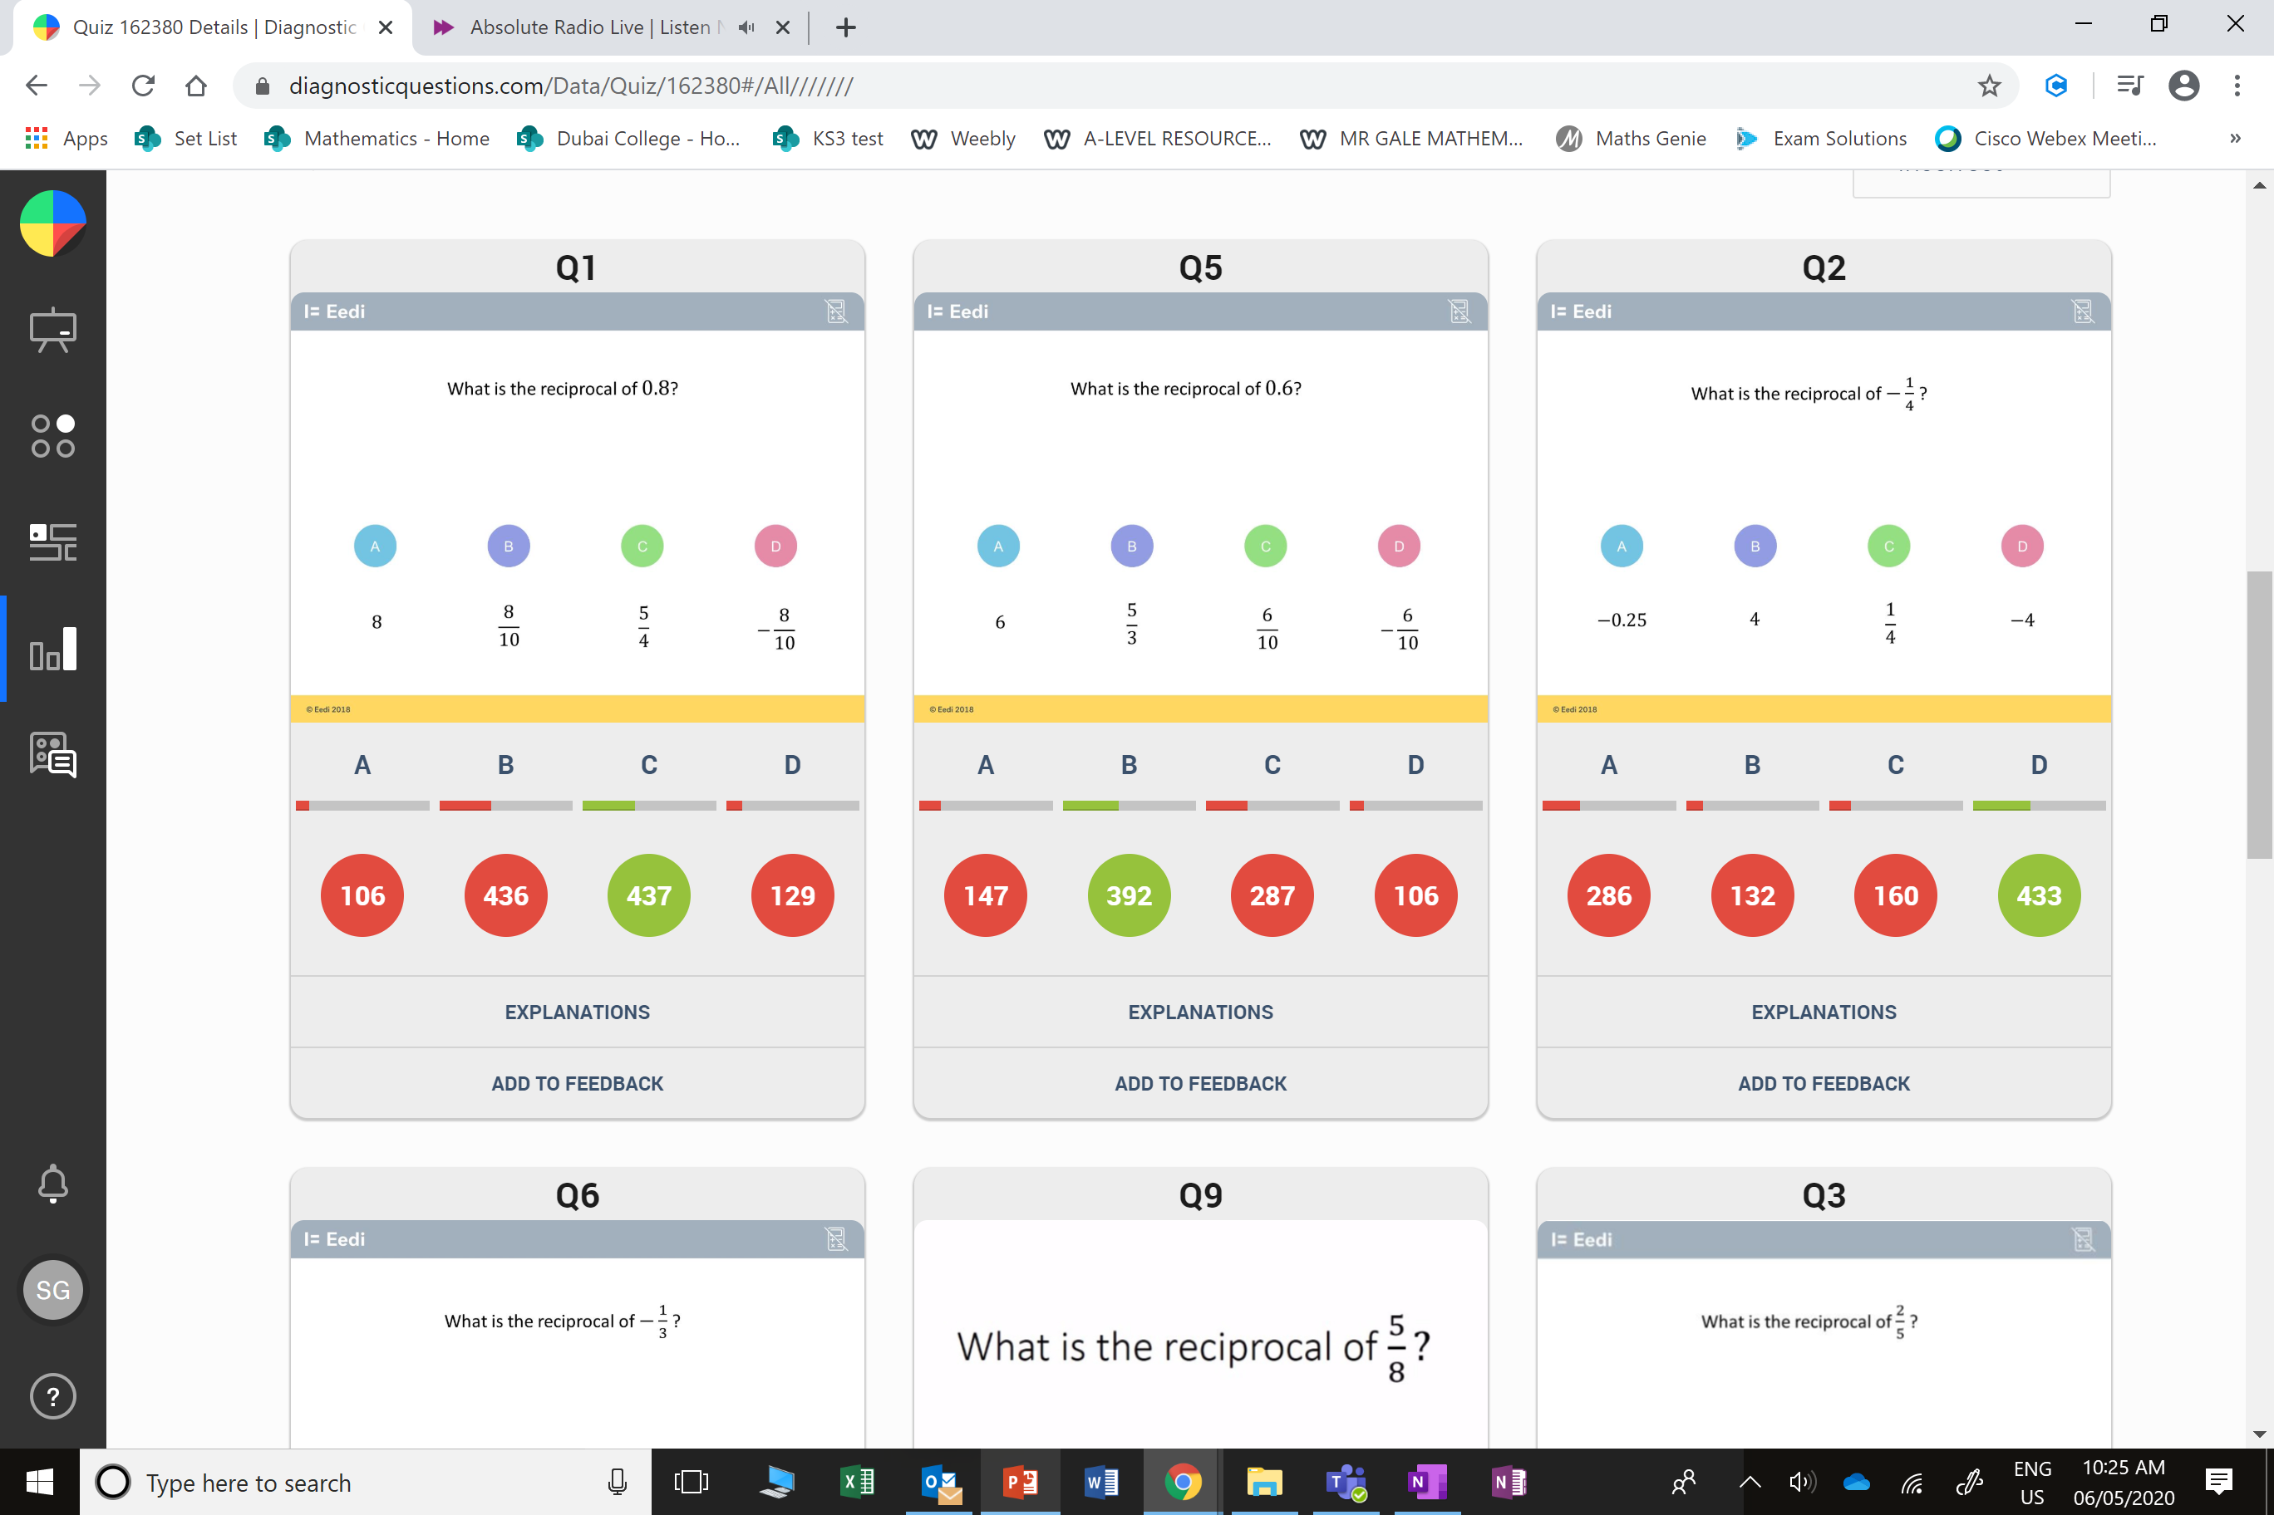
A
The just turned the fraction into a decimal.

Slide 5
B
The converted 0.8 into a fraction but did not take the reciprocal.

