Slide 1
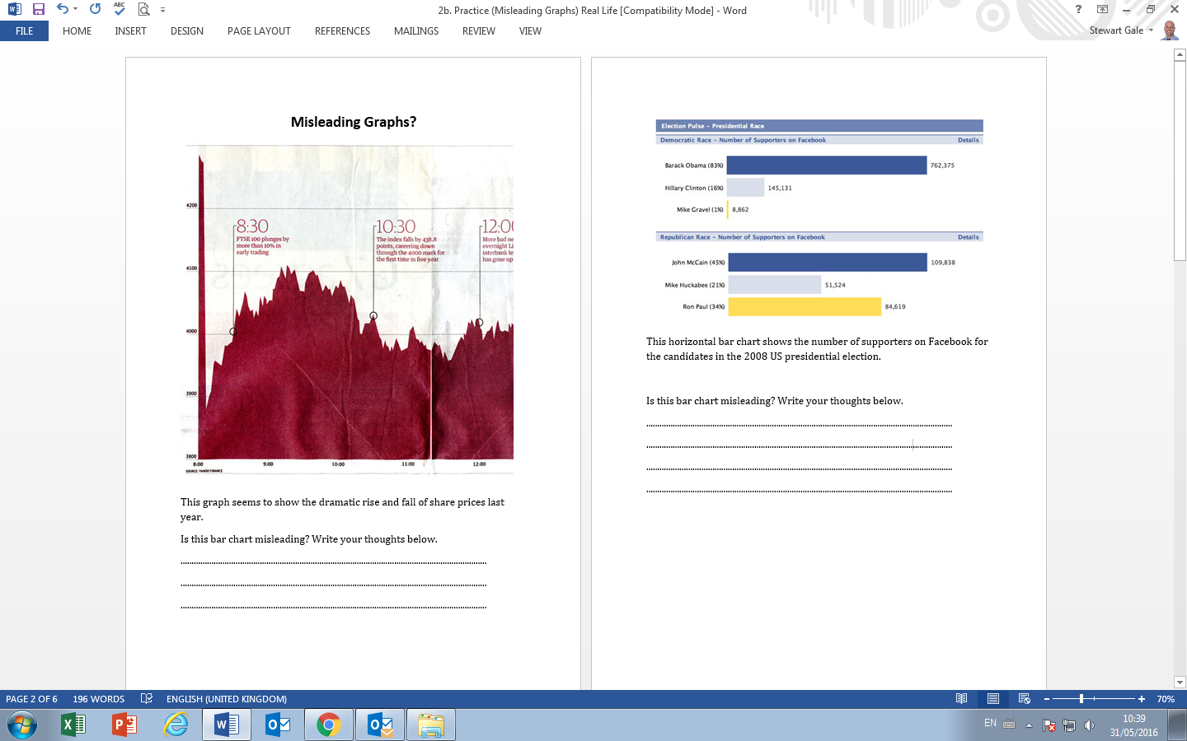

Slide 2
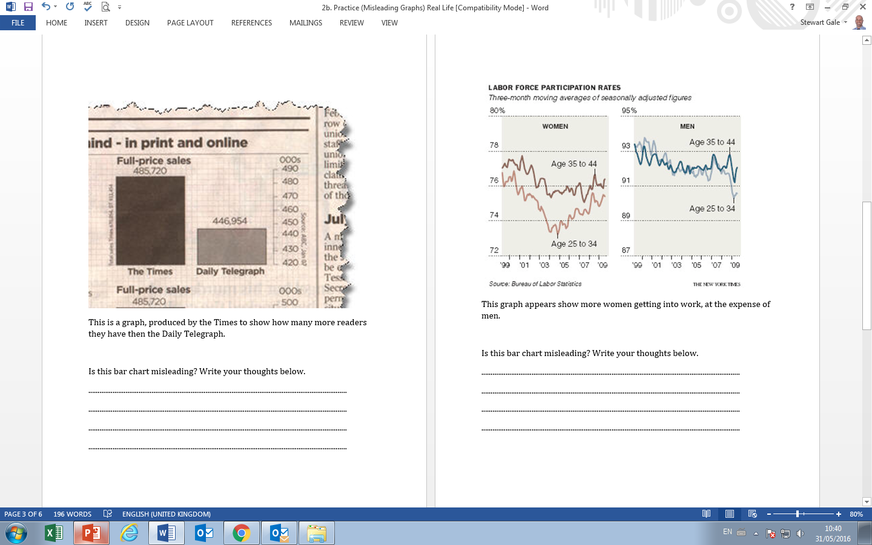

Slide 3
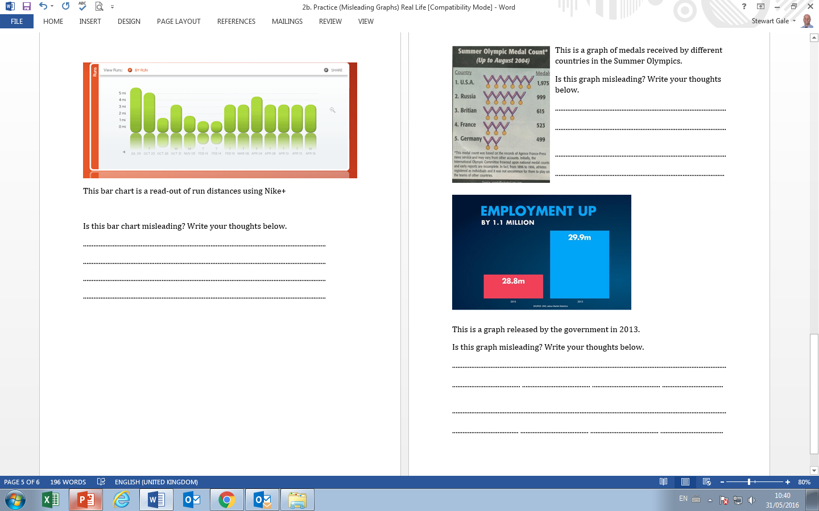

Slide 4
ANSWERS

Slide 5
The scale is in 100’s and only varies approximately from 3900 to 4200.

Slide 6
The scales are not the same and therefore make it look as they have similar numbers.

Slide 7
They have used a small scale to make the difference look bigger than it is.

Slide 8
The y axis do not start at the same value and therefore misleading to compare.

Slide 9
The x axis is not continuous and therefore makes is look like they have run everyday.

Slide 10
The medals do not have the same value and therefore make it look like the other countries are close to USA in the number of medals they received.

Slide 11
There is no scale so it the bars look out of proportion to each other.

