Slide 1

Diagnostic Assessment
Delta 1
Unit 2
Product of Prime Numbers
HCF and LCM
Negative Numbers
Squares, Cubes and Roots
Order or Operations

Slide 2
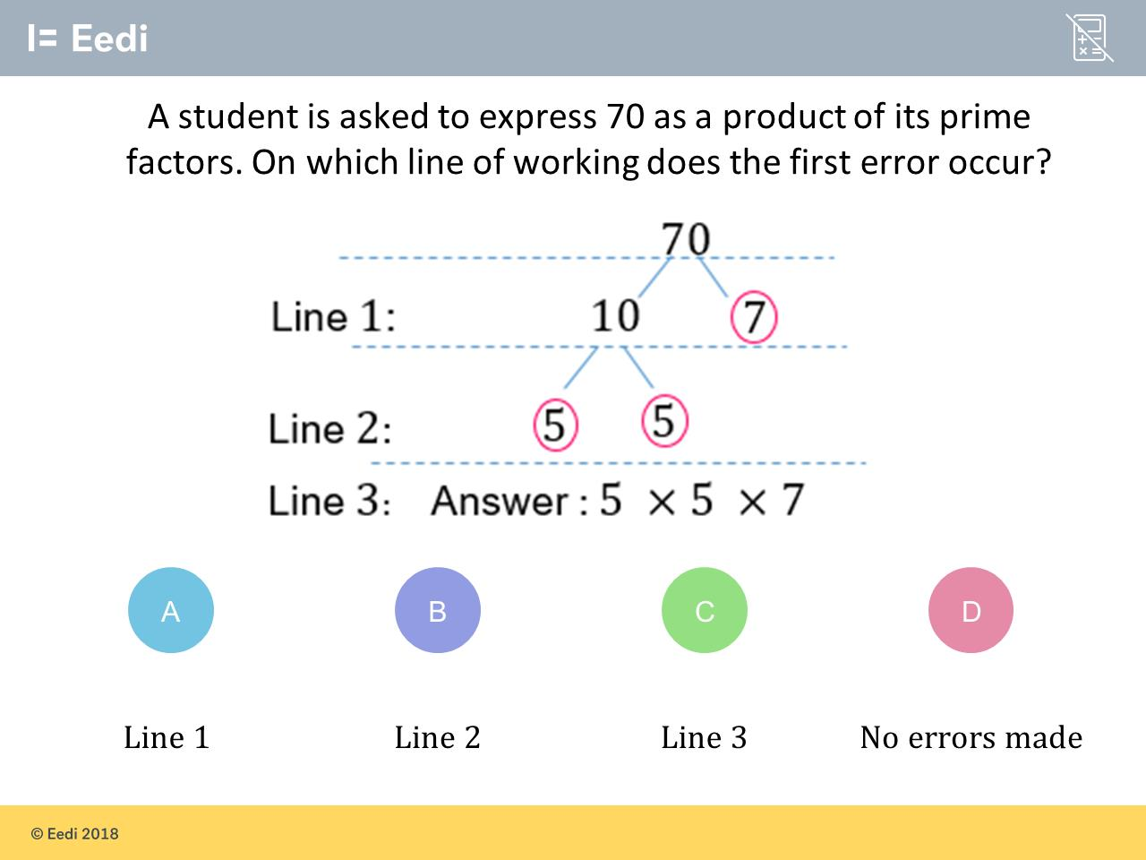
Question 1 – Product of Prime Numbers

Slide 3
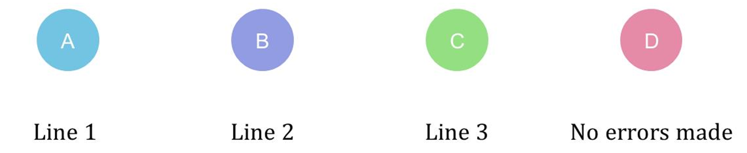
Answer 1 – Product of Prime Numbers
CORRECT ANSWER | CORRECT EXPLANATION
B | Line 2 is where the first error occurs. 5 x 5 does not equal 10. Instead, 10 is equal to 5 x 2.
COMMON MISTAKES | WHAT MIGHT BE YOUR MISTAKE
A | Not quite! 10 x 7 does equal 70. And 7 (which the student has circled) is indeed a prime number. So on this line the student is still on track.
C | Nearly! You have correctly identified that 5 x 5 x 7 does not equal 70 :) However, the student made their first error in the line above: where they said that 10 is equal to 5 x 5 (which is it not).
D | Not quite! You have successfully identified that all the numbers contained in the student's answer are prime numbers! :) But 5 x 5 x 7 makes 175, not 70 (so their answer is incorrect) and the student makes the mistake that got them there in line 2.

Slide 4
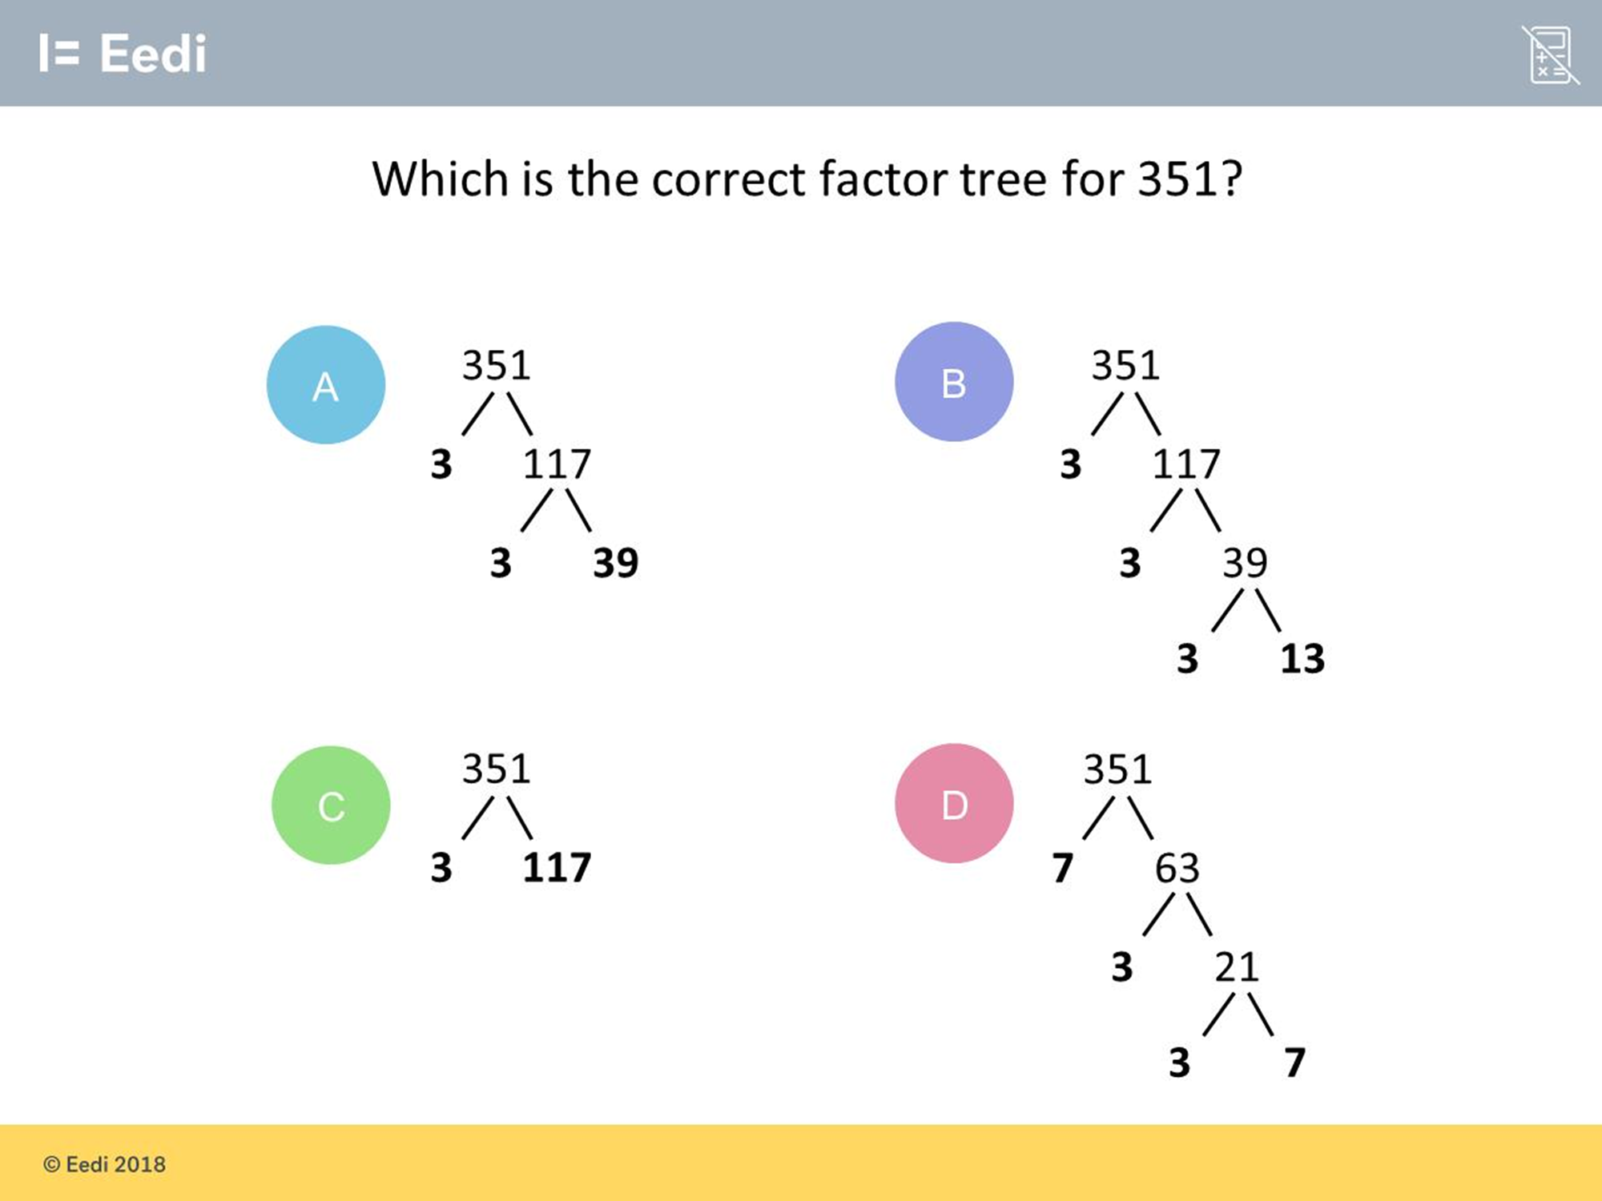
Question 2 – Product of Prime Numbers
Which is the correct factor tree for 351?

Slide 5
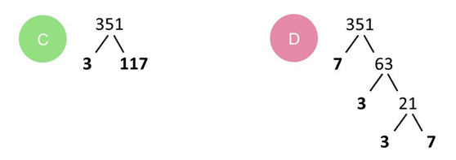
Answer 2 – Product of Prime Numbers
Which is the correct factor tree for 351?
CORRECT ANSWER | CORRECT EXPLANATION
B | This is the correct tree. All calculations are correct and each factor is prime.
COMMON MISTAKES | WHAT MIGHT BE YOUR MISTAKE
A | The student may believe that 39 is prime.
C | The student may believe that 117 is prime.
D | The student has made a calculation error. 7 x 63 = 441

Slide 6
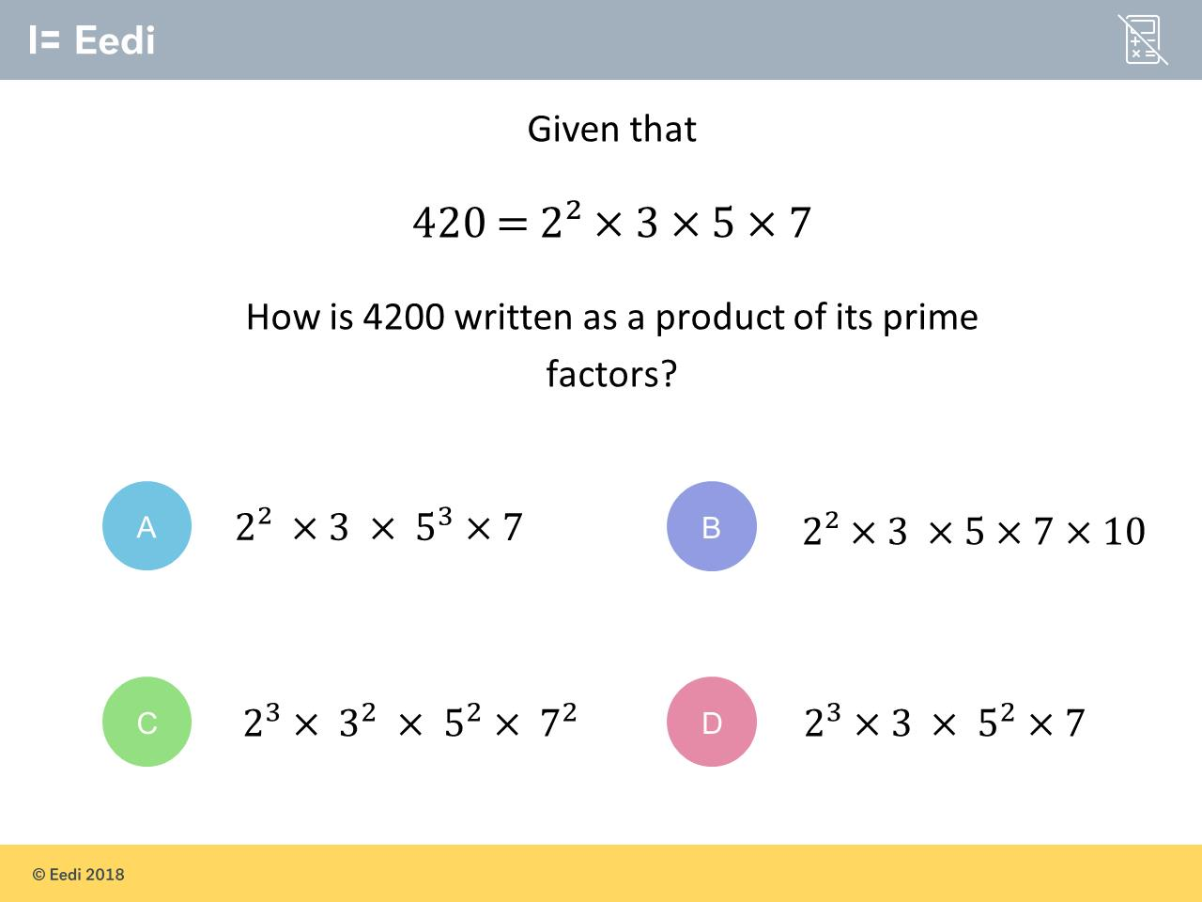
Question 3 – Product of Prime Numbers

Slide 7
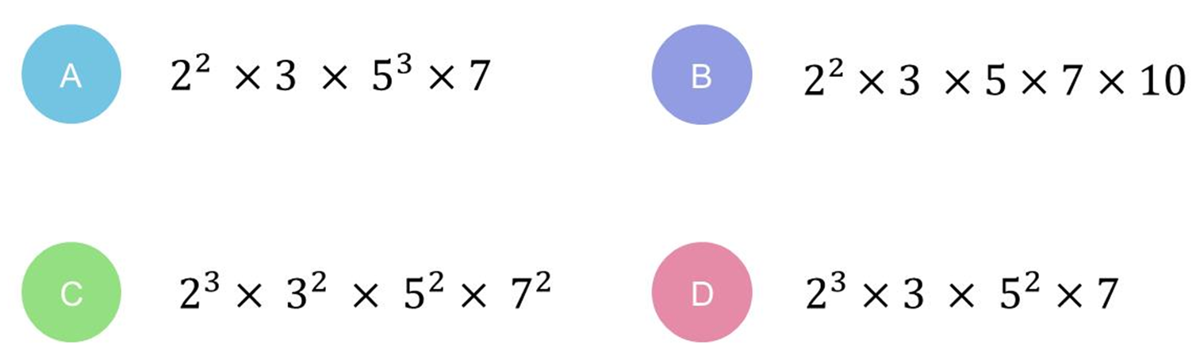
Answer 3 – Product of Prime Numbers
CORRECT ANSWER | CORRECT EXPLANATION
D | We need to multiply by 10, which is 5 × 2. That means we need to increase the power on 2 and 5.
COMMON MISTAKES | WHAT MIGHT BE YOUR MISTAKE
A | The student has written 10 as 5².
B | The student has not used prime factors.
C | The student has increased all powers by 1, instead of just the 5 and 2.

Slide 8
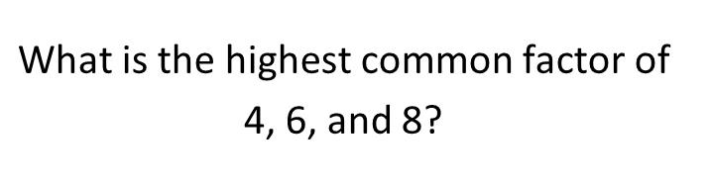
Question 4 – HCF and LCM

Slide 9
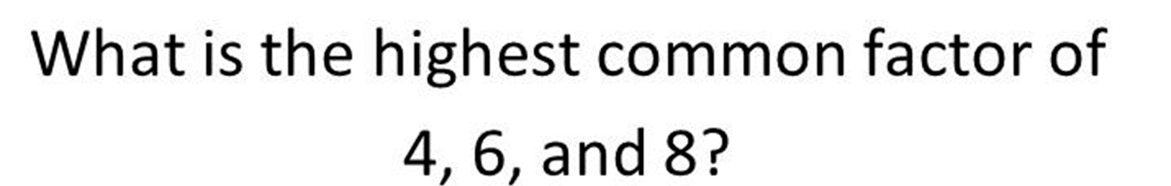
Answer 4 – HCF and LCM
CORRECT ANSWER | CORRECT EXPLANATION
2 | The factors of 4 are 1,2 and 4, the factors of 6 are 1,2,3 and 6 and the factors of 8 are 1,2,4 and 8. Clearly the highest common factor is 2.
COMMON MISTAKES | WHAT MIGHT BE YOUR MISTAKE
4 | The student has chosen the lowest number
8 | The student may have picked the highest number.
24 | The student has confused LCM and HCF, as this is the HCF.

Slide 10
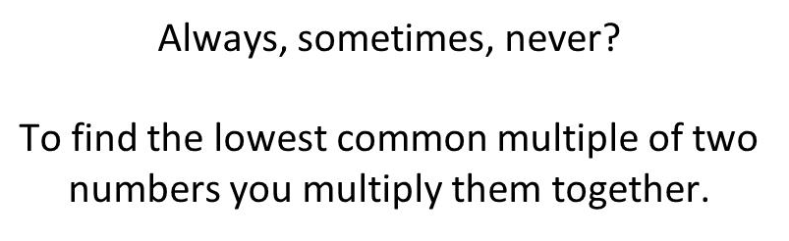
Question 5 – HCF and LCM

Slide 11
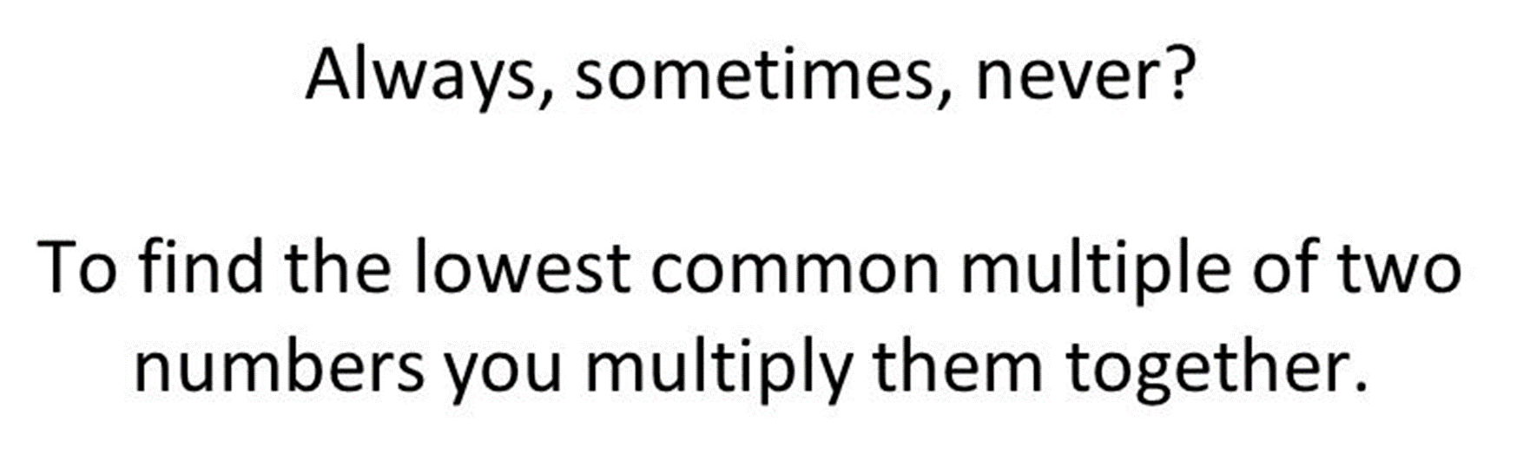
Answer 5 – HCF and LCM
CORRECT ANSWER | CORRECT EXPLANATION
Sometimes | We only multiply them together if the numbers share no factors, except 1.
COMMON MISTAKES | WHAT MIGHT BE YOUR MISTAKE
Always | Not quite! You think that you can always find a common multiple of two numbers if you multiply them together! But this will not always be the LOWEST common multiple. Only sometimes. When the two numbers share factors (other than 1), then there is a lower common multiple than this.
Never | Not quite! You think that multiplying two numbers together is not a reliable way of finding their lowest common multiple, but it does work sometimes (when the numbers share no factors except 1). You were close!

Slide 12
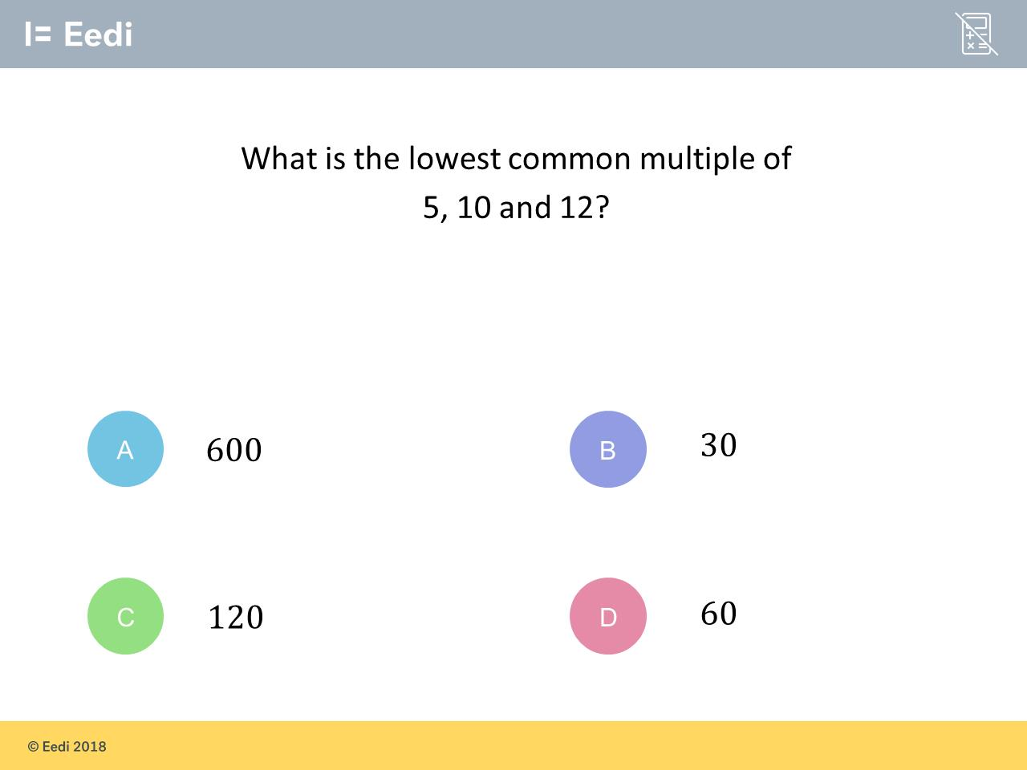
Question 6 – HCF and LCM

Slide 13
Answer 6 – HCF and LCM
CORRECT ANSWER | CORRECT EXPLANATION
60 | The multiples of 10 are 10,20,30,40,50,60... and the multiples of 12 are 12,24,36,48,60... so 60 is the LCM of 10 and 12. As 5 is a factor of 10, 60 is also the LCM of all 3 numbers.
COMMON MISTAKES | WHAT MIGHT BE YOUR MISTAKE
600 | The student has multiplied all of the numbers together.
30 | The student may believe that 12 is a factor of 30.
120 | The student has found a common multiple, but not the lowest.

Slide 14
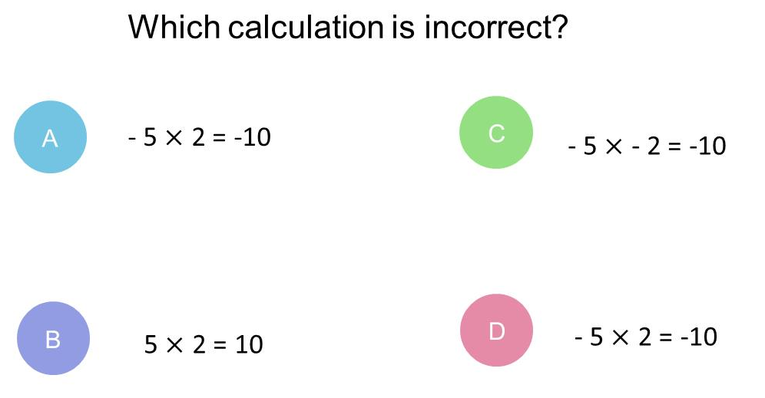
Question 7 – Negative Numbers

Slide 15
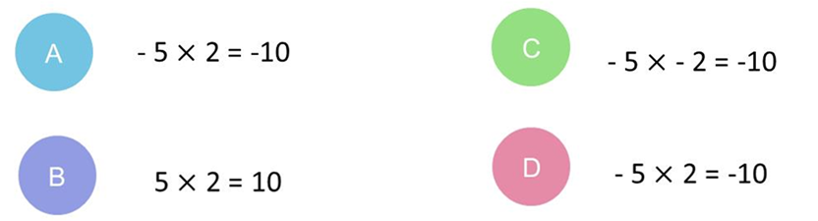
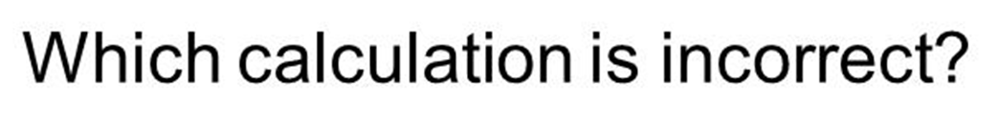
Answer 7 – Negative Numbers
CORRECT ANSWER | CORRECT EXPLANATION
C | This is incorrect. Multiplying two negative numbers gives a positive number.
COMMON MISTAKES | WHAT MIGHT BE YOUR MISTAKE
A | The student has ignored the negative sign.
B | The student may has picked a correct calculation.
D | The student has ignored the negative sign.

Slide 16
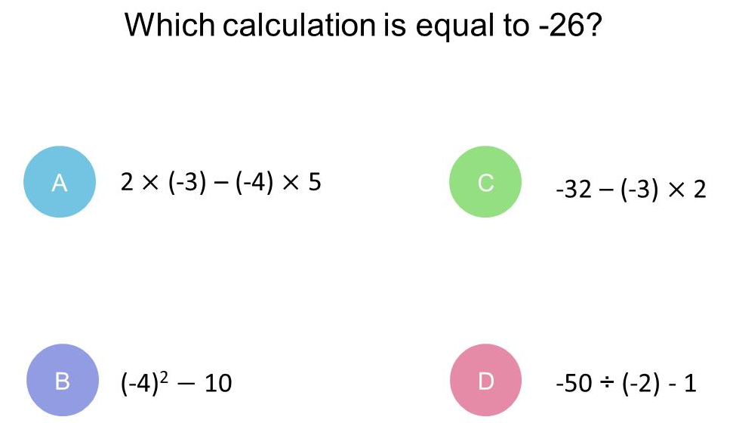
Question 8 – Negative Numbers

Slide 17
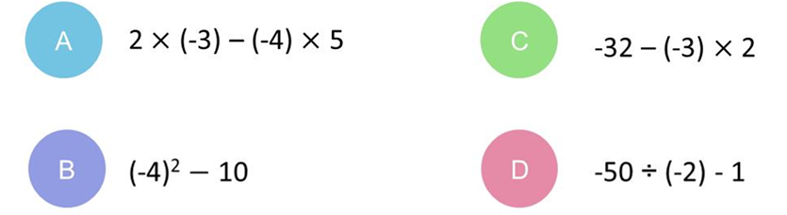
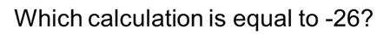
Answer 8 – Negative Numbers
CORRECT ANSWER | CORRECT EXPLANATION
C | This is correct. We have -32 - (-3) × 2 = -32 - -6 = -32 + 6 = -26.
COMMON MISTAKES | WHAT MIGHT BE YOUR MISTAKE
A | The student has treated a double negative as a negative.
B | The student has calculated (-4)² as -16.
D | The student has not recognised that dividing two negative numbers gives a positive number.

Slide 18
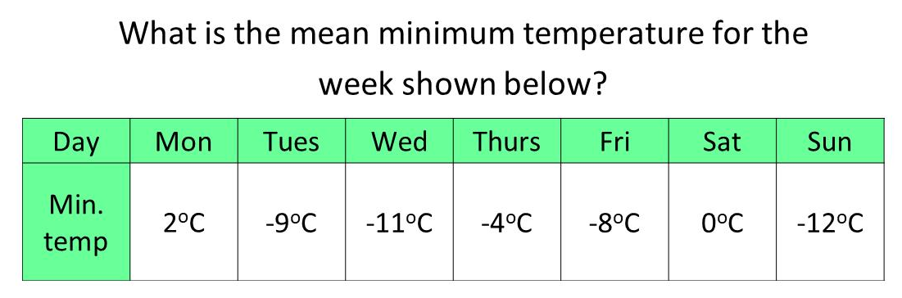
Question 9 – Negative Numbers

Slide 19
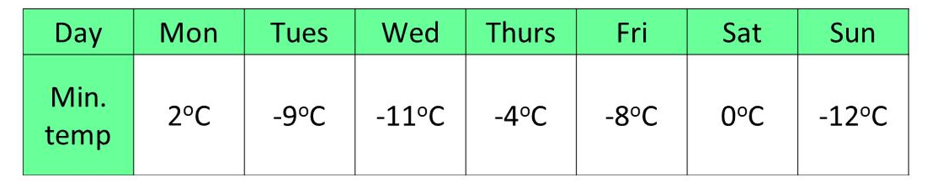
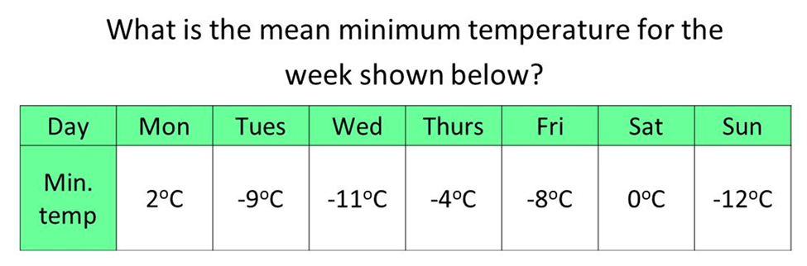
Answer 9 – Negative Numbers
CORRECT ANSWER | CORRECT EXPLANATION
-6 | The total of all of the numbers is -42. As there are 7 numbers, we divided -42 by 7 to get -6.
COMMON MISTAKES | WHAT MIGHT BE YOUR MISTAKE
-42 | The student has given the total, without dividing by 7.
-7 | The student has divided by 6, rather than 7. They may not have included 0.
-8 | The student has found the median, rather than the mean.

Slide 20
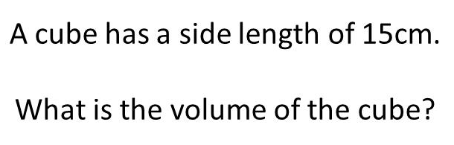
Question 10 – Squares, Cubes and Roots

Slide 21
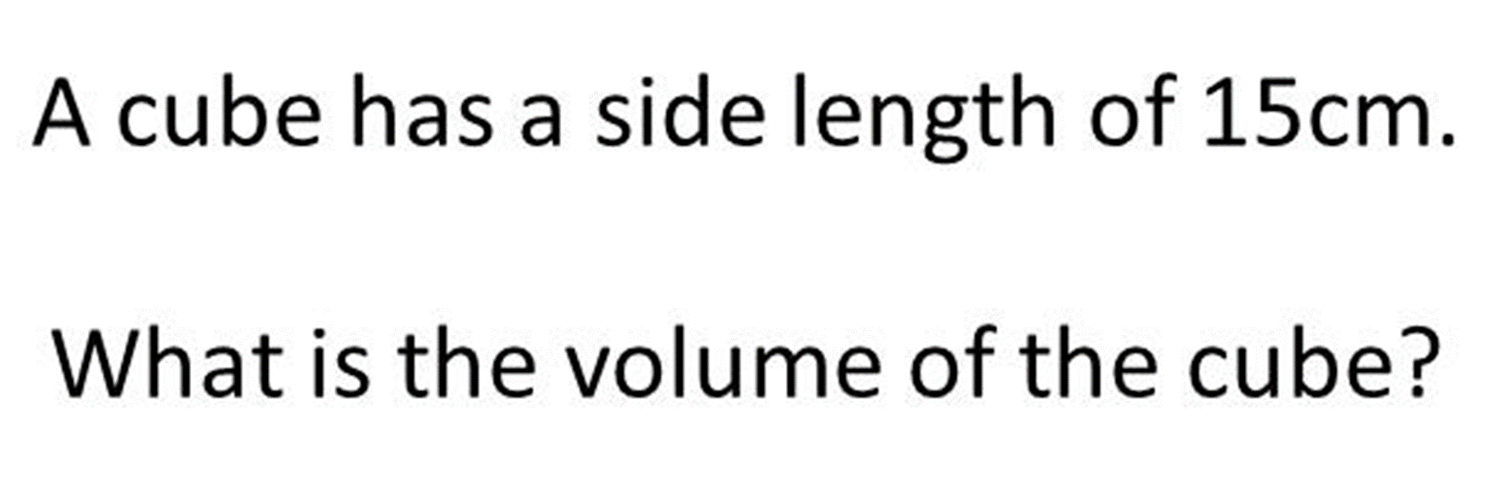
Answer 10 – Squares, Cubes and Roots
CORRECT ANSWER | CORRECT EXPLANATION
3375 | 15 x 15 x 15 = 3375
COMMON MISTAKES | WHAT MIGHT BE YOUR MISTAKE
225 | 15 x 15 = 225
45 | 15 x 3 = 45

Slide 22
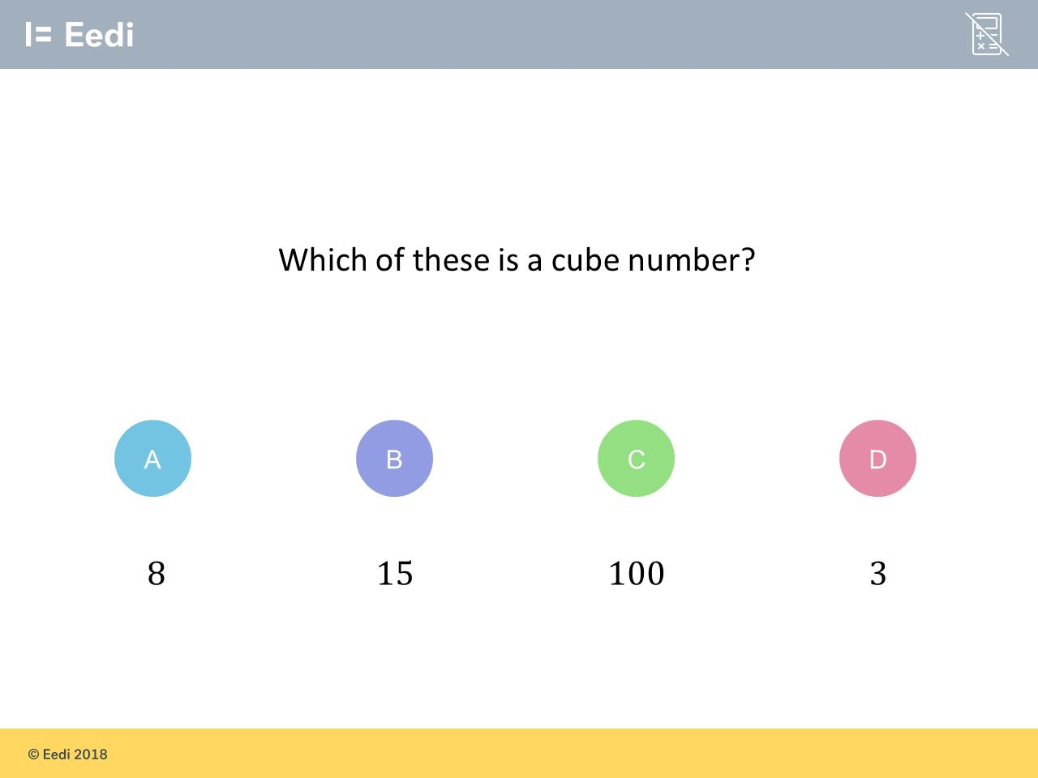
Question 11 – Squares, Cubes and Roots

Slide 23
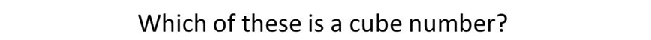
Answer 11 – Squares, Cubes and Roots
CORRECT ANSWER | CORRECT EXPLANATION
8 | 8 is a cube number, as 2³ = 8.
COMMON MISTAKES | WHAT MIGHT BE YOUR MISTAKE
15 | The student may have mistaken cube numbers with multiples of 3.
100 | The student may have confused square and cube numbers.
3 | The student has found the number of people who just ordered drinks.
A B C D The student may have recognised 3 as the power.

Slide 24
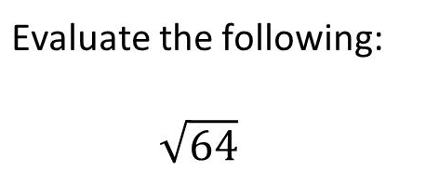
Question 12 – Squares, Cubes and Roots

Slide 25
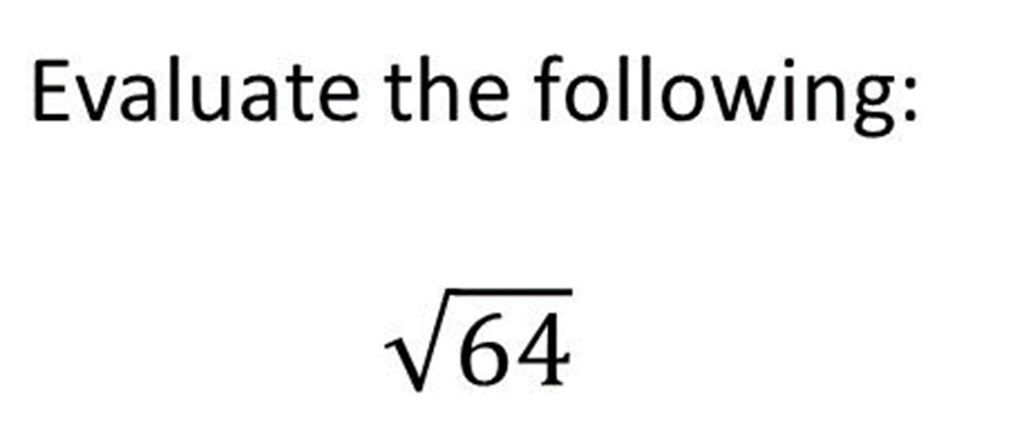
Answer 12 – Squares, Cubes and Roots
CORRECT ANSWER | CORRECT EXPLANATION
8 and –8 | You are correct that 8 x 8 = 64 and –8 x –8 = 64
COMMON MISTAKES | WHAT MIGHT BE YOUR MISTAKE
4 | The student may have found the cube root by mistake.
32 | The student has just divided by 2.
8 | You are correct that 8 x 8 = 64 but so is –8 x –8 = 64

Slide 26
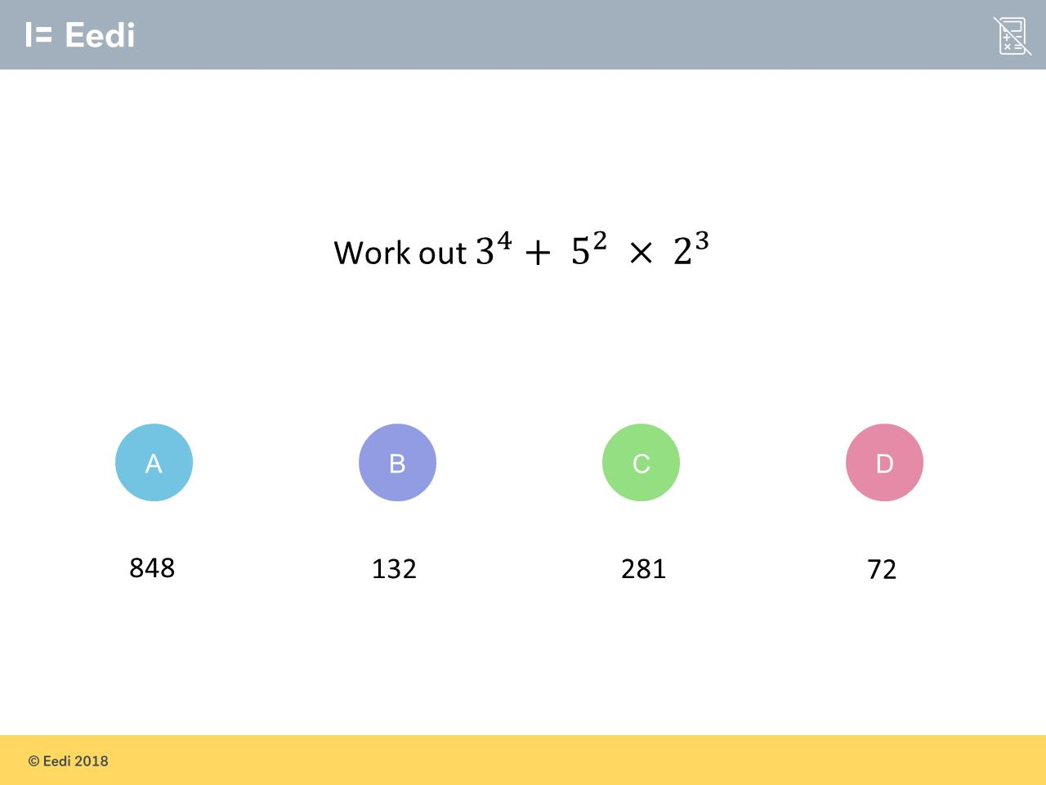
Question 13 – Order of Operations

Slide 27
Answer 13 – Order of Operations
CORRECT ANSWER | CORRECT EXPLANATION
281 | 81 + 25 × 8 = 81 + 200 = 281
COMMON MISTAKES | WHAT MIGHT BE YOUR MISTAKE
848 | You have evaluated the powers correct but add before multiplying. BIMAS needs you to multiply then add.
132 | The student has multiplied the powers and added before multiplying.
72 | The student has multiplied the powers, rather than evaluating them correctly.

Slide 28
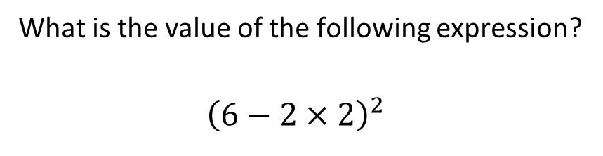
Question 14 – Order of Operations

Slide 29
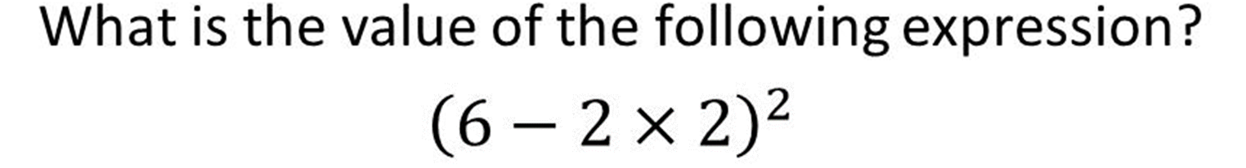
Answer 14 – Order of Operations
CORRECT ANSWER | CORRECT EXPLANATION
4 | (6 – 2 × 2)² = (6 – 4)² = 2² = 4.
COMMON MISTAKES | WHAT MIGHT BE YOUR MISTAKE
128 | The student has squared each term first, and also subtracted before multiplying.
64 | The student has subtracted 2 first.
28 | The student has squared the terms separately, after multiplying.

Slide 30
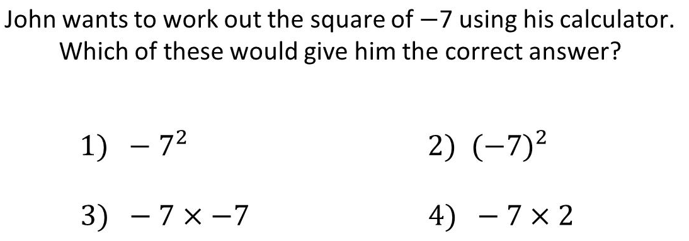
Question 15 – Order of Operations
(You can choose more than one option)

Slide 31
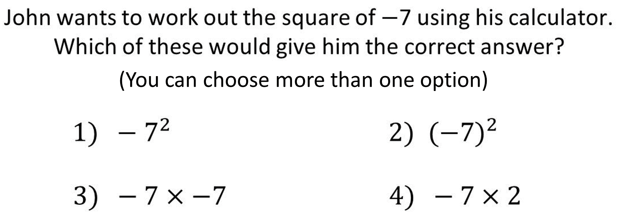
Answer 15 – Order of Operations
CORRECT ANSWER | CORRECT EXPLANATION
2 and 3 | Both 2 and 3 are correct. We need to consider BIDMAS when using a calculator.
COMMON MISTAKES | WHAT MIGHT BE YOUR MISTAKE
1 | The calculator sees –1 x $7^{2}$ so will do -1 x 49 = –40 due to BIDMAS.
4 | To square a number you multiply it by it self not by 2.

