Slide 1
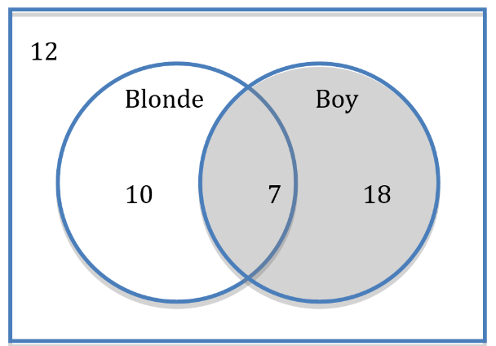
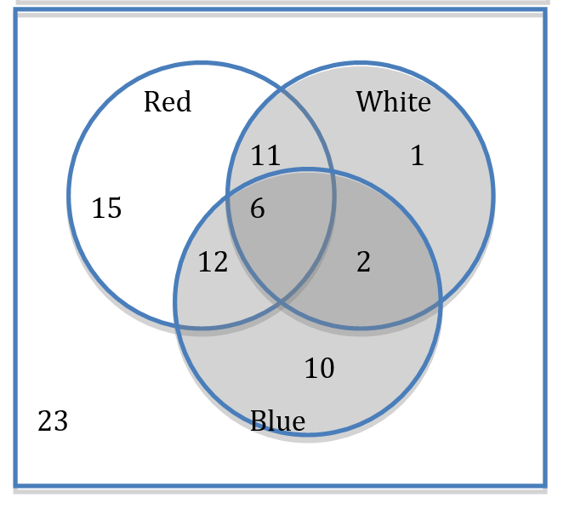
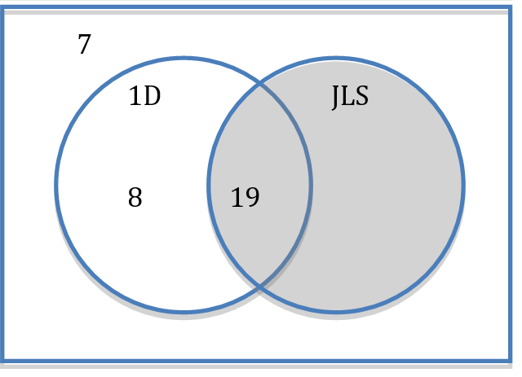
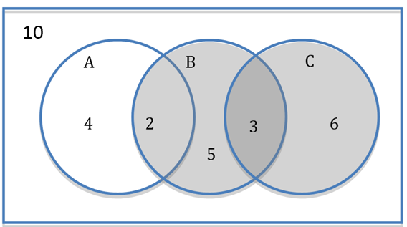
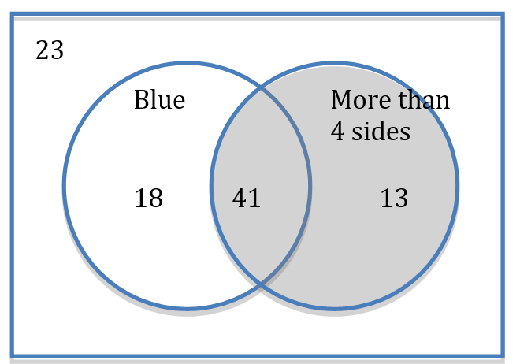
1) A group of boys and girls are shown in this Venn Diagram.
A person is chosen at random
a) What is the probability a boy is chosen?
b) What is the probability a blonde boy is chosen?
c) What is the probability a girl is chosen?
4) The colors of some flags were recorded.
A flag is chosen at random.
a) How many flags were recorded?
b) What is the probability the flag chosen uses white?
c) What is the probability the flag chosen has no red?
d) What is the probability the flag chosen has 2 of the listed color?
e) What is the probability the flag chosen uses blue and white?
2) 50 people were asked if they liked One Direction or JLS.
A person is chosen at random.
a) What is the missing value in the Venn
b) What is the probability the person did not like 1D
c) What is the probability the person likes both groups
d) What is the probability the person likes just one of the groups
e) What is the probability the person likes at least one of
the groups
3) Shapes are sorted into 2 groups depending on their color and number of sides.
A shape is chosen at random
a) How many shape are there altogether?
b) What is the probability that it is a blue shape?
c) What is the probability that it has 4 or fewer sides?
d) What is the probability a triangle is chosen?
5) Students were asked in a class who read any of 3 magazines A, B and C.
a) Which two magazines were mutually exclusive?
b) What was the probability of a student reading only one magazine?
c) What was the probability of a student reading only two magazines?
d) What was the probability of a student reading all 3 magazines?

Slide 2
ANSWERS

Slide 3
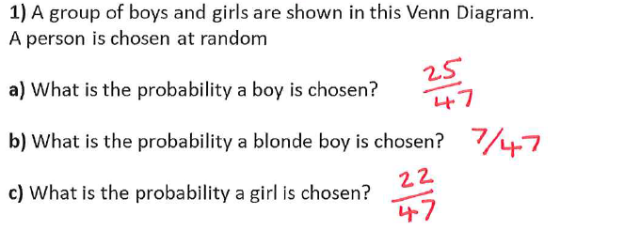

Slide 4
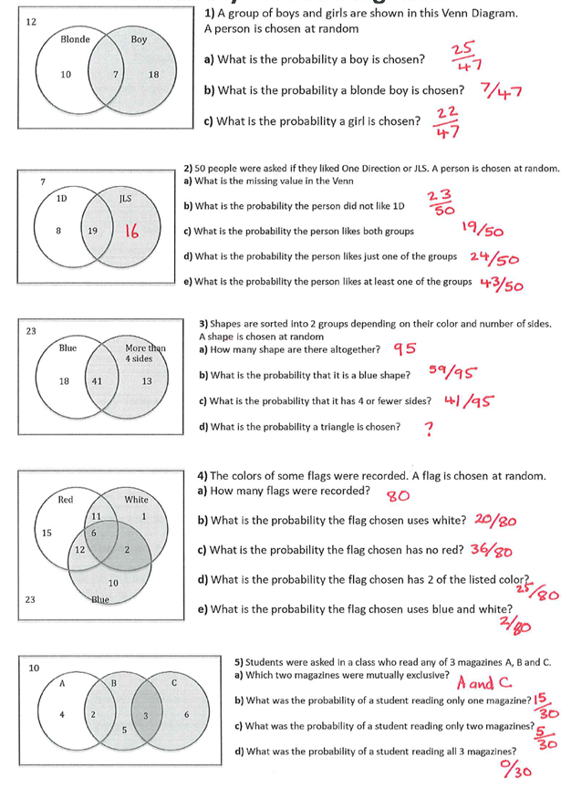

Slide 6
4) The colors of some flags were recorded. A flag is chosen at random.
a) How many flags were recorded?
b) What is the probability the flag chosen uses white?
c) What is the probability the flag chosen has no red?
d) What is the probability the flag chosen has 2 of the listed color?
e) What is the probability the flag chosen uses blue and white?
8/80

Slide 7
5) Students were asked in a class who read any of 3 magazines A, B and C.
a) Which two magazines were mutually exclusive?
b) What was the probability of a student reading only one magazine?
c) What was the probability of a student reading only two magazines?
d) What was the probability of a student reading all 3 magazines?

