Slide 1
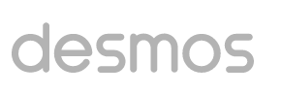
Quadratic Functions
https://teacher.desmos.com/collection/5da649da5a46437eff2441d0

Slide 2
