Slide 1
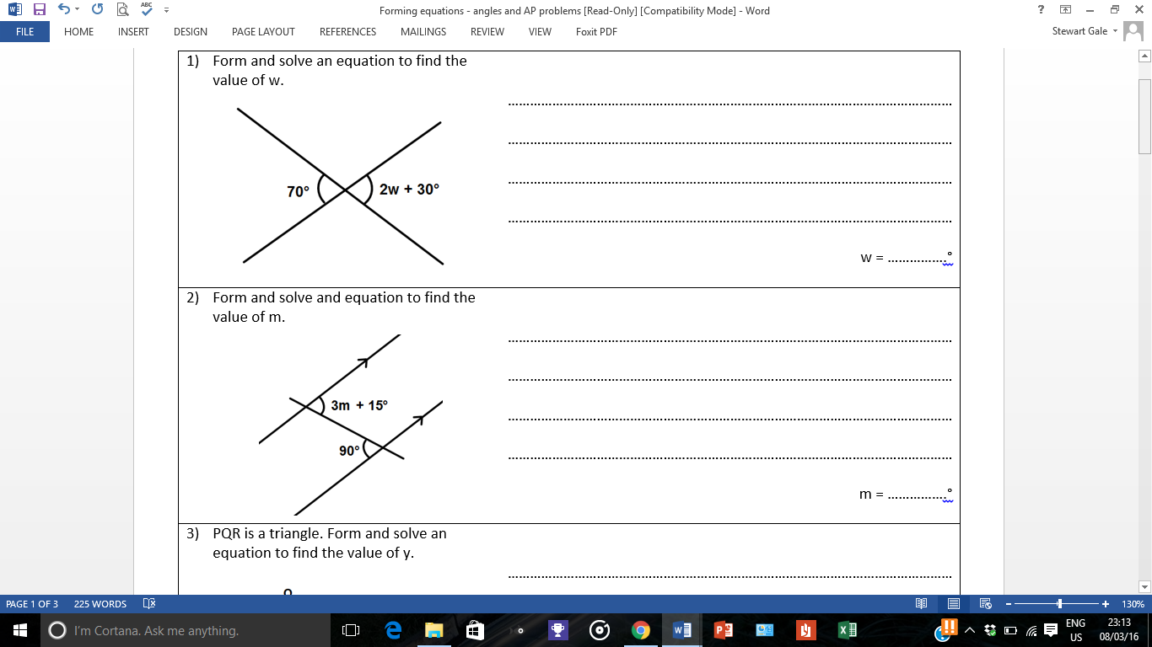
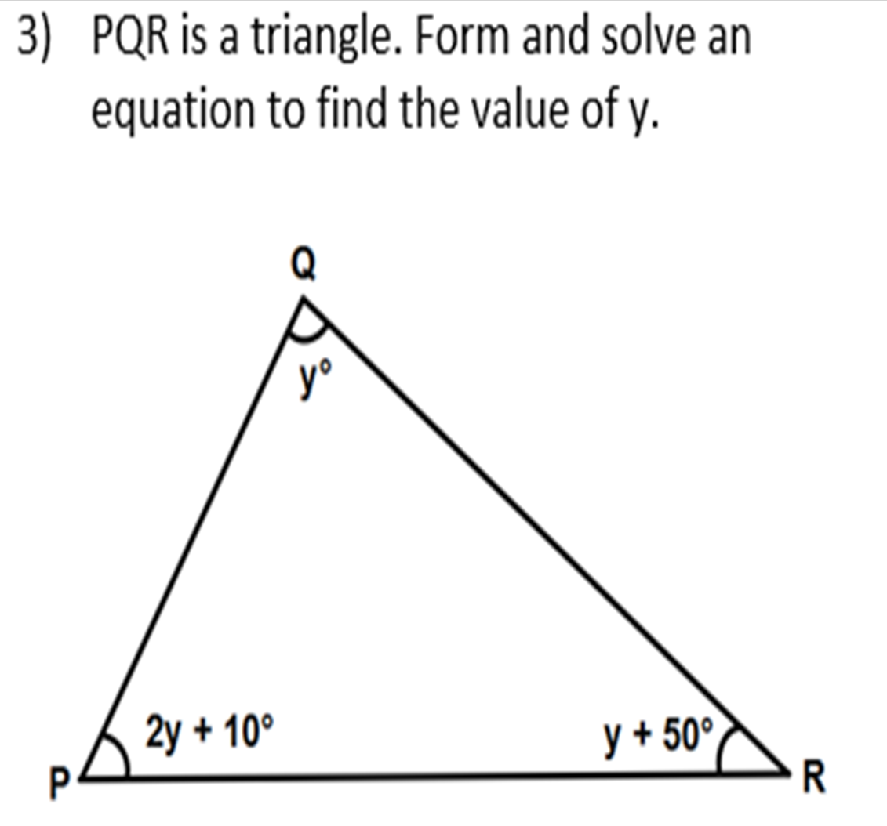
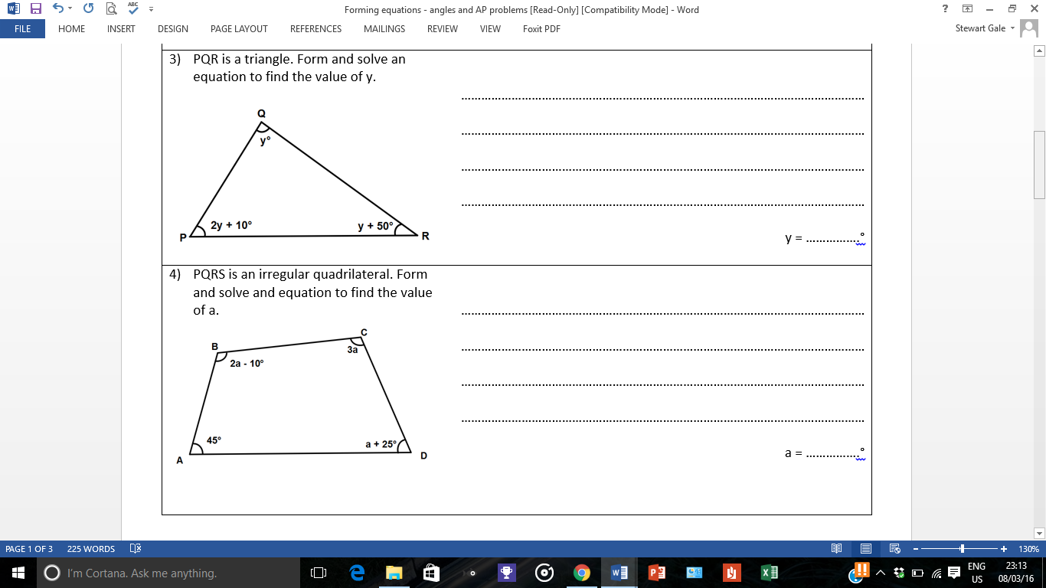
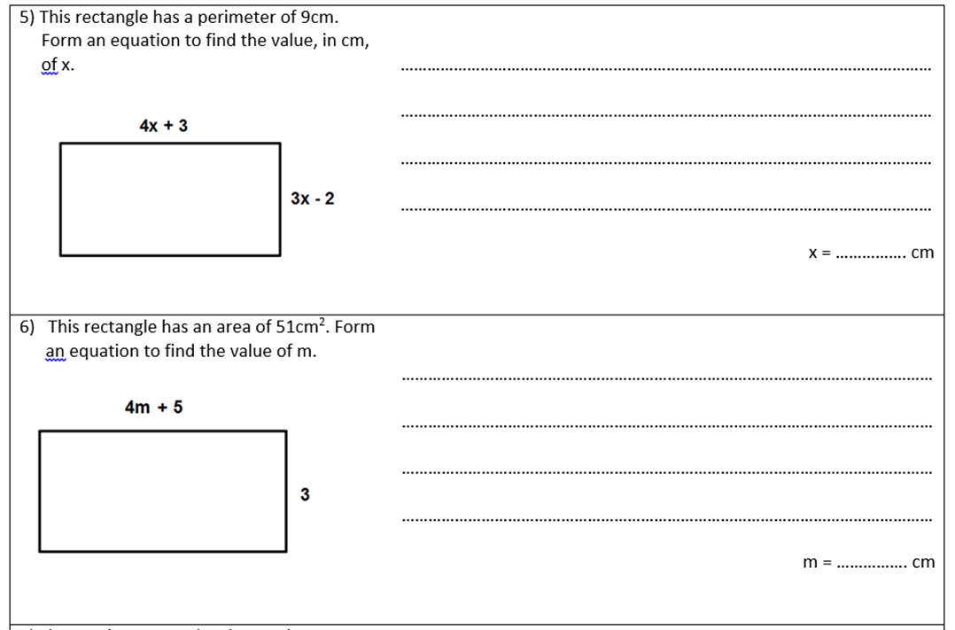
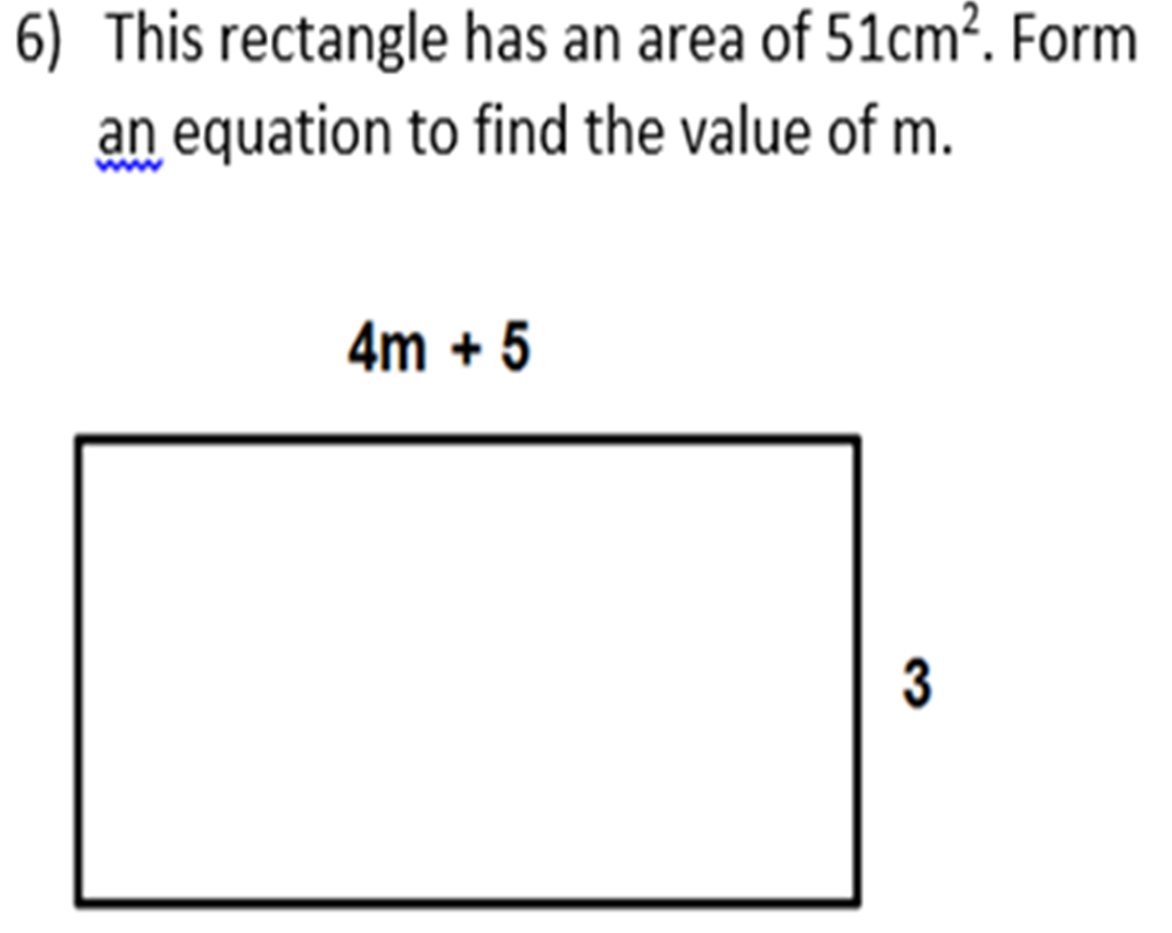
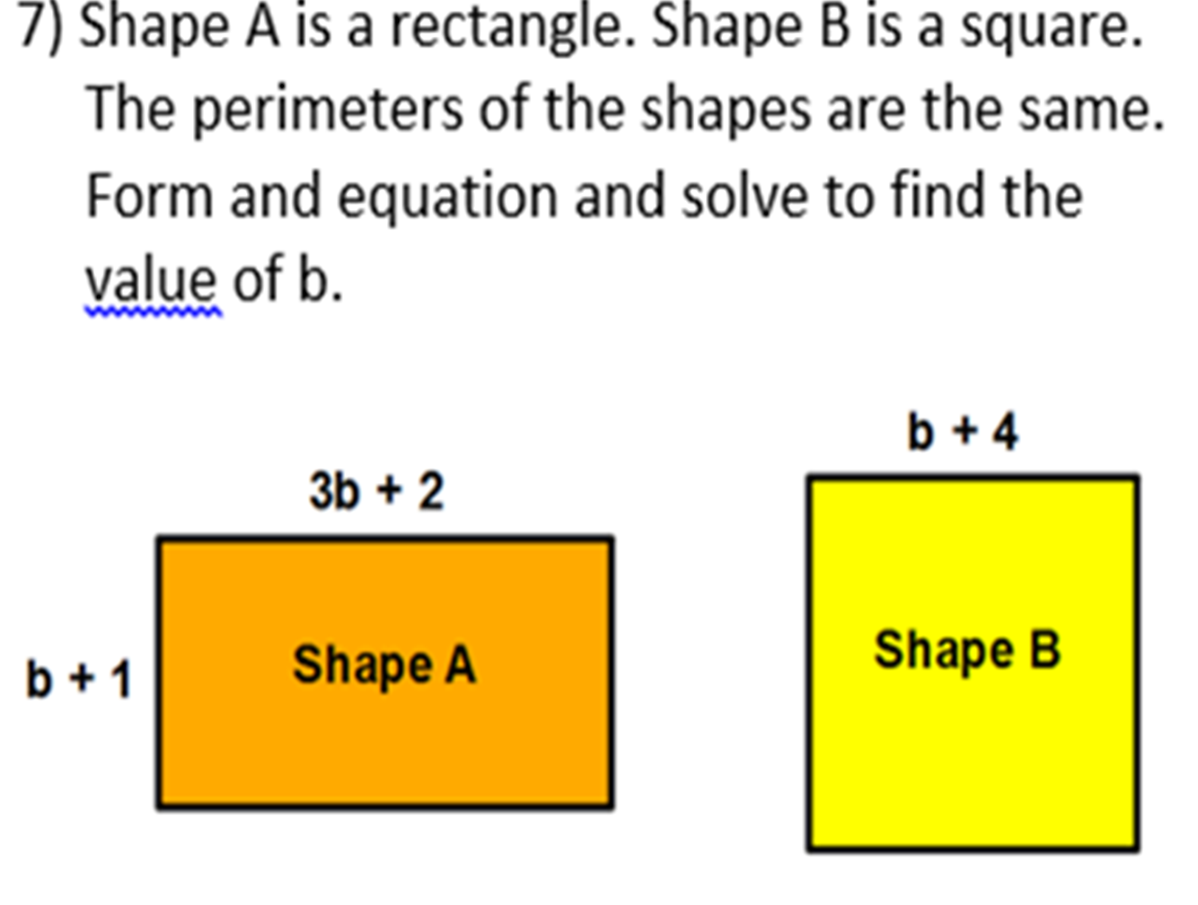
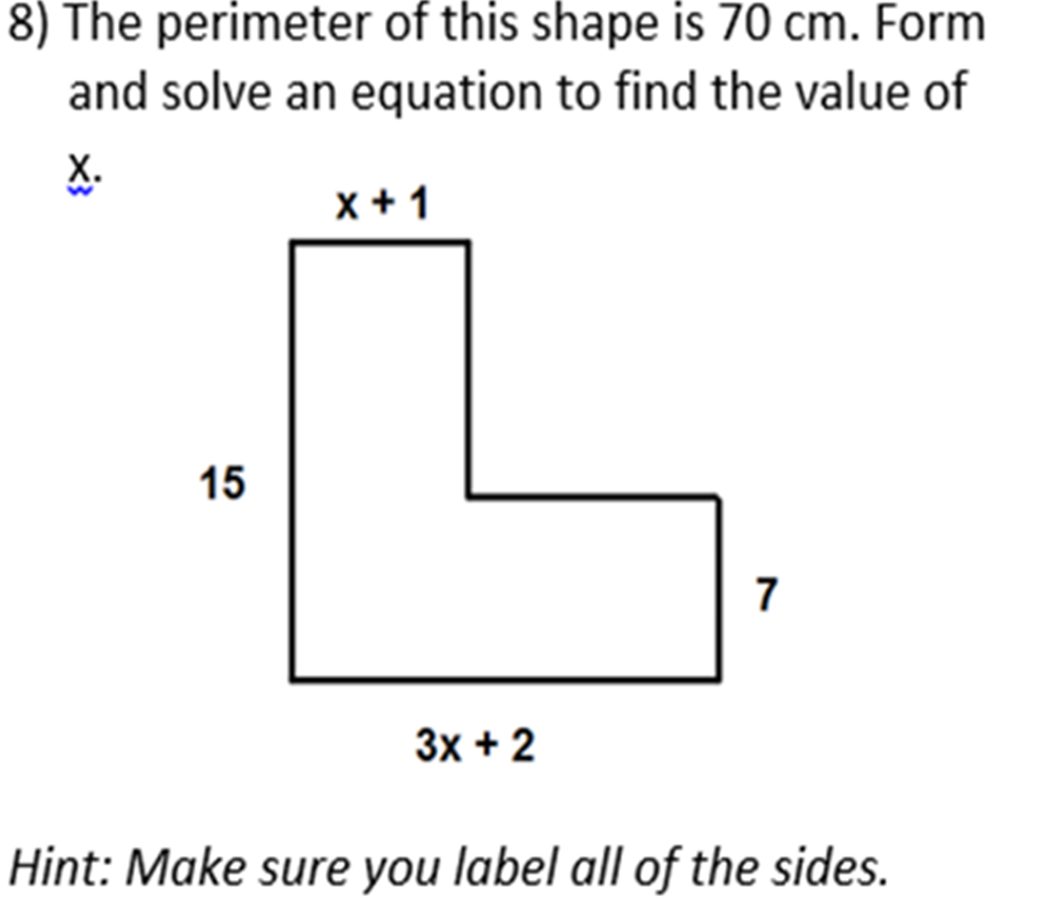

Slide 2
ANSWERS

Slide 3
2w + 30 = 70
2w + 30 = 40
2w + 30 = 20

Slide 4
3m + 15 = 90
3m + 30 = 75
2m + 30 = 25

Slide 5
4y + 60 = 180
4y + 30 = 120
y + 30 = 30

Slide 6
6a + 60 = 360
6a + 60 = 300
6a + 60 = 350

Slide 7
14x + 2 = 9
14x + 0 = 7
1 4x + 0 = 0.5

Slide 8
3(4m + 5) = 51
12m + 15 = 51
12m + 5) = 36
12m + 15 = 53

Slide 9
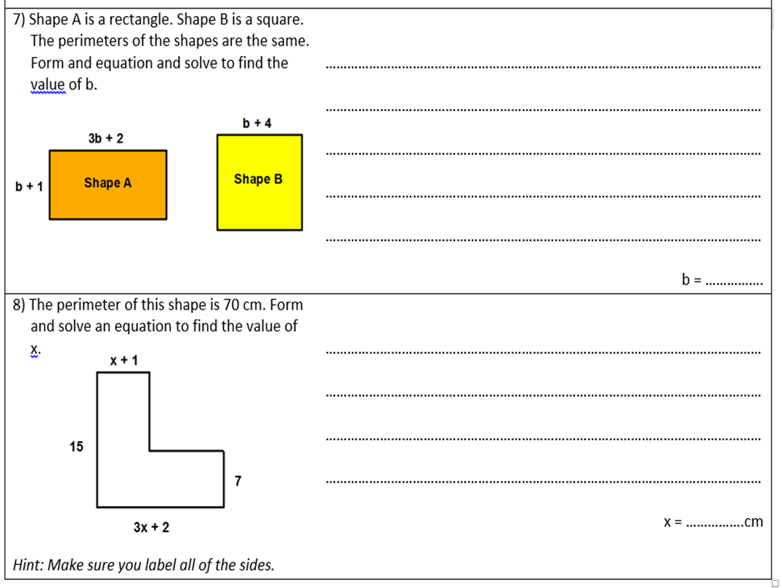
8b + 6 = 4b + 16
4b = 10
b = 2.5

Slide 10
6x + 34 = 70
6x + 0 = 36
x + 0 = 6

