Slide 1
Application of Forces
Statics Rigid Bodies Hinges
Chapter 7
(Part 4 of 6)

Slide 2
Hinged Static Bodies
Freely hinged means
that a rod can rotate
about the point it is hinged.

Slide 3
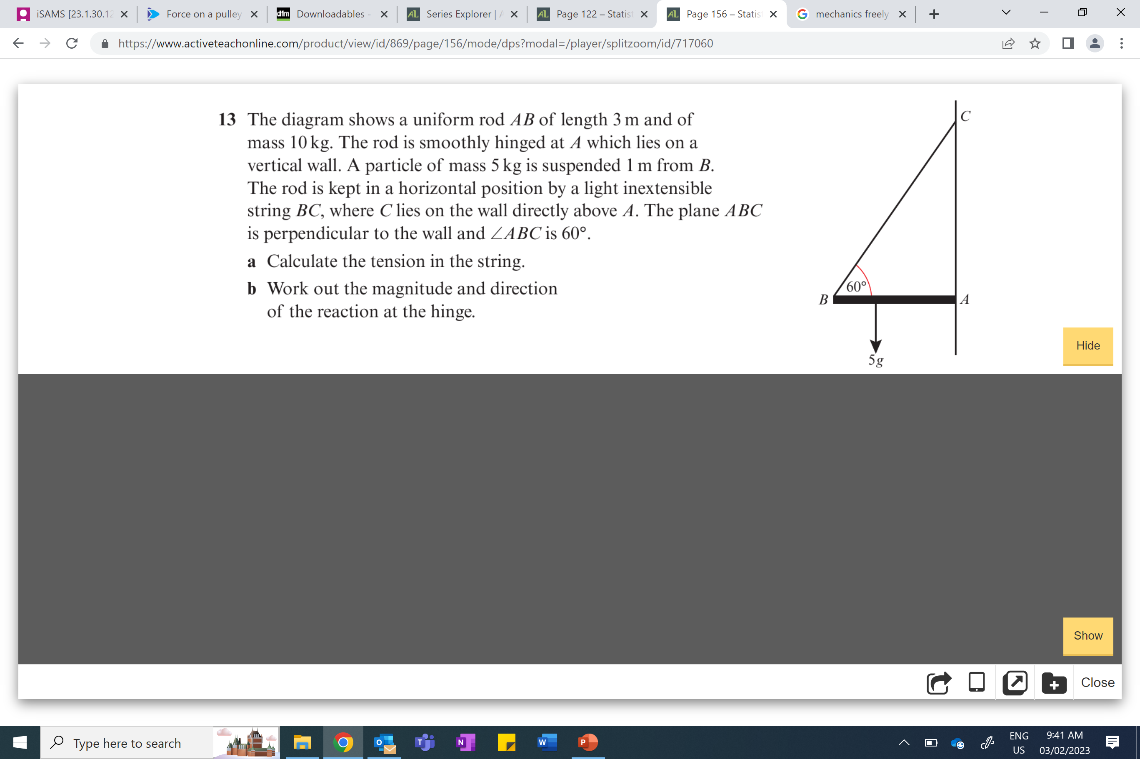
The reaction at the hinge acts at an angle.
V
R
H
Therefore, you will need to write the reaction
in term of a vertical and horizontal force.

Slide 4
Example A

Slide 5
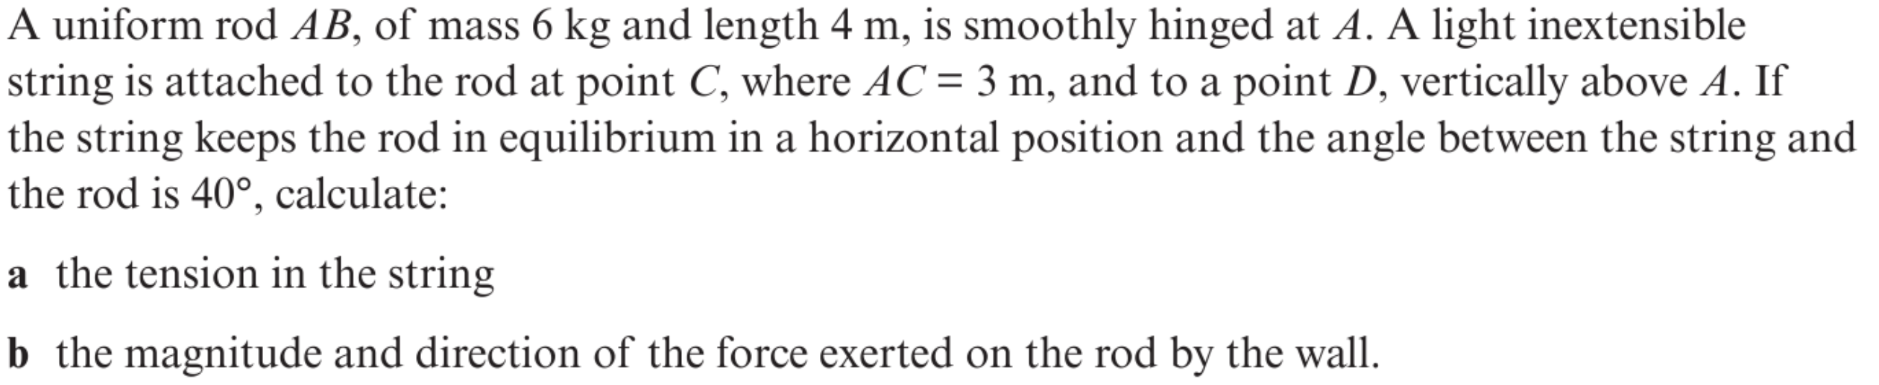
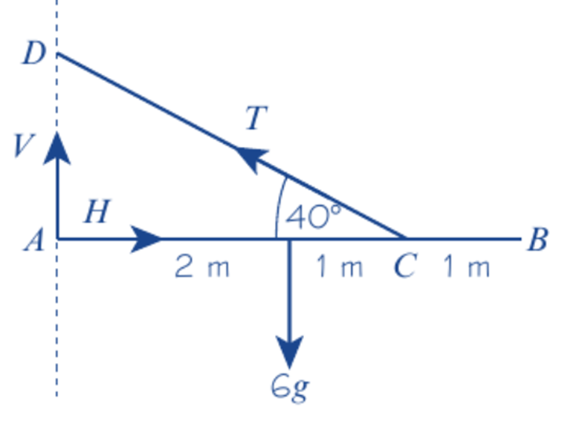

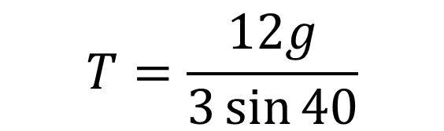




a)
Moments (A)
$$V$$
$$Tsin 40$$
$$6g\left(2\right)=\left(3\right)T sin 40$$
$$T=\frac{12g}{3\sin{40}}$$
$$T=61.0N$$

Slide 6
b)
Find the magnitude of the blue force.
$$V$$
Therefore, you need to find the values of V and H.
H

Slide 7



b)
Resolve Vertical
$$V$$
$$Tsin 40$$
$$6g=V+T\sin{40}$$
$$6g=V+(61)\sin{40}$$
$$V=19.6$$

Slide 8



$$Tcos 40$$
Resolve Horizontally
b)
$$H=T\cos{40}$$
H
$$H=46.7$$

Slide 9
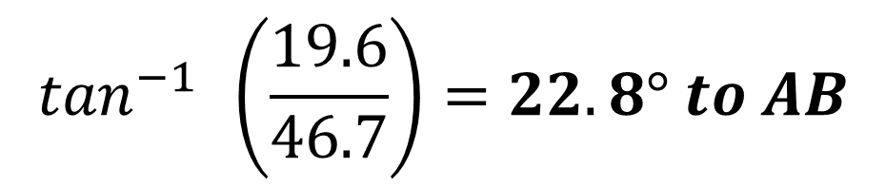
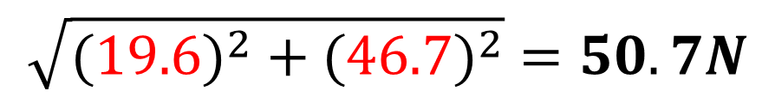
b)
Force exerted on the rob by the wall
19.6
$$\sqrt{{(19.6)}^{2} +{ (46.7)}^{2}}=50.7N$$
46.7
$$\tan^{−1}{ }\left(\frac{19.6}{46.7}\right)=22.8° to AB$$

Slide 10
Example B

Slide 11
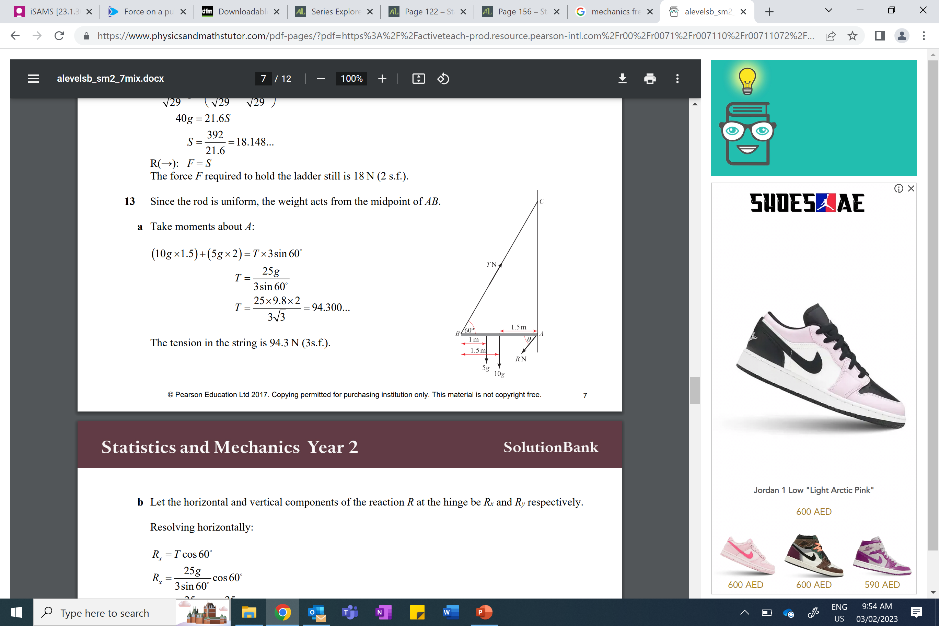


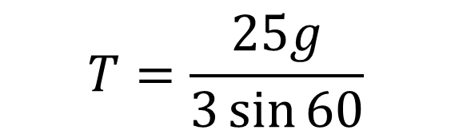

The diagram shows a uniform rod AB of length 3m and of mass 10kg. The rod is smoothly hinged at A which lies on a vertical wall. A particle of mass 5kg is suspended 1m from B. The rod is kept in a horizontal position by a light inextensible string BC, where C lies on the wall directly above A.
The plane ABC is perpendicular to the wall and ABC is 60°.
a) Calculate the tension in the string.
b) Work out the magnitude and direction of the reaction at the hinge.
a)
Moments (A)
$$Tsin 60$$
$$1.5\left(10g\right)+2\left(5g\right)=\left(3\right) T sin 60$$
$$T=\frac{25g}{3\sin{60}}$$
$$T=94.3N$$
5g
$$10g$$

Slide 12



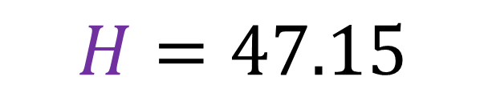
The diagram shows a uniform rod AB of length 3m and of mass 10kg. The rod is smoothly hinged at A which lies on a vertical wall. A particle of mass 5kg is suspended 1m from B. The rod is kept in a horizontal position by a light inextensible string BC, where C lies on the wall directly above A.
The plane ABC is perpendicular to the wall and ABC is 60°.
a) Calculate the tension in the string.
b) Work out the magnitude and direction of the reaction at the hinge.
$$T cos 60$$
b)
Resolve Horizontally
$$H=T\cos{60}$$
$$H=(94.3)\cos{60}$$
H
$$H=47.15$$
5g
$$10g$$

Slide 13
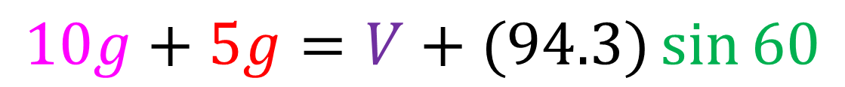
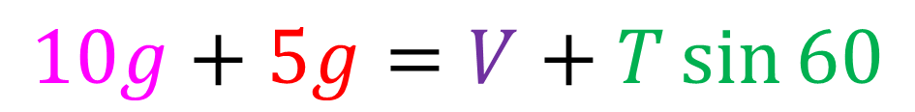
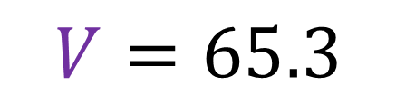
The diagram shows a uniform rod AB of length 3m and of mass 10kg. The rod is smoothly hinged at A which lies on a vertical wall. A particle of mass 5kg is suspended 1m from B. The rod is kept in a horizontal position by a light inextensible string BC, where C lies on the wall directly above A.
The plane ABC is perpendicular to the wall and ABC is 60°.
a) Calculate the tension in the string.
b) Work out the magnitude and direction of the reaction at the hinge.
b)
Resolve Vertical
$$Tsin 60$$
$$10g+5g=V+T\sin{60}$$
V
$$10g+5g=V+(94.3)\sin{60}$$
$$V=65.3$$
5g
$$10g$$

Slide 14
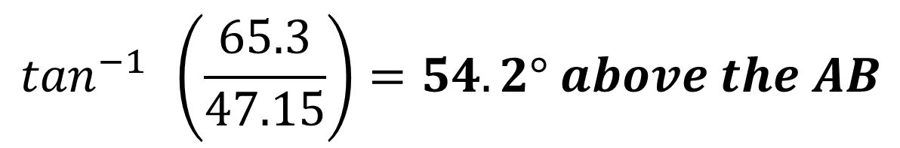
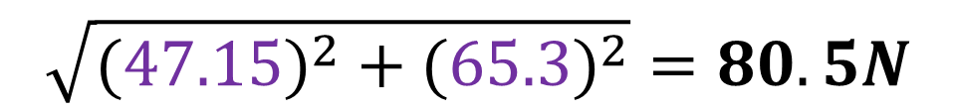

The diagram shows a uniform rod AB of length 3m and of mass 10kg. The rod is smoothly hinged at A which lies on a vertical wall. A particle of mass 5kg is suspended 1m from B. The rod is kept in a horizontal position by a light inextensible string BC, where C lies on the wall directly above A.
The plane ABC is perpendicular to the wall and ABC is 60°.
a) Calculate the tension in the string.
b) Work out the magnitude and direction of the reaction at the hinge.
b)
Force exerted on the rod by the wall
$$\sqrt{{(47.15)}^{2} +{ (65.3)}^{2}}=80.5N$$
$$\tan^{−1}{ }\left(\frac{65.3}{47.15}\right)=54.2° above the AB$$
$$R$$

