Slide 1
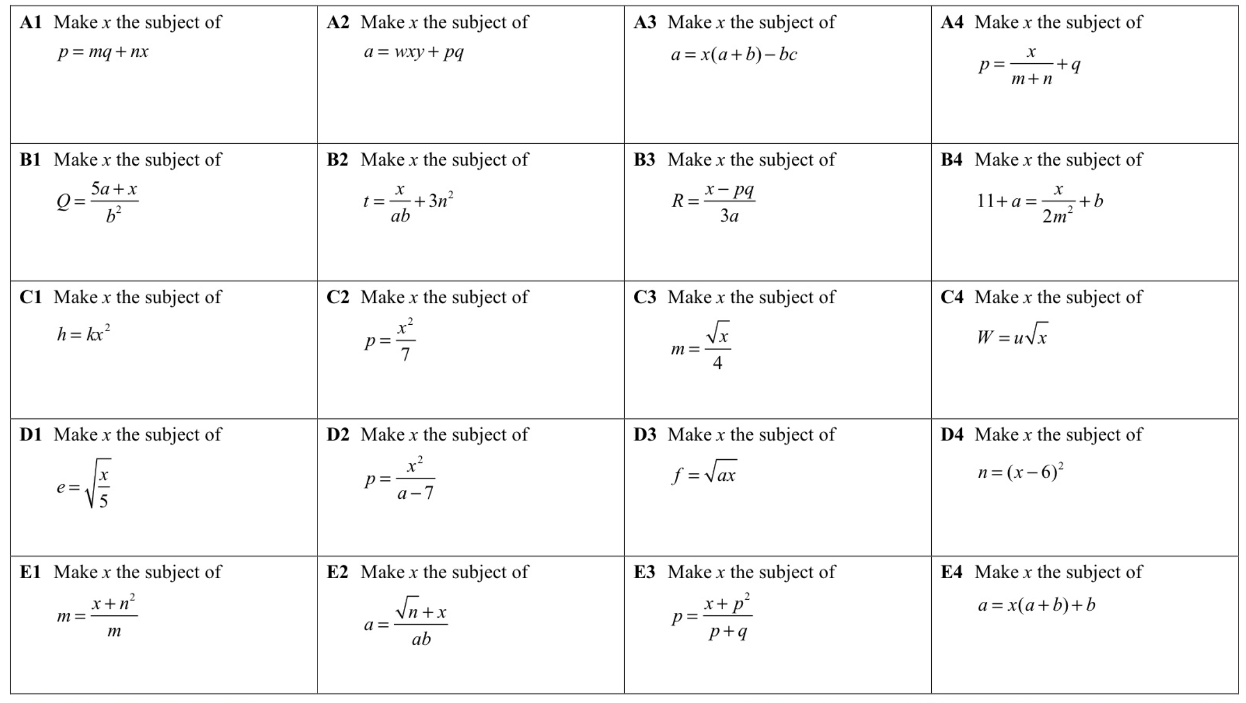

Slide 2
ANSWERS

Slide 3
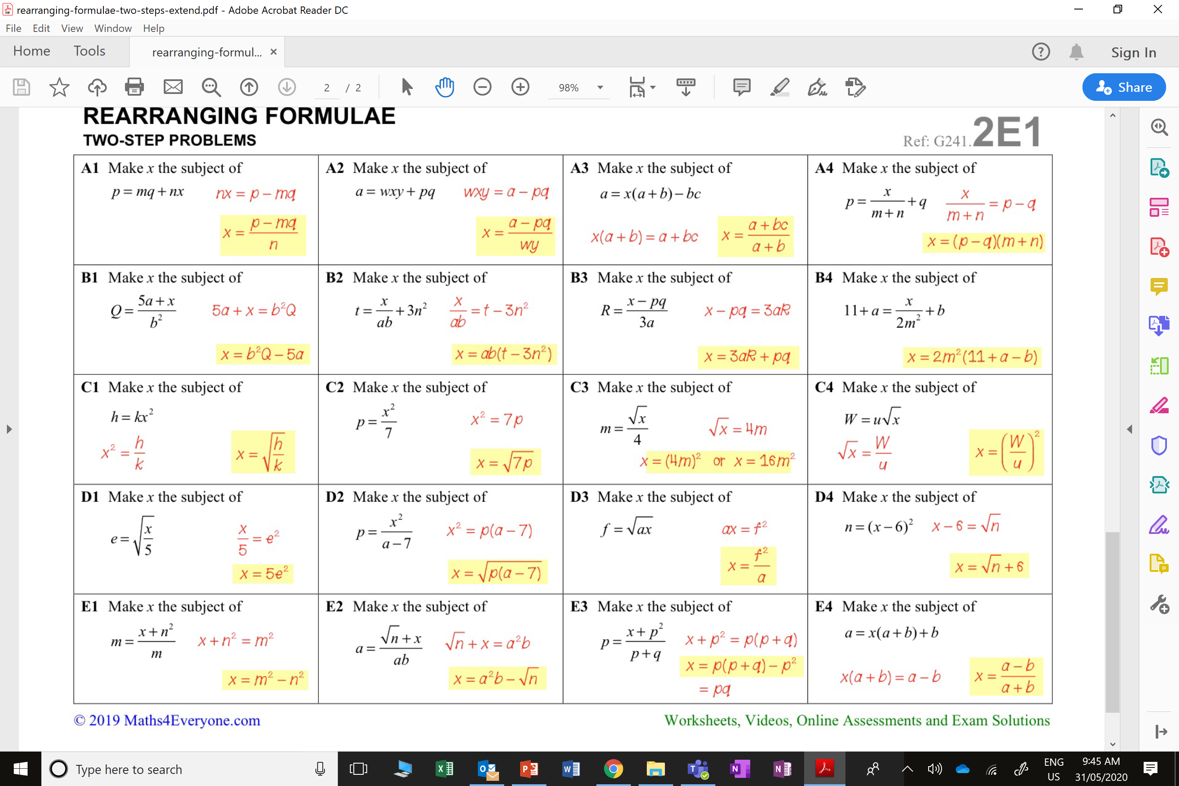


Slide 5
