Slide 1
LO: Angles in Quadrilaterals

Slide 2
How many different types of quadrilaterals can you name?

Slide 3
How many degrees in a quadrilateral?
Hint:
Think about a square.
360˚
360˚
360˚
360˚
360˚
360˚

Slide 4
What is the missing angle?
90°
90°
360˚- 270˚ = 90˚
90°

Slide 5
What is the missing angle?
100°
100°
360˚- 280˚ = 80˚
80°

Slide 6
What is the missing angle?
120°
360˚- 300˚ = 60˚
60°
120°

Slide 7
What is the missing angle?
105°
360˚- 285˚ = 75˚
75°
105°

Slide 8
What is the missing angle?
85°
110°
360˚- 285˚ = 75˚
90°

Slide 9
What is the missing angle?
90°
125°
360˚- 305˚ = 55˚
90°

Slide 10
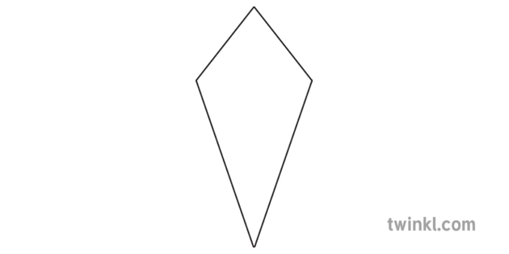
What is the missing angle?
120°
85°
85°
360˚- 290˚ = 70˚

