Slide 1
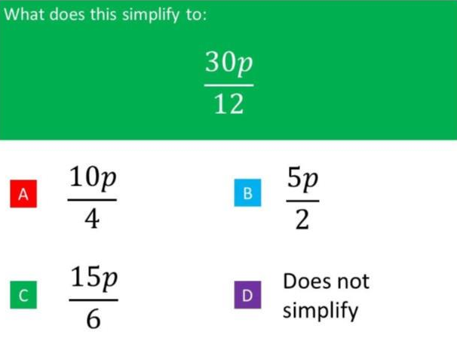
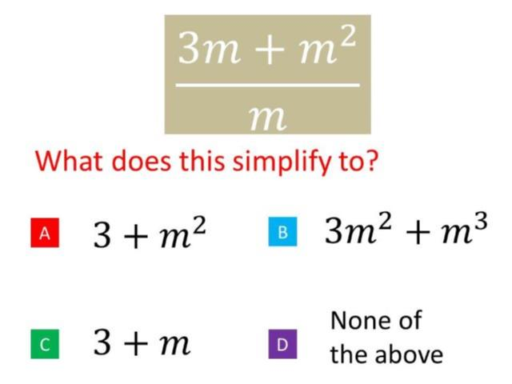
Worst answered question?
Most common wrong answer?

Slide 2
ANSWERS

Slide 3
Worst answered question?

Slide 4
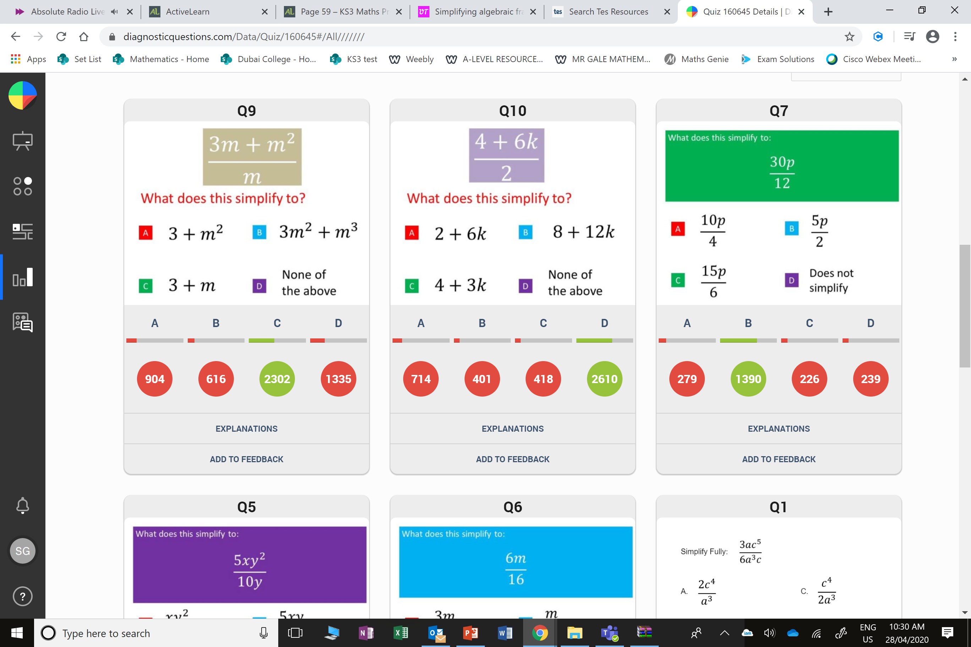
D
They have not realized they need to divide both numerator terms by m.

Slide 5
A
They have simplified
but not fully.

