Slide 1
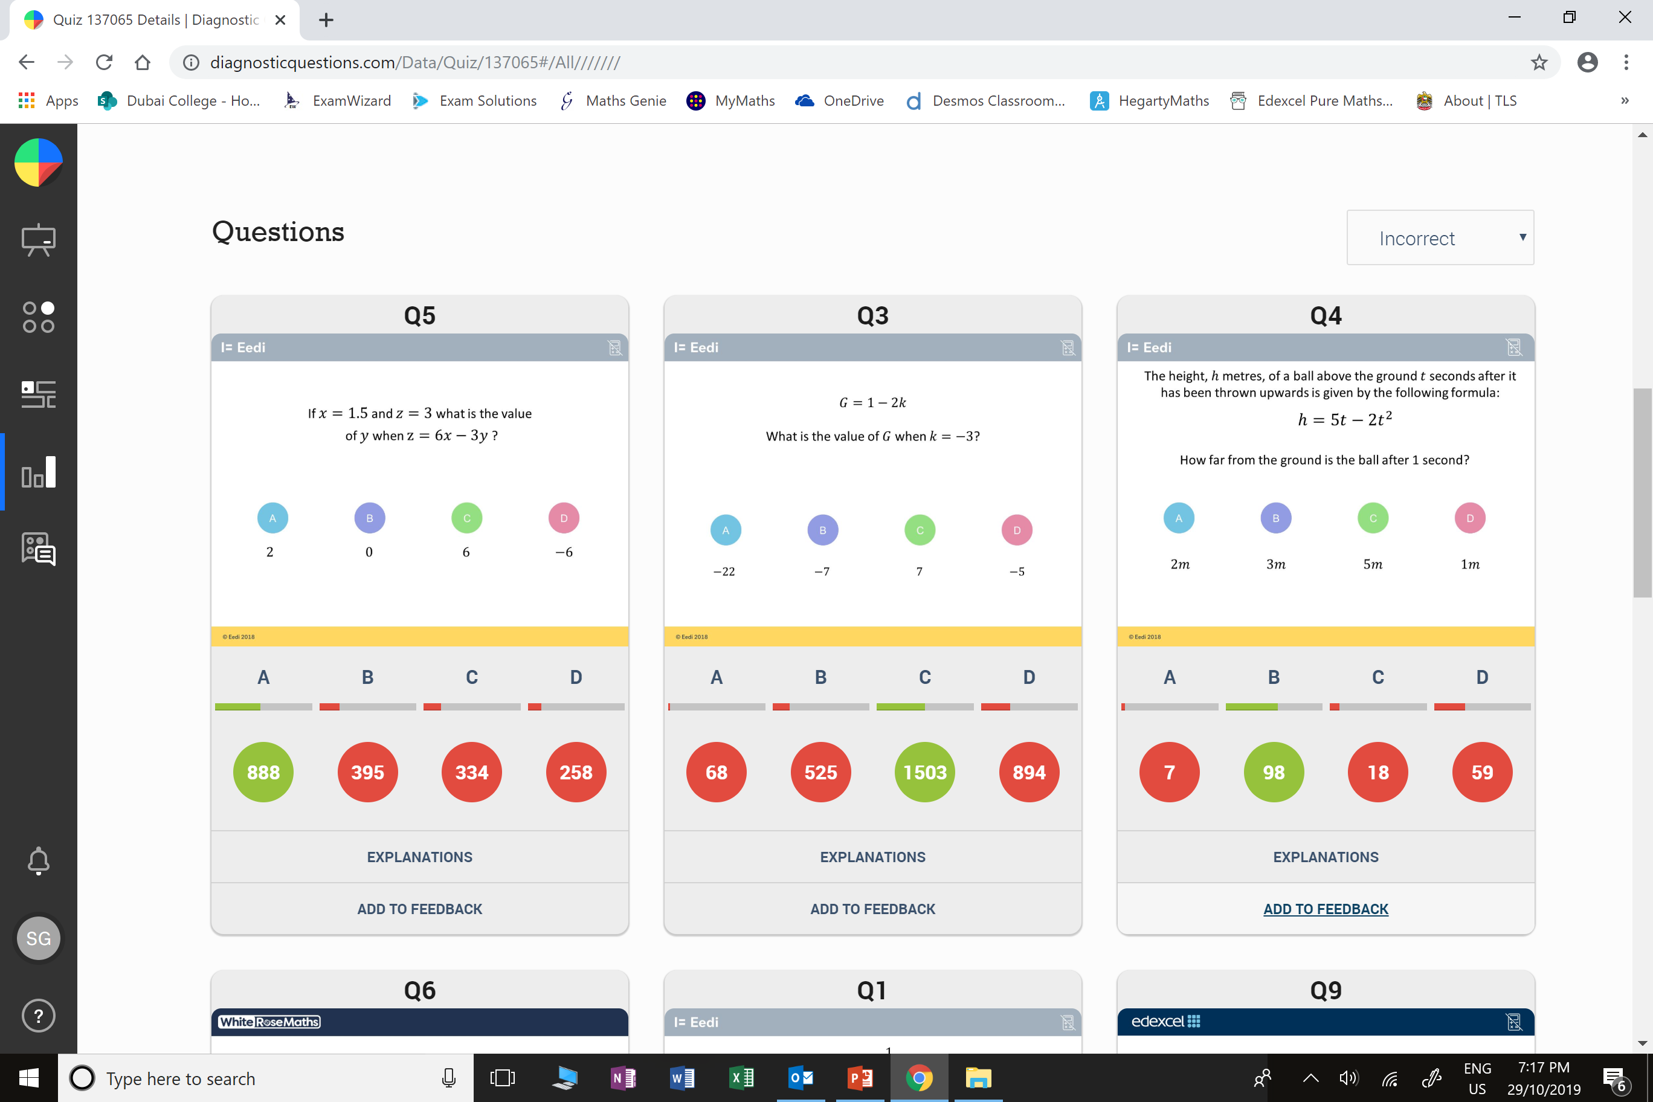
Which question had the lowest percentage
of correct answers?
For each question, what was the most common
wrong answer?

Slide 2
ANSWERS

Slide 3
Which question had the lowest percentage
of correct answers?

Slide 4
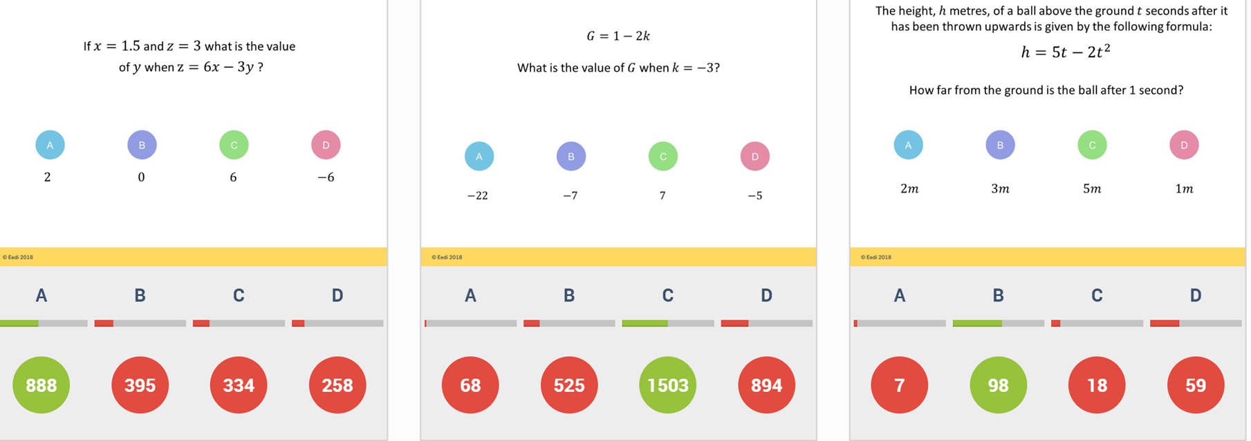
B
The student has substituted in
y = 3 and found z.

Slide 5
D
G = 1 + 6 (not 1 - 6),
so the answer is 7 (not -5).

