Slide 1
LO: Expand Brackets
(Single Bracket)

Slide 2
2 x –5 =
–10

Slide 3
–2 x 5 =
–10

Slide 4
–2 x –5 =
10

Slide 5
x x x x x x x =
x⁴
x + x + x + x =
4x

Slide 6
(x + 5)
(x + 5)
3(x + 5)
= 3x + 15
(x + 5)

Slide 7
(x – 3)
(x – 3)
4(x – 3)
= 4x – 12
(x – 3)
(x – 3)

Slide 8
3(2x + 5) =
6x + 15

Slide 9
3(2x – 5) =
6x – 15

Slide 10
–3(2x – 5) =
–6x + 15

Slide 11
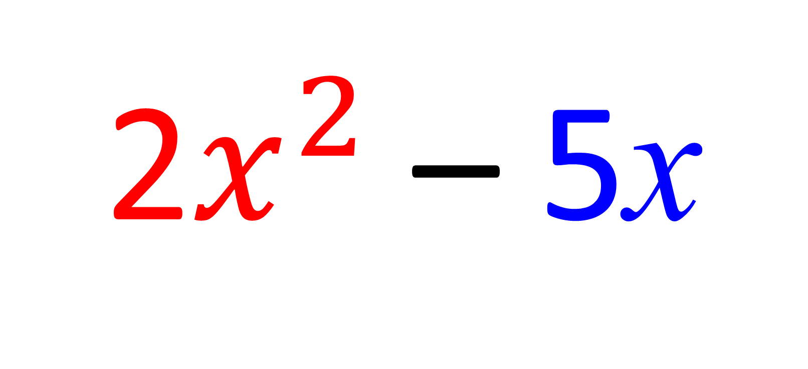
x(2x – 5) =
2$x^{2}$ – 5x

Slide 12
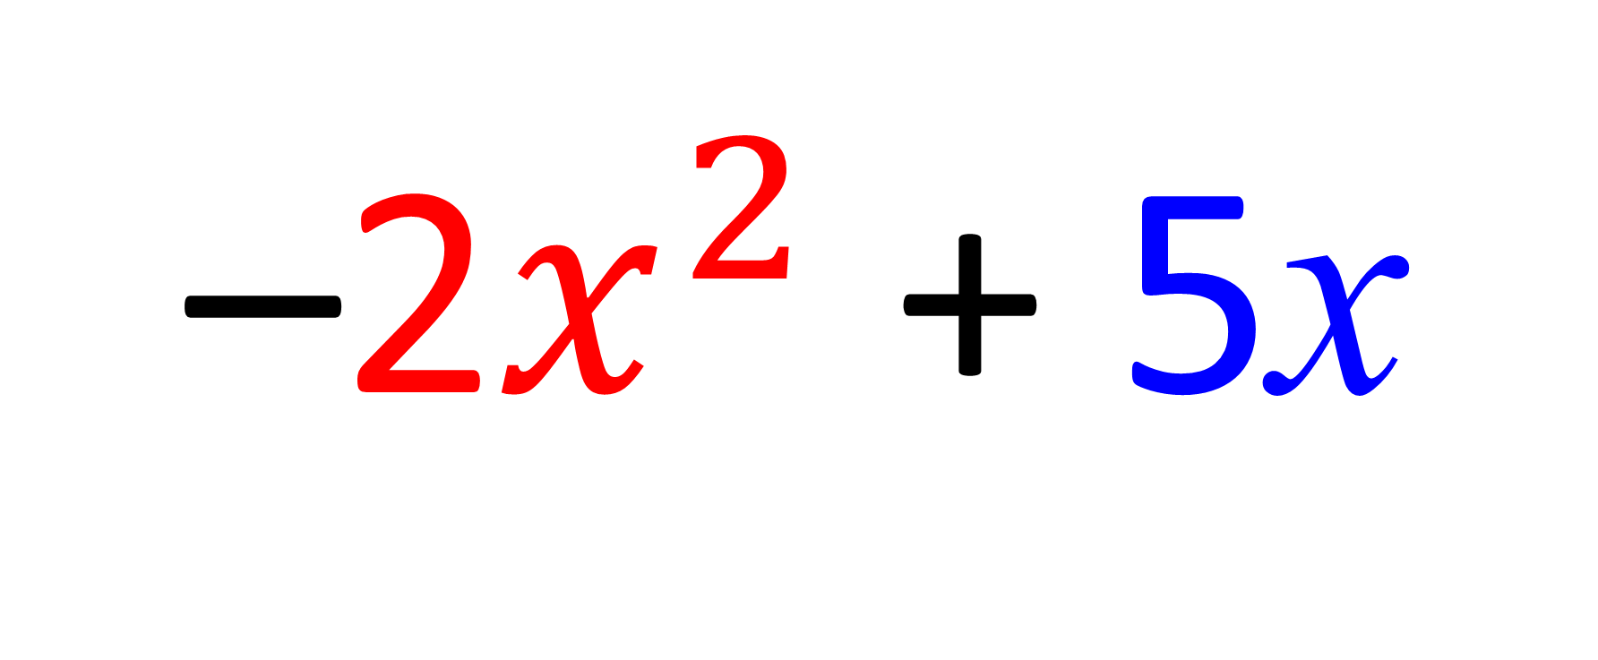
–x(2x – 5) =
–2$x^{2}$ + 5x

Slide 13
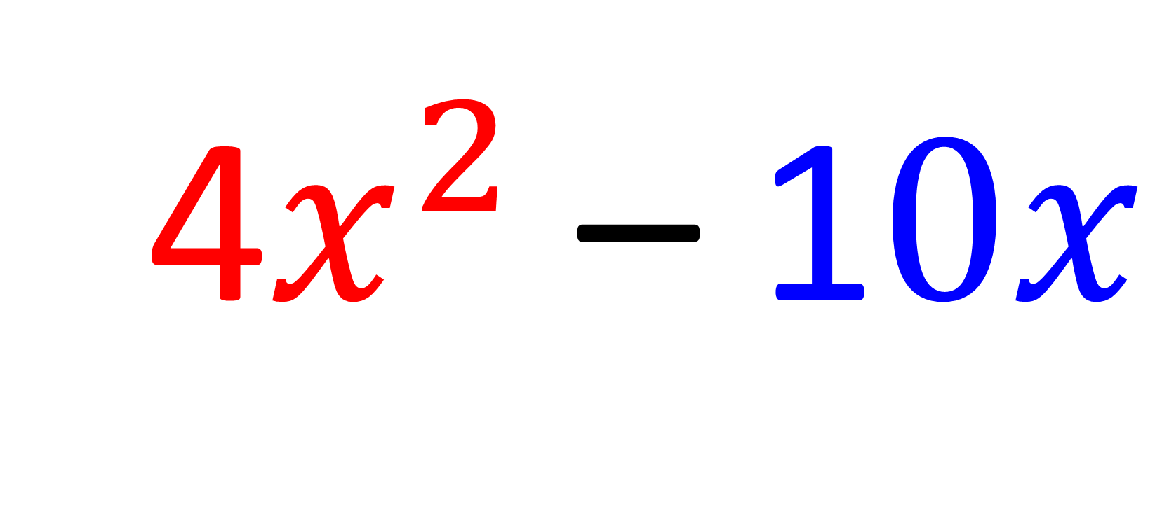
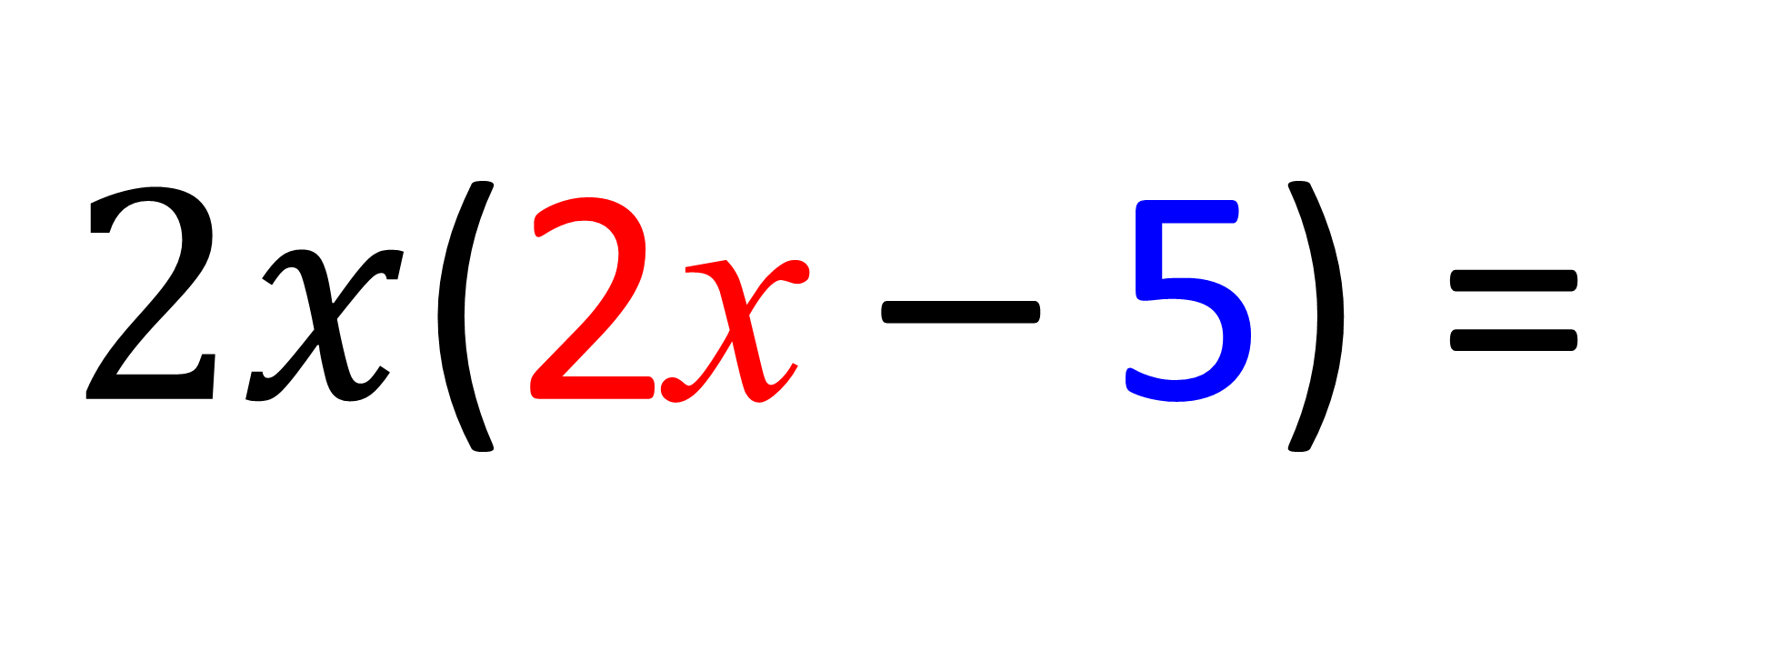
$2x$(2x – 5) =
4$x^{2}$ – 1$0x$

Slide 14
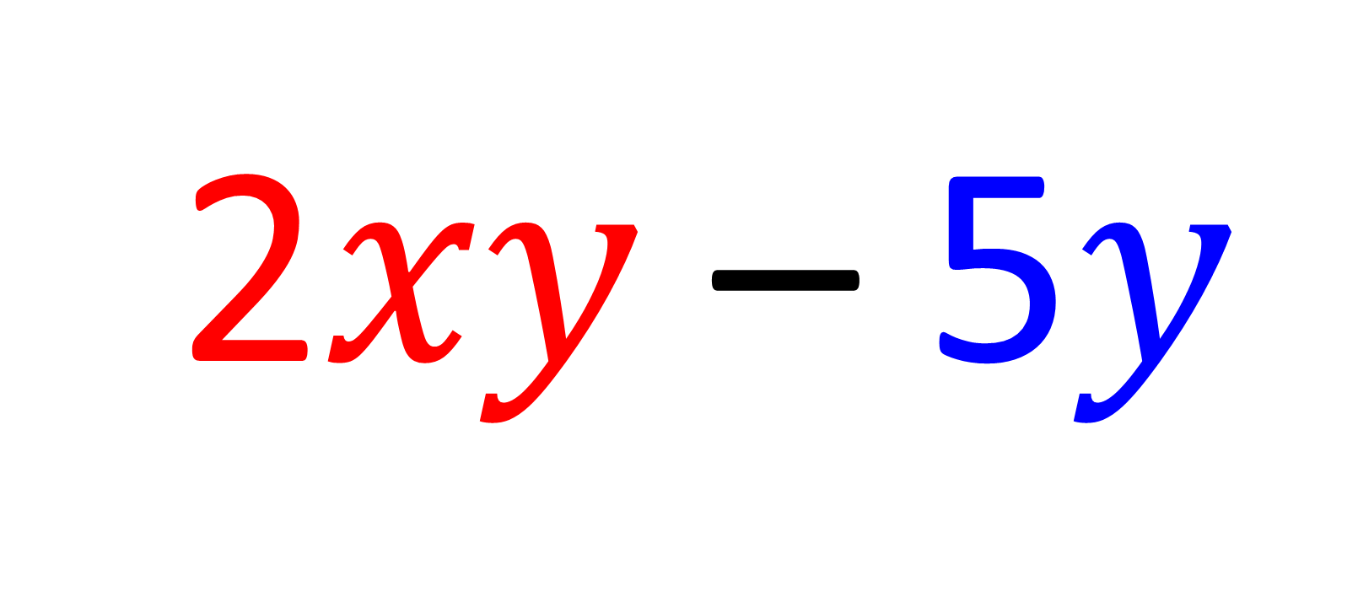
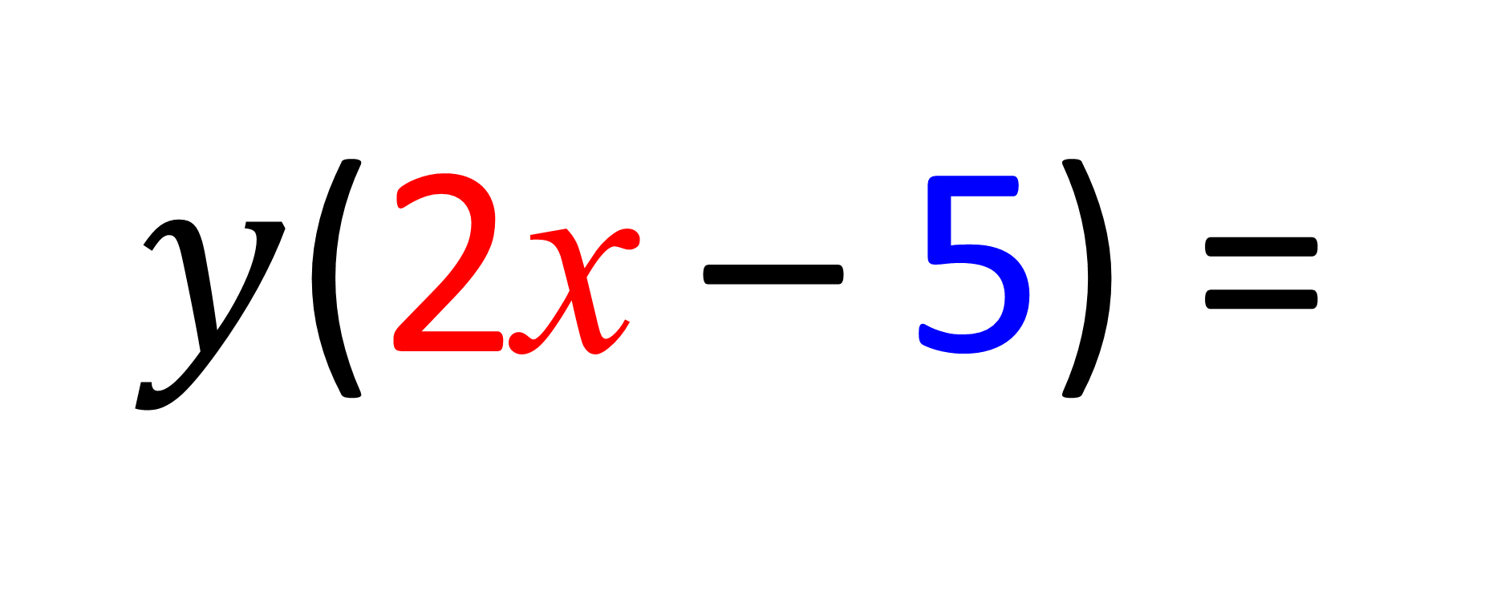
$y$(2x – 5) =
2$xy$ – 5$y$

Slide 15
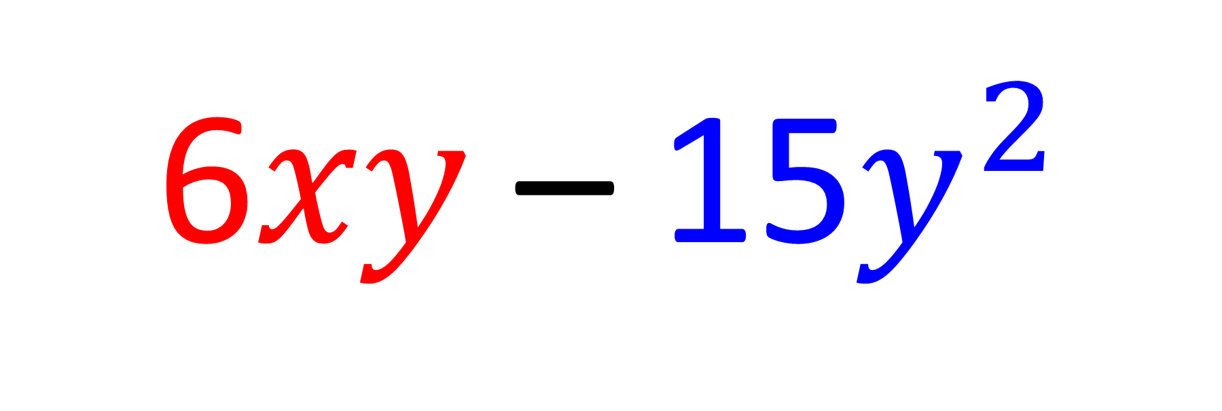
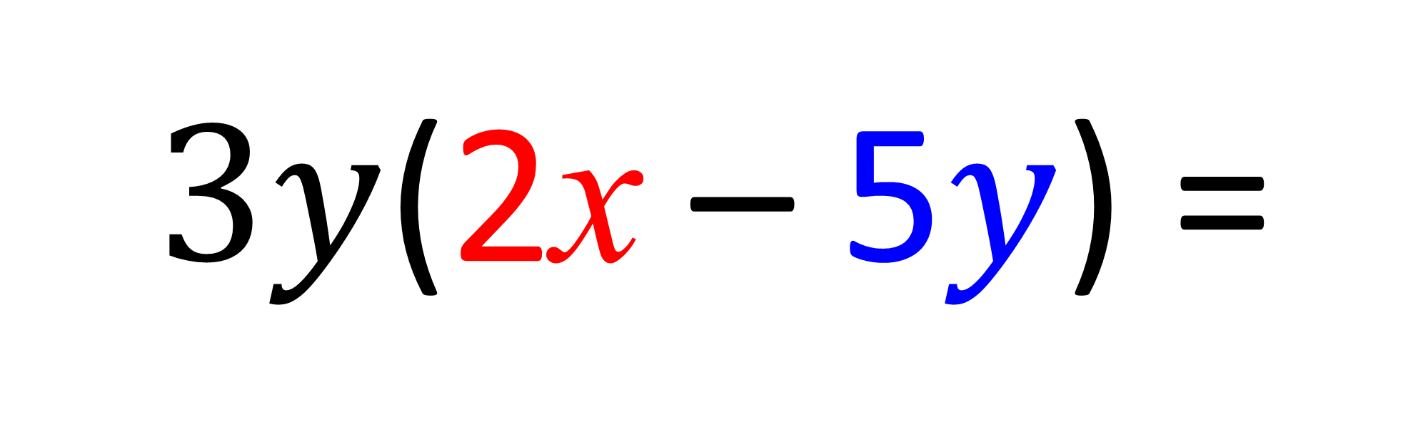
$3y$(2x – 5$y$) =
6$xy$ – 15$y^{2}$

Slide 16
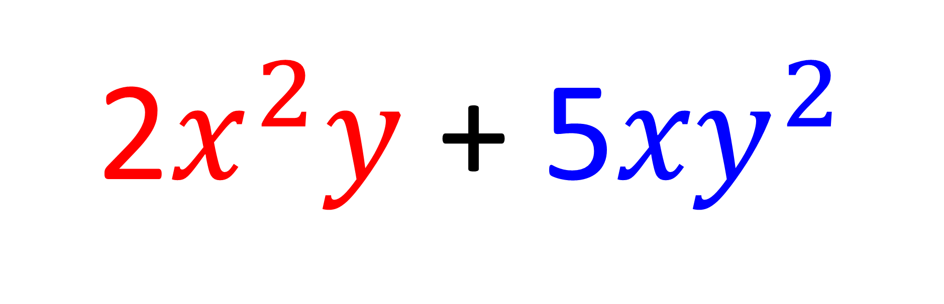
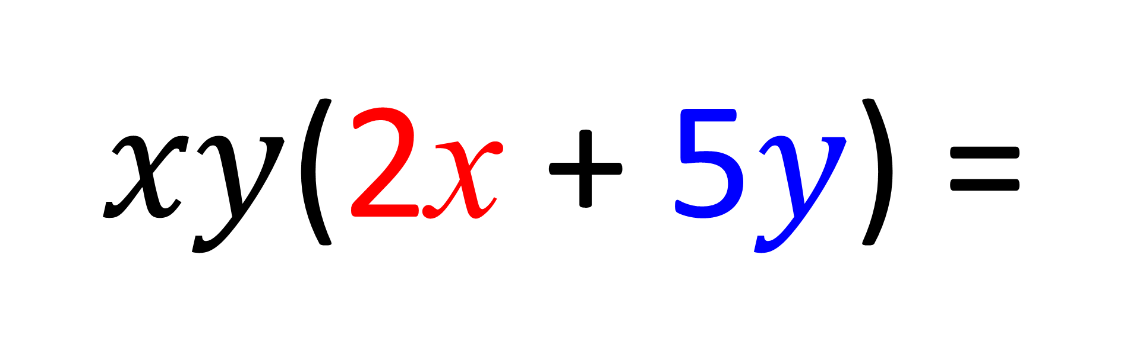
$xy$(2x + 5$y$) =
2$x^{2}y$ + 5${xy}^{2}$

Slide 17
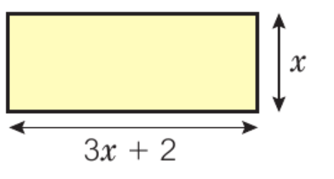
What is the area of the rectangle?
x(3x + 2) = 3x² + 2x

