Slide 1
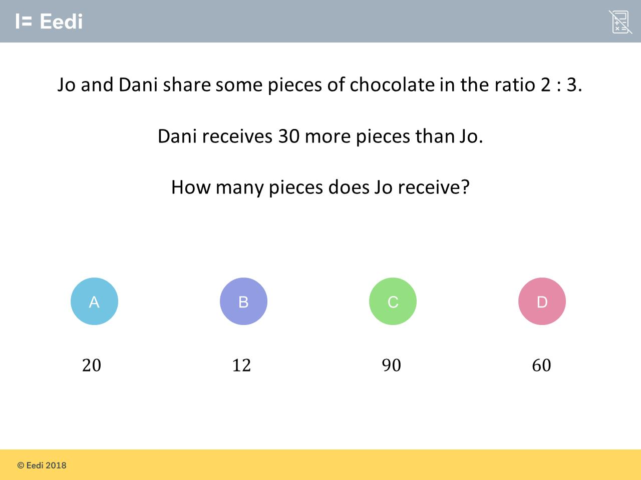
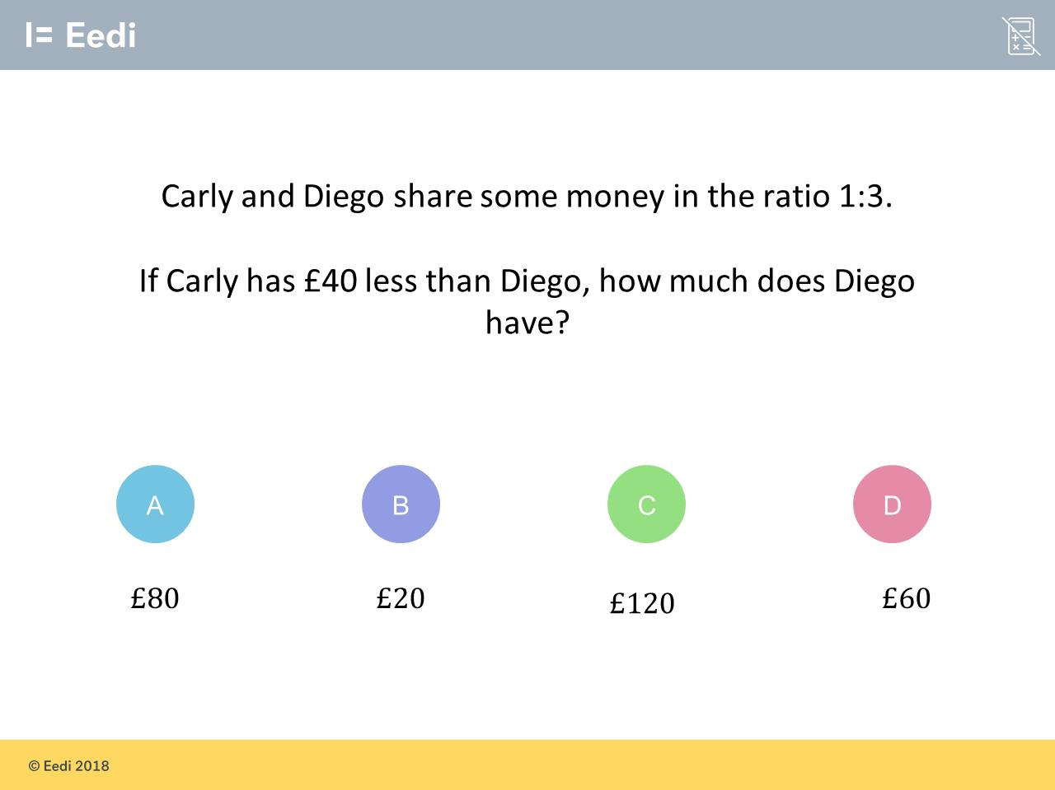
Worst answered question?
Most common wrong answer?

Slide 2
ANSWERS

Slide 3
Worst answered question?

Slide 4

A
They think Dani’s ratio has been multiplied by 10 and therefore done 2 x 10.

Slide 5
C
They have taken 40 and multiplied it by Diego’s ratio 3.

