Slide 1
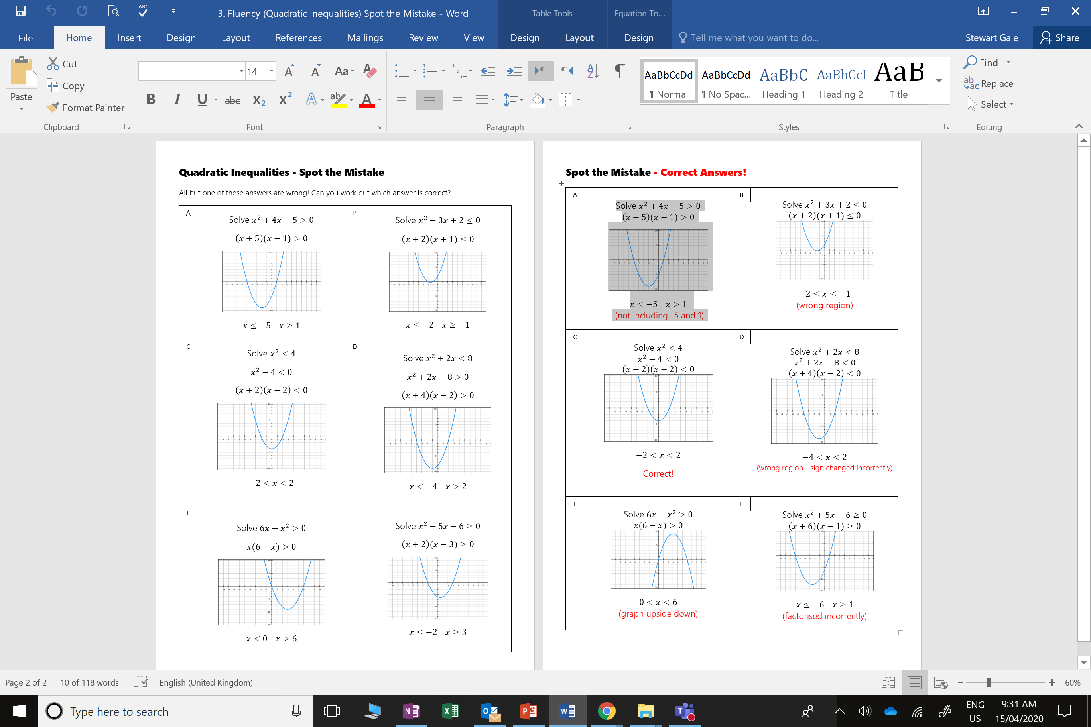

Slide 2
ANSWERS

Slide 3
(not including -5 and 1)
(wrong region)

Slide 4
Correct!
(wrong region - sign changed incorrectly)

Slide 5
(graph upside down)
(factorised incorrectly)

