Slide 1
LO: Sine Rule (Sides)

Slide 2

Right Angle Triangle or Not?
70˚
30˚

Slide 3

Right Angle Triangle or Not?
90˚
30˚

Slide 4
Right Angle Triangle or Not?
60˚
30˚

Slide 5
Right Angle Triangle or Not?
50˚
30˚

Slide 6
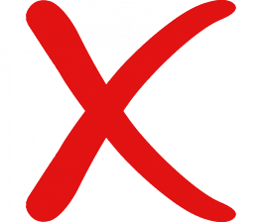
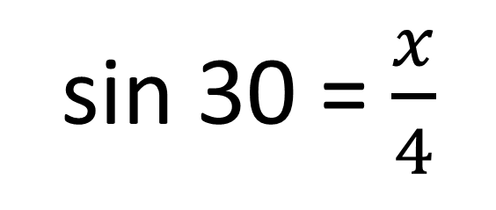
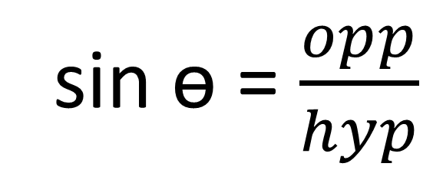
What did the student do wrong?
sin ɵ = $\frac{opp}{hyp}$
sin 30 = $\frac{x}{4}$
x
4cm
4 sin 30 = x
70˚
30˚
x = 2 cm

Slide 7

For non right angle triangles you can not use SOHCAHTOA!
You must use either the
SINE Rule or the COSINE Rule

Slide 8
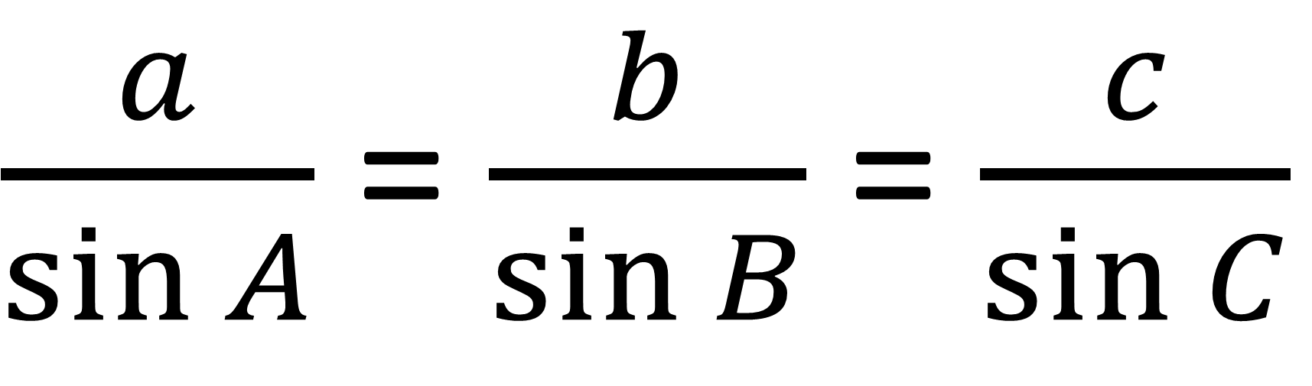
Sine Rule
$\frac{a}{\sin{A}}$ = $\frac{b}{\sin{B}}$ = $\frac{c}{\sin{C}}$
Capital letters represent angles.
Lower case letters represent sides.

Slide 9
A
Labelling a Triangle
b
c
C
a
B

Slide 10
Don't be afraid to relabel the triangle
A
X
b
c
Z
C
a
Y
B

Slide 11
Do you have the correct information to use sine rule?
A
a | A
7 | 56˚
b | B
x | 34˚
b
x
56˚
c
c | C
Do you have two complete pairs?
C
34˚
7cm
B
a

Slide 12
Sine rule or Not
A
a | A
7
b | B
x | 34˚
c
b
x
8cm
c | C
8
Not
C
34˚
7cm
B
a

Slide 13
Sine rule or Not
A
a | A
 | 40˚
b | B
x
c
b
x
40˚
8cm
c | C
8
Not
C
B
a

Slide 14
Sine rule or Not
c
B
A
a | A
4 | 40˚
b | B
x
40˚
b
x
4cm
c | C
Not
a
C

Slide 15
Sine rule or Not
c
A
7cm
a | A
5
b | B
x | 34˚
B
34˚
x
b
5cm
c | C
7 | 56˚
Yes
56˚
a
C

Slide 16
Sine rule or Not
c
B
A
a | A
4 | 40˚
b | B
x
40˚
80˚
b
x
4cm
c | C
 | 60˚
Yes
a
60˚
C

Slide 17
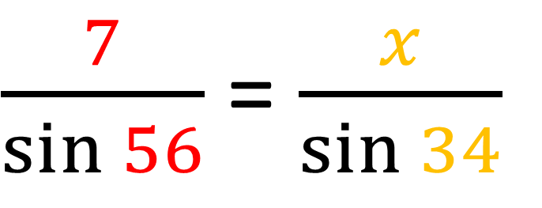
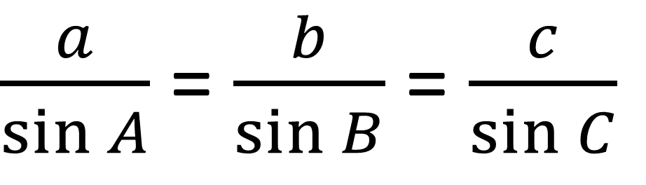
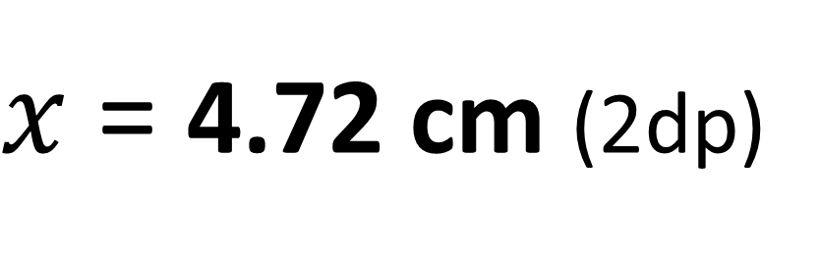
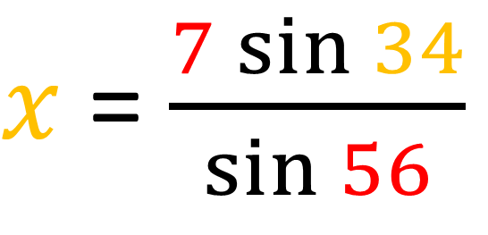
$\frac{a}{\sin{A}}$ = $\frac{b}{\sin{B}}$ = $\frac{c}{\sin{C}}$
A
b
x
56˚
c
$\frac{7}{\sin{56}}$ = $\frac{x}{\sin{34}}$
C
34˚
7cm
B
$x$ = $\frac{7\sin{34}}{\sin{56}}$
a
$x$ = 4.72 cm (2dp)

Slide 18
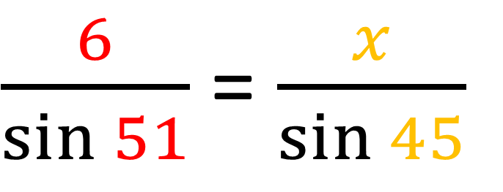
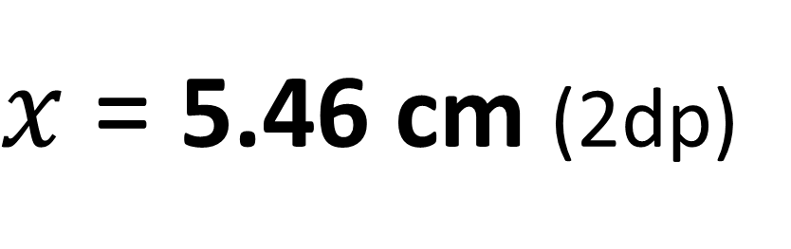
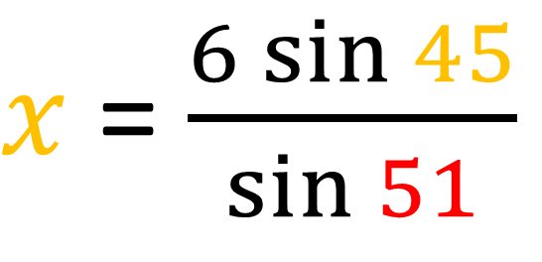
$\frac{a}{\sin{A}}$ = $\frac{b}{\sin{B}}$ = $\frac{c}{\sin{C}}$
A
b
x
51˚
C
$\frac{6}{\sin{51}}$ = $\frac{x}{\sin{45}}$
c
6cm
45˚
a
$x$ = $\frac{6\sin{45}}{\sin{51}}$
B
$x$ = 5.46 cm (2dp)

Slide 19
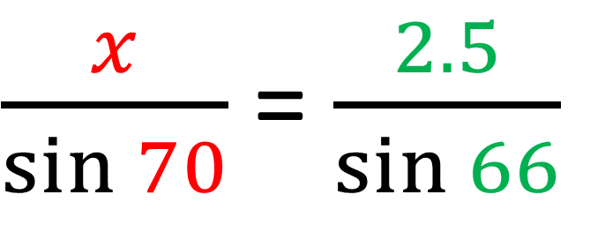
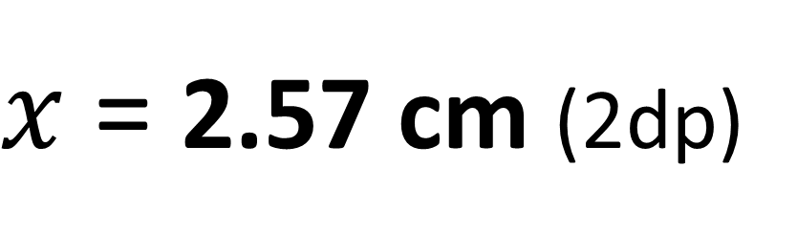
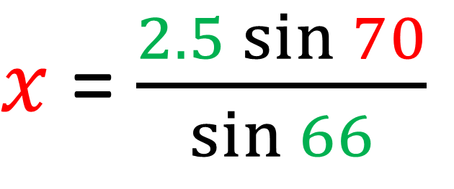
If you have two angles
you have all the angles!
$\frac{a}{\sin{A}}$ = $\frac{b}{\sin{B}}$ = $\frac{c}{\sin{C}}$
A
c
$\frac{x}{\sin{70}}$ = $\frac{2.5}{\sin{66}}$
70˚
b
2.5cm
66˚
$x$ = $\frac{2.5\sin{70}}{\sin{66}}$
C
44˚
x
B
a
$x$ = 2.57 cm (2dp)

