Slide 1
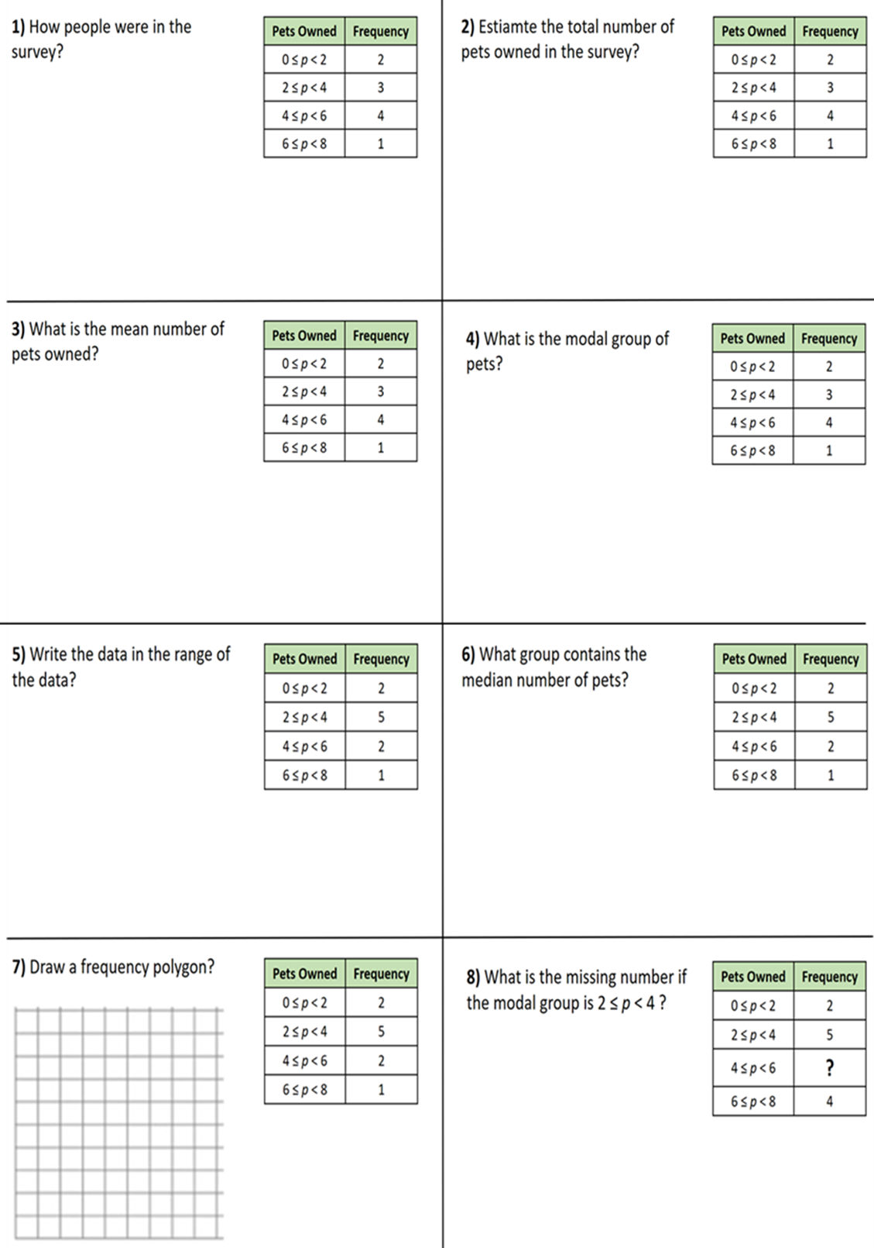
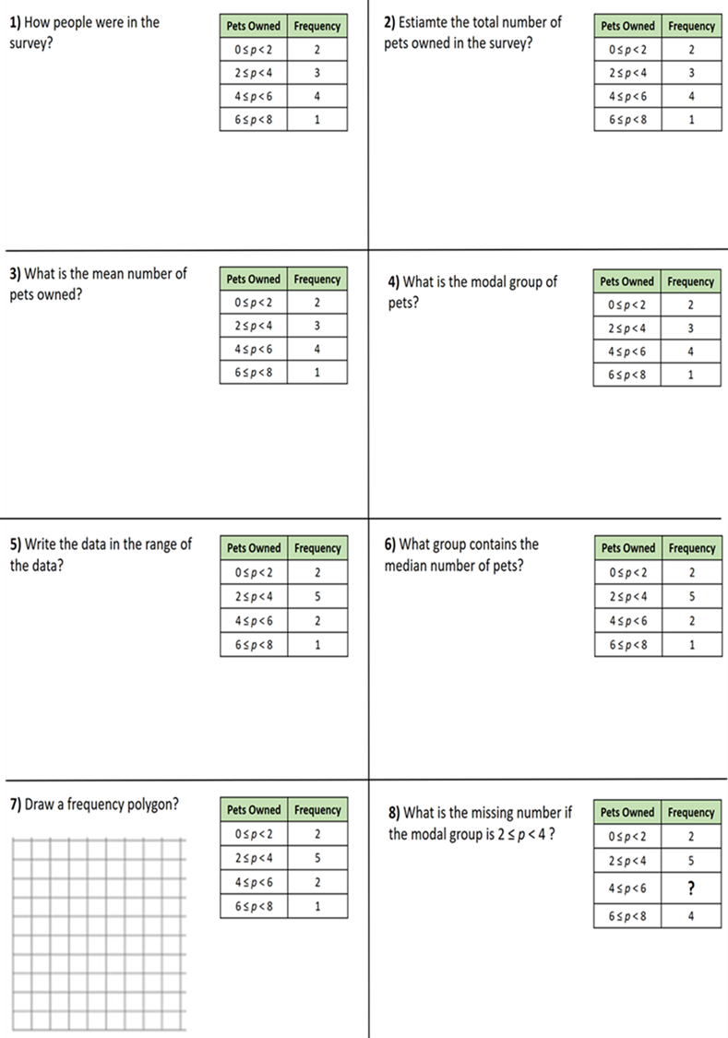

Slide 2
ANSWERS

Slide 3
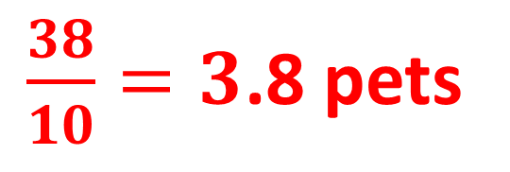
1) How people were in the survey?
Pets Owned | Frequency
0 ≤ p < 2 | 2
2 ≤ p < 4 | 3
4 ≤ p < 6 | 4
6 ≤ p < 8 | 1
2) Estiamte the total number of pets owned in the survey?
Pets Owned | Frequency
0 ≤ p < 2 | 2
2 ≤ p < 4 | 3
4 ≤ p < 6 | 4
6 ≤ p < 8 | 1
10 people
2 + 9 + 20 + 7
38 pets
3) What is the mean number of pets owned?
Pets Owned | Frequency
0 ≤ p < 2 | 2
2 ≤ p < 4 | 3
4 ≤ p < 6 | 4
6 ≤ p < 8 | 1
4) What is the modal group of pets?
Pets Owned | Frequency
0 ≤ p < 2 | 2
2 ≤ p < 4 | 3
4 ≤ p < 6 | 4
6 ≤ p < 8 | 1
$\frac{38}{10}=3$.8 pets
4 ≤ p < 6

Slide 4
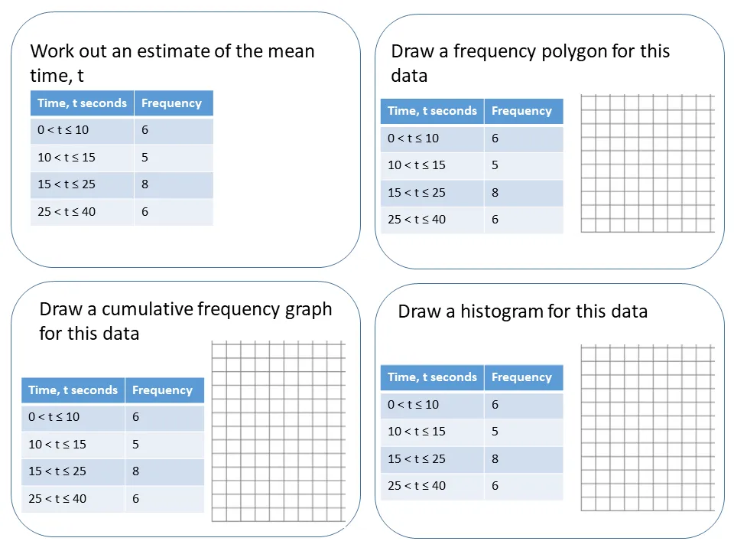
5) Write the data in the range of the data?
Pets Owned | Frequency
0 ≤ p < 2 | 2
2 ≤ p < 4 | 5
4 ≤ p < 6 | 2
6 ≤ p < 8 | 1
6) What group contains the median number of pets?
Pets Owned | Frequency
0 ≤ p < 2 | 2
2 ≤ p < 4 | 5
4 ≤ p < 6 | 2
6 ≤ p < 8 | 1
8 – 0 =
8 pets
2 ≤ p < 4
7) Draw a frequency polygon?
Pets Owned | Frequency
0 ≤ p < 2 | 2
2 ≤ p < 4 | 5
4 ≤ p < 6 | 2
6 ≤ p < 8 | 1
8) What is the missing number if the modal group is 2 ≤ p < 4 ?
Pets Owned | Frequency
0 ≤ p < 2 | 2
2 ≤ p < 4 | 5
4 ≤ p < 6 | ?
6 ≤ p < 8 | 4
5
4
Frequency
3
Any number less than 5
2
1
0
Pets Owned
0
2
4
6
8

