Slide 1
LO: Calculating with Mixed Fractions

Slide 2
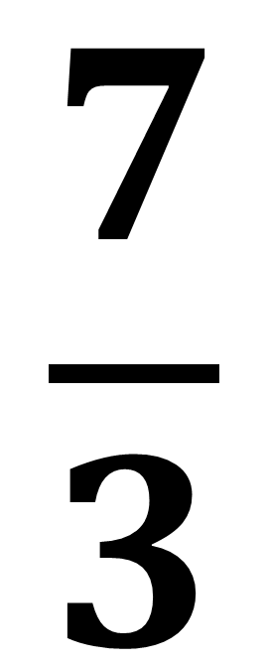
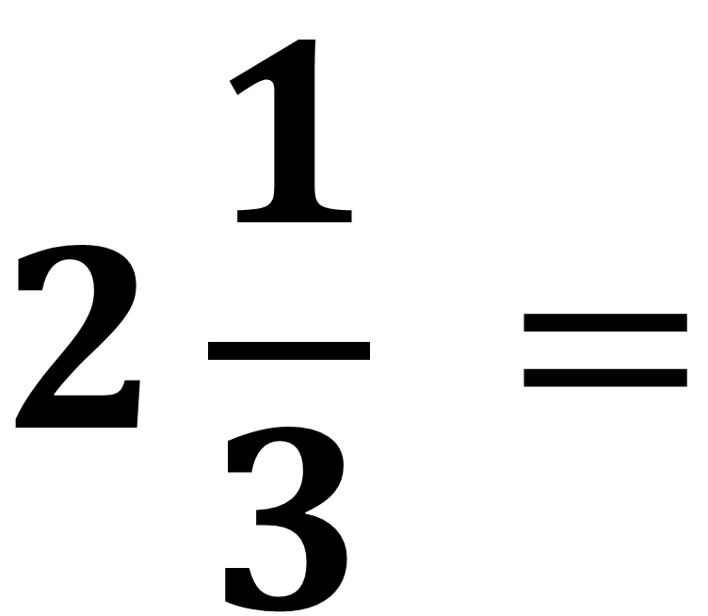
Convert the mixed fraction to an improper.
$$2\frac{1}{3} =$$
$$\frac{7}{3}$$

Slide 3
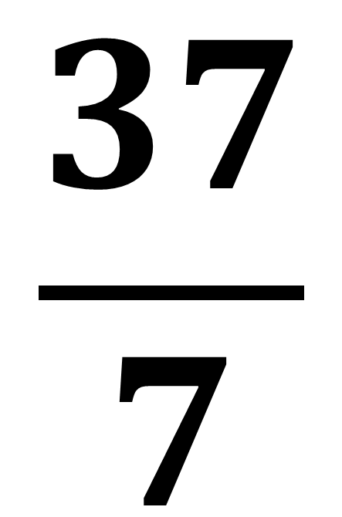
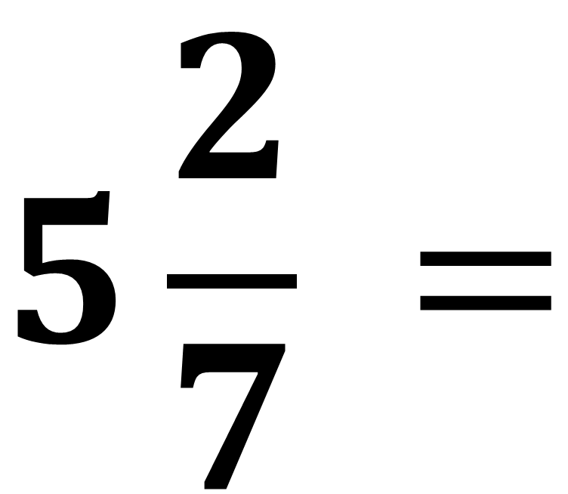
Convert the mixed fraction to an improper.
$$5\frac{2}{7} =$$
$$\frac{37}{7}$$

Slide 4
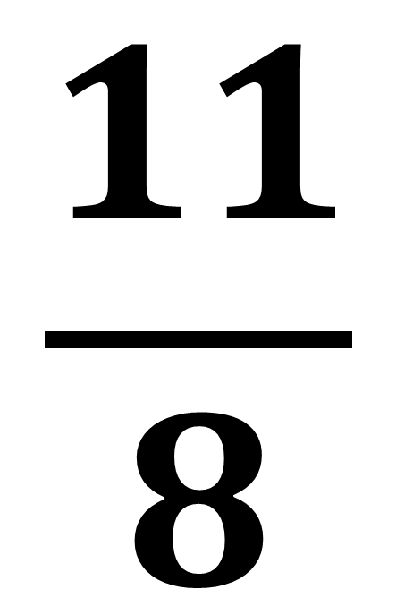
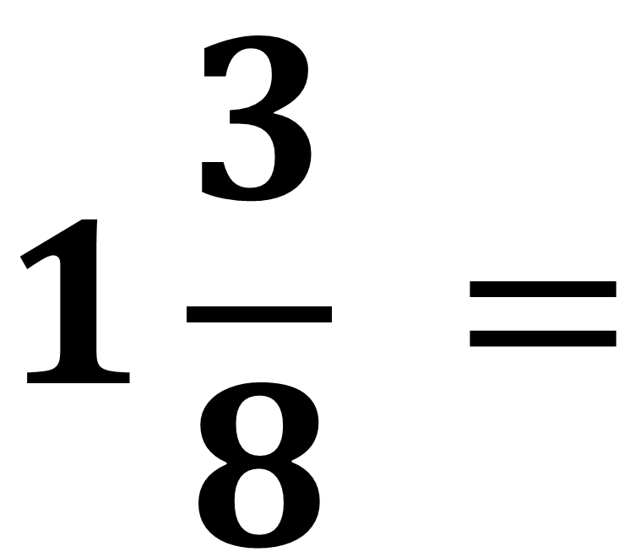
Convert the mixed fraction to an improper.
$$1\frac{3}{8} =$$
$$\frac{11}{8}$$

Slide 5
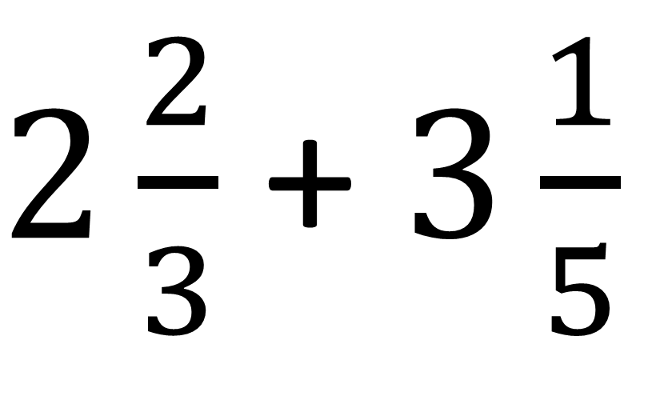
$2\frac{2}{3}$ + $3\frac{1}{5}$
When calculating with mixed fractions the golden rule is to
convert the mixed fractions to improper.

Slide 6
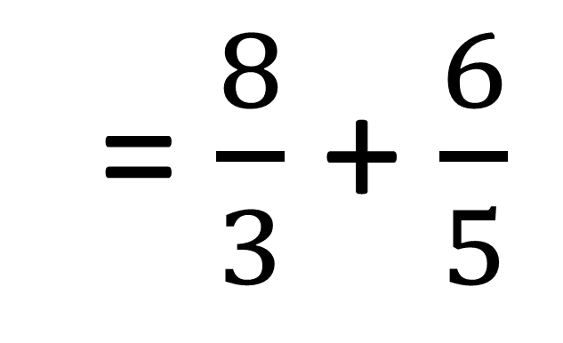
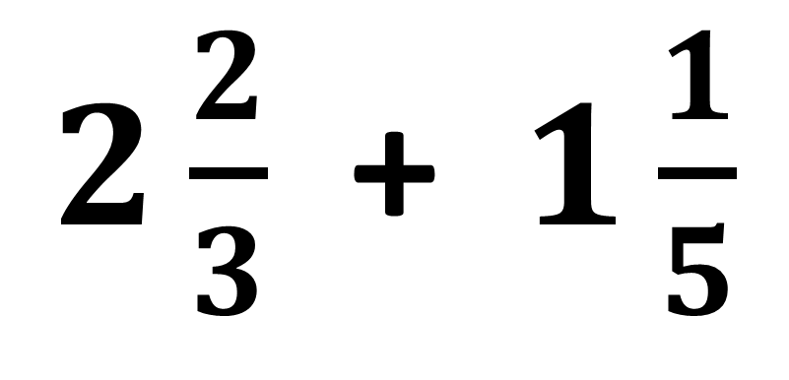
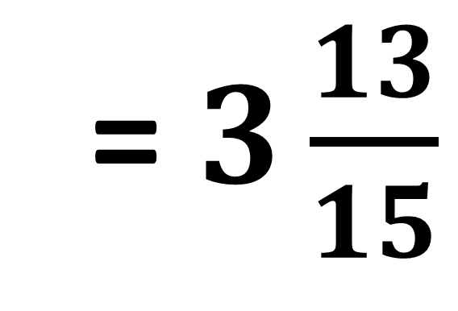
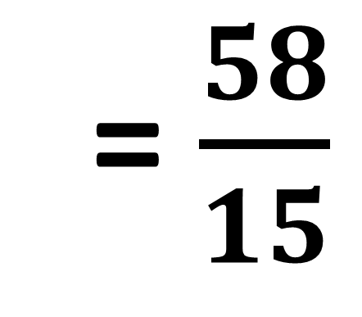
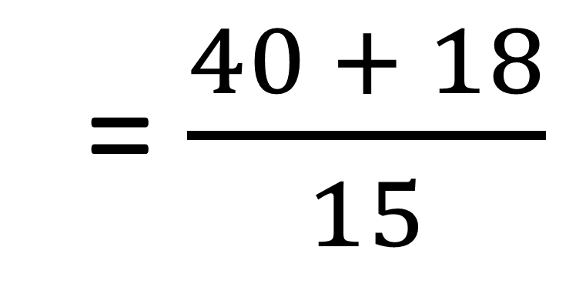
$2\frac{2}{3}$ + $1\frac{1}{5}$
= $\frac{8}{3}$ + $\frac{6}{5}$
= $\frac{40 + 18}{15}$
= $\frac{58}{15}$
= $3\frac{13}{15}$

Slide 7
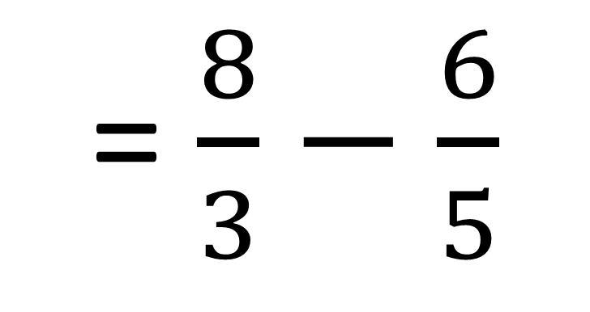
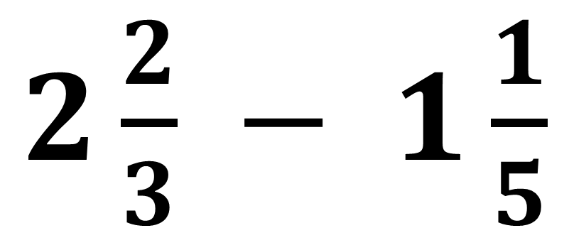
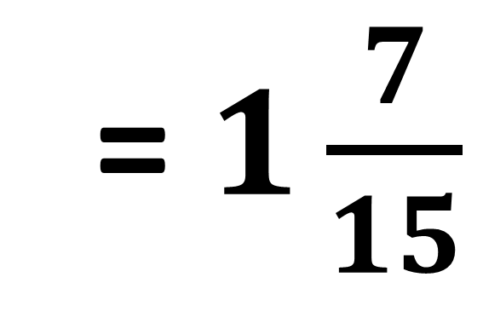
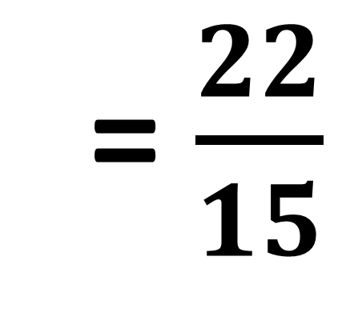
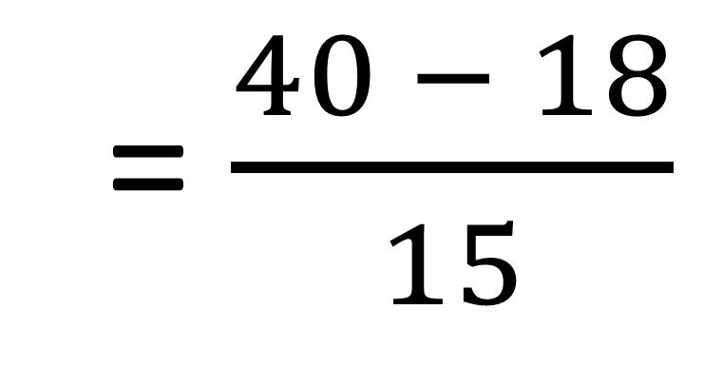
$2\frac{2}{3}$ $−$ $1\frac{1}{5}$
= $\frac{8}{3}−$ $\frac{6}{5}$
= $\frac{40 − 18}{15}$
= $\frac{22}{15}$
= $1\frac{7}{15}$

Slide 8
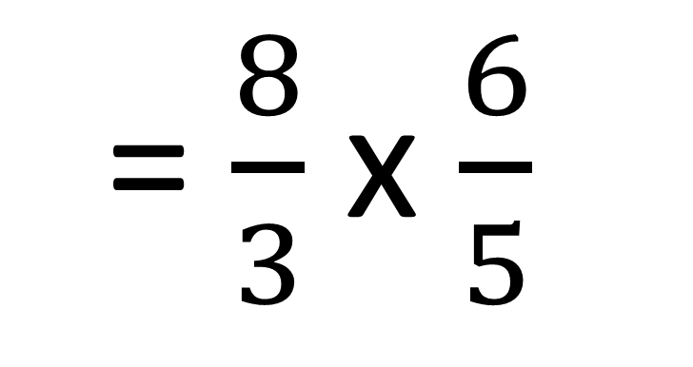
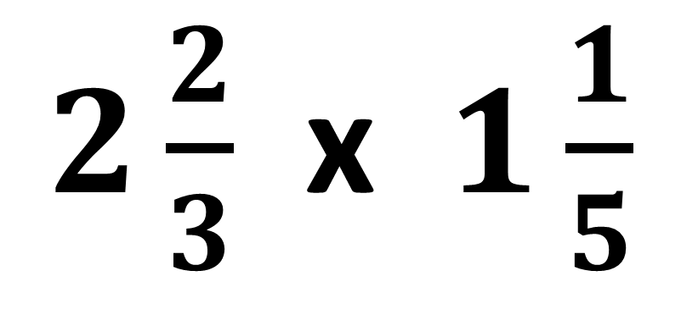
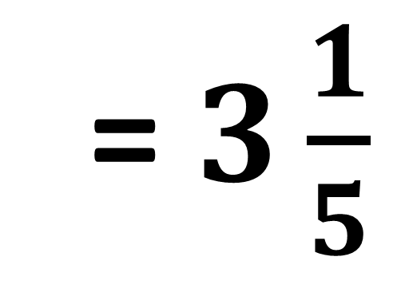
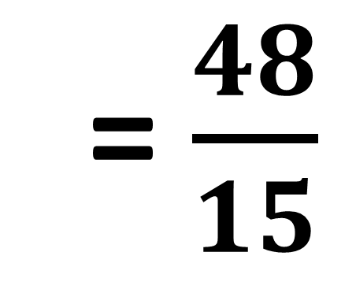
$2\frac{2}{3}$ x $1\frac{1}{5}$
= $\frac{8}{3}$ x $\frac{6}{5}$
= $\frac{48}{15}$
= $3\frac{1}{5}$

Slide 9
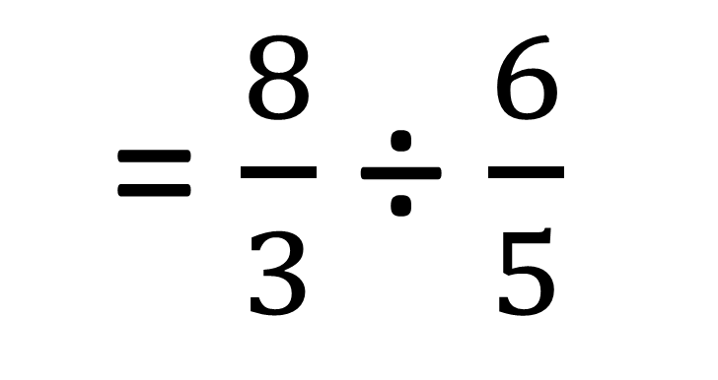
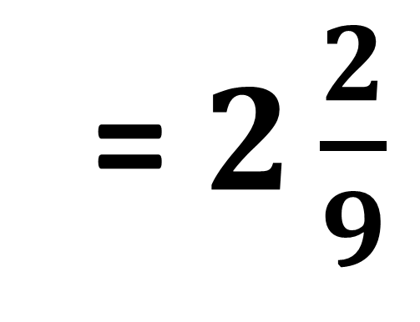
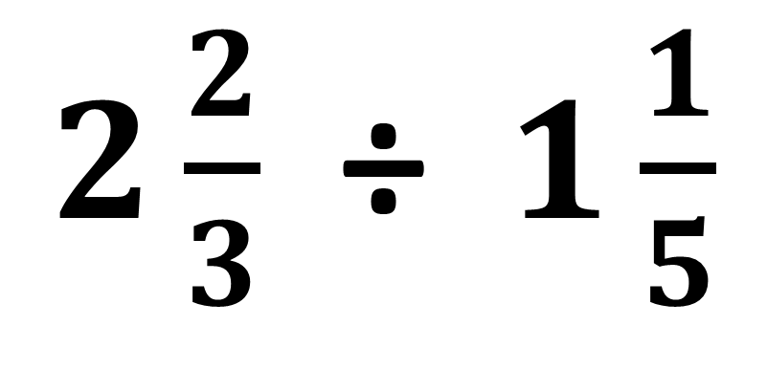
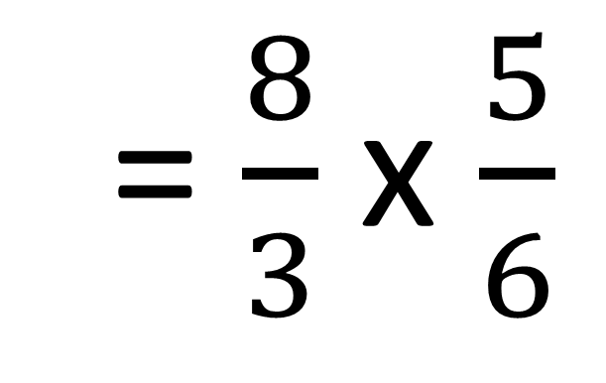
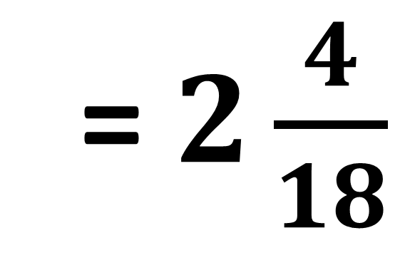
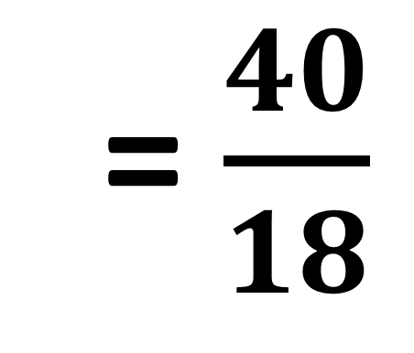
$2\frac{2}{3}$ ÷ $1\frac{1}{5}$
= $\frac{8}{3}$ ÷ $\frac{6}{5}$
= $\frac{8}{3}$ x $\frac{5}{6}$
= $\frac{40}{18}$
= $2\frac{4}{18}$
= $2\frac{2}{9}$

Slide 10
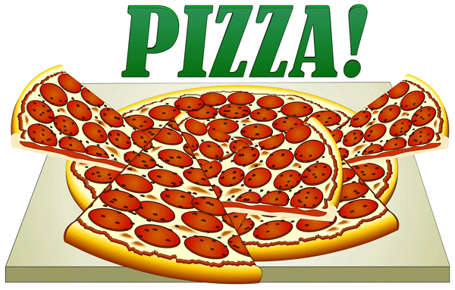
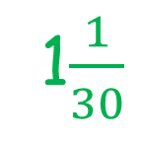
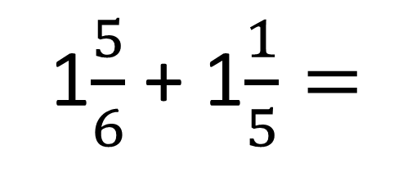
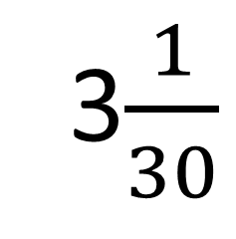
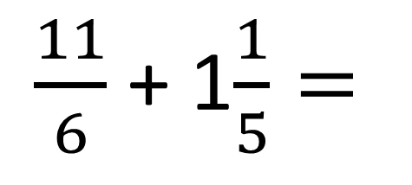
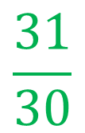
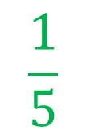
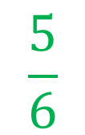
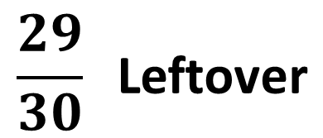
James and Brian order pizzas.
James eats eleven sixths of the pizzas.
Brian only manages to eat one and one fifth of the pizzas.
What was the minimum number of pizzas that they ordered?
What fraction of pizza was leftover?
$\frac{11}{6}$ + 1$\frac{1}{5}=$
1$\frac{5}{6}$ + 1$\frac{1}{5}=$
3$\frac{1}{30}$
$$\frac{5}{6}$$
$$\frac{1}{5}$$
$$\frac{31}{30}$$
$$\frac{29}{30} \text{L}\text{eftover}$$
+
=
=
1$\frac{1}{30}$
4 Pizzas ordered

