Slide 1
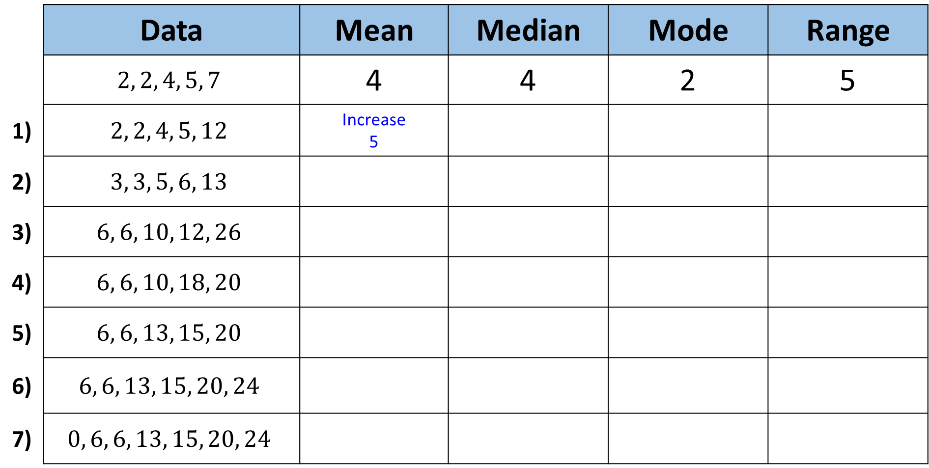
Predict if the average will increase, decrease or stay the same from the previous question.
Then calculate the average.
 | Data | Mean | Median | Mode | Range
 | $$2, 2, 4, 5, 7$$ | 4 | 4 | 2 | 5
1) | $$2, 2, 4, 5, 12$$ | Increase 5
2) | $$3, 3, 5, 6, 13$$
3) | $$6, 6, 10, 12, 26$$
4) | $$6, 6, 10, 18, 20$$
5) | $$6, 6, 13, 15, 20$$
6) | $$6, 6, 13, 15, 20, 24$$
7) | $$0, 6, 6, 13, 15, 20, 24$$

Slide 2
ANSWERS

Slide 3
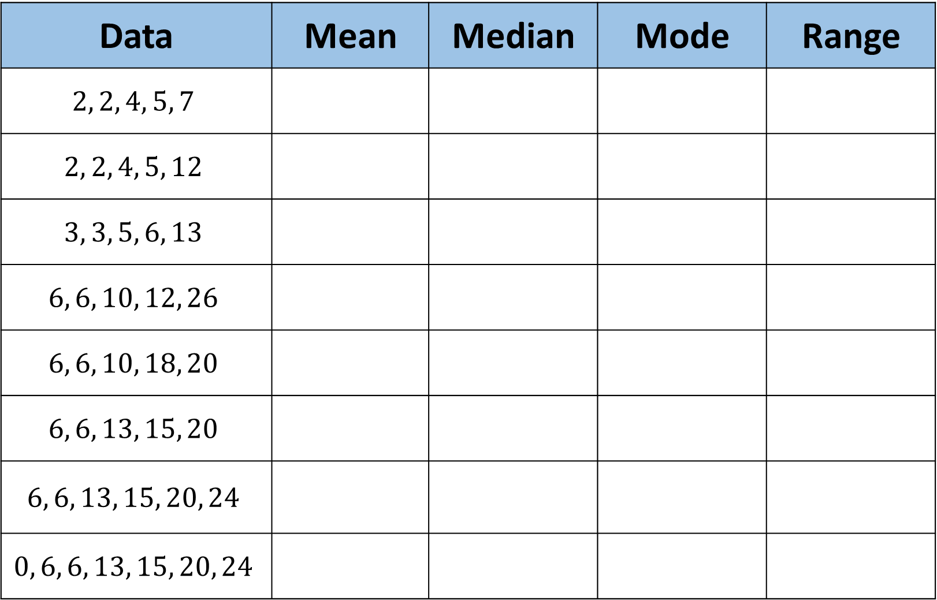
Data | Mean | Median | Mode | Range
$$2, 2, 4, 5, 7$$
$$2, 2, 4, 5, 12$$
$$3, 3, 5, 6, 13$$
$$6, 6, 10, 12, 26$$
$$6, 6, 10, 18, 20$$
$$6, 6, 13, 15, 20$$
$$6, 6, 13, 15, 20, 24$$
$$0, 6, 6, 13, 15, 20, 24$$
4
4 | 2 | 5
Increase 5
Same 4 | Same 2 | Increase 10
1)
2)
Increase 6 | Increase 5 | Increase 3 | Same 10
3)
Increase 12 | Increase 10 | Increase 6 | Increase 20
4)
Same 12 | Same 10 | Same 6 | Decrease 14
Same 12 | Increase 13 | Same 6 | Same 14
5)
Increase 14 | Increase 14 | Same 6 | Increase 18
6)
Decrease 12 | Decrease 13 | Same 6 | Increase 24
7)

