Slide 1
Identities and Equations
Harder Equations
Chapter 10
(Part 3 of 4)

Slide 2
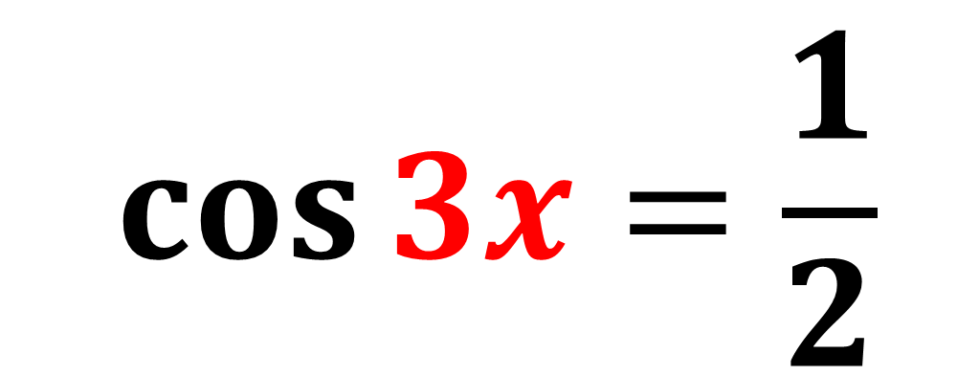
Harder Trigonometric Equations
$$\cos{3x=\frac{1}{2}}$$
If you have a multiple of x (that is not 1) then there are some extra steps to be done.

Slide 3
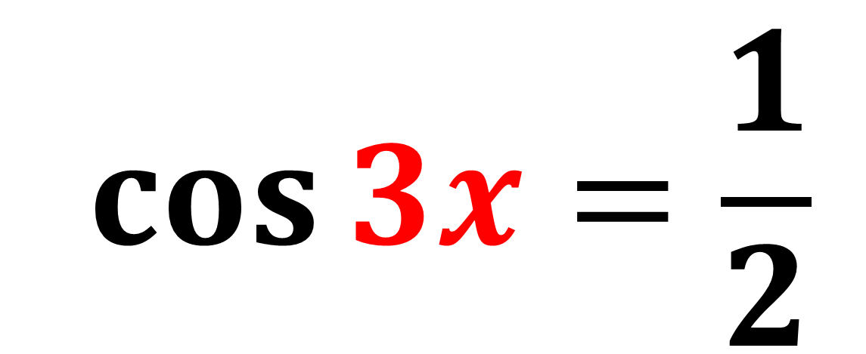
$$\cos{3x=\frac{1}{2}}$$
What transformation does the 3 have on a cos x graph?

Slide 4
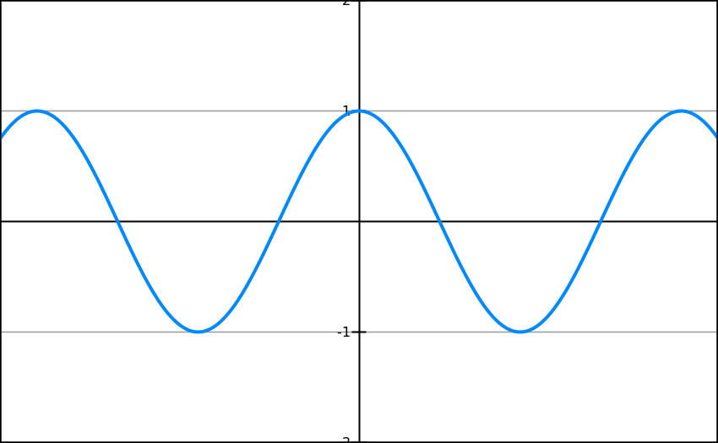
1 cycle
1 cycle
1 cycle
cos 3x will generate
more answers than cos x

Slide 5
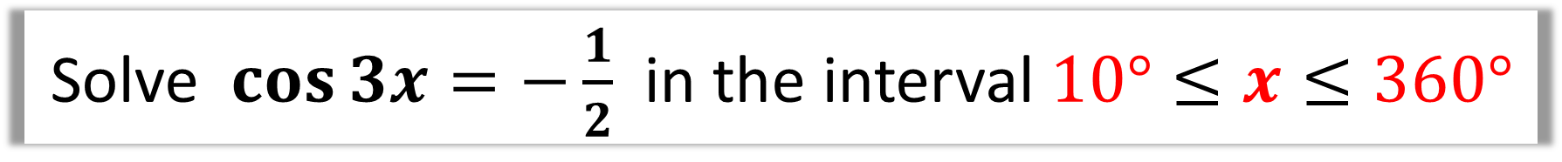
The easiest way to find the extra answers is to adjust the interval.
Solve $\cos{3x=−\frac{1}{2}}$ in the interval $10°≤x≤360°$
Solve $\cos{3x=−\frac{1}{2}}$ in the interval $30°≤3x≤1080°$

Slide 6
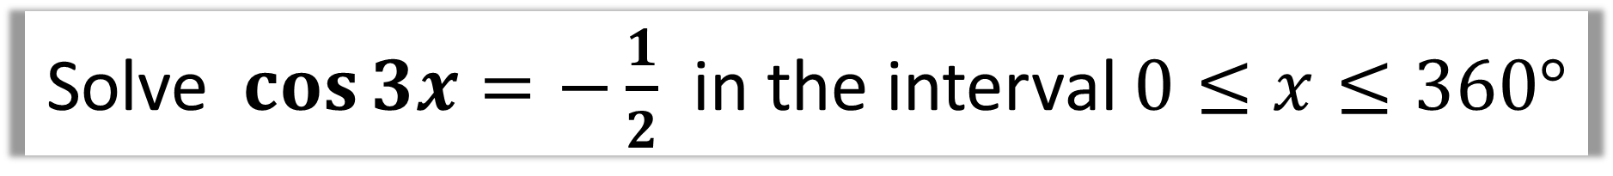
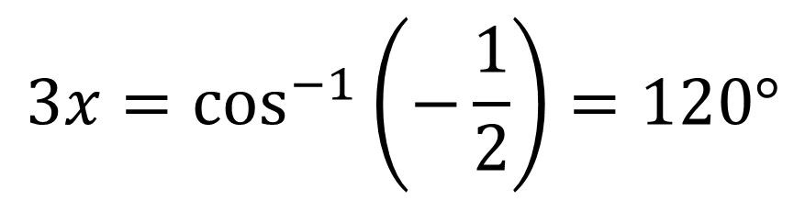
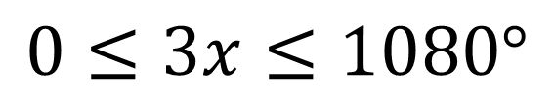
Solve $\cos{3x=−\frac{1}{2}}$ in the interval $0≤x≤360°$
STEP 1: Adjust the range to match
$$0≤3x≤1080°$$
STEP 2: Solve for 3x
BEFORE dividing by 3
find all solutions in the interval.
$$3x=\cos^{−1}\left(−\frac{1}{2}\right)=120°$$
$$3x=120°,240°,480°,600°,840°,960°$$
STEP 3: Dividing by 3 to find x
$$x=40°,80°,160°,200°,280°,320°$$

Slide 7
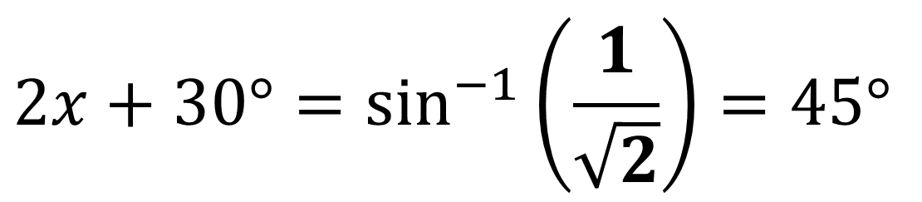
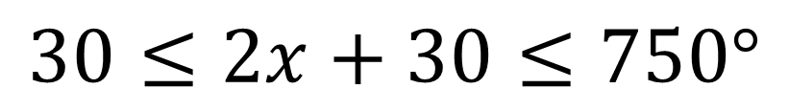
Solve $\sin{(2x+30°)=\frac{1}{\sqrt{2}}}$ in the interval $0≤x≤360°$
$$30≤2x+30≤750°$$
$$2x+30°=\sin^{−1}\left(\frac{1}{\sqrt{2}}\right)=45°$$
$$2x+30°=45°,135°,405°,495°$$
$$x=7.5°,52.5°,187.5°,232.5°$$

Slide 8
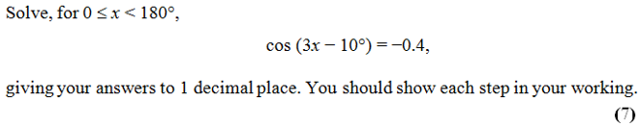

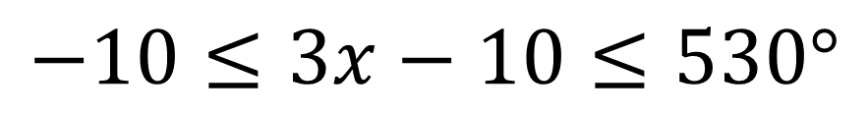
$$−10≤3x−10≤530°$$
$$3x−10°=\cos^{−1}\left(−0.4\right)=113.6°$$
$$3x−10°=113.6°,246.4°,473.6°$$
$$x=41.2°,85.5°,161.2°$$

Slide 9



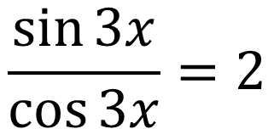
Solve $\sin{3x}=2\cos{3x}$ in the interval $0≤x<300°$
$$\frac{\sin{3x}}{\cos{3x}}=2$$
$$\tan{3x}=2$$
$$0≤3x<900°$$
$$3x=\tan^{−1}{(2)}=63.4°$$
$$3x=63.4°, 243.4°,423.4°,603.4°,783.4°$$
$$x=21.1°, 81.4°, 141.4°,201.4°,261.4°$$

