Slide 1
Writing and Solving Equations
1) I think of a number. I double it, add 50 and my answer is 74. What was my number?
2) I think of a number. I multiple by 3, subtract 30 and my answer is 36.
What was my number?
3) I think of a number. I subtract 10. I then double it. My answer is 50,
what was my number?
4) I think of a number. I add 3 and double it. Then I half it and my answer is 6,
what was my number?
5) I think of a number. I divide by 2, add 98 and my answer is 100. What was my number?
6) I think of a number. I add 20, double it and subtract 25. My answer is 75.
What was my number?
7) I think of a number.I half it, and subtract 5. The answer is 25.
What was my number?
8) I think of a number. I subtract 5 and then half it. The answer is 25.
What was my number?
9) I think of a number. I double it, add 10, and then divide by 4. My answer is 40,
what was my number?
10) I think of a number, I multiply by itself and subtract 36. My answer is 64.
What was the number?

Slide 2
ANSWERS

Slide 3
Writing and Solving Equations
1) I think of a number. I double it, add 50 and my answer is 74. What was my number?
2) I think of a number. I multiple by 3, subtract 30 and my answer is 36.
What was my number?
3) I think of a number. I subtract 10. I then double it. My answer is 50,
what was my number?
4) I think of a number. I add 3 and double it. Then I half it and my answer is 6,
what was my number?
5) I think of a number. I divide by 2, add 98 and my answer is 100. What was my number?
6) I think of a number. I add 20, double it and subtract 25. My answer is 75.
What was my number?
7) I think of a number.I half it, and subtract 5. The answer is 25.
What was my number?
8) I think of a number. I subtract 5 and then half it. The answer is 25.
What was my number?
9) I think of a number. I double it, add 10, and then divide by 4. My answer is 40,
what was my number?
10) I think of a number, I multiply by itself and subtract 36. My answer is 64.
What was the number?
2x + 50 = 74
x = 12
3x - 30 = 36
x = 22
2(x – 10) = 50
x = 35

Slide 4
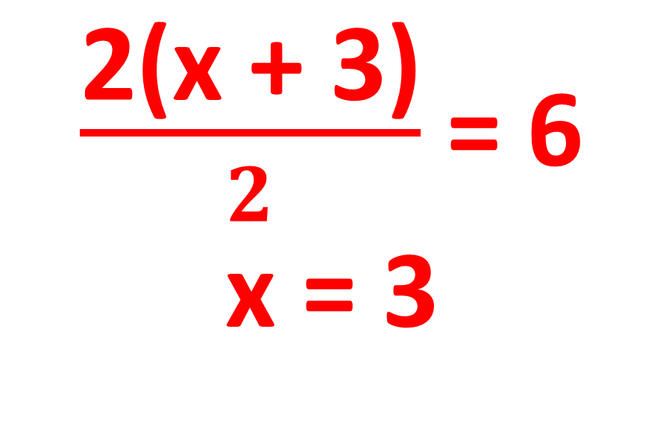
4) I think of a number. I add 3 and double it. Then I half it and my answer is 6, what was my number?
$\frac{\text{2(}\text{x}\text{ + 3)}}{2}$ = 6
x = 3

Slide 5
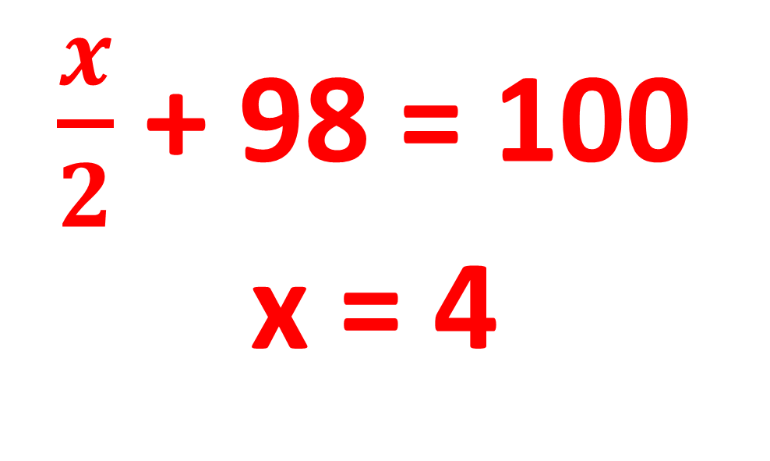
5) I think of a number. I divide by 2, add 98 and my answer is 100. What was my number?
$\frac{x}{2}$ + 98 = 100
x = 4

Slide 6
6) I think of a number. I add 20, double it and subtract 25. My answer is 75. What was my number?
2(x + 20) - 25 = 75
x = 30

Slide 7
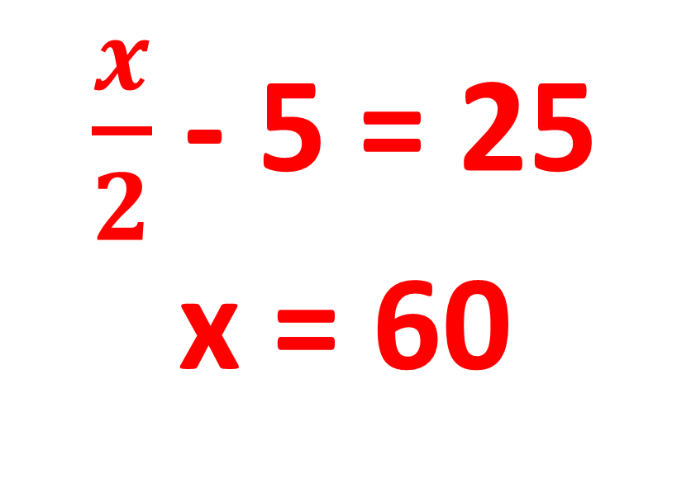
7) I think of a number. I half it, and subtract 5. The answer is 25.
What was my number?
$\frac{x}{2}$ - 5 = 25
x = 60

Slide 8
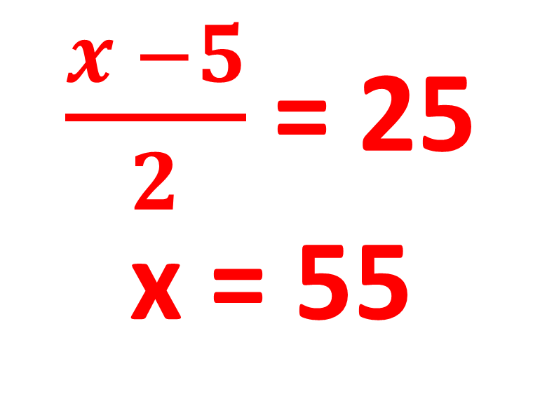
8) I think of a number. I subtract 5 and then half it. The answer is 25. What was my number?
$\frac{x −5}{2}$ = 25
x = 55

Slide 9
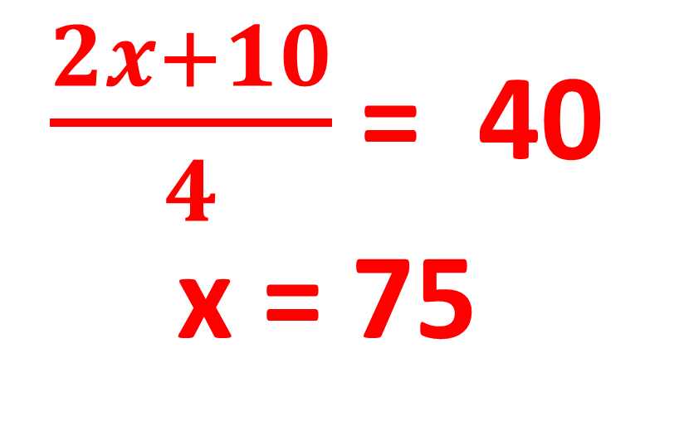
9) I think of a number. I double it, add 10, and then divide by 4. My answer is 40, what was my number?
$\frac{2x+10}{4}$= 40
x = 75

Slide 10
10) I think of a number, I multiply by itself and subtract 34. My answer is 66. What was the number?
x² - 34 = 66
x = 10

