Slide 1
LO: Pythagoras Theorem
(Missing Sides)

Slide 2
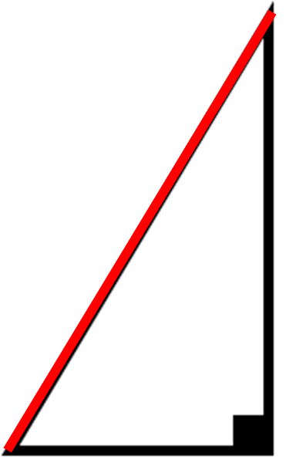
What is the name of the longest side of a triangle?
Hypotenuse

Slide 3
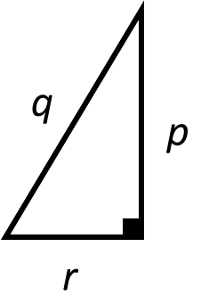
Which side is the longest (hypotenuse)?

Slide 4
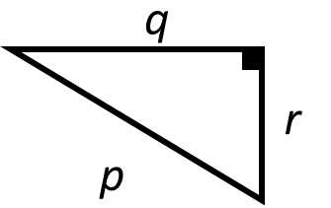
Which side is the longest (hypotenuse)?

Slide 5
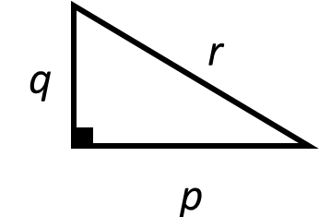
Which side is the longest (hypotenuse)?

Slide 6
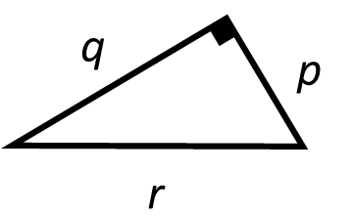
Which side is the longest (hypotenuse)?

Slide 7
Pythagoras Theorem
only works with
right angle triangle.

Slide 8
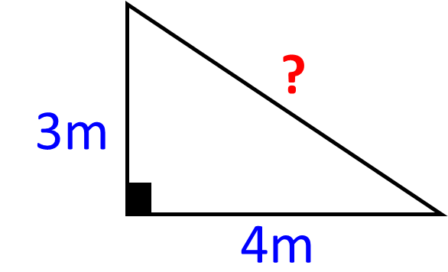
Given the length of two sides
you can find the missing side.

Slide 9
c² = Area of Small Square
c²
a²
a² = Area of Small Square
c
a
b
b²
b² = Area of Small Square
+
=
c²
a²
b²

Slide 10
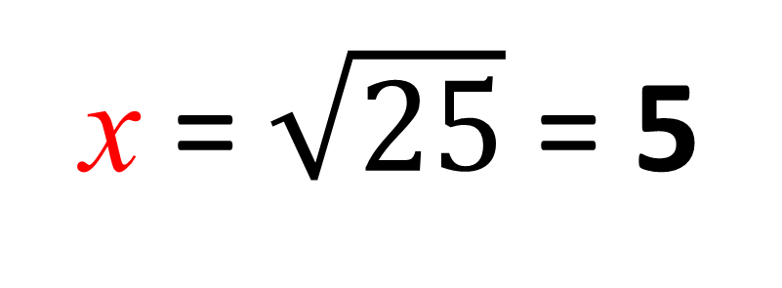
x
3
4
x² = 25
 |  | + |  |  |  | =
3 |  |  | 4 |  |  |  | C
25
16
x = $\sqrt{25}$ = 5
9

Slide 11
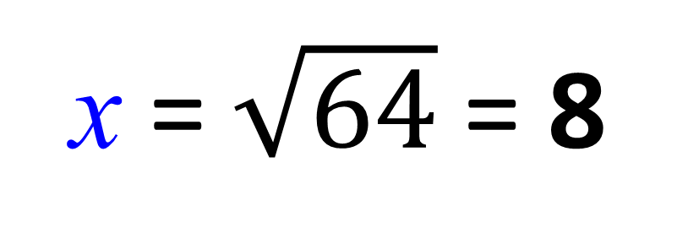
10
6
x
x² = 64
 |  | + |  |  |  | =
6 |  |  |  |  |  |  | 100
100
64
x = $\sqrt{64}$ = 8
36

Slide 12
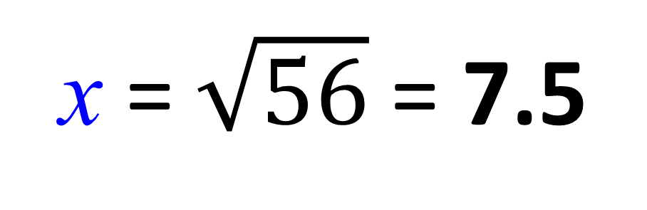
x
5
9
x² = 56
 |  | + |  |  |  | =
5 |  |  |  |  |  |  | 9
81
56
x = $\sqrt{56}$ = 7.5
25

Slide 13
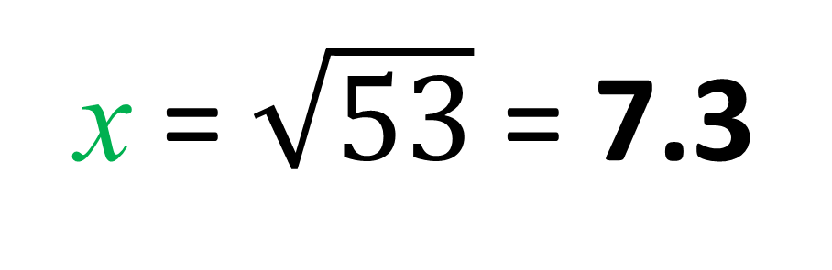
x
7
2
x² = 53
 |  | + |  |  |  | =
2 |  |  | 7
53
49
x = $\sqrt{53}$ = 7.3
4

Slide 14
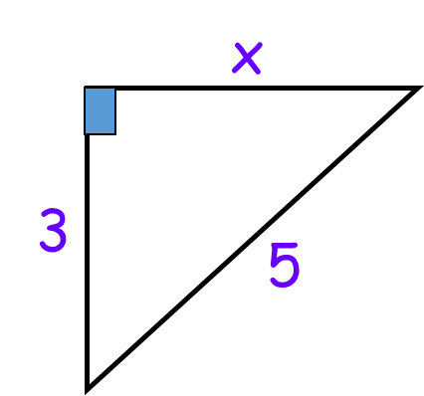
Add or subtract the areas?
Subtract

Slide 15
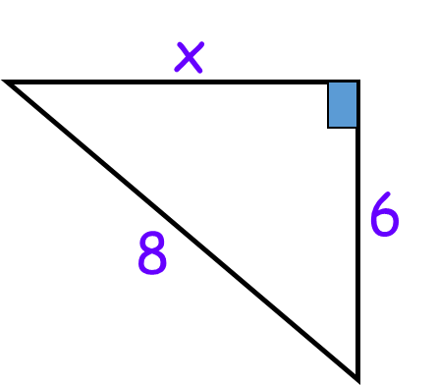
Add or subtract the areas?
Subtract

Slide 16
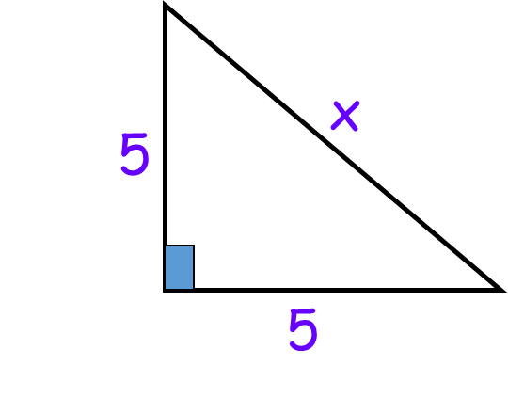
Add or subtract the areas?
Add

Slide 17
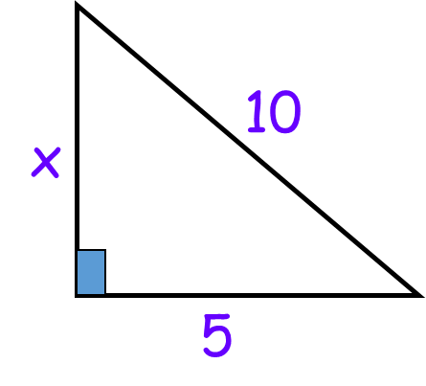
Add or subtract the areas?
Subtract

Slide 18
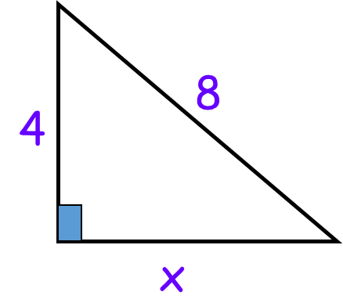
Add or subtract the areas?
Subtract

Slide 19
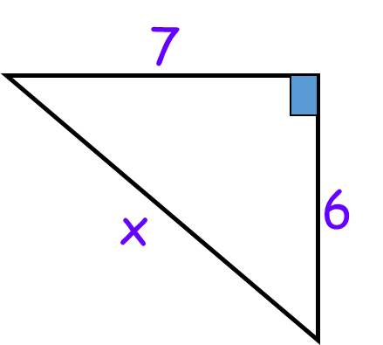
Add or subtract the areas?
Add

Slide 20
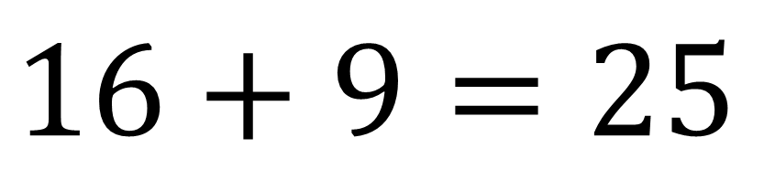
Right Angle Triangle or Not?
$$16+9=25$$
5
4
Right Angle Triangle
3

Slide 21
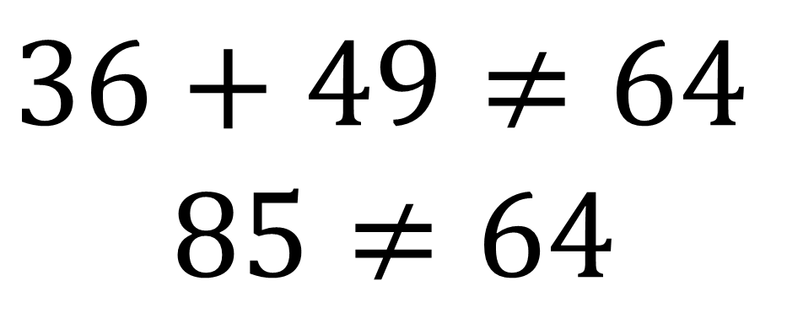
Right Angle Triangle or Not?
$$36+49≠64$$
$$85≠64$$
8
6
Not a
Right Angle Triangle
7

Slide 22
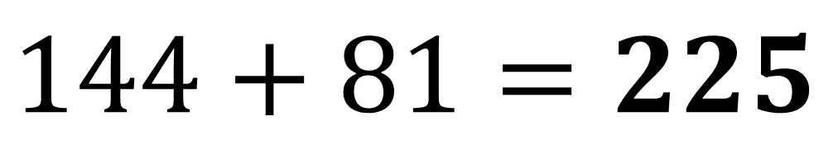
Right Angle Triangle or Not?
$$144+81=225$$
15
12
Right Angle Triangle
9

Slide 23
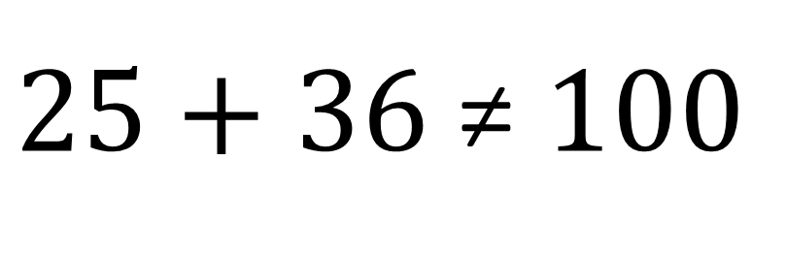
Right Angle Triangle or Not?
$25+36$≠ $100$
10
5
Not a
Right Angle Triangle
6

