Slide 1
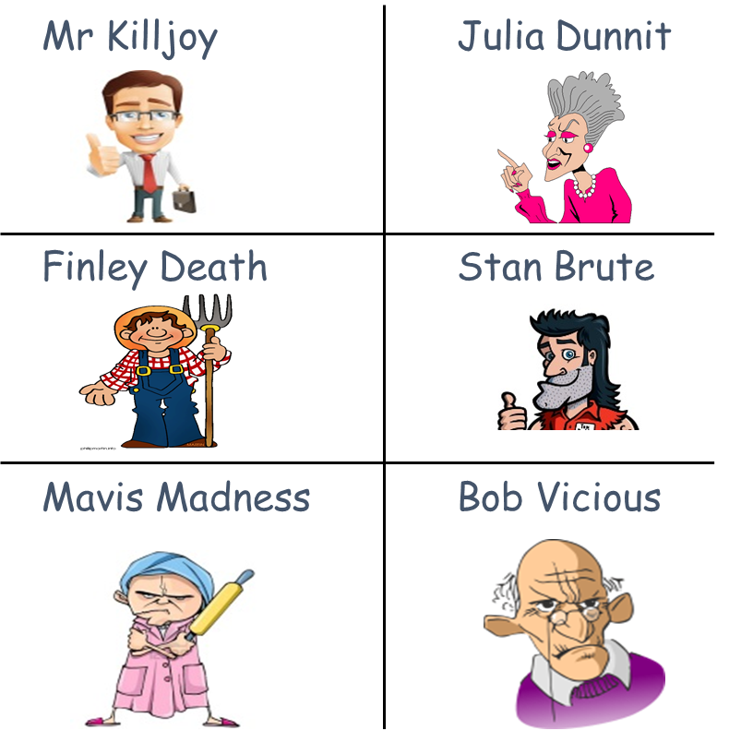

Murder Mystery
A person was killed in the village of Midsomer at 7 pm.
There are 6 suspects…you need to find who did it!

Slide 2






Julia Dunnit –
Lives 0.09 x 100 miles away. She owns an electric buggy that travels at a maximum speed of 0.003 x 1000 miles per hour and
a neighbour saw her entering her home at 9.30 p.m.
Mr Killjoy –
Neighbours describe him as odd. He claims to have been at home all night but a neighbour saw him leave his house at 6 pm and return 9.5 x 6 minutes later looking tired.
Mavis Madness –
Was seen watching Coronation Street in her home at 7.30 pm.
She lives 20 miles away but has a car that can travel a maximum speed of 0.02 x 1000 miles per hour.
Stan Brute – Has a car that can travel 9.25 x 8 miles per hour.
At 8 pm he was captured on camera at a petrol station covering something in the boot of his car.
The petrol station was located 100 x 0.729 miles away from the scene of the crime.
Finley Death –
Lives in the town of Midsomer and has a short temper. He works the night shift and arrived at work at 7.50 pm.
As he was setting off to work, he got into his car and slammed the door angrily. Finley’s journey to work takes a minimum of 2.5 x 24 minutes to get there.
Bob Vicious –
Lives 0.25 x 8 miles away. At 7.30 pm he was seen acting suspiciously in ASDA. When security looked at CCTV footage,
they noted that he entered the store 11.25 x 4 minutes earlier.

Slide 3
ANSWERS

Slide 4

Julia Dunnit
Lives 9 miles away.
Her buggy travels at 3 mph.
That would take her 3 hours.
Murder was at 7pm
and she was seen entering home at 9.30 pm.
Therefore Julia couldn’t have committed the murder.

Slide 5

Mr Killjoy
Left his house at 6 pm
and returned home 57 minutes later.
Therefore he arrived at his home at 6.57 pm.
The murder took place at 7 pm
and so he couldn’t have committed the crime.

Slide 6
Mavis Madness
Car can travel 20 mph.
She lives 20 miles away so if she committed the crime
she would get home at 8 pm.
However, she was watching Coronation Street at 7.30 pm
and so it couldn’t have been her.

Slide 7

Stan Brute
His car can travel 74 mph.
He was seen at 8pm at a petrol station 72.9 miles away.
His car is fast enough to reach this destination
within 1 hour and so
he could have been at the scene of the crime at 7 pm.

Slide 8

Finley Death
Arrives at work at 7.50 pm.
His journey to work takes a minimum of 60 minutes.
60 minutes = 1 hour.
So the latest he could have set off to work
would have been 6.50 pm.
The person was killed at 7 pm
and so he couldn’t have done it.

Slide 9
Bob Vicious
Lives 2 miles away.
He entered ASDA 45 minutes before he was caught
acting suspiciously at 7.30.
He therefore entered ASDA at 6.45 pm meaning that he
couldn’t have been at the crime scene at 7 pm.

Slide 10

Who done it?
Therefore, Stan Brute is the only one
who could have done the murder!

