Slide 1
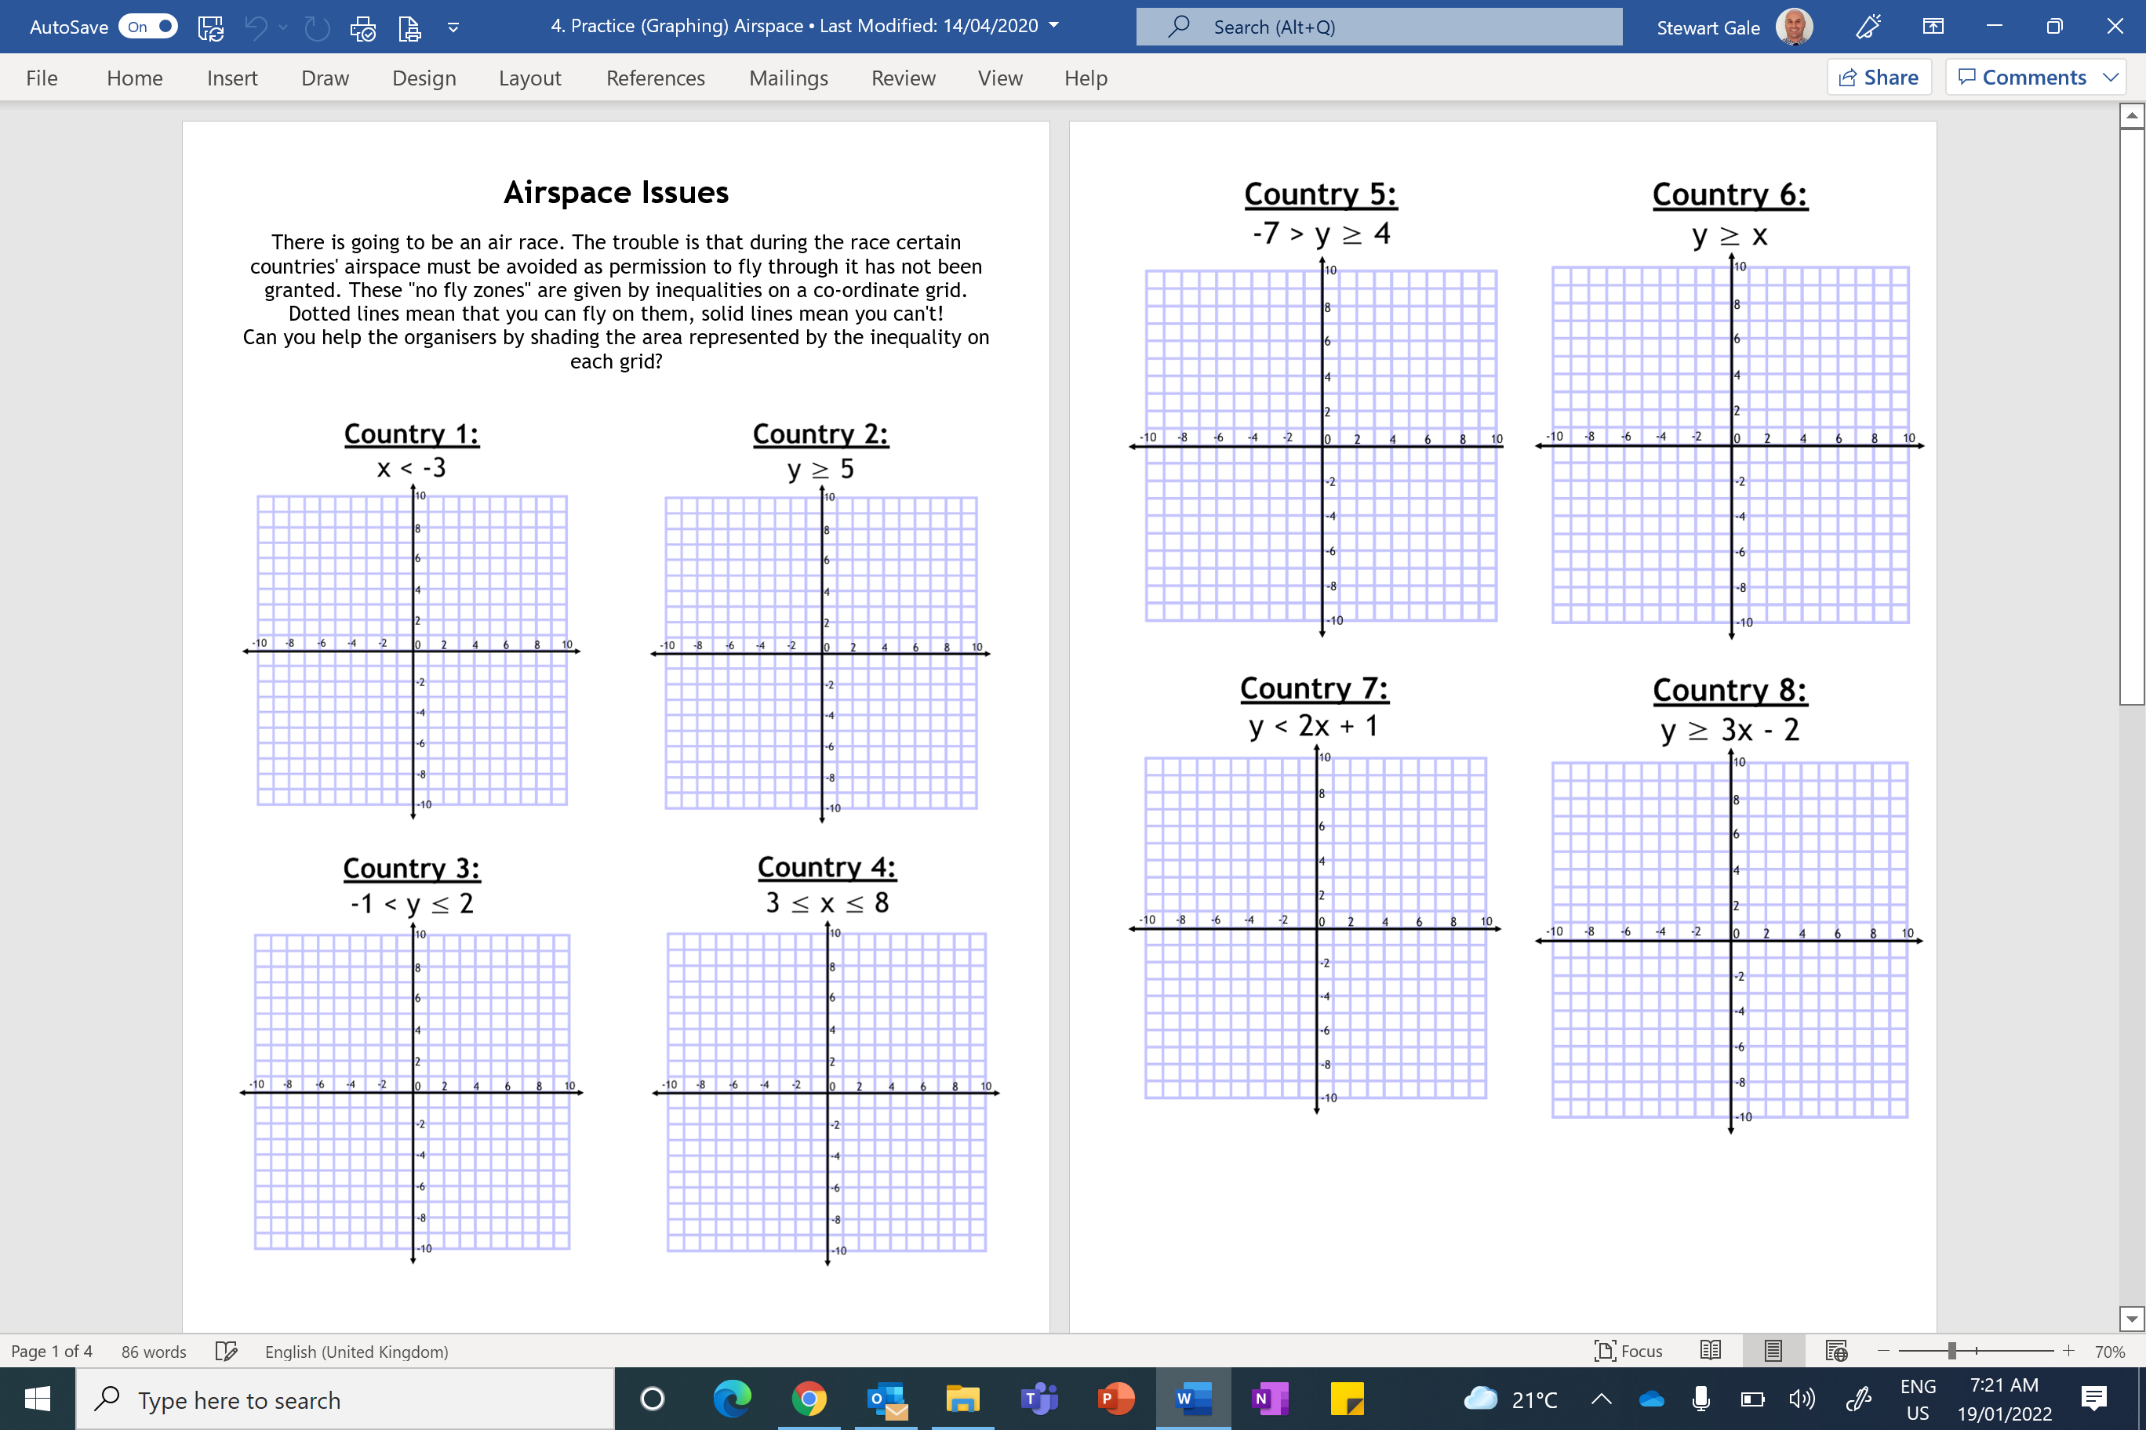

Slide 2
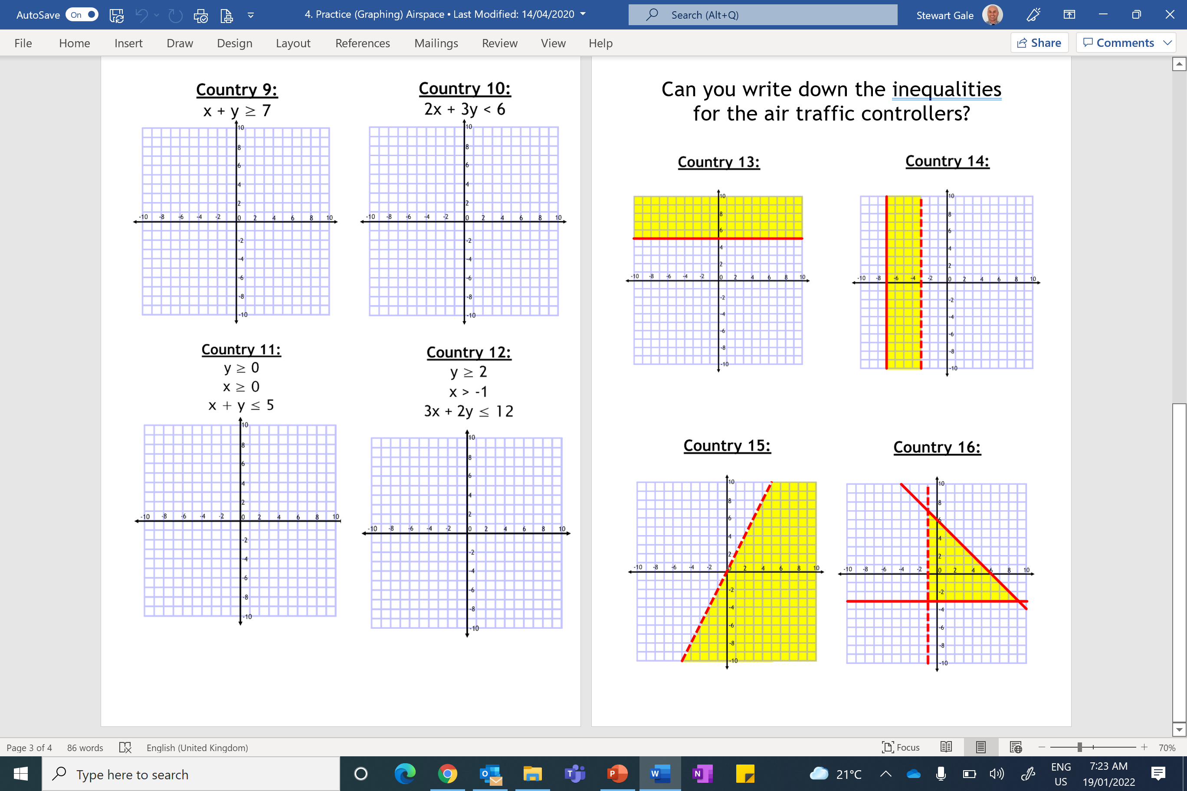

Slide 3
ANSWERS

Slide 4
Country 1 - Answers:
x < -3
Country 2 - Answers:
y ≥ 5
10
10
8
8
6
6
4
4
2
2
-10
-8
-6
-4
-2
0
2
4
6
8
10
-10
-8
-6
-4
-2
0
2
4
6
8
10
-2
-2
-4
-4
-6
-6
-8
-8
-10
-10

Slide 5
Country 3 - Answers:
-1 < y ≤ 2
Country 4 - Answers:
3 ≤ x ≤ 8
10
10
8
8
6
6
4
4
2
2
-10
-8
-6
-4
-2
0
2
4
6
8
10
-10
-8
-6
-4
-2
0
2
4
6
8
10
-2
-2
-4
-4
-6
-6
-8
-8
-10
-10

Slide 6
Country 5 - Answers:
-7 > y ≥ 4
Country 6 - Answers:
y ≥ x
10
10
8
8
6
6
4
4
2
2
-10
-8
-6
-4
-2
0
2
4
6
8
10
-10
-8
-6
-4
-2
0
2
4
6
8
10
-2
-2
-4
-4
-6
-6
-8
-8
-10
-10

Slide 7
Country 7 - Answer:
y < 2x + 1
Country 8 - Answer:
y ≥ 3x - 2
10
10
8
8
6
6
4
4
2
2
-10
-8
-6
-4
-2
0
2
4
6
8
10
-10
-8
-6
-4
-2
0
2
4
6
8
10
-2
-2
-4
-4
-6
-6
-8
-8
-10
-10

Slide 8
Country 9 - Answers:
x + y ≥ 7
Country 10 - Answer:
2x + 3y < 6
10
10
8
8
6
6
4
4
2
2
-10
-8
-6
-4
-2
0
2
4
6
8
10
-10
-8
-6
-4
-2
0
2
4
6
8
10
-2
-2
-4
-4
-6
-6
-8
-8
-10
-10

Slide 9
Country 11 - Answer:
y ≥ 0
x ≥ 0
x + y ≤ 5
Country 12 - Answer:
y ≥ 2
x > -1
3x + 2y ≤ 12
10
10
8
8
6
6
4
4
2
2
-10
-8
-6
-4
-2
0
2
4
6
8
10
-10
-8
-6
-4
-2
0
2
4
6
8
10
-2
-2
-4
-4
-6
-6
-8
-8
-10
-10

Slide 10
Country 13 - Answer:
Country 14 - Answer:
-7 ≤ x < -3
10
10
8
8
6
6
y ≥ 5
4
4
2
2
-10
-8
-6
-4
-2
0
2
4
6
8
10
-10
-8
-6
-4
-2
0
2
4
6
8
10
-2
-2
-4
-4
-6
-6
-8
-8
-10
-10

Slide 11
Country 16 - Answer:
Country 15 - Answer:
y < 2x
x + y ≤ 6
10
10
8
8
6
6
4
4
2
2
-10
-8
-6
-4
-2
0
2
4
6
8
10
-10
-8
-6
-4
-2
0
2
4
6
8
10
-2
-2
y ≥ -3
-4
-4
-6
-6
-8
-8
x > -1
-10
-10

