Slide 1
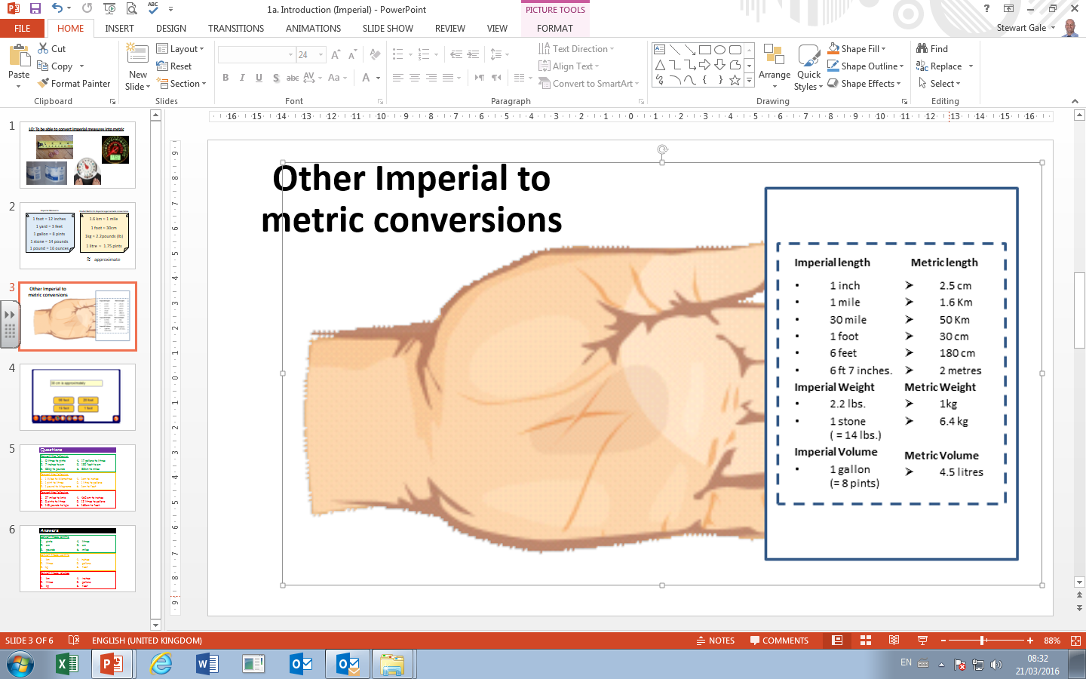
Questions
Convert the following
5 litres to pints
7 inches to cm
55kg to pounds
17 gallons to litres
135 feet to cm
88km to miles
Convert the following
1 Miles to Kilometres
1 pint to litres
1 pound to kilograms
1cm to inches
1 litre to gallons
1cm to feet
Convert the following
27 miles to km’s
5 pints to litres
145 pounds to kg’s
465 cm to inches
12 litres to gallons
168cm to feet.

Slide 2
ANSWERS

Slide 3
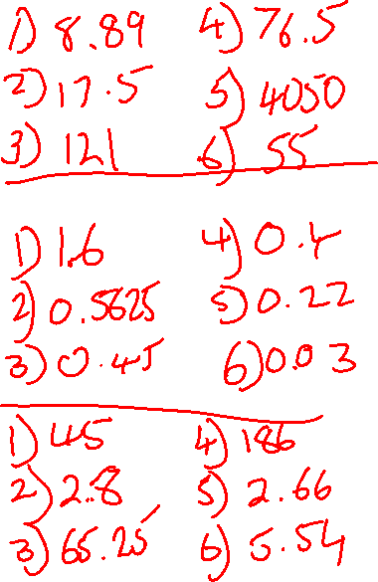
Answers
Convert the following
5 litres to pints
7 inches to cm
55kg to pounds
17 gallons to litres
135 feet to cm
88km to miles
pints
cm
pounds
litres
cm
miles
Convert the following
1 Miles to Kilometres
1 pint to litres
1 pound to kilograms
1cm to inches
1 litre to gallons
1cm to feet
km
litres
kg
inches
gallons
feet
Convert the following
27 miles to km’s
5 pints to litres
145 pounds to kg’s
465 cm to inches
12 litres to gallons
168cm to feet.
km
litres
kg
inches
gallons
feet

