Slide 1
Algebraic Methods
Proofs
Chapter 1
(Part 1 of 4)

Slide 2
Proof By Contradiction
To prove a statement is true by contradiction:
Assume that the statement is in fact false.
Prove that this would lead to a contradiction.
Therefore, we were wrong in assuming the statement was false, and therefore it must be true.

Slide 3
How to word you proof:
Assumption
“Assume that [negation of statement].”
Show Contradiction
Reasoning followed by… “This is a contradiction”.
Conclusion
“Therefore [restate original statement].”

Slide 4
Negating the Original Statement
The first part of a proof by contradiction requires you to make an assumption that negates the original statement.

Slide 5
Proof
Prove that there is no greatest odd integer.
Assumption
There is a greatest odd integer.

Slide 6
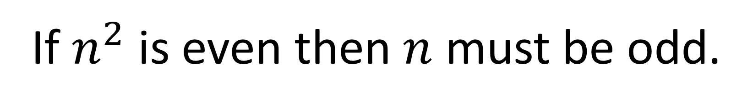

Proof
If $n^{2}$ is even, then $n$ must be even.
Assumption
If $n^{2}$ is even then $n$ must be odd.

Slide 7
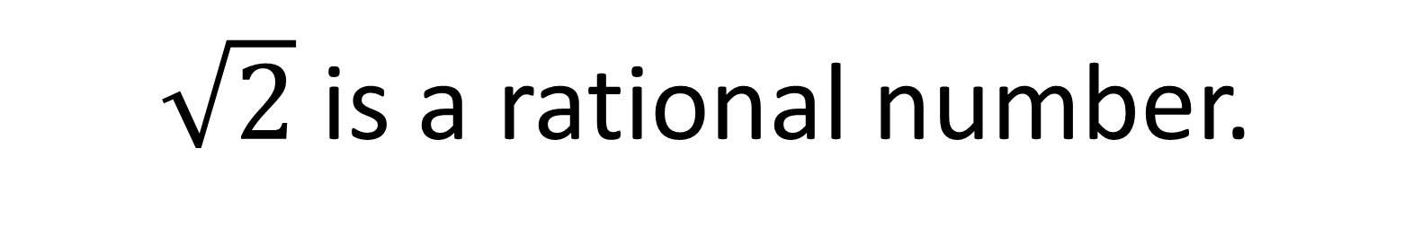

Proof
$\sqrt{2}$ is an irrational number.
Assumption
$\sqrt{2}$ is a rational number.

Slide 8
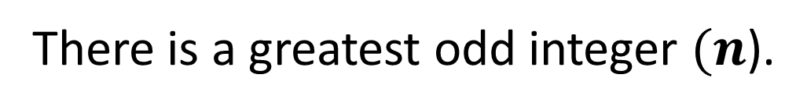
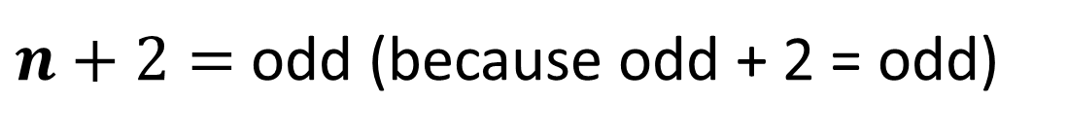

Prove that there is no greatest odd integer.
Assumption
There is a greatest odd integer $(n$).
Show contradiction
$n+2=$ odd (because odd + 2 = odd)
$$n+2>n$$
This contradicts the assumption that $n$ is the greatest odd integer.
Conclusion
Therefore, there is no greatest odd integer.

Slide 9


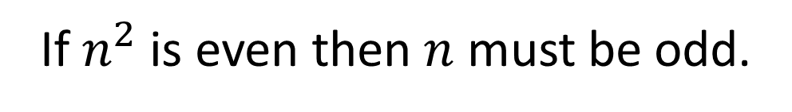
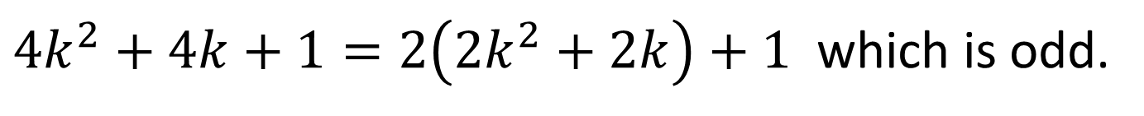

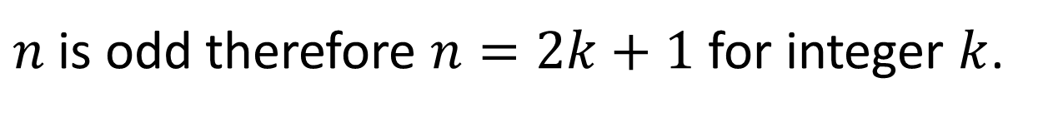

Prove by contradiction that if $n^{2}$ is even, then $n$ must be even.
Assumption
If $n^{2}$ is even then $n$ must be odd.
Show contradiction
$n$ is odd therefore $n=2k+1$ for integer $k$.
$$n^{2}={\left(2k+1\right)}^{2}$$
$$n^{2}=4k^{2}+4k+1$$
$4k^{2}+4k+1=2\left(2k^{2}+2k\right)+1$ which is odd.
This contradicts the assumption that $n^{2}$ is even.
Conclusion
Therefore, if $n^{2}$ is even then $n$ must be even.

Slide 10
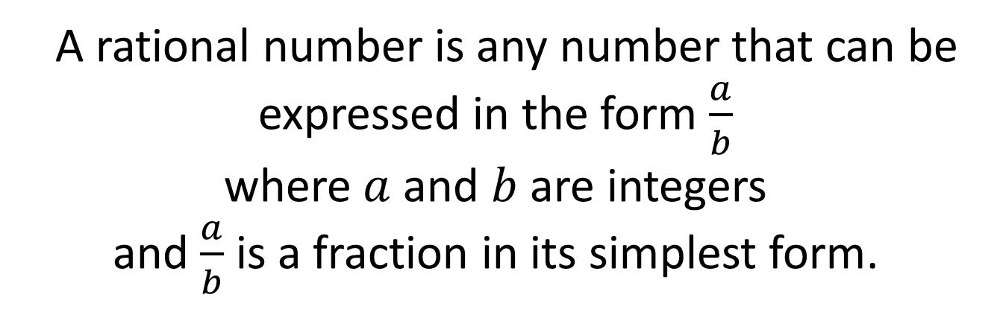
Rational Numbers
A rational number is any number that can be
expressed in the form $\frac{a}{b}$
where $a$ and $b$ are integers
and $\frac{a}{b}$ is a fraction in its simplest form.
Irrational Numbers
A irrational number cannot be expressed as a fraction
(where the denominator is not a zero).

Slide 11


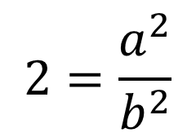

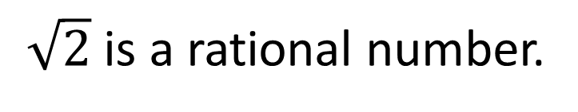
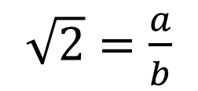




Prove by contradiction that $\sqrt{2}$ is an irrational number.
Assumption
$\sqrt{2}$ is a rational number.
Show contradiction
$\sqrt{2}=\frac{a}{b}$ where $a$ and $b$ are integers and $\frac{a}{b}$ is a fraction in its simplest form.
$\sqrt{2}=\frac{a}{b}$
Let $a=2k$ where $k$ is an integer.
$$2b^{2}={\left(2k\right)}^{2}$$
$$2=\frac{a^{2}}{b^{2}}$$
$$2b^{2}=4k^{2}$$
$$2b^{2}=a^{2}$$
$$b^{2}=2k^{2}$$
Hence $a^{2}$ is even, therefore $a$ is even.
Hence, $b^{2}$ is even, therefore $b$ is even.

Slide 12

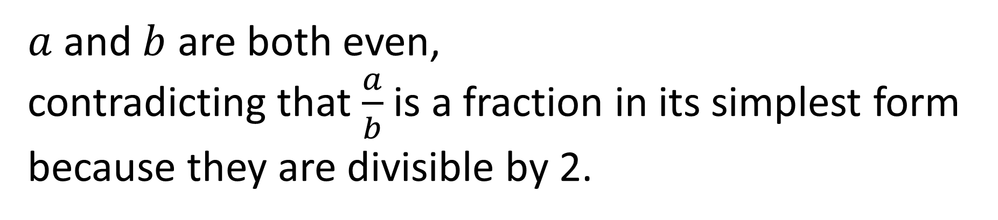
Show contradiction
$a$ and $b$ are both even,
contradicting that $\frac{a}{b}$ is a fraction in its simplest form because they are divisible by 2.
Conclusion
Therefore $\sqrt{2}$ is irrational.

