Slide 1





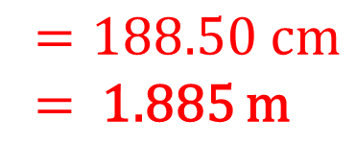


1)
2)
Find the circumference of the circle.
Give you answer in cm to 2 d.p.
How many complete revolutions does it take to for a wheel with a 60 cm radius to travel 1000 cm?
60cm
60cm
$$120π=376.99 cm$$
$1000÷376.99=$ 2.6525….
2 complete turns
3)
4)
How many complete revolutions does it take to for a wheel with a 6 cm radius to travel 100 metres?
Find the circumference of the circle.
Give you answer in terms of $π$.
6cm
6cm
$$12π$$
$$Circumference=18.85 cm$$
$100÷37.699=$ 2.6525….
2 complete turns
5)
Find the circumference of the circle.
Give you answer in metres to 2 d.p.
6)
Find the perimeter of the shape.
Give you answer in cm to 2 d.p.
60cm
$$=188.50 cm$$
= 1.885 m
60cm
$(188.5÷2)+60$ = 154.25 cm

Slide 2
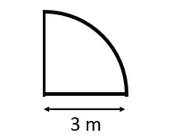
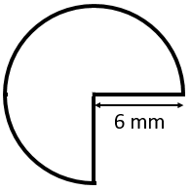
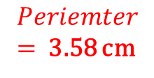
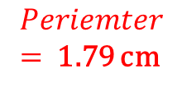
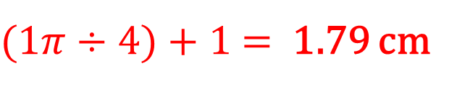
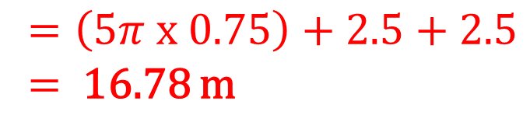
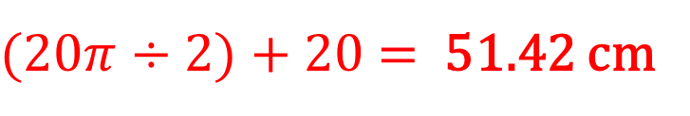
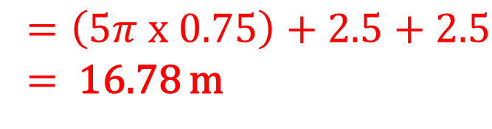
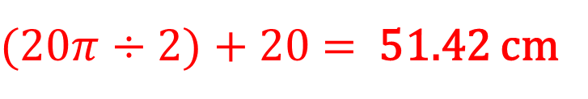

7)
Find the perimeter of the shape.
Give you answer in cm to 2 d.p.
8)
Find the perimeter of the shape.
Give you answer in cm to 2 d.p.
10cm
20cm
$(20π÷2)+20$ = 51.42 cm
$(20π÷2)+20$ = 51.42 cm
9)
Find the perimeter of the shape.
Give you answer in cm to 2 d.p.
10)
What is the increase in perimeter when the radius is 1cm compared to 0.5cm?
Give you answer in cm to 2 d.p.
$$Periemter$$
= 1.79 cm
$$Periemter$$
= 3.58 cm
0.5cm
$(1π÷4)+1$ = 1.79 cm
1cm
$$1.79 cm$$
11)
Find the perimeter of the shape.
Give you answer in metres to 2 d.p.
12)
A small garden is enclosed by fencing as shown by the diagram.
How much fencing is needed?
Give you answer in metres to 2 d.p.
5m
2.5m
0.4cm
0.4cm
$$=\left(5π x 0.75\right)+2.5+2.5$$
= 16.78 m
$$=\left(5π x 0.75\right)+2.5+2.5$$
= 16.78 m

