Slide 1
LO: Add and Subtract Fractions

Slide 2
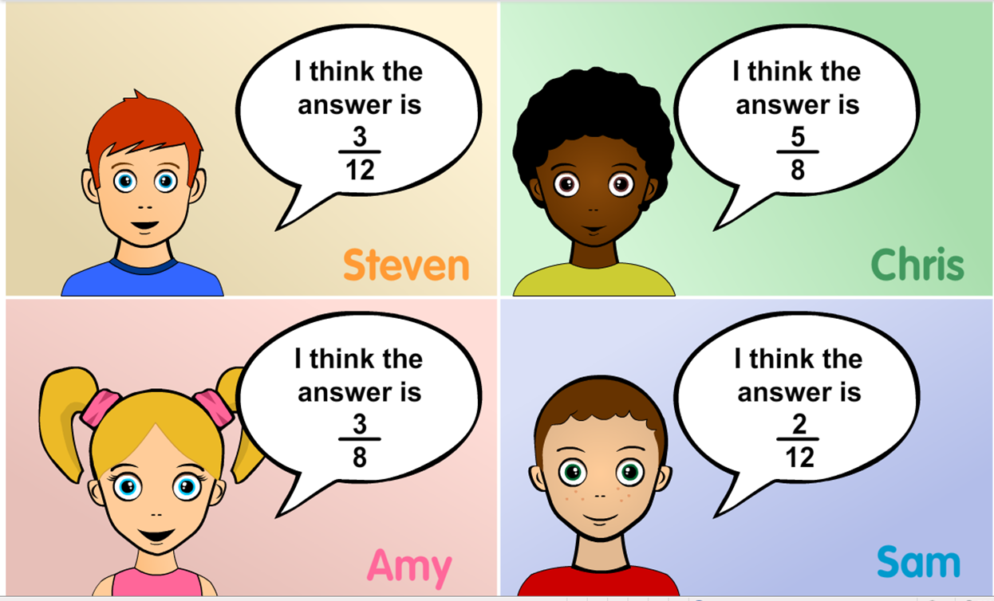
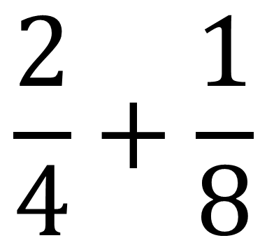
$$\frac{2}{4}+\frac{1}{8}$$
Who is right and why?

Slide 3
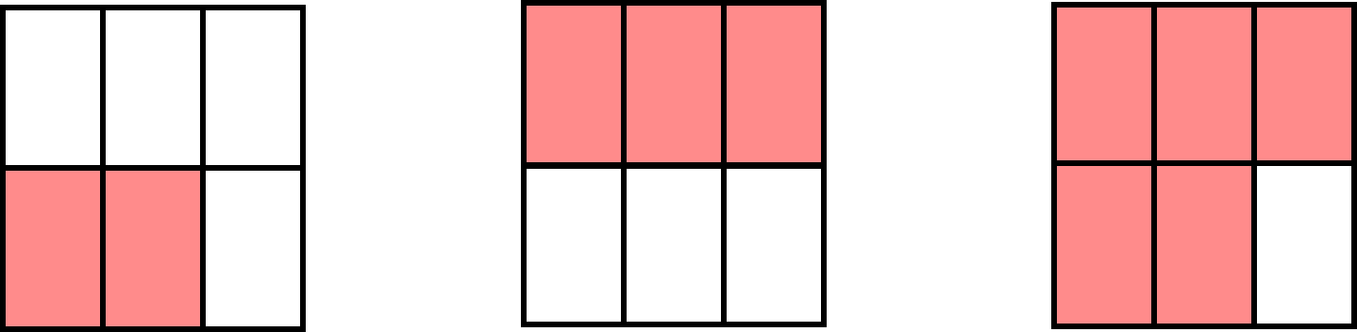
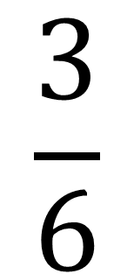
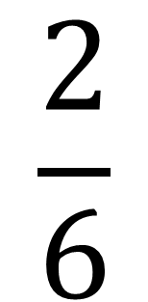
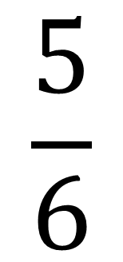
$$\frac{2}{6}$$
$$\frac{3}{6}$$
$$\frac{5}{6}$$
+
=

Slide 4
The Golden Rule when
adding and subtracting fractions is:
Denominators
must be Equal.

Slide 5
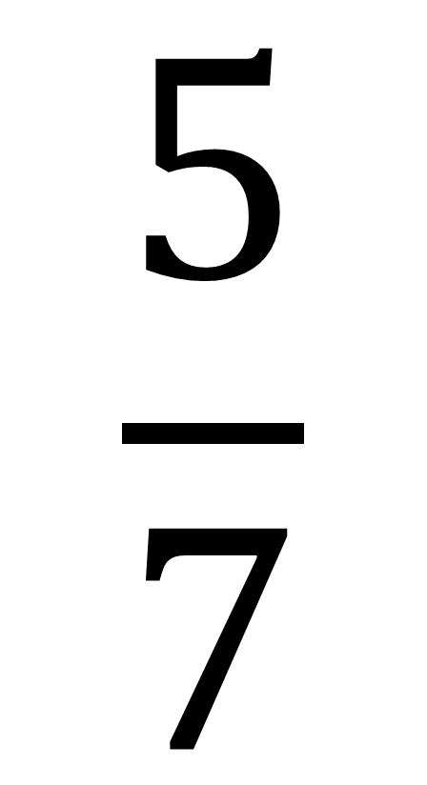
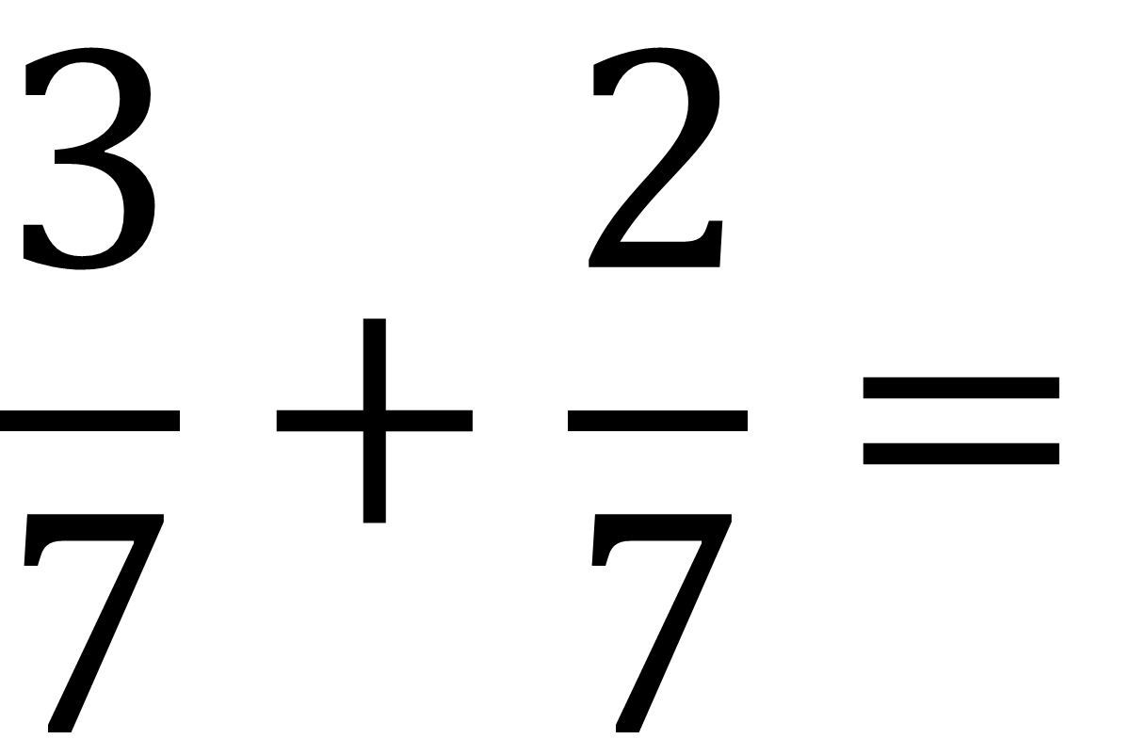
$$\frac{3}{7}+\frac{2}{7}=$$
$$\frac{5}{7}$$

Slide 6
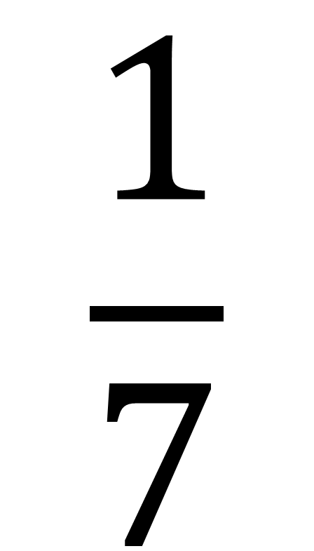
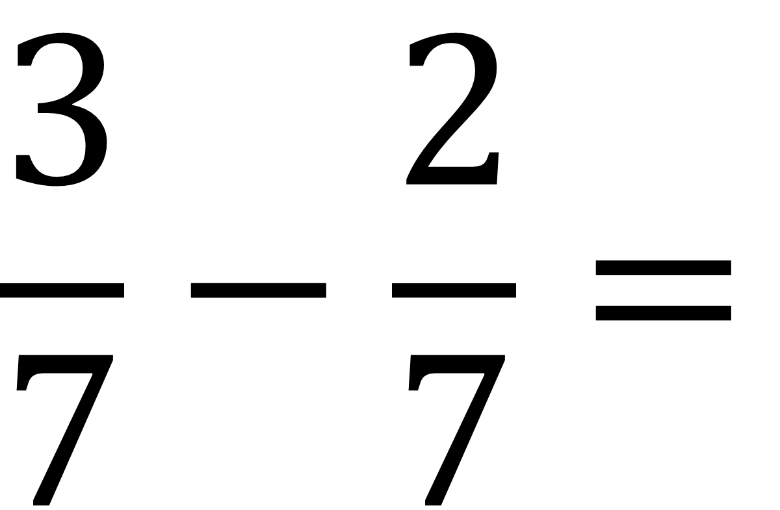
$$\frac{3}{7}−\frac{2}{7}=$$
$$\frac{1}{7}$$

Slide 7
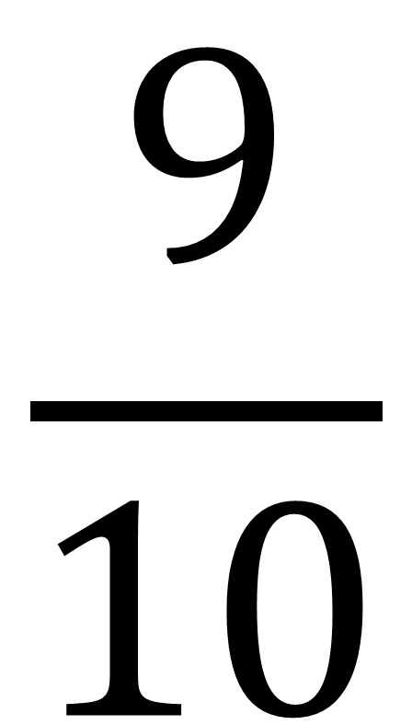
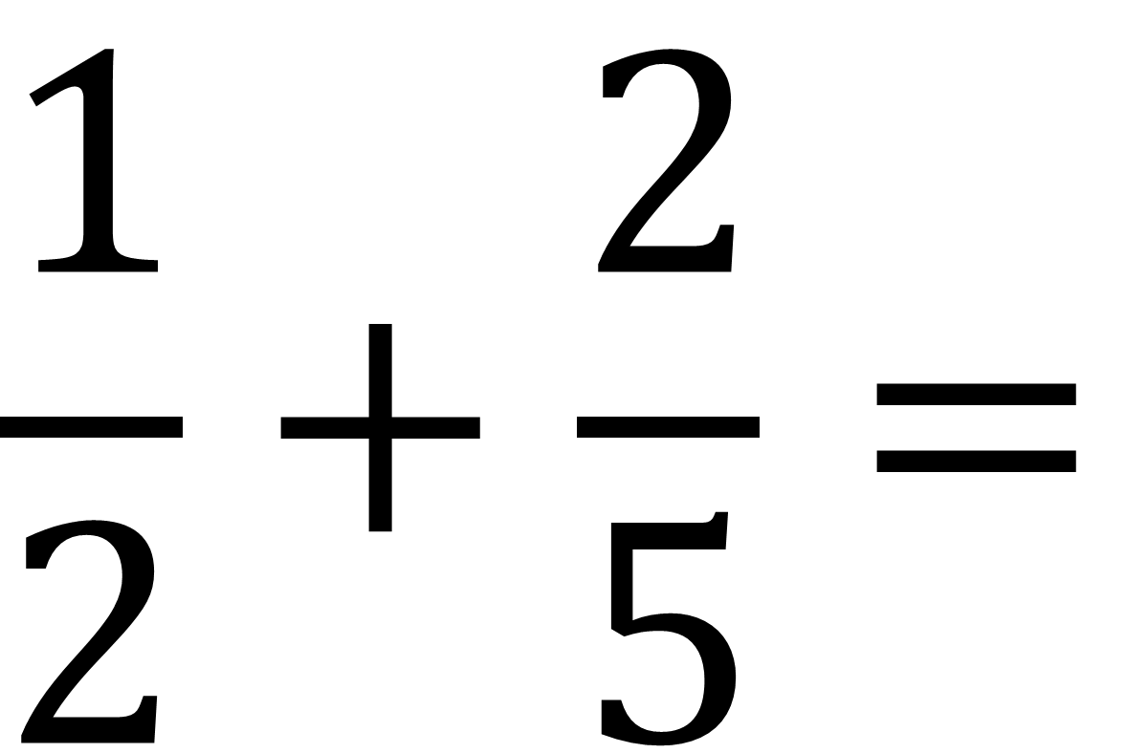
What if the denominators are not equal?
$$\frac{1}{2}+\frac{2}{5}=$$
$$\frac{9}{10}$$

Slide 8


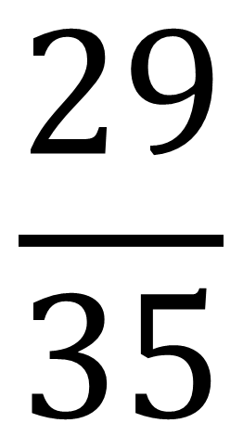
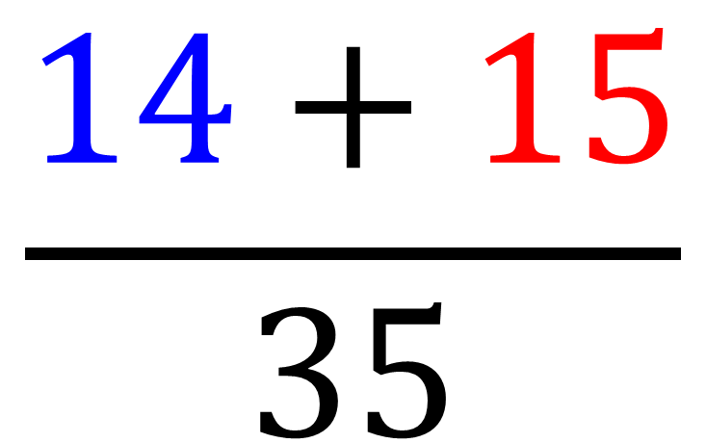
Think about as cross multiplying.
$$\frac{2}{5}$$
$$\frac{3}{7}$$
$$\frac{14+15}{35}$$
$$\frac{29}{35}$$
+
=
=

Slide 9


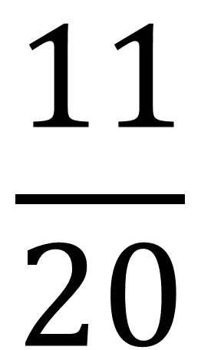
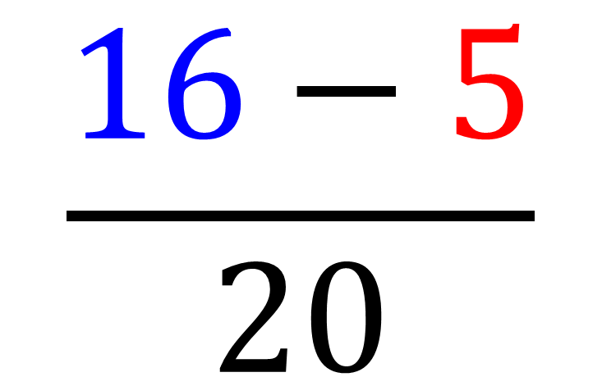

Think about as cross multiplying.
$$\frac{4}{5}$$
$$\frac{1}{4}$$
$$\frac{16−5}{20}$$
$$\frac{11}{20}$$
$$−$$
=
=

Slide 10



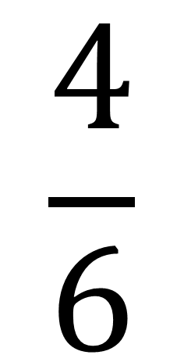
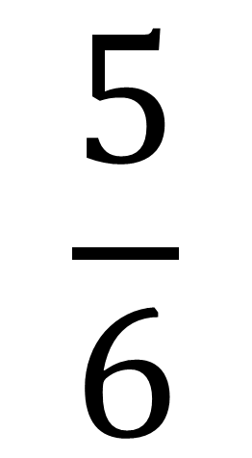
Watch out for short cuts.
$$\frac{2}{3}$$
$$\frac{1}{6}$$
$$\frac{4}{6}$$
$$\frac{1}{6}$$
$$\frac{5}{6}$$
+
=
+
=

Slide 11
Common
Denominator
3 | + | 1 | =
7 |  | 7
4
7
1 | + | 2 | =
2 |  | 6
3 | + | 2 | =
6 |  | 6
5
6
Shortcuts
Different
Denominators
3 | + | 2 | =
5 |  | 4
12 + 10 | =
20
22
20

