Slide 1
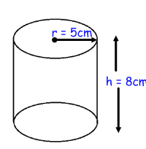

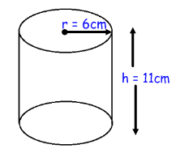
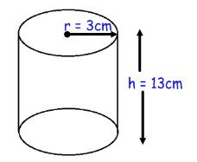
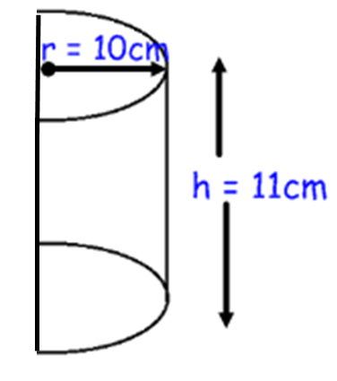
1)
3)
2)
4)
5)
12cm
6cm

Slide 2
ANSWERS

Slide 3
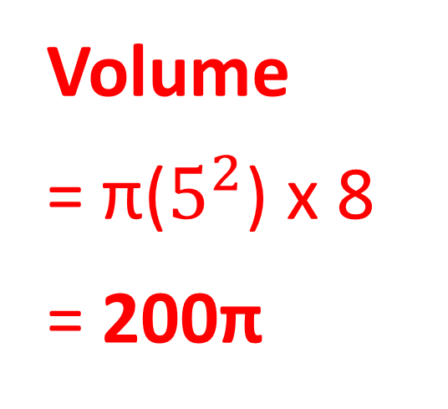
1)
Volume
= π($5^{2}$) x 8
= 200π
Surface Area
= 25π + 25π + (10π x 8)
= 130π

Slide 4
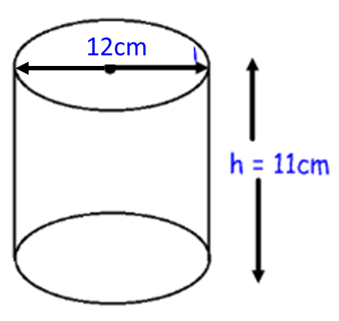
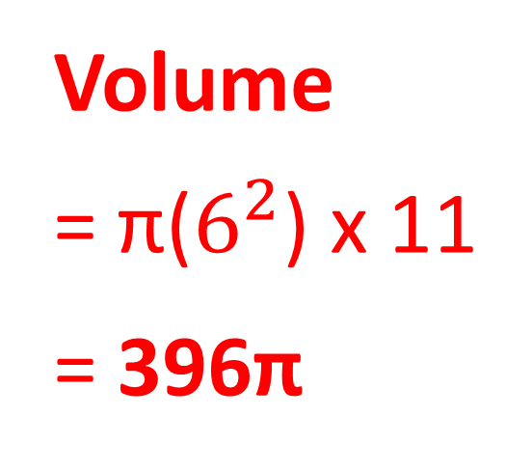
2)
Volume
= π($6^{2}$) x 11
= 396π
Surface Area
= 36π + 36π + (12π x 11)
= 204π

Slide 5
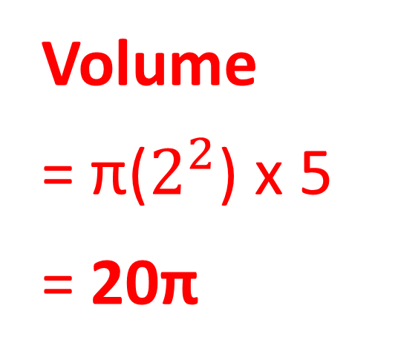
3)
Volume
= π($2^{2}$) x 5
= 20π
Surface Area
= 4π + 4π + (4π x 5)
= 28π

Slide 6
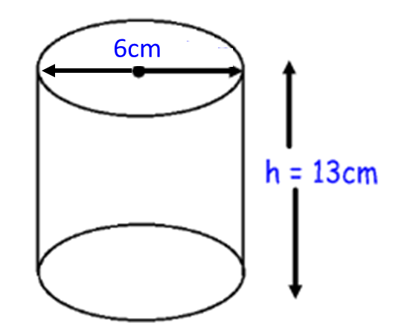
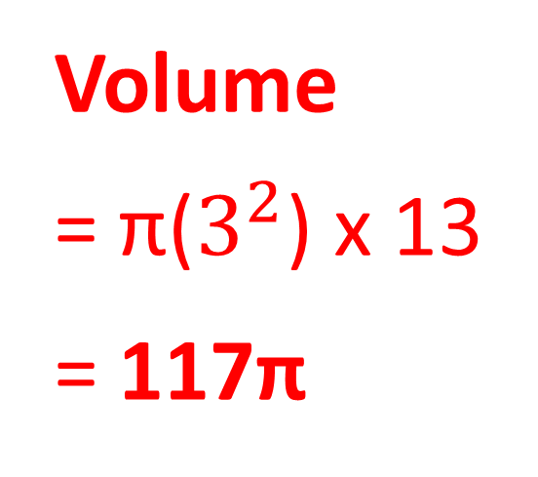
4)
Volume
= π($3^{2}$) x 13
= 117π
Surface Area
= 9π + 9π + (6π x 13)
= 96π

Slide 7
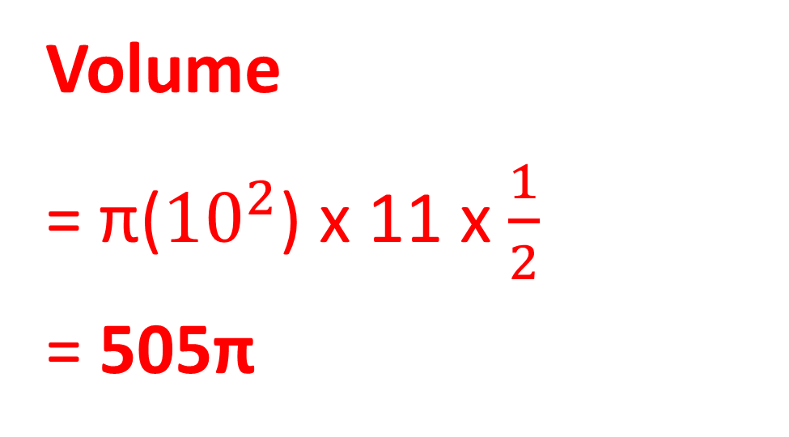
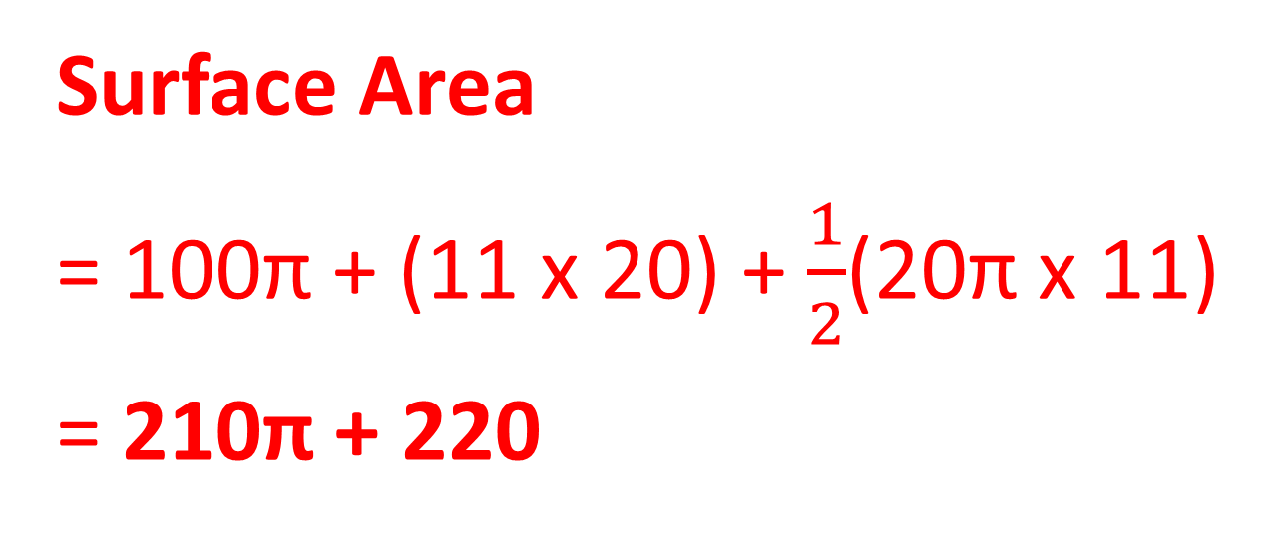
5)
Volume
= π(${10}^{2}$) x 11 x $\frac{1}{2}$
= 505π
Surface Area
= 100π + (11 x 20) + $\frac{1}{2}$(20π x 11)
= 210π + 220

