Slide 1
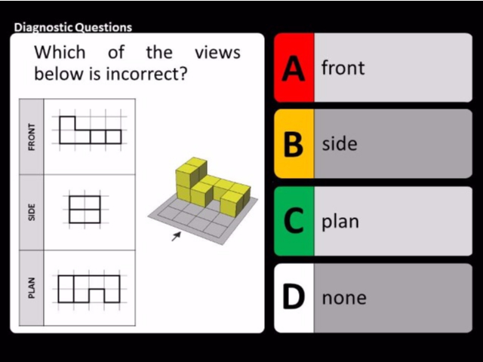
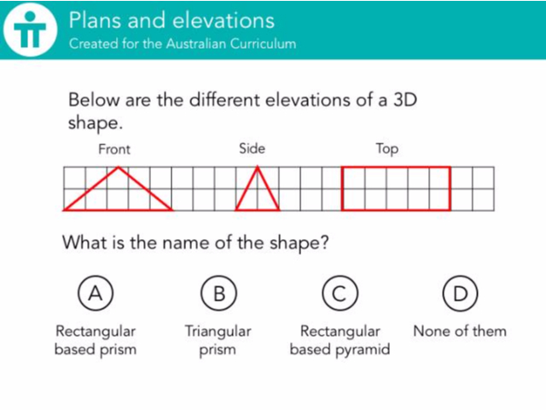
Worst answered question?
Most common wrong answer?

Slide 2
ANSWERS

Slide 3
Worst answered question?

Slide 4
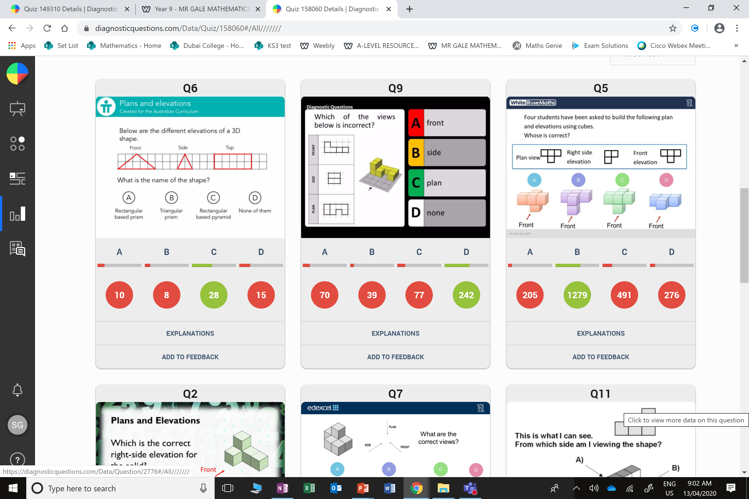
D
They where not sure about the
Top view.

Slide 5
C
They are all correct.

