Slide 1
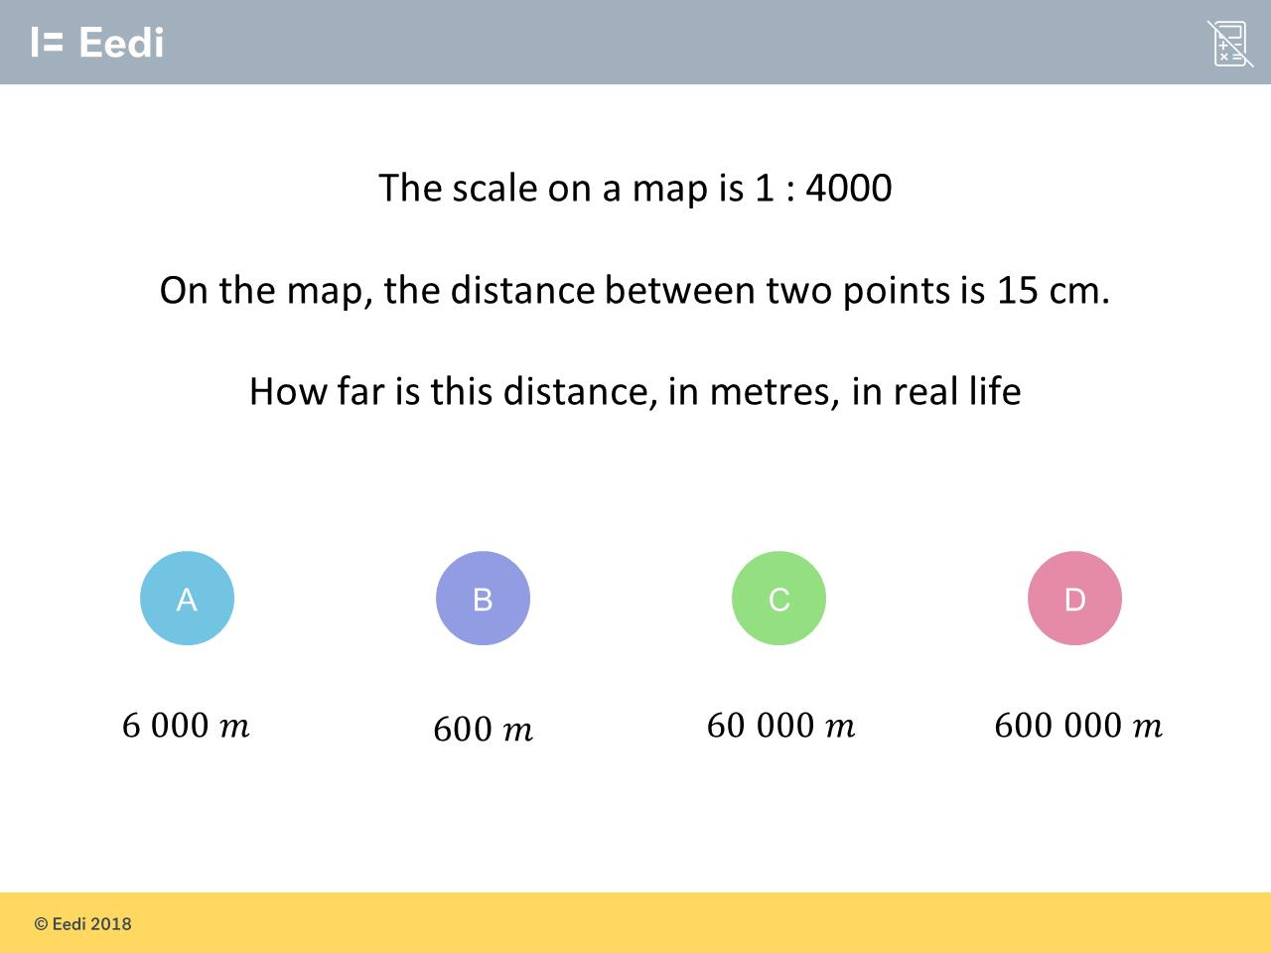
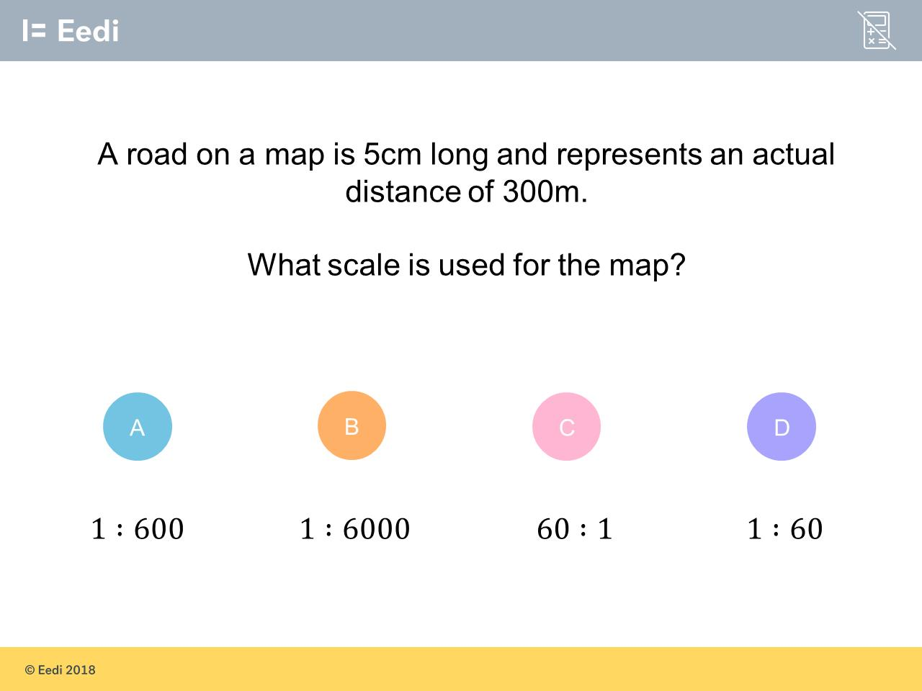
Worst answered question?
Most common wrong answer?

Slide 2
ANSWERS

Slide 3
Worst answered question?

Slide 4
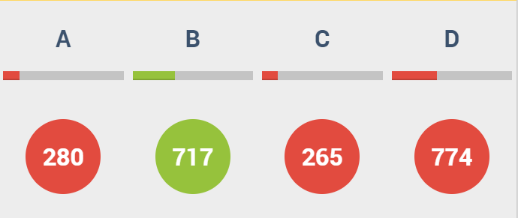
D
They did not notice the units were different and needed converting.

Slide 5

C
They gave their answer in cm
and not metres.

