Slide 1
LO: Adding and Subtracting
Algebraic Fractions
(Two Terms)

Slide 2


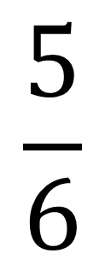
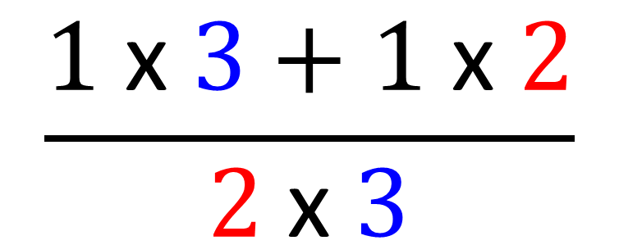

$$\frac{1}{2}$$
$$\frac{1}{3}$$
$$\frac{1 \text{x} 3+1 \text{x} 2}{2 \text{x} 3}$$
$$\frac{5}{6}$$
+
=
=
$$make sure you have a$$
$$common denomiator$$

Slide 3
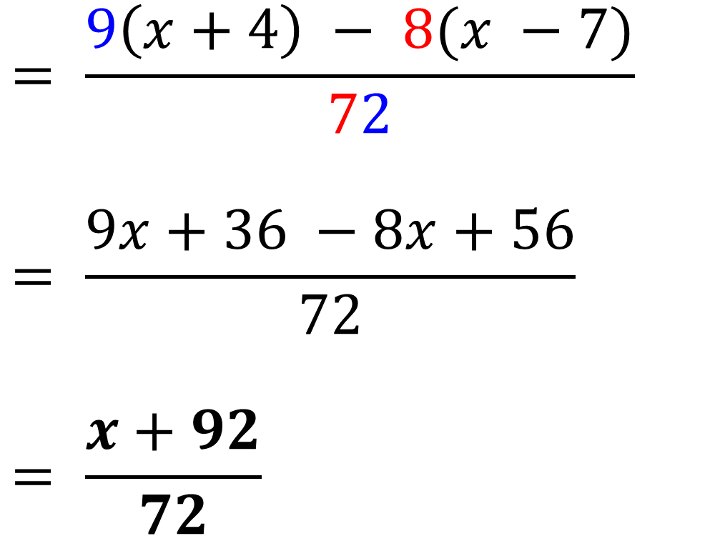
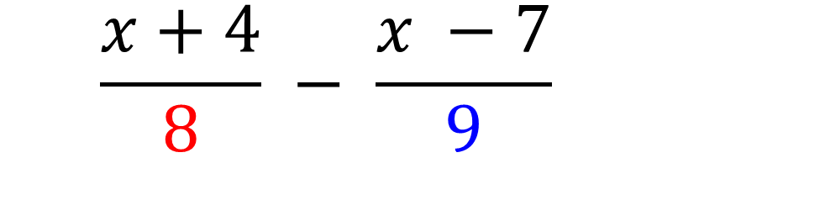
$$= \frac{x+4}{8} − \frac{x −7}{9}$$
$$= \frac{9\left(x+4\right) − 8(x −7)}{72}$$
$$= \frac{9x+36 −8x+56}{72}$$
$$= \frac{x+92}{72}$$

Slide 4
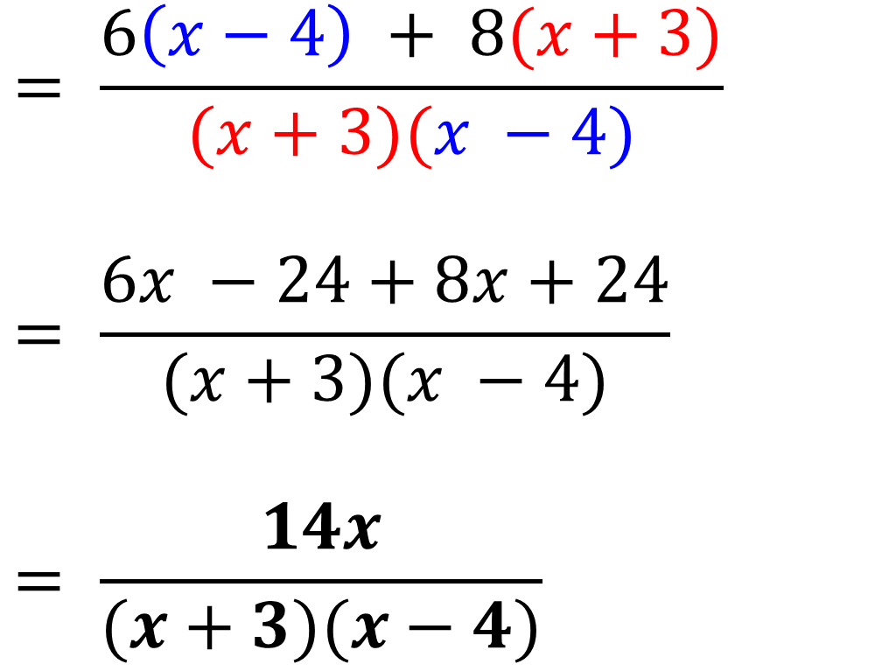
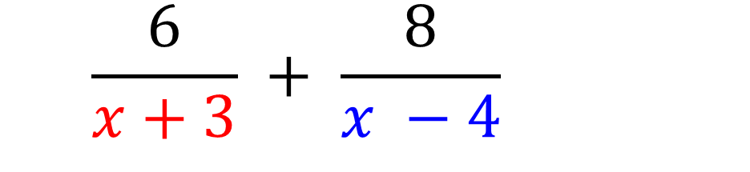
$$= \frac{6}{x+3} + \frac{8}{x −4}$$
$$= \frac{6\left(x−4\right) + 8(x+3)}{(x+3)(x −4)}$$
$$= \frac{6x −24+8x+24}{(x+3)(x −4)}$$
$$= \frac{14x}{(x+3)(x−4)}$$

Slide 5
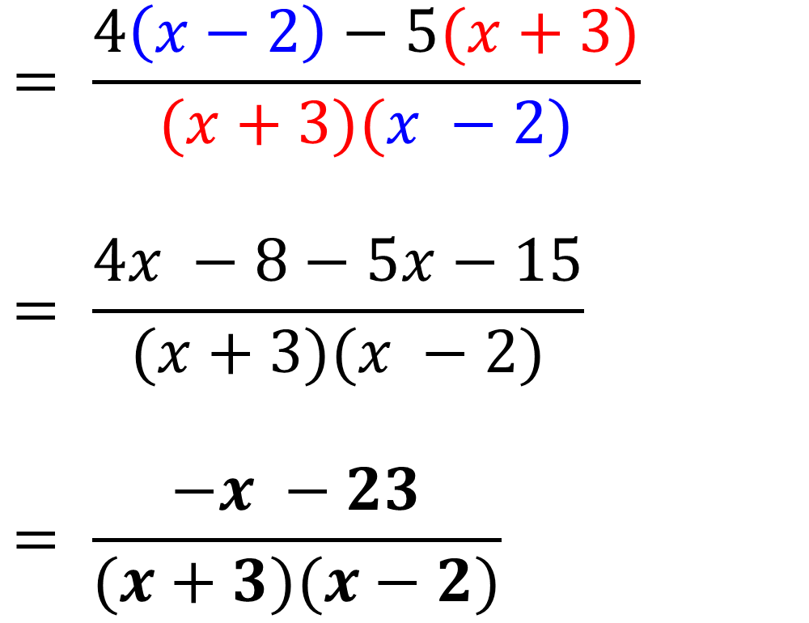
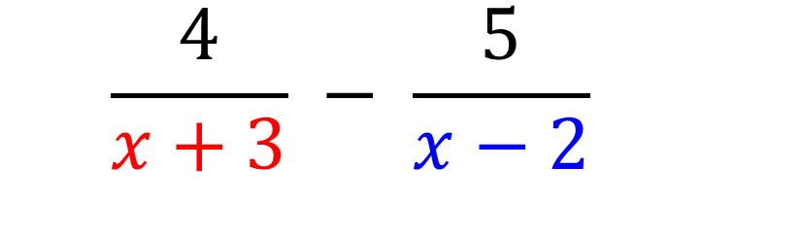
$$= \frac{4}{x+3} − \frac{5}{x−2}$$
$$= \frac{4\left(x−2\right)−5(x+3)}{(x+3)(x −2)}$$
$$= \frac{4x −8−5x−15}{(x+3)(x −2)}$$
$$= \frac{−x −23}{(x+3)(x−2)}$$

Slide 6
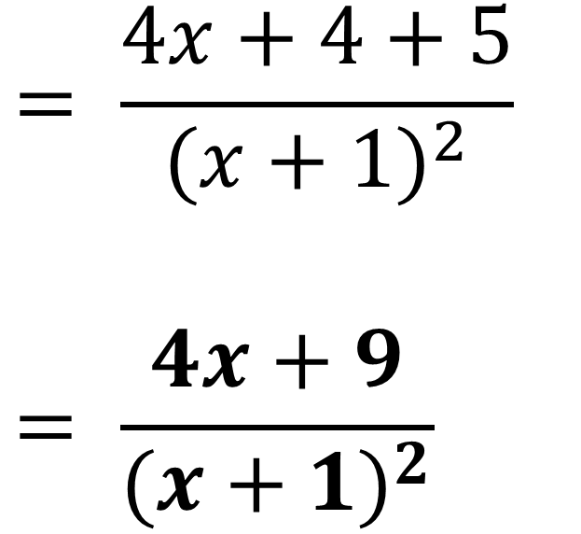
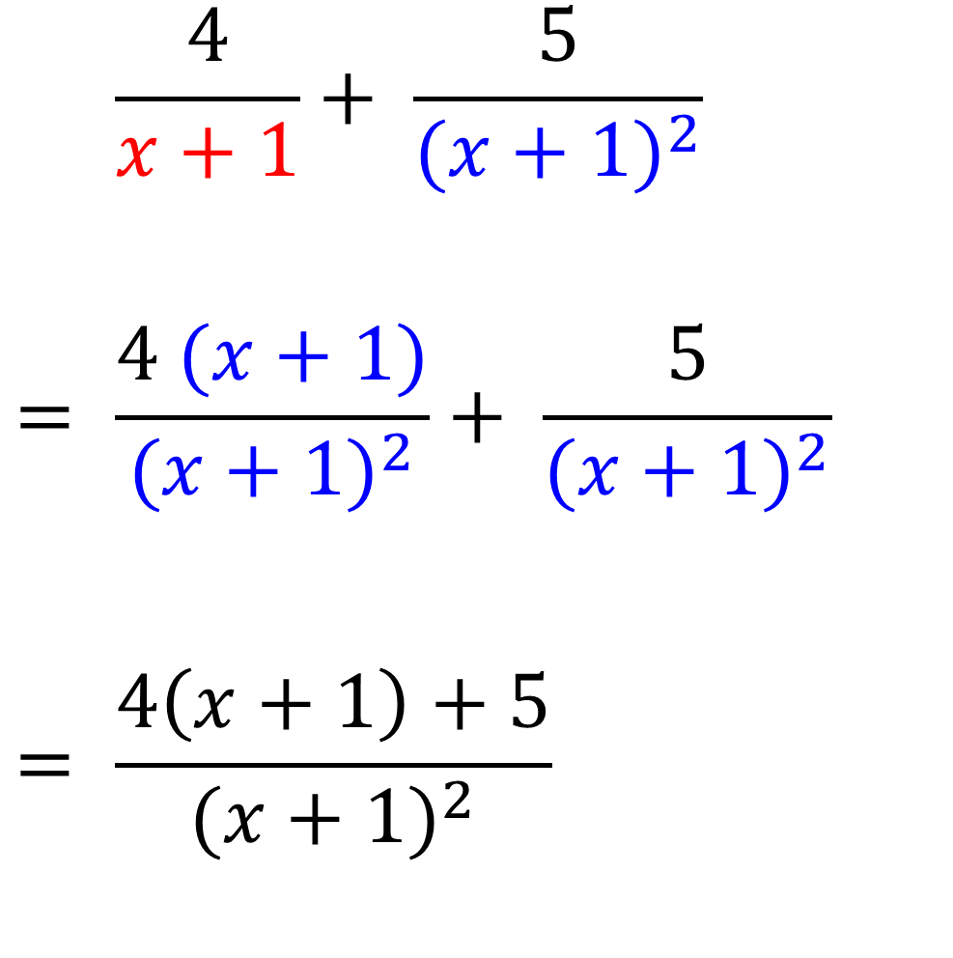
$$= \frac{4}{x+1}+ \frac{5}{{(x+1)}^{2}}$$
$$= \frac{4 (x+1)}{{(x+1)}^{2}}+ \frac{5}{{(x+1)}^{2}}$$
$$= \frac{4\left(x+1\right)+5}{{(x+1)}^{2}}$$
$$= \frac{4x+4+5}{{(x+1)}^{2}}$$
$$= \frac{4x+9}{{(x+1)}^{2}}$$

