Slide 1
LO: Spheres

Slide 2

Can you describe a sphere?

Slide 3

Sphere

Slide 4


Volume of a Sphere
Volume = $\frac{4}{3}$ $πr^{3}$
r

Slide 5
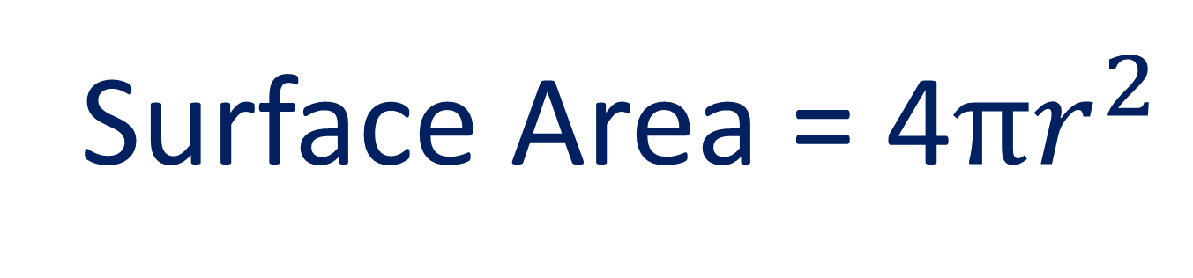
Surface Area of a Sphere
Surface Area = 4$πr^{2}$
r

Slide 6
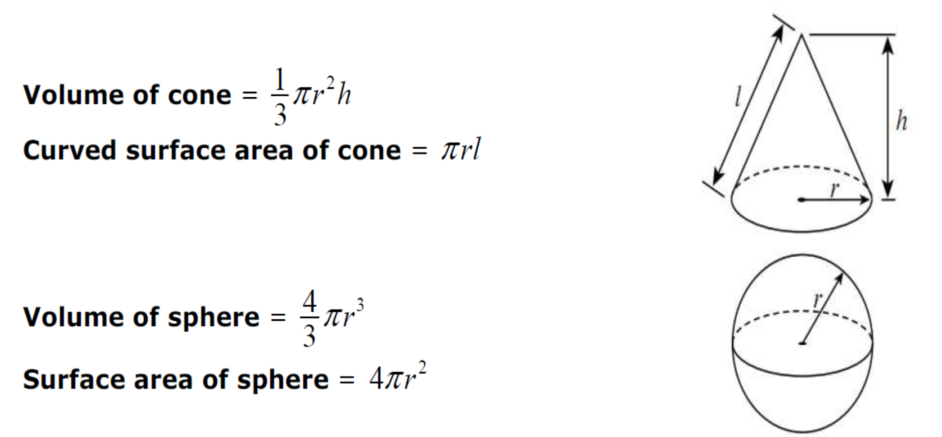
FORMULA SHEET

Slide 7
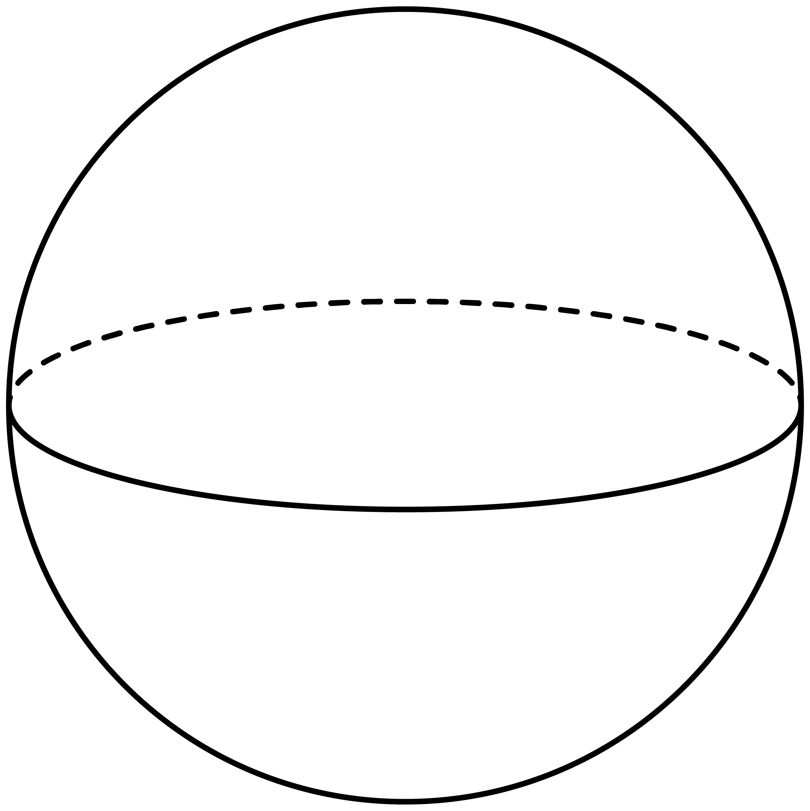
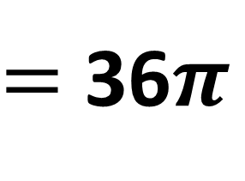
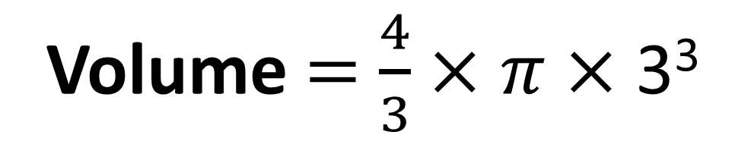
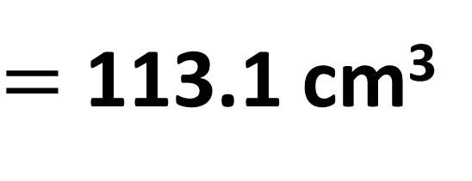
Find the volume of the sphere.
Volume $=$ $\frac{4}{3}×$ $π$ $×$ 3³
3cm
$=$ 36$π$
$=$ 113.1 cm³

Slide 8
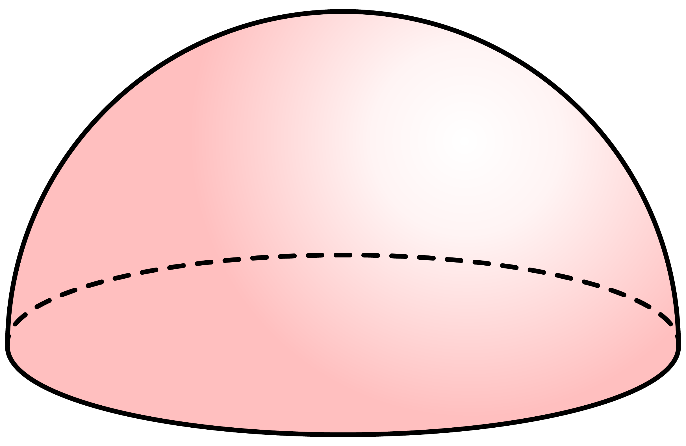
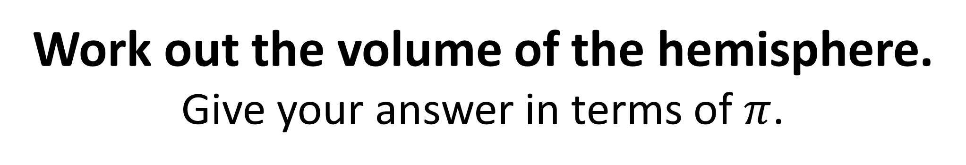
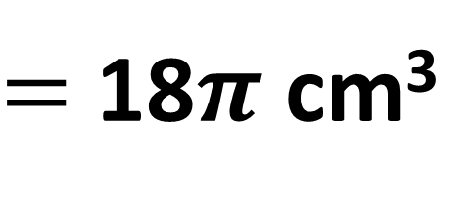
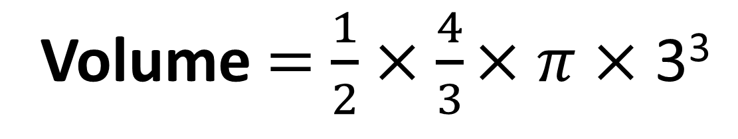
Work out the volume of the hemisphere.
Give your answer in terms of $π$.
Volume $=$ $\frac{1}{2}×\frac{4}{3}$ $×$ $π$ $×$ 3³
3cm
$=$ 18$π \text{cm}\text{3}$

Slide 9
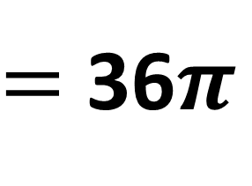
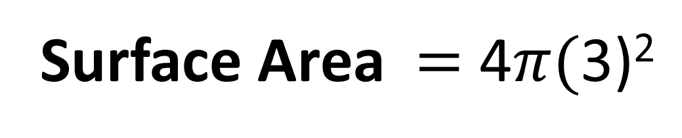
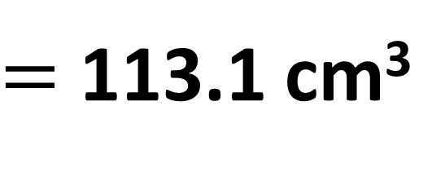
Find the surface area of the sphere.
Give you answer to 1 decimal place.
Surface Area $=$ 4$π($3)²
3cm
$=$ 36$π$
$=$ 113.1 cm³

Slide 10
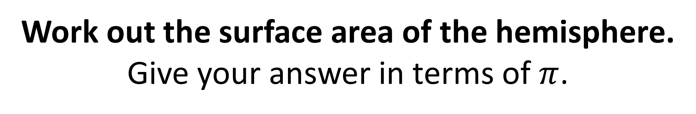
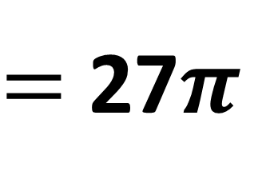
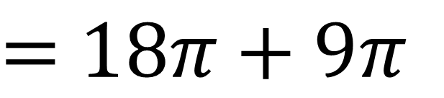
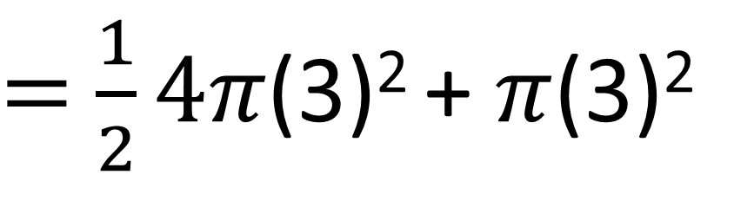
Work out the surface area of the hemisphere.
Give your answer in terms of $π$.
Surface Area
$=$ $\frac{1}{2}4π$(3)² + $π$(3)²
3cm
$=$ $18π\text{ + 9}π$
$=$ 27$π$

Slide 11
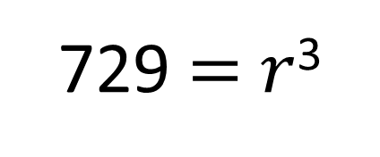
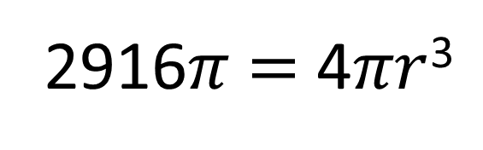
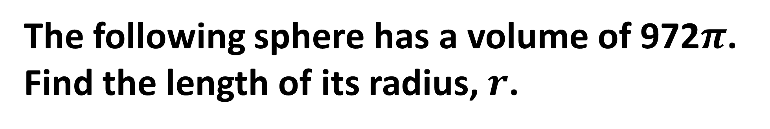
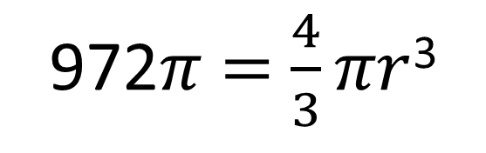
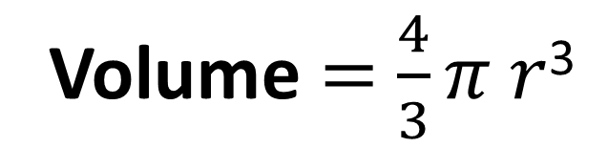

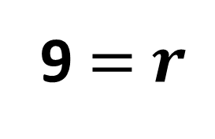
The following sphere has a volume of 972$π$.
Find the length of its radius, $r$.
Volume $=$ $\frac{4}{3}π$ $r$³
$$r$$
972$π$ $=$ $\frac{4}{3}πr$³
2916$π$ $=$ 4$πr$³
729 $=$ $r$³
9 $=$ $r$

