Slide 1
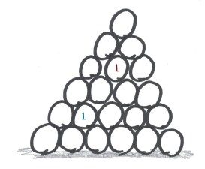
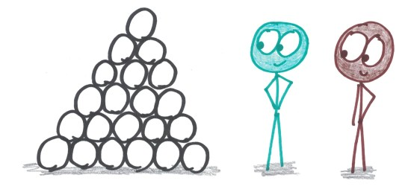
Blackhole
Then, take turns writing a 1 in a circle of your choice.
You begin by drawing a pyramid of 21 circles.
Draw six on the bottom row, five on top of that,
four on top of that, and so on.
After that, take turns writing 2, 3, and so on, in order. (You must write your numbers in order; no skipping ahead.)
When you have each written your 10, there will be one circle left blank: the black hole.

Slide 2
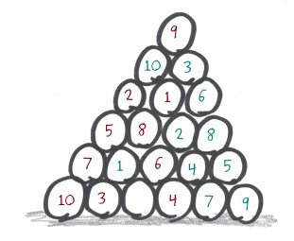
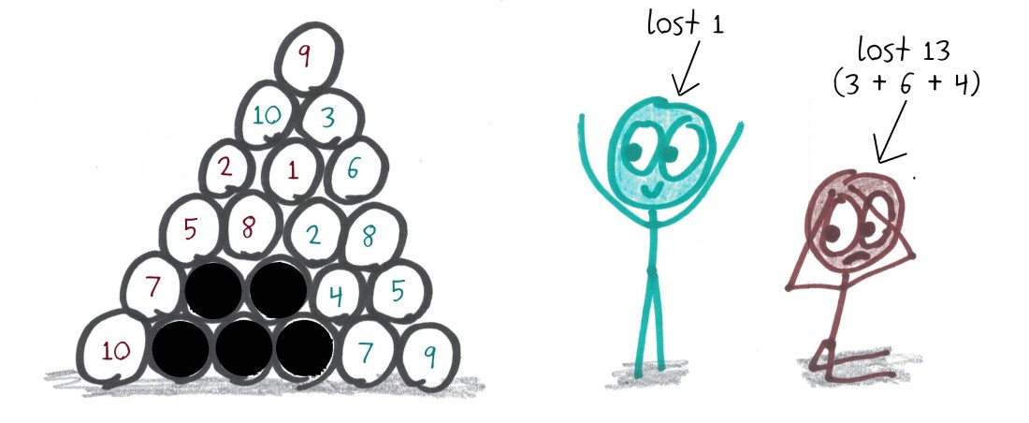
The black hole destroys all its neighboring circles. Whoever has a greater sum of numbers left over – that is, whoever loses a smaller sum to the black hole – is the winner.
Have fun playing

