Slide 1
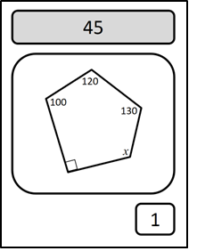
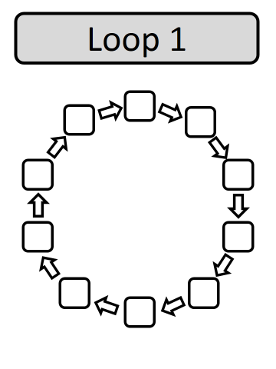
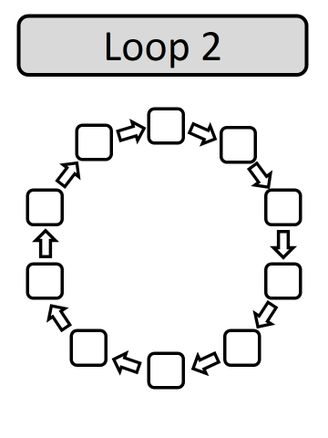
Follow the answers.
There are 2 loops to be found.

Slide 2
ANSWERS

Slide 3
