Slide 1
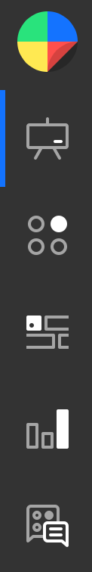
Simplifying
Algebraic Fractions
(with factorising)
https://diagnosticquestions.com/Quizzes/Go#/160727

