Slide 1

Junior Challenge 3
BRONZE

Slide 2
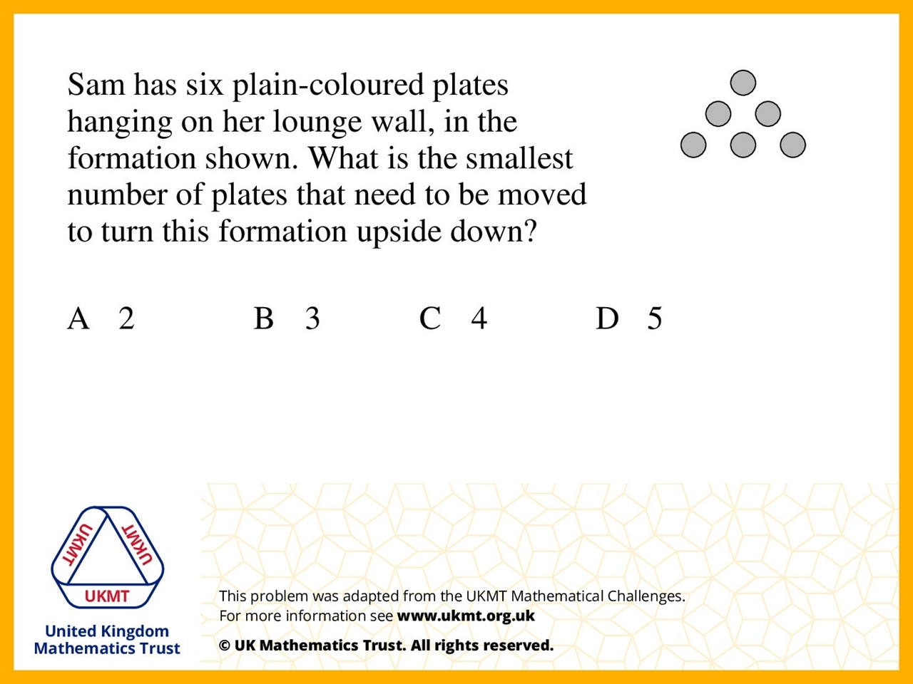
Q1.
If you moved the two outside plates on the bottom and put them either side of the top one then you would have another triangle.

Slide 3
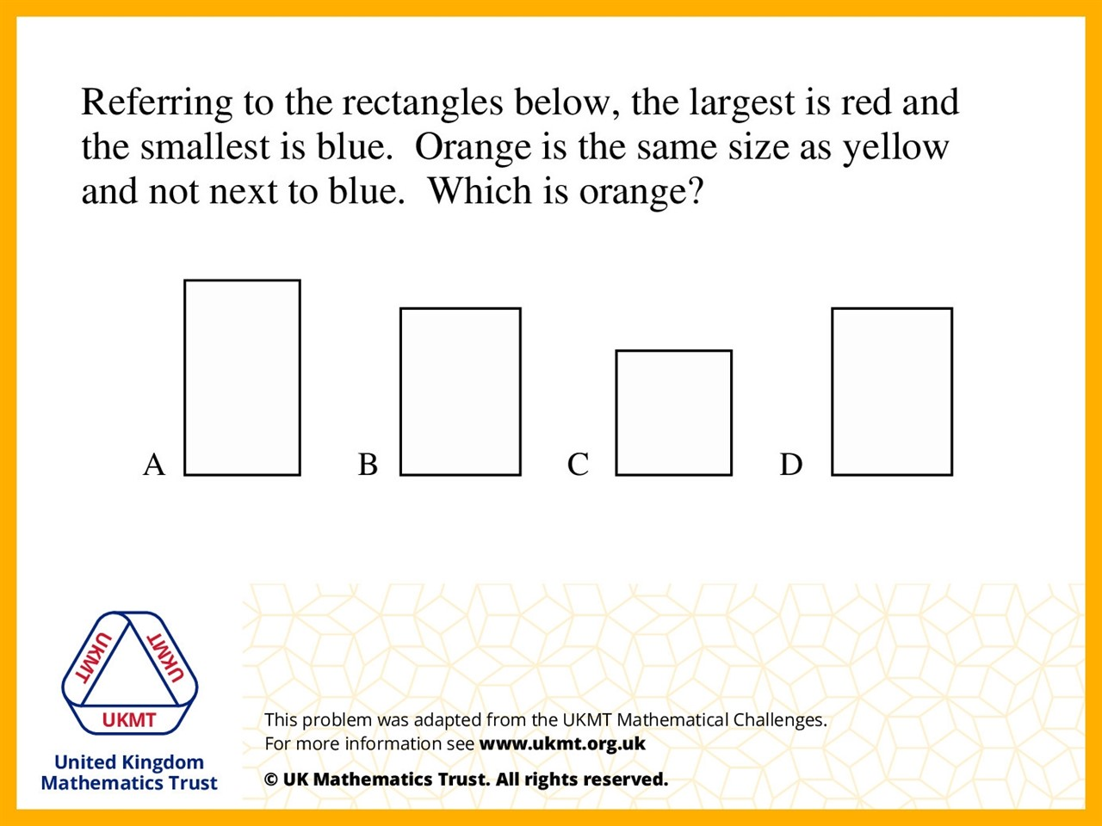
Q2.
A is the largest and red and C is the smallest so it is blue. Therefore B and D are equal. So 'B' is orange.

Slide 4
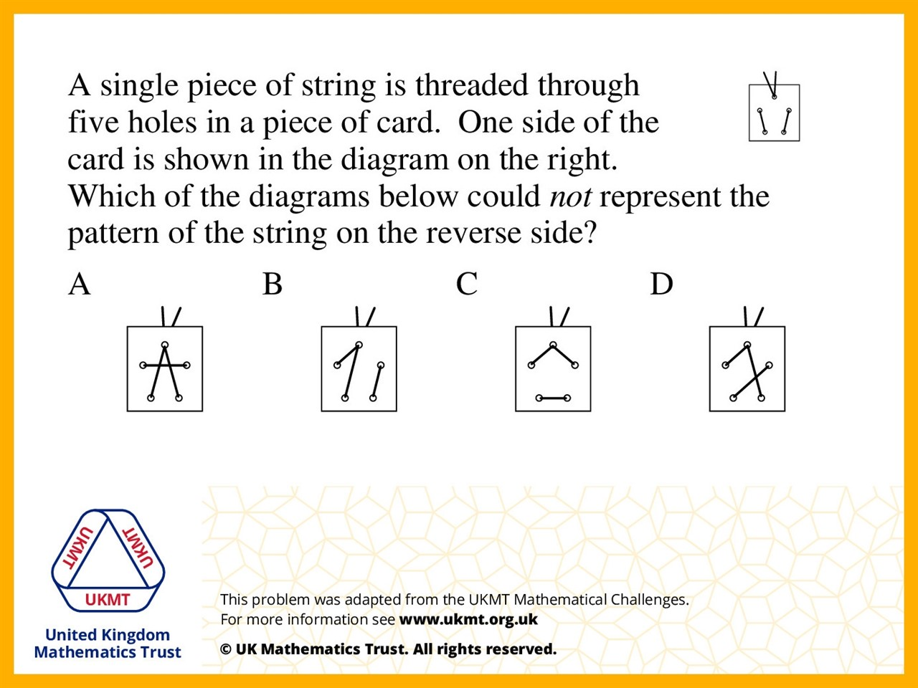
Q3.
The lines would go horizontal not vertical

Slide 5
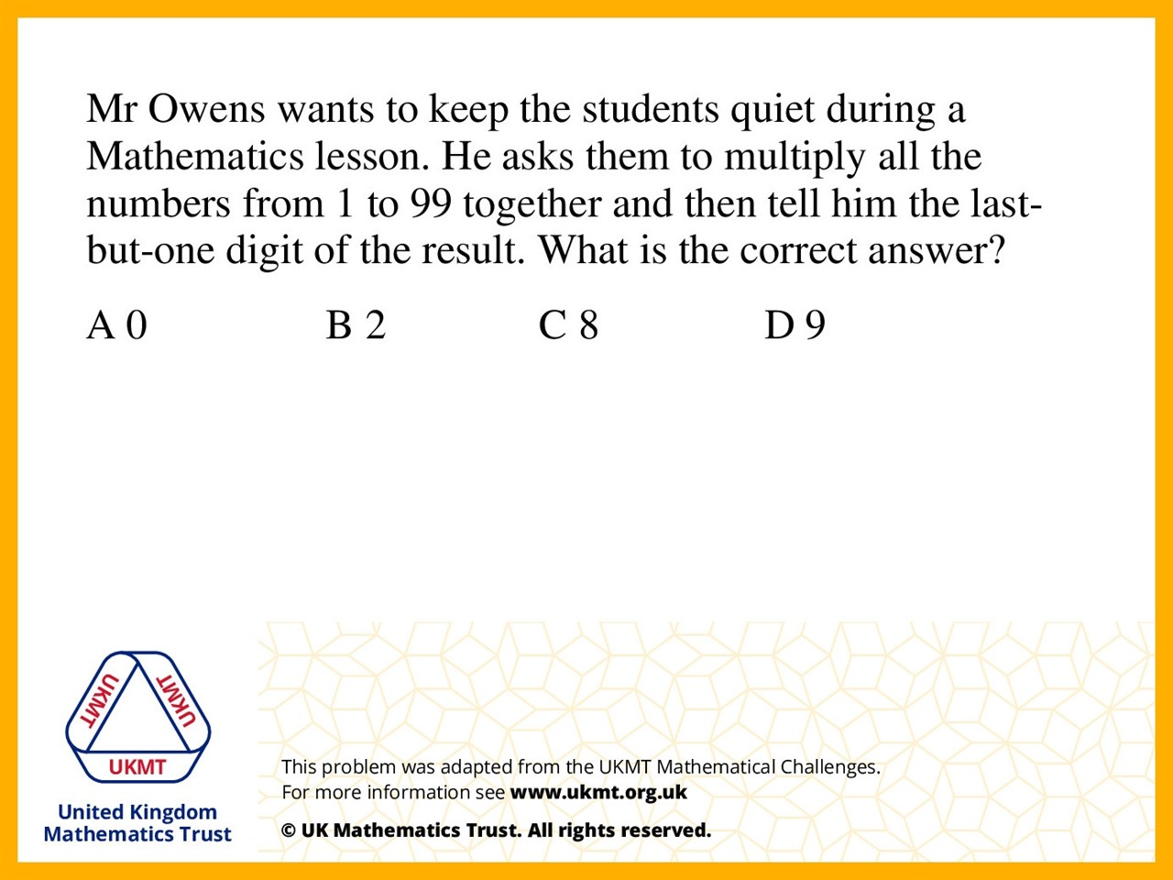
Q4.
In the list is 10, 20, 30, 40, 50, 60, 70, 80 and 90 which will add zeroes to the end of answer.

Slide 6
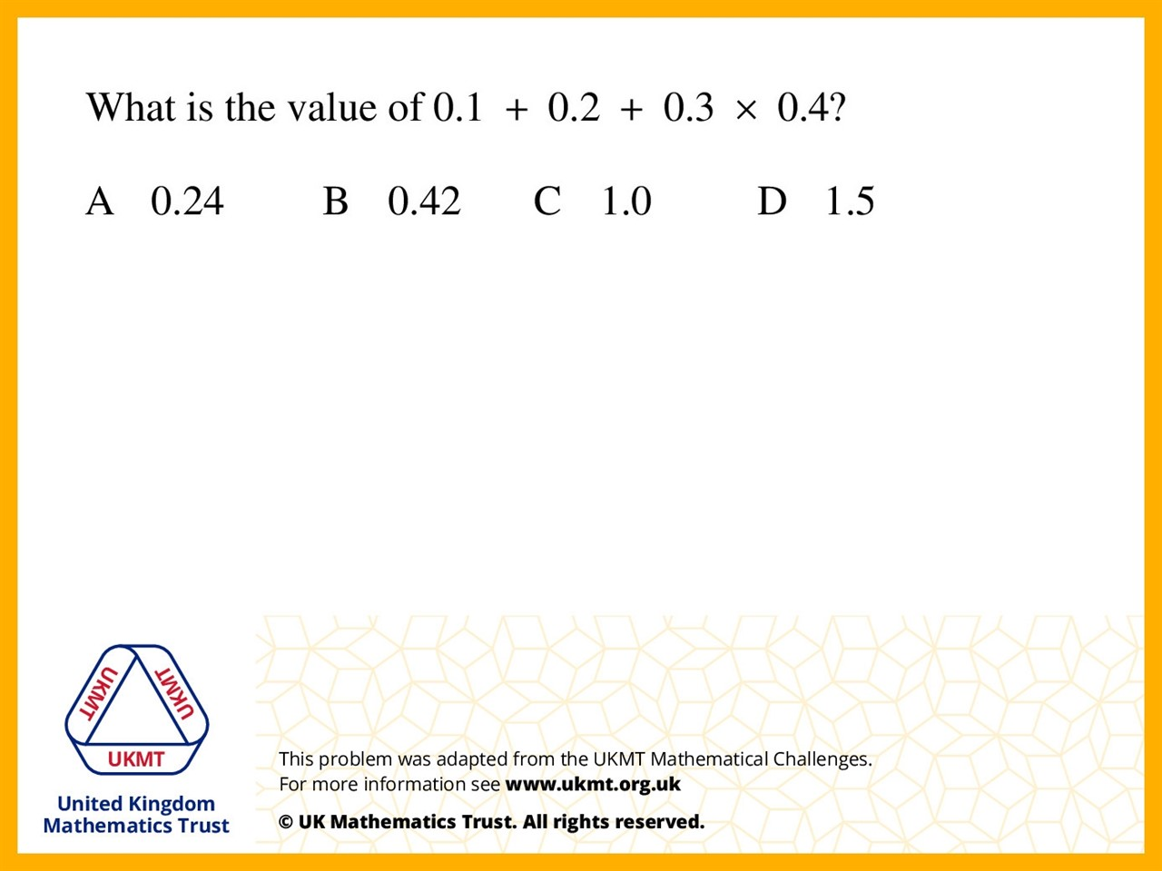
Q5.
BIDMAS. Do multiplication first
and addition second

