Slide 1
LO: Direct and Inverse
Proportion

Slide 2
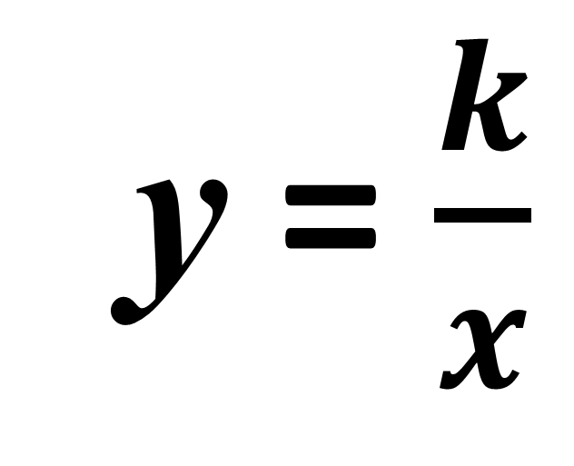
Direct Proportion
Inverse Proportion
y = $\frac{k}{x}$
y = kx
When one amount is zero the other
amount will also be zero.

Slide 3
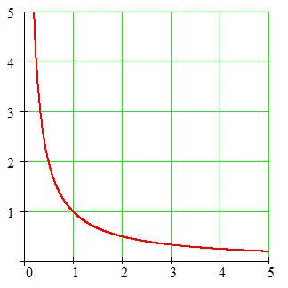
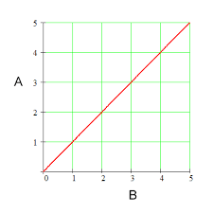
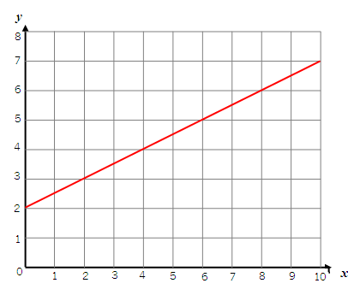
Not in proportion
Not in proportion
Proportion
When one amount is zero
the other amount will also be zero.

Slide 4
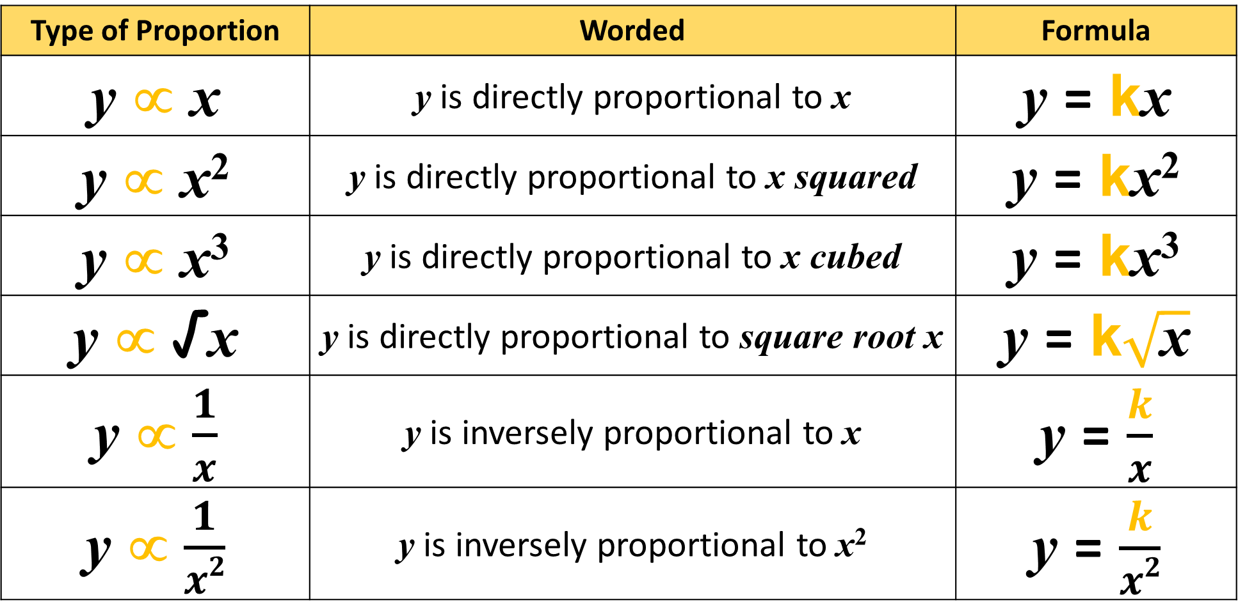
The following are the general equations you need to know with proportion.
Type of Proportion | Worded | Formula
y ∝ x | y is directly proportional to x | y = kx
y ∝ x² | y is directly proportional to x squared | y = kx²
y ∝ x³ | y is directly proportional to x cubed | y = kx³
y ∝ √x | y is directly proportional to square root x | y = k$\sqrt{\text{x}}$
y ∝ $\frac{1}{x}$ | y is inversely proportional to x | y = $\frac{k}{x}$
y ∝ $\frac{1}{x2}$ | y is inversely proportional to x² | y = $\frac{k}{x2}$

Slide 5
Match up the statement and formula.
y is inversely proportional to x³
=
k
y =
x³
y is proportional to x²
=
y = kx
y is inversely proportional to x²
=
k
y =
x²
y is directly proportional to x
=
k
y =
x
y is proportional to √x
=
y = kx²
y is inversely proportional to x
=
y = k √x

Slide 6
y is directly proportional to x
=
y = kx
y is proportional to x²
=
y = kx²
y is directly proportional to x³
=
y = kx³
k
y is inversely proportional to x
=
y =
x
=
k
y is inversely proportional to x²
y =
x²
k
y is inversely proportional to x³
=
y =
x³
y is proportional to √x
=
y = k√x

