Slide 1
Algebraic Methods
Algebraic Fractions
Chapter 1
(Part 2 of 4)

Slide 2
Algebraic Fractions
When calculating with fractions
before you do anything else
FACTORISE
anything that you can factorise!

Slide 3
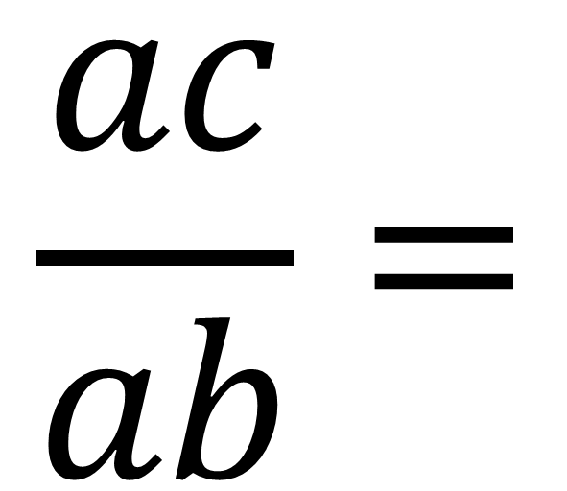
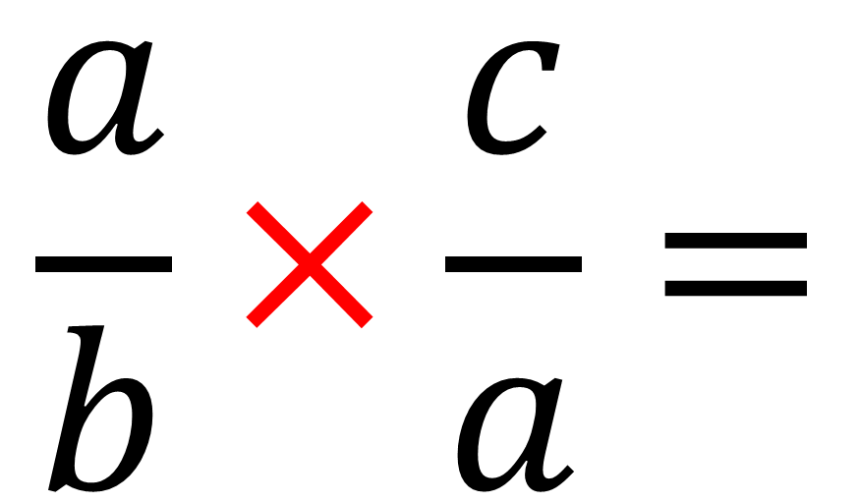
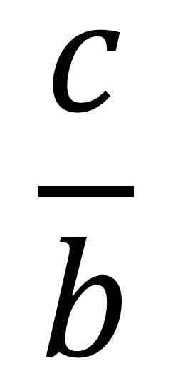
Algebraic Fractions - Multiplying
$$\frac{a}{b}×\frac{c}{a}=$$
$$\frac{ac}{ab}=$$
$$\frac{c}{b}$$

Slide 4
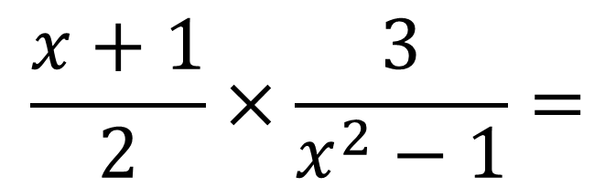
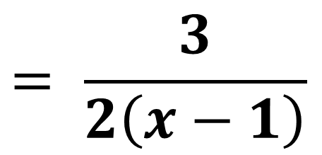
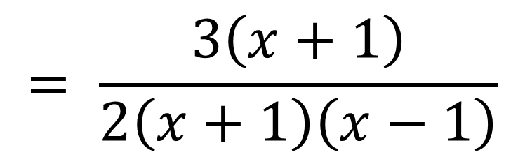
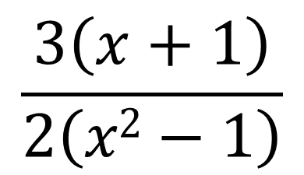
Write $\frac{x+1}{2}×\frac{3}{x^{2}−1}$as a single fraction in its simplest form.
$$\frac{x+1}{2}×\frac{3}{x^{2}−1}=$$
$$\frac{3\left(x+1\right)}{2\left(x2−1\right)}$$
$$= \frac{3\left(x+1\right)}{2\left(x+1\right)\left(x−1\right)}$$
$$= \frac{3}{2\left(x−1\right)}$$

Slide 5
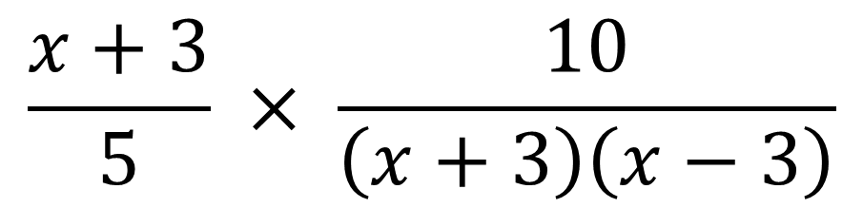
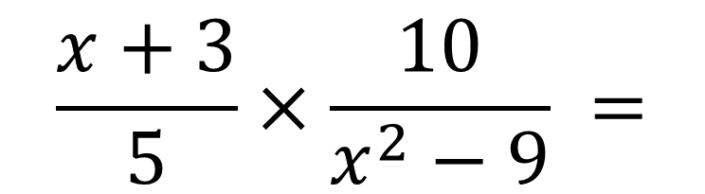
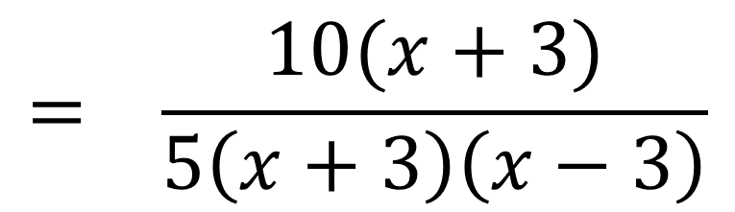
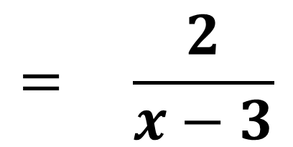
Write $\frac{x+3}{5}×\frac{10}{x^{2}−9}$ as a single fraction in its simplest form.
$$\frac{x+3}{5}×\frac{10}{x^{2}−9} =$$
$$\frac{x+3}{5} × \frac{10}{\left(x+3\right)\left(x−3\right)}$$
$$= \frac{10(x+3)}{5\left(x+3\right)\left(x−3\right)}$$
$$= \frac{2}{x−3}$$

Slide 6
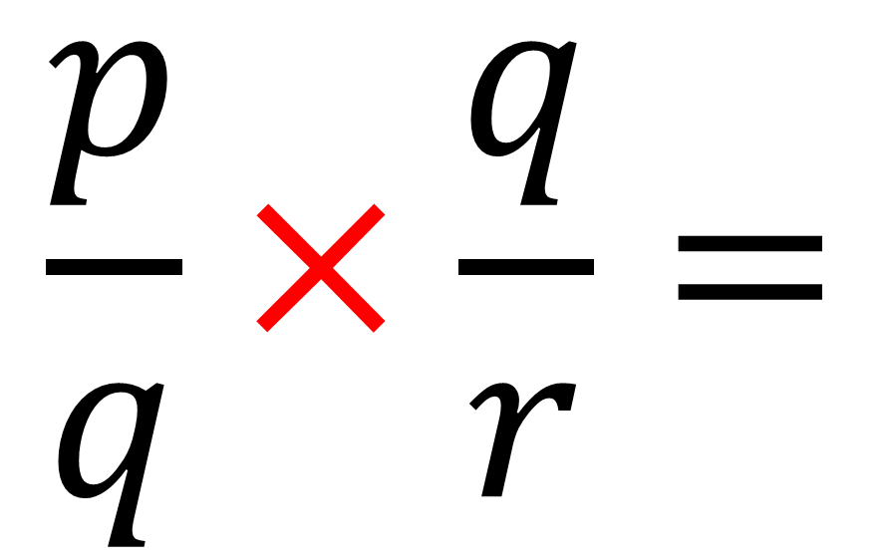
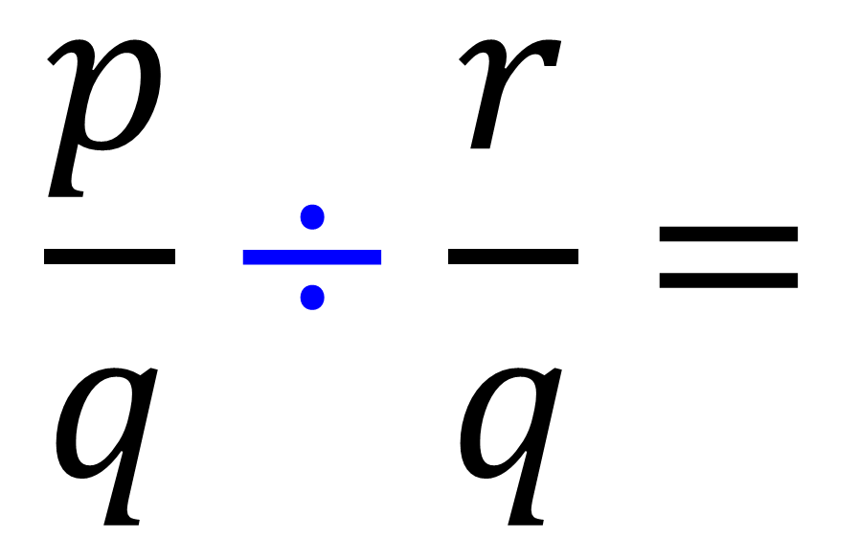
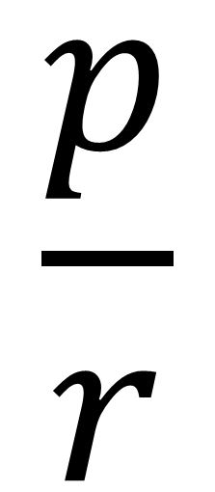
Algebraic Fractions - Dividing
$$\frac{p}{q}÷\frac{r}{q}=$$
$$\frac{p}{q}×\frac{q}{r}=$$
$$\frac{p}{r}$$

Slide 7
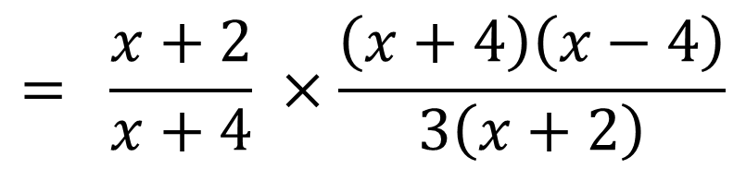
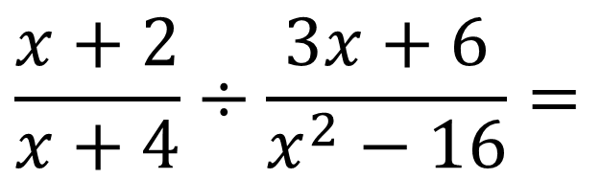
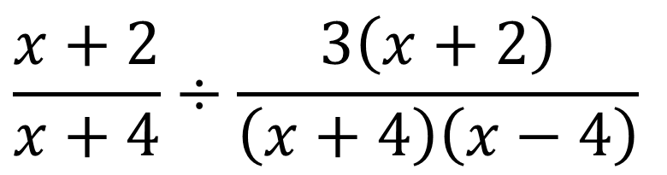
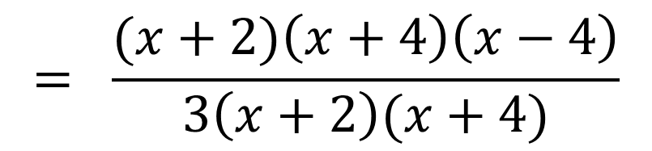
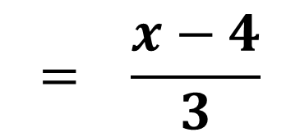
Write $\frac{x+2}{x+4}÷\frac{3x+6}{x^{2}−16}$ as a single fraction in its simplest form.
$$\frac{x+2}{x+4}÷\frac{3x+6}{x^{2}−16}=$$
$$\frac{x+2}{x+4}÷\frac{3\left(x+2\right)}{\left(x+4\right)\left(x−4\right)}$$
$$= \frac{x+2}{x+4} ×\frac{\left(x+4\right)\left(x−4\right)}{3\left(x+2\right)}$$
$$= \frac{(x+2)\left(x+4\right)\left(x−4\right)}{3\left(x+2\right)(x+4)}$$
$$= \frac{x−4}{3}$$

Slide 8
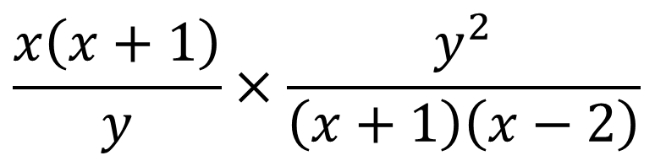
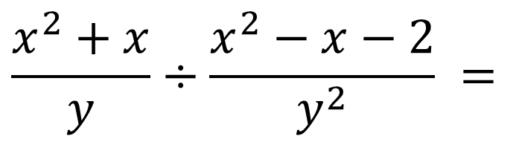
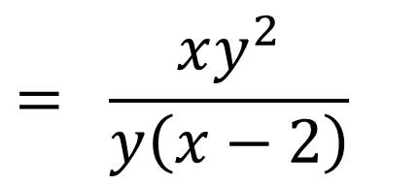
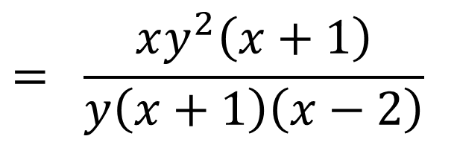
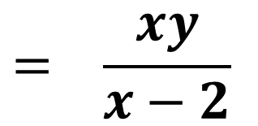
Write $\frac{x^{2}+x}{y}÷\frac{x^{2}−x−2}{y^{2}}$as a single fraction in its simplest form.
$$\frac{x^{2}+x}{y}÷\frac{x^{2}−x−2}{y^{2}} =$$
$$\frac{x\left(x+1\right)}{y}×\frac{y^{2}}{\left(x+1\right)\left(x−2\right)}$$
$$= \frac{xy^{2}\left(x+1\right)}{y\left(x+1\right)\left(x−2\right)}$$
$$= \frac{xy^{2}}{y\left(x−2\right)}$$
$$= \frac{xy}{x−2}$$

Slide 9
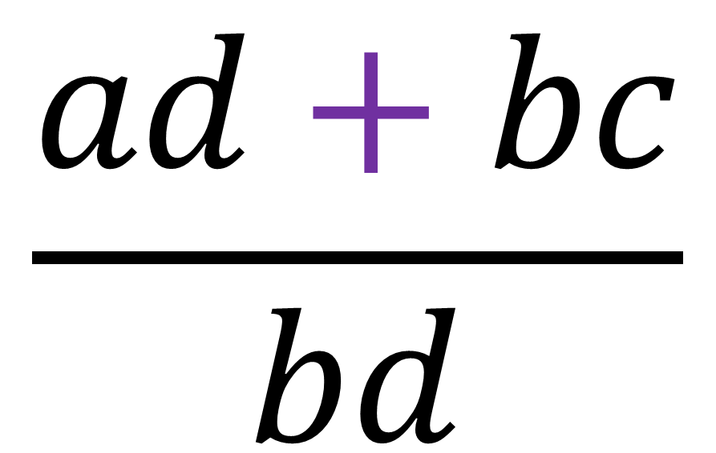
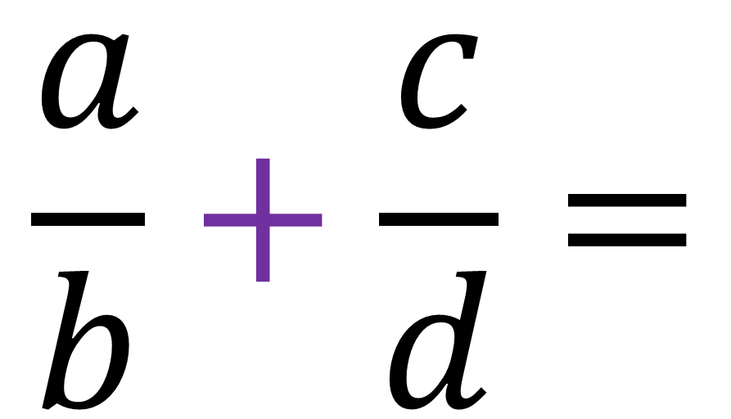
Algebraic Fractions – Adding
$$\frac{ad+bc}{bd}$$
$$\frac{a}{b}+\frac{c}{d}=$$

Slide 10

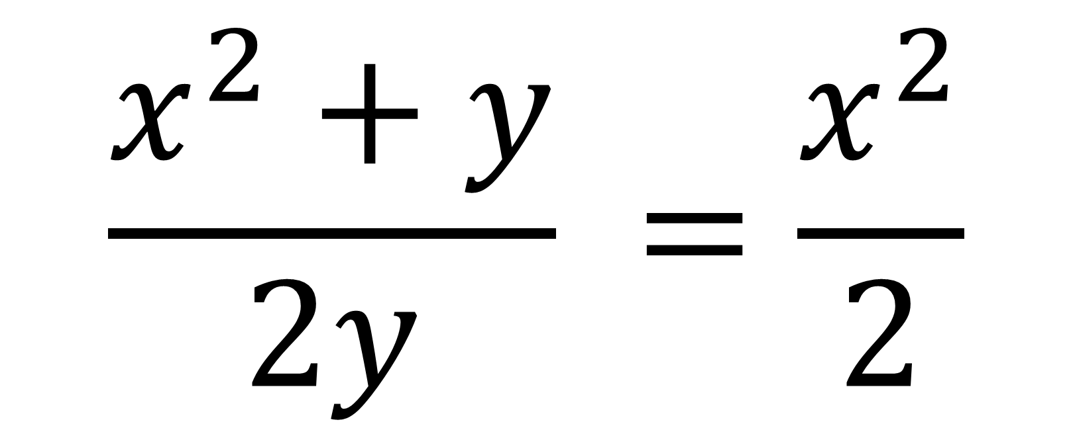
Common student mistakes
“Crime against Mathematics”
$$\frac{x^{2}+y}{2y} =\frac{x^{2}}{2}$$

Slide 11

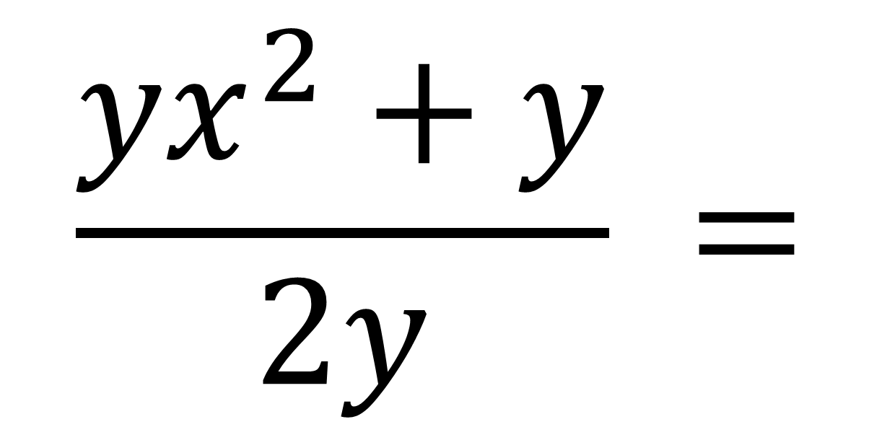
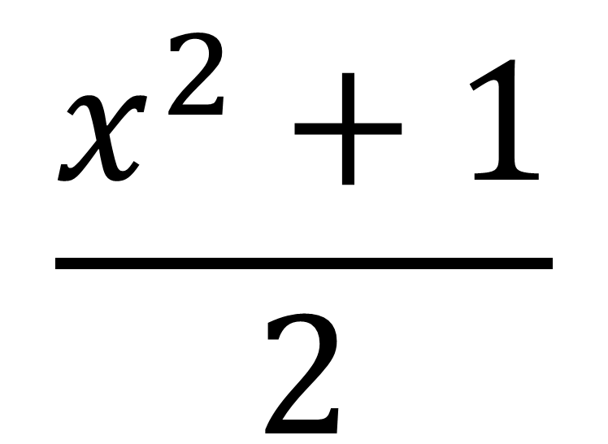
Get it right
“Know what you are doing”
$$\frac{{yx}^{2}+y}{2y} =$$
$$\frac{x^{2}+1}{2}$$

Slide 12
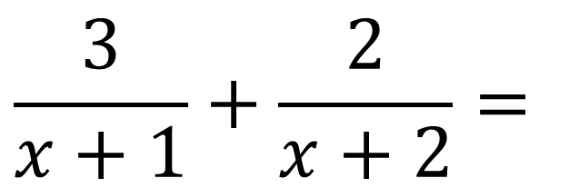
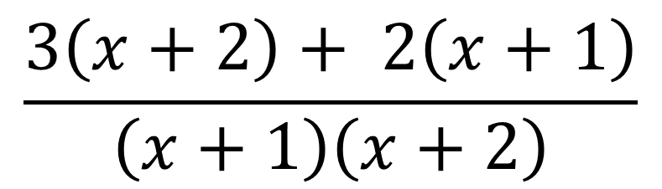
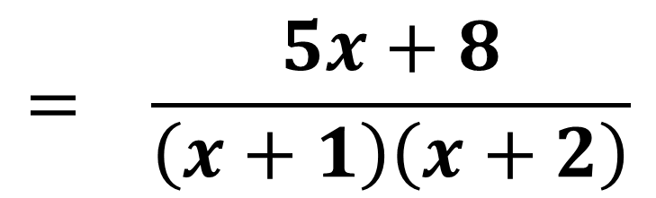
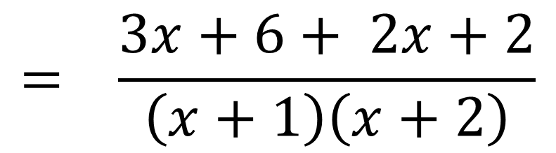
Write $\frac{3}{x+1}+\frac{2}{x+2}$ as a single fraction in its simplest form.
$$\frac{3}{x+1}+\frac{2}{x+2}=$$
$$\frac{3\left(x+2\right)+ 2\left(x+1\right)}{\left(x+1\right)\left(x+2\right)}$$
$$= \frac{3x+6+ 2x+2}{\left(x+1\right)\left(x+2\right)}$$
$$= \frac{5x+8}{\left(x+1\right)\left(x+2\right)}$$

Slide 13
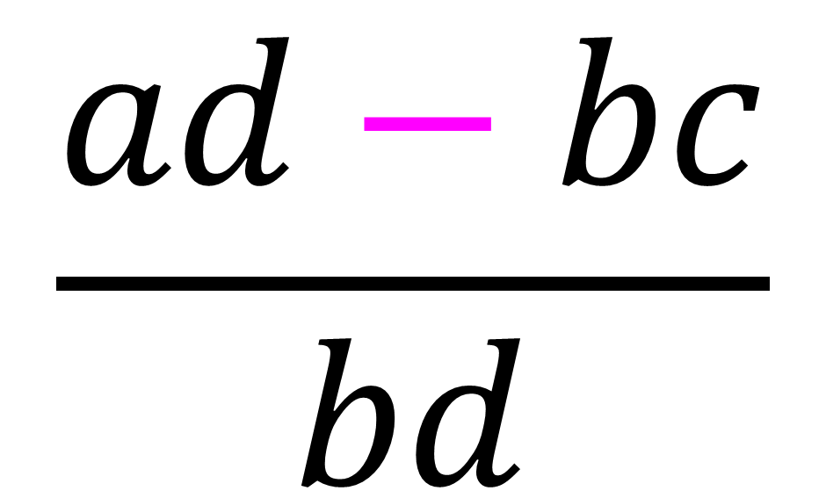
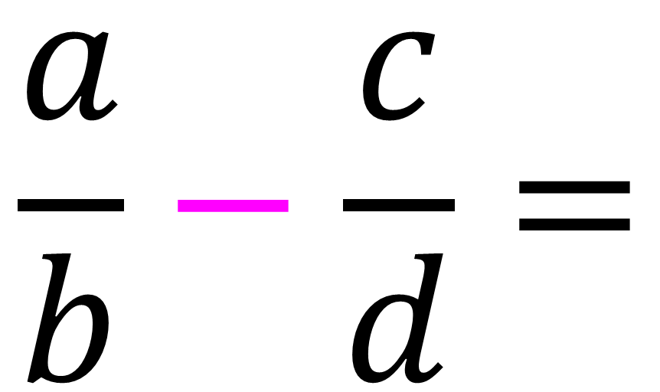
Algebraic Fractions - Subtract
$$\frac{ad−bc}{bd}$$
$$\frac{a}{b}−\frac{c}{d}=$$

Slide 14
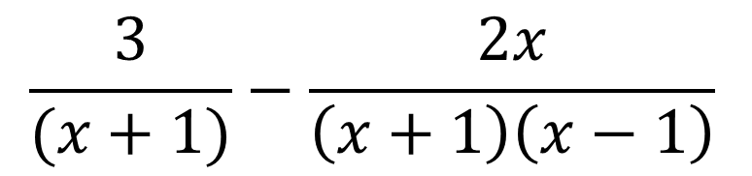
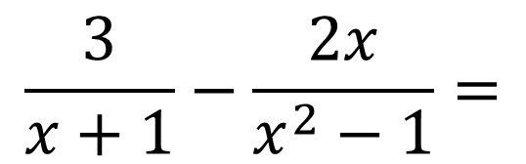
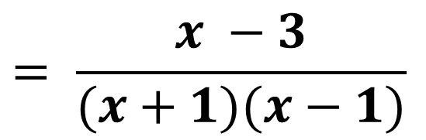
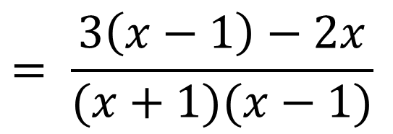
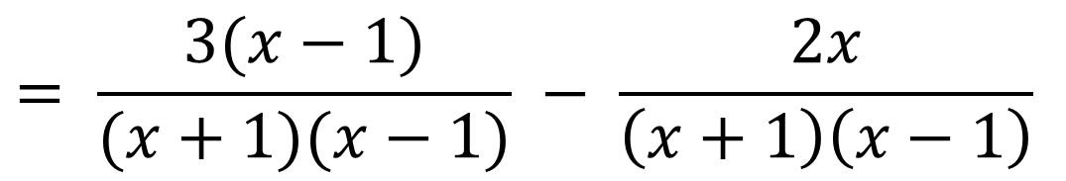
Write $\frac{3}{x+1}−\frac{2x}{x^{2}−1}$as a single fraction in its simplest form.
$$\frac{3}{x+1}−\frac{2x}{x^{2}−1}=$$
$$\frac{3}{(x+1)}−\frac{2x}{\left(x+1\right)\left(x−1\right)}$$
$$= \frac{3(x−1)}{(x+1)(x−1)} − \frac{2x}{\left(x+1\right)\left(x−1\right)}$$
$$= \frac{3\left(x−1\right)−2x}{(x+1)(x−1)}$$
$$= \frac{x −3}{(x+1)(x−1)}$$

Slide 15
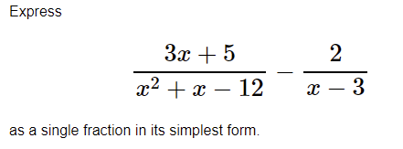
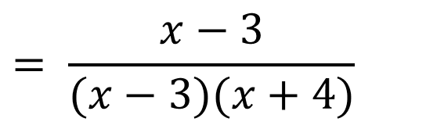
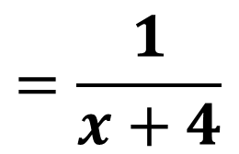
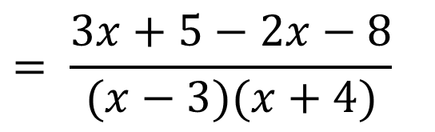
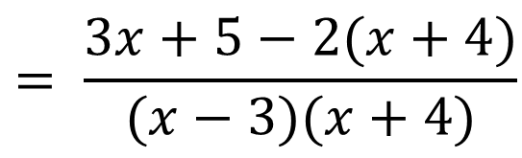
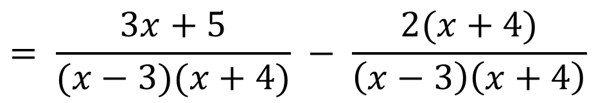
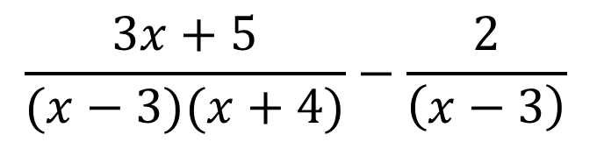
$$\frac{3x+5}{(x−3)(x+4)}−\frac{2}{\left(x−3\right)}$$
$$= \frac{3x+5−2x−8}{(x−3)(x+4)}$$
$$= \frac{3x+5}{(x−3)(x+4)} − \frac{2(x+4)}{\left(x−3\right)\left(x+4\right)}$$
$$= \frac{x−3}{(x−3)(x+4)}$$
$$= \frac{3x+5−2(x+4)}{(x−3)(x+4)}$$
$$=\frac{1}{x+4}$$

Slide 16
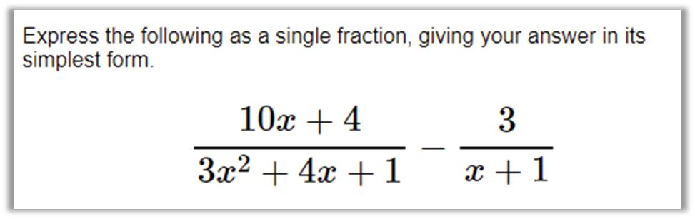
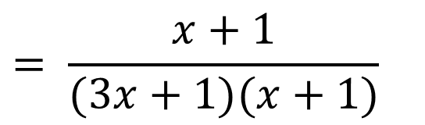
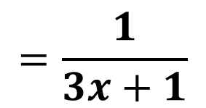




$$\frac{10x+4}{(3x+1)(x+1)}−\frac{3}{\left(x+1\right)}$$
$$= \frac{10x+4−9x−3}{(3x+1)(x+1)}$$
$$= \frac{10x+4}{(3x+1)(x+1)} − \frac{3(3x+1)}{\left(x+1\right)\left(3x+1\right)}$$
$$= \frac{x+1}{(3x+1)(x+1)}$$
$$= \frac{10x+4−3(3x+1)}{(3x+1)(x+1)}$$
$$=\frac{1}{3x+1}$$

