Slide 1
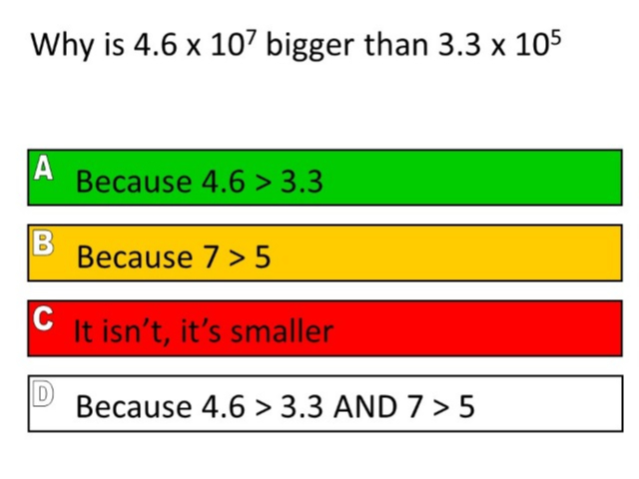
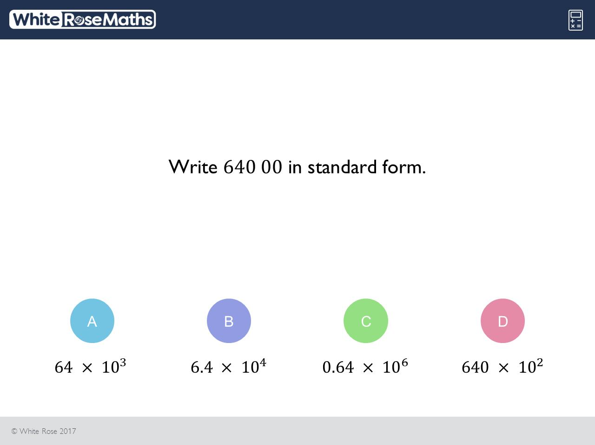
Worst answered question?
Most common wrong answer?

Slide 2
ANSWERS

Slide 3
Worst answered question?

Slide 4
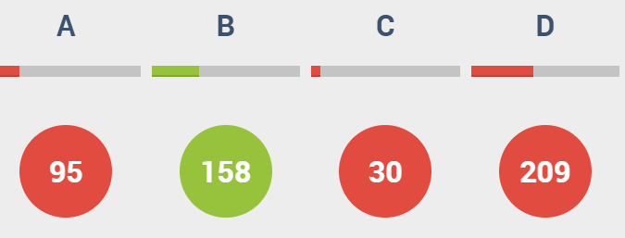
D
They have compared the coefficient when they did not need to.

Slide 5
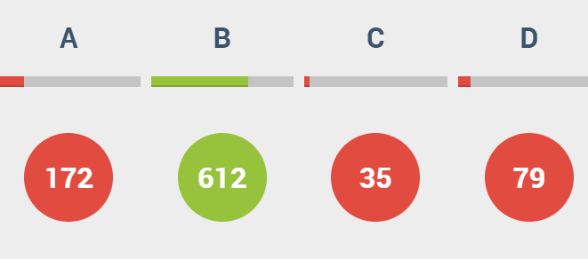
A
The coefficient is not less than 10.

