Slide 1
LO: 3D Shapes
and Properties

Slide 2
Which is the odd-one out?

Slide 3
Which is the odd-one out?

Slide 4
Which is the odd-one out?

Slide 5
Which is the odd-one out?

Slide 6

How would you describe a
3D Shape?
A shape that has
3 dimensions!

Slide 7
What is my name?
Cube

Slide 8
What is my name?
Cuboid

Slide 9
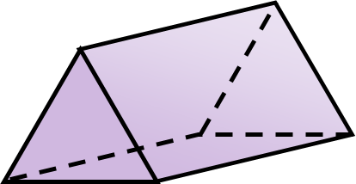
What is my name?
Triangular Prism

Slide 10
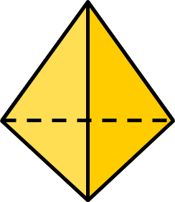
What is my name?
Tetrahedron

Slide 11
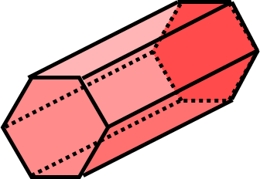
What is my name?
Hexagonal Prism

Slide 12

What is my name?
Cylinder

Slide 13

What is my name?
Sphere

Slide 14
How would you describe a face
of a 3D Shape?
A face is a 2D shape that makes up one surface of a 3D shape.

Slide 15
How would you describe an edge
of a 3D Shape?
An edge is where two faces meet.

Slide 16
How would you describe an vertex
of a 3D Shape?
A vertex is a point where
three or more edges meet.

Slide 17
How many faces?
4
How many edges?
6
How many vertices?
4

