Slide 1
Forces and Motions
Connected Particles
(Vertically)
Chapter 10
(Part 4 of 9)

Slide 2

Connected Particles – Vertically Up
Driving Force
3kg
Tension
3g
Tension
5kg
5g

Slide 3
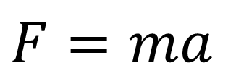
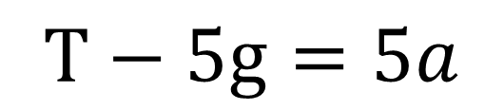
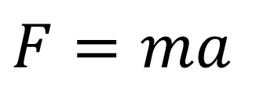
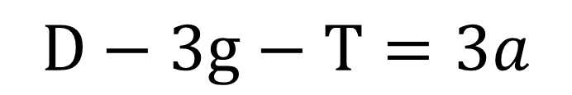
D
D
$F=ma$
3kg
3kg
$$D−3g−T=3a$$
T
3g
T
3g
T
T
5kg
$F=ma$
5kg
$$T−5g=5a$$
5g
5g

Slide 4
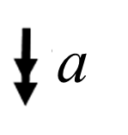
Connected Particles – Vertically Down
3kg
Tension
3g
Tension
5kg
5g

Slide 5
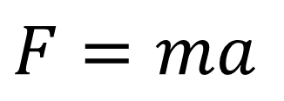
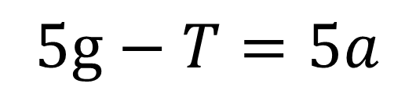
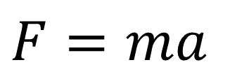

$F=ma$
3kg
3kg
$$3g+T=3a$$
T
3g
3g
T
T
5kg
T
$F=ma$
5kg
$$5g−T=5a$$
5g
5g

Slide 6
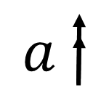
Vertically connected particles often
involve lifts and scale pans.
A
A
B
B
A lift will have a mass.
A scale-pan is light, and its mass is zero.

Slide 7
Question A
A lift weighs 100kg.
The lift is carrying two people weighing 50kg and 60kg
respectively and is moving upwards.
The acceleration of the lift is 0.5 ms⁻².
Find the tension in the cable.

Slide 8

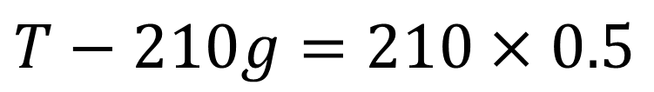
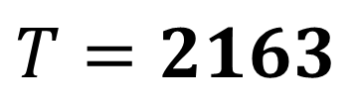
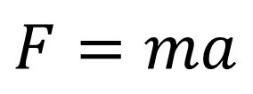
A lift weighs 100kg. The lift is carrying two people weighing 50kg and 60kg respectively and is moving upwards.
The acceleration of the lift is 0.5 ms⁻². Find the tension in the cable.
T
T
$$F=ma$$
210kg
$$T−210g=210×0.5$$
50kg
60kg
$T=2163$
210g
50g
60g
100g

Slide 9
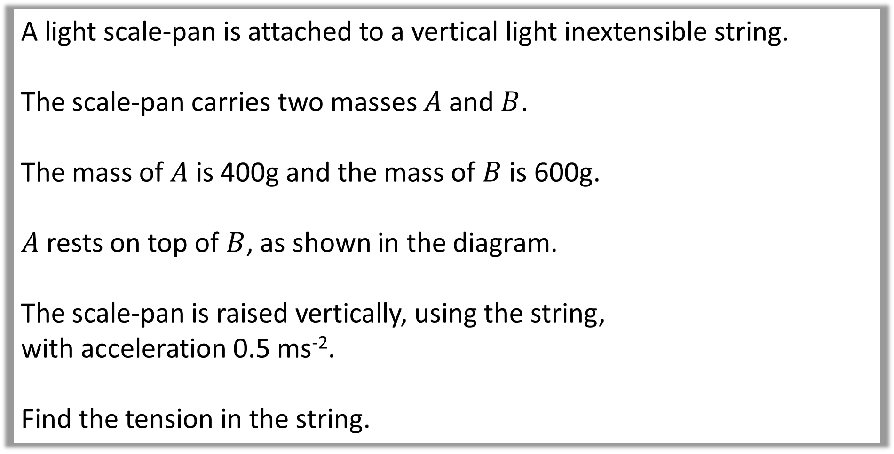
Question B
A light scale-pan is attached to a vertical light inextensible string.
The scale-pan carries two masses $A$ and $B$.
The mass of $A$ is 400g and the mass of $B$ is 600g.
$A$ rests on top of $B$, as shown in the diagram.
The scale-pan is raised vertically, using the string,
with acceleration 0.5 ms⁻².
Find the tension in the string.

Slide 10
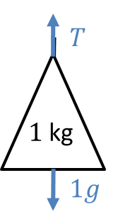
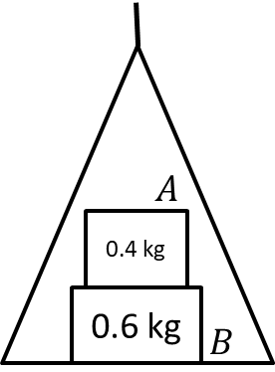
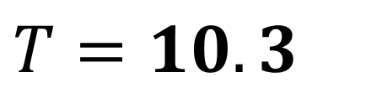
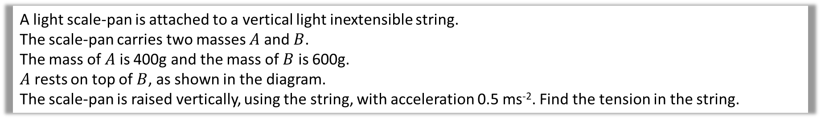
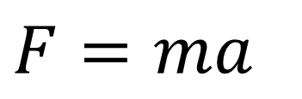
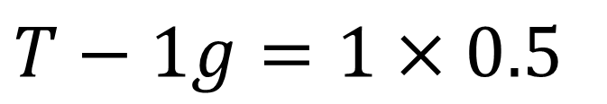
A light scale-pan is attached to a vertical light inextensible string.
The scale-pan carries two masses $A$ and $B$.
The mass of $A$ is 400g and the mass of $B$ is 600g.
$A$ rests on top of $B$, as shown in the diagram.
The scale-pan is raised vertically, using the string, with acceleration 0.5 ms⁻². Find the tension in the string.
$$F=ma$$
$$T−1g=1×0.5$$
$T=10.3$

