Slide 1

Diagnostic Assessment ..Delta 1
Unit 3
Simplifying Expressions
Writing Expressions
Formulae
Expanding Brackets
Factorising

Slide 2
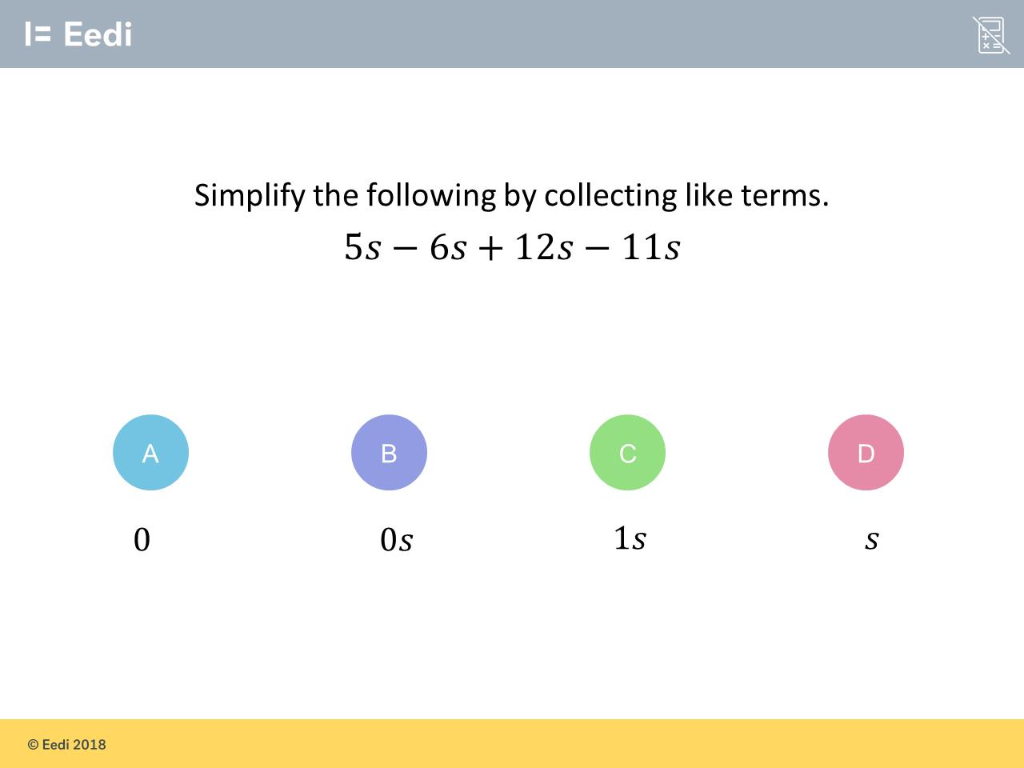
Question 1 – Simplifying Expressions

Slide 3
Answer 1 – Simplifying Expressions
CORRECT ANSWER | CORRECT EXPLANATION
0 | We have 5 - 6 + 12 - 11 = 0.
COMMON MISTAKES | WHAT MIGHT BE YOUR MISTAKE
0s | The student has given the correct answer, but the wrong convention. We can just leave this as 0.
1s | The student may have calculated the coefficient correctly, but has not understood the significance of 0.
s | The student may have calculated the coefficient correctly, but has not understood the significance of 0.

Slide 4
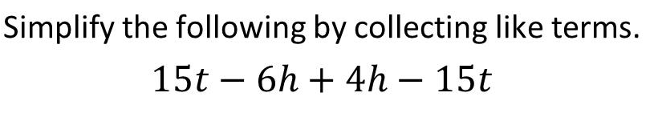
Question 2 – Simplifying Expressions

Slide 5
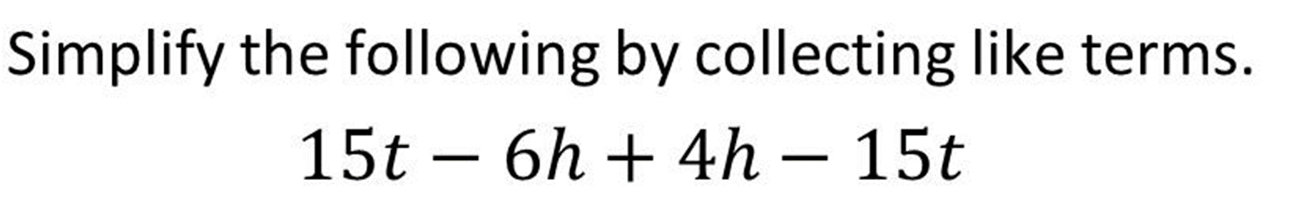
Answer 2 – Simplifying Expressions
CORRECT ANSWER | CORRECT EXPLANATION
-2h | We have 12 + 8 = 20 people who bought just food and 4 + 6 = 10 people who just bought drinks. Adding them together gives 30.
COMMON MISTAKES | WHAT MIGHT BE YOUR MISTAKE
1t – 2h | The student may have calculated the coefficient of t correctly, but has not understood the significance of 0.
0 – 2h | The student has calculated the answer correctly, but has left 0 in the answer. This is not the convention.
0t – 2h | The student has calculated the answer correctly, but has left 0 in the answer. This is not the convention.

Slide 6
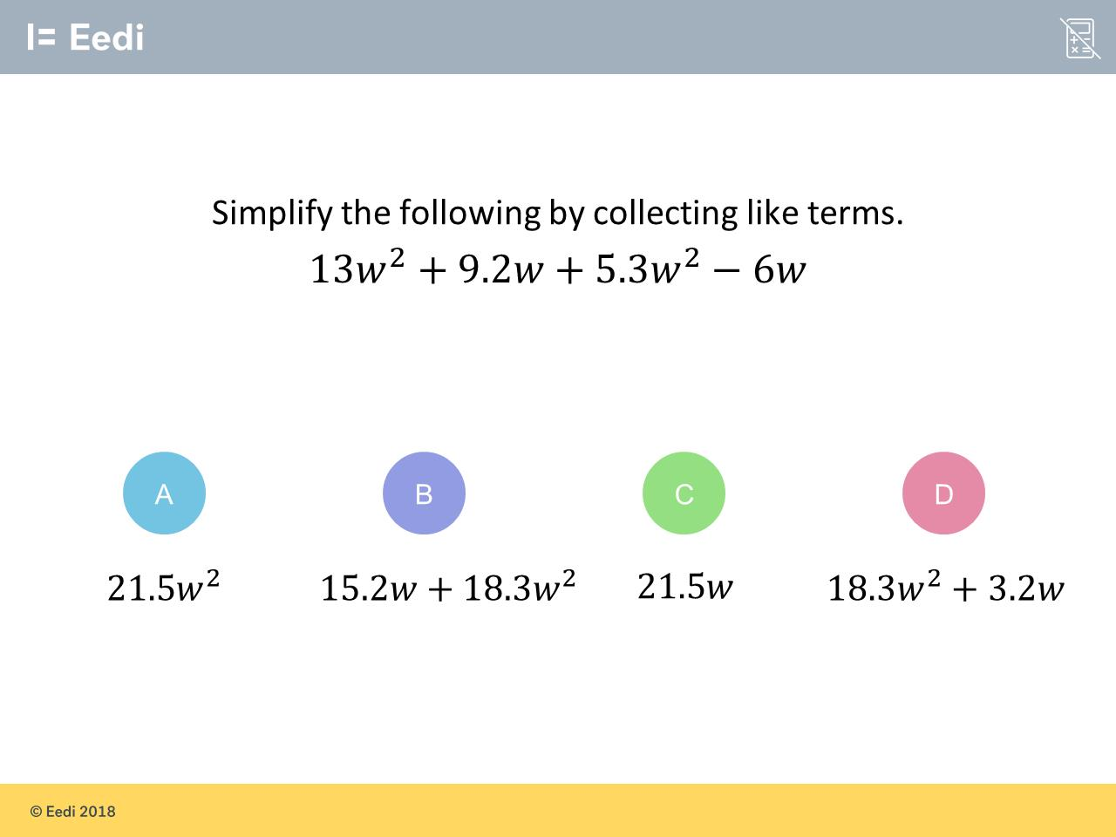
Question 3 – Simplifying Expressions

Slide 7
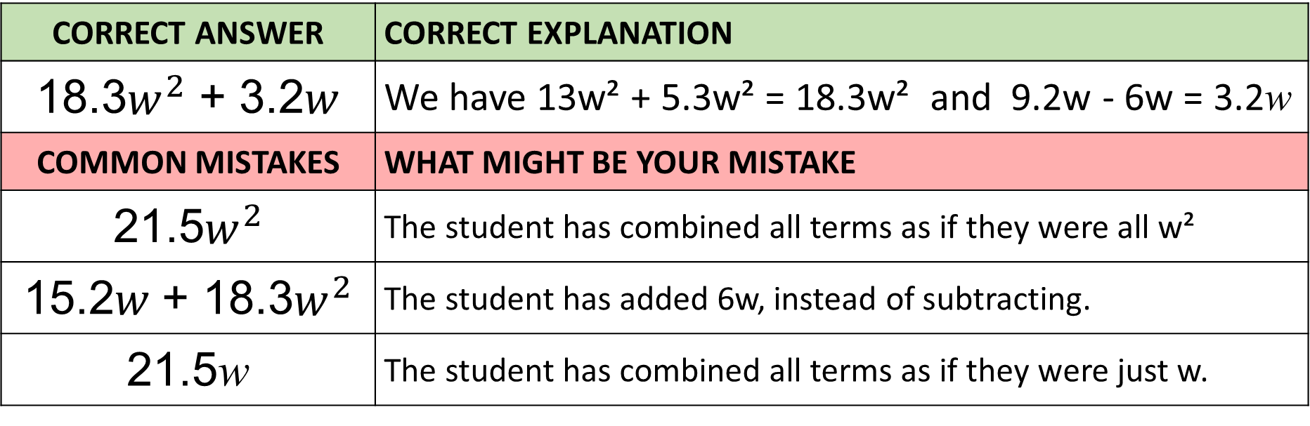
Answer 3 – Simplifying Expressions
CORRECT ANSWER | CORRECT EXPLANATION
18.3$w^{2}$ + 3.2$w$ | We have 13w² + 5.3w² = 18.3w² and 9.2w - 6w = 3.2w
COMMON MISTAKES | WHAT MIGHT BE YOUR MISTAKE
21.5$w^{2}$ | The student has combined all terms as if they were all w²
15.2𝑤 + 18.3$w^{2}$ | The student has added 6w, instead of subtracting.
21.5w | The student has combined all terms as if they were just w.

Slide 8
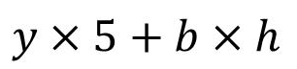
Question 4 – Writing Expression
Rewrite the expression using correct algebraic notation.

Slide 9
Answer 4 – Writing Expression
Rewrite the expression using correct algebraic notation.
CORRECT ANSWER | CORRECT EXPLANATION
5y + bh | We have numbers in front of letters i.e. 5y, and we can remove the multiplication symbols.
COMMON MISTAKES | WHAT MIGHT BE YOUR MISTAKE
y5 + bh | The student has not switched around 5 and y.
y + 5bh | The student has moved the 5 to the wrong operation.
5bhy | The student has removed all symbols, rather than just the multiplication symbols.

Slide 10
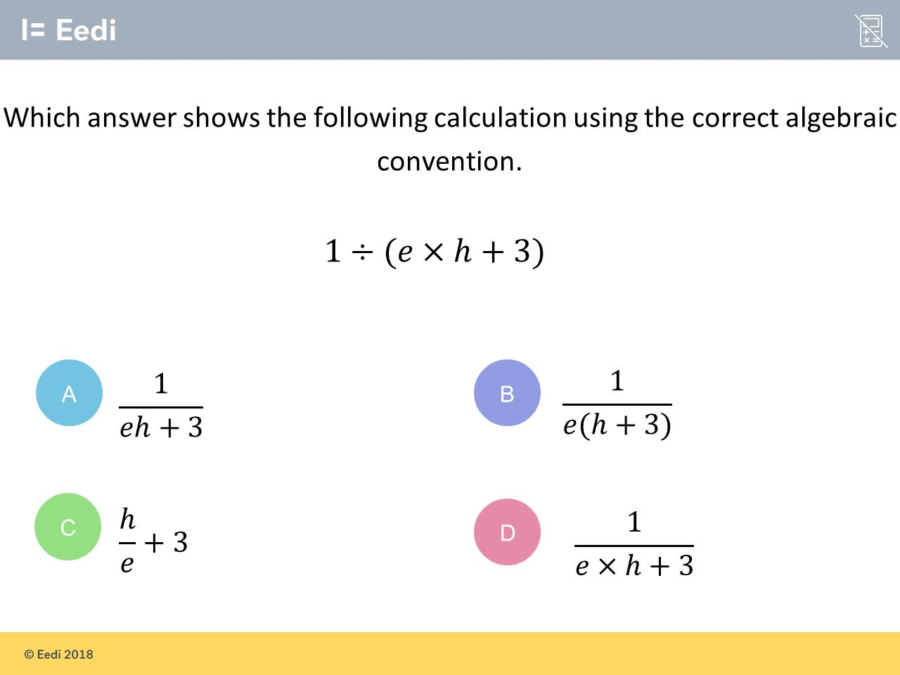
Question 5 – Writing Expression
Rewrite the expression using correct algebraic notation.

Slide 11
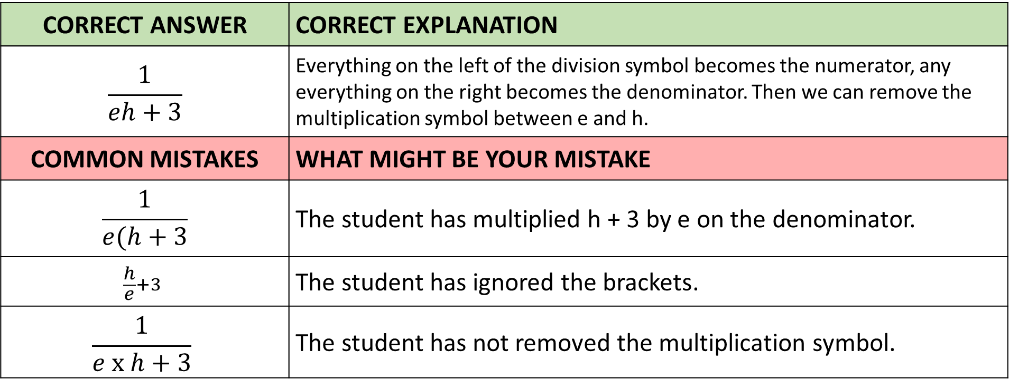
Answer 5 – Writing Expressions
Rewrite the expression using correct algebraic notation.
CORRECT ANSWER | CORRECT EXPLANATION
$$\frac{1}{eh+3}$$ | Everything on the left of the division symbol becomes the numerator, any everything on the right becomes the denominator. Then we can remove the multiplication symbol between e and h.
COMMON MISTAKES | WHAT MIGHT BE YOUR MISTAKE
$$\frac{1}{e(h+3}$$ | The student has multiplied h + 3 by e on the denominator.
$$\frac{h}{e}+3$$ | The student has ignored the brackets.
$$\frac{1}{e x h+3}$$ | The student has not removed the multiplication symbol.

Slide 12
Question 6 – Writing Expression
Write an algebraic expressions for
the following statement:
“Subtract five from h and then multiply by six”

Slide 13
Answer 6 – Writing Expressions
Write an algebraic expressions for
the following statement:
“Subtract five from h and then multiply by six”
CORRECT ANSWER | CORRECT EXPLANATION
6(h – 5) | We subtract 5 from h first, to get h - 5, and then multiply the entire thing by 6
COMMON MISTAKES | WHAT MIGHT BE YOUR MISTAKE
6(5 – h) | 'subtract five from h' means h - 5, not 5 - h. Be careful about which way round you write subtractions
(5 – h) x 6 | 'Subtract five from h' means h - 5, rather than 5 - h. Also, the conventions for multiplying by 6 are that we should have the 6 at the front.
(h – 5) x 6 | Your answer is actually correct but the way we indicate multiplication in algebraic expressions means that the 6 goes at the front and we do not need the multiplication sign.

Slide 14
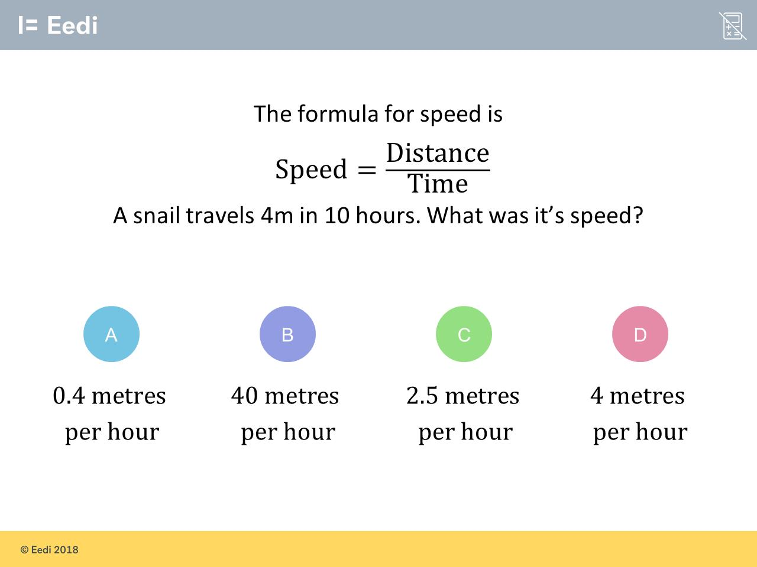
Question 7 – Substitution into Formulae

Slide 15
Answer 7 – Substitution into Formulae
CORRECT ANSWER | CORRECT EXPLANATION
0.4 | 4 ÷ 10 = 0.4 metres per hour.
COMMON MISTAKES | WHAT MIGHT BE YOUR MISTAKE
40 | The student has made a place value error.
2.5 | The student has divided the wrong way.
4 | The student has made a place value error.

Slide 16
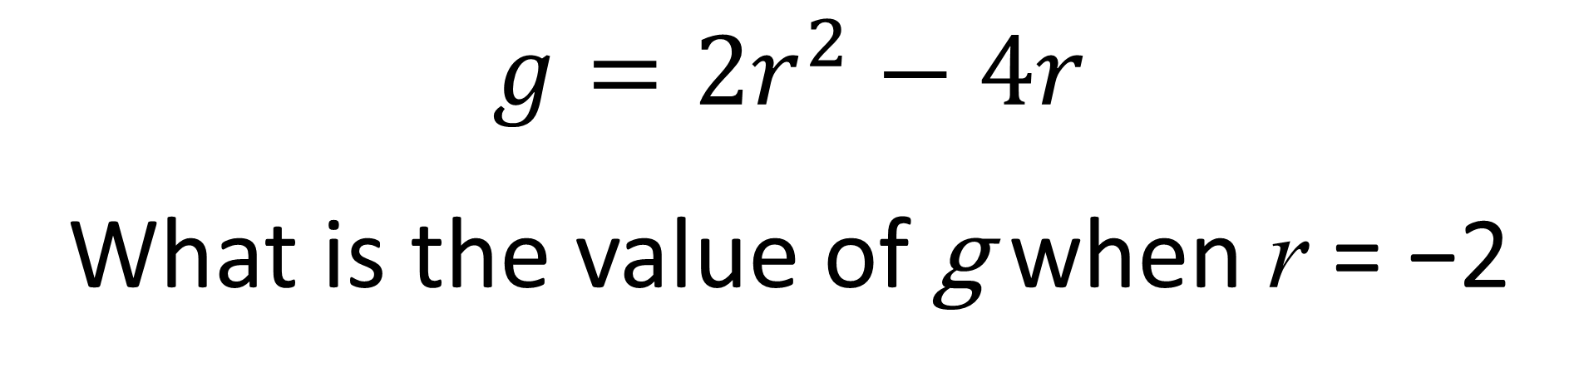
Question 8 – Substitution into Formulae
$$g=2r^{2}−4r$$
What is the value of g when r = −2

Slide 17
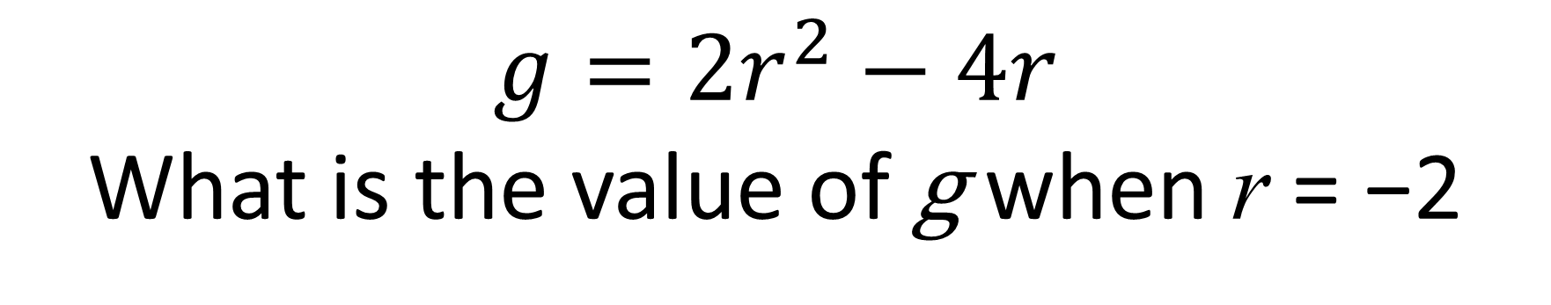
Answer 8 – Substitution into Formulae
$$g=2r^{2}−4r$$
What is the value of g when r = −2
CORRECT ANSWER | CORRECT EXPLANATION
16 | We have 2 × (-2)² - 4×( -2) = 2 × 4 + 8 = 16.
COMMON MISTAKES | WHAT MIGHT BE YOUR MISTAKE
-34 | The student has calculated the first term correctly, then subtracted 42.
-16 | The student may not know that two negatives make a positive.
0 | The student has subtracted 8, rather than adding.

Slide 18
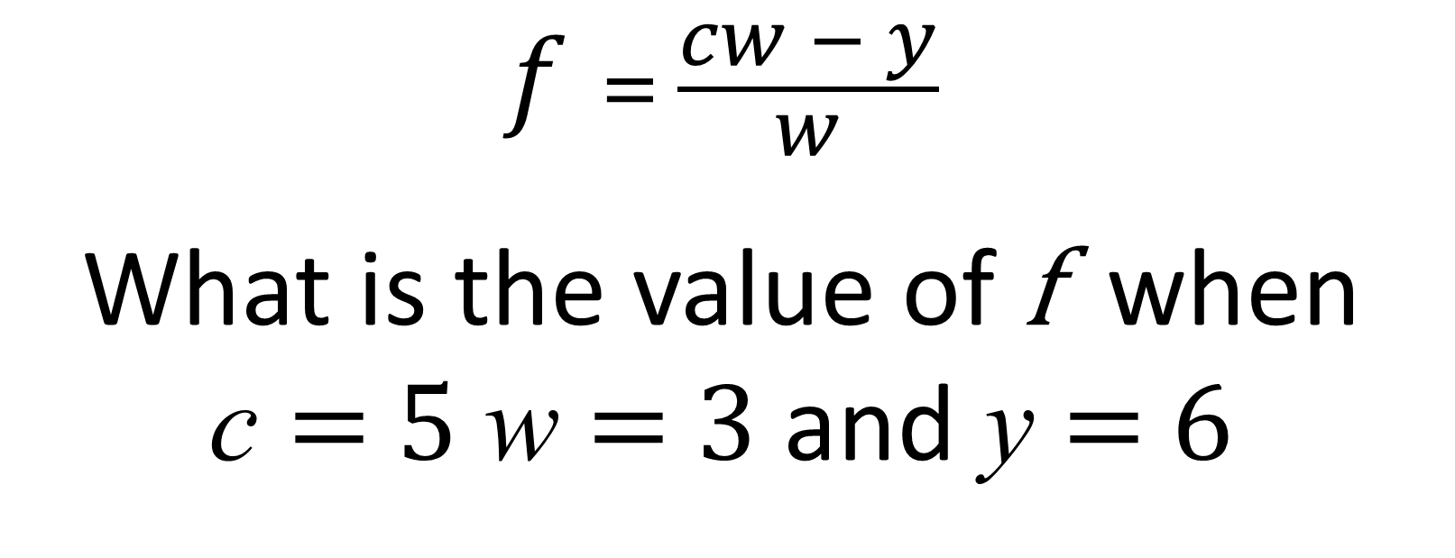
Question 9 – Substitution into Formulae
$$f= \frac{cw − y}{w}$$
What is the value of f when
c = 5 w = 3 and y = 6

Slide 19

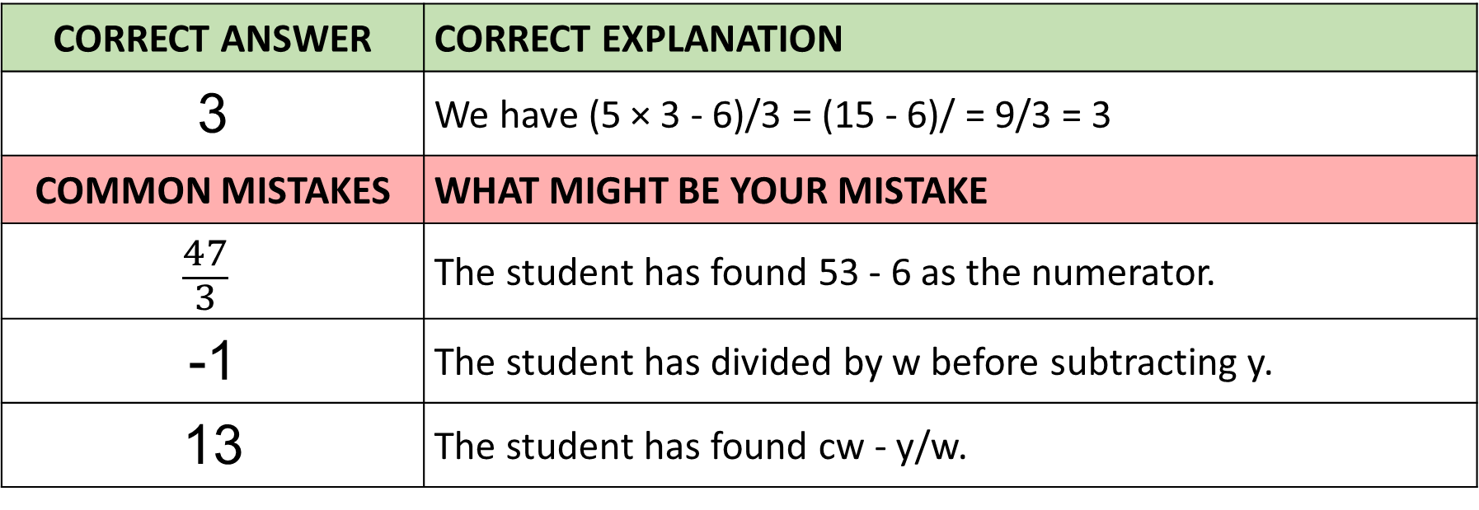
Answer 9 – Substitution into Formulae
$$f= \frac{cw − y}{w}$$
What is the value of f when
c = 5 w = 3 and y = 6
CORRECT ANSWER | CORRECT EXPLANATION
3 | We have (5 × 3 - 6)/3 = (15 - 6)/ = 9/3 = 3
COMMON MISTAKES | WHAT MIGHT BE YOUR MISTAKE
$$\frac{47}{3}$$ | The student has found 53 - 6 as the numerator.
-1 | The student has divided by w before subtracting y.
13 | The student has found cw - y/w.

Slide 20
Question 10 – Expanding Brackets
Expand:
4c(5d – 3)

Slide 21
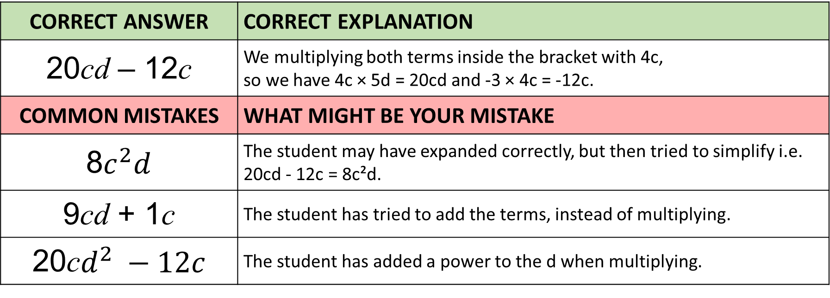
Answer 10 – Expanding Brackets
Expand:
4c(5d – 3)
CORRECT ANSWER | CORRECT EXPLANATION
20cd – 12c | We multiplying both terms inside the bracket with 4c, so we have 4c × 5d = 20cd and -3 × 4c = -12c.
COMMON MISTAKES | WHAT MIGHT BE YOUR MISTAKE
8$c^{2}d$ | The student may have expanded correctly, but then tried to simplify i.e. 20cd - 12c = 8c²d.
9cd + 1c | The student has tried to add the terms, instead of multiplying.
20c$d^{2} −12c$ | The student has added a power to the d when multiplying.

Slide 22
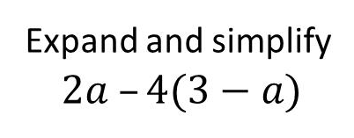
Question 11 – Expanding and Simplifying

Slide 23
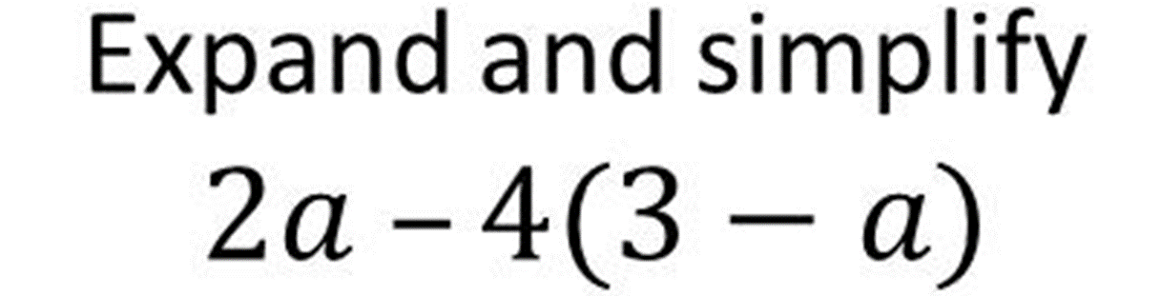
Answer 11 – Expanding and Simplifying
CORRECT ANSWER | CORRECT EXPLANATION
6a – 12 | We have 2a - 4(3-a) = 2a -12 +4a = 6a - 12.
COMMON MISTAKES | WHAT MIGHT BE YOUR MISTAKE
–2a – 12 | The student has not recognised that the a term is a double negative.
–6a | The student may believe that 3 - a = 2a.
a – 12 | The student has not multiplied -a by 4.

Slide 24
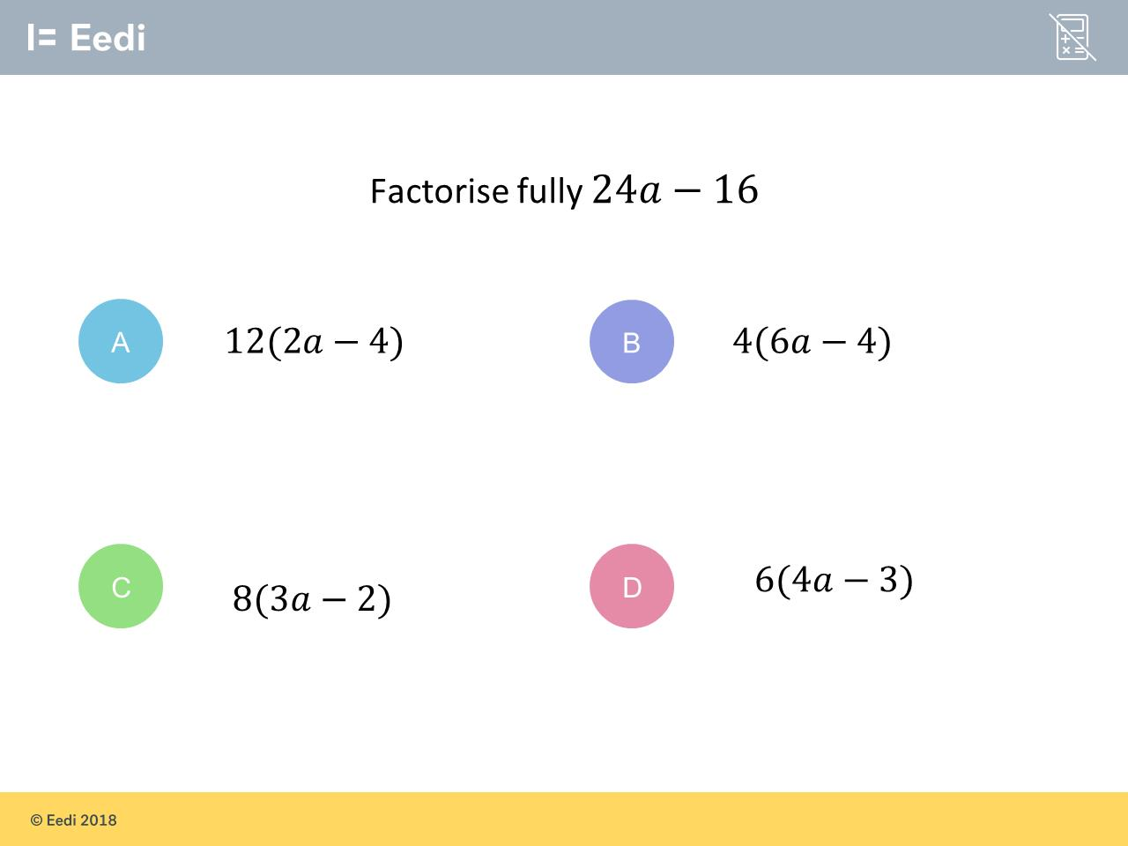
Question 12 – Factorising

Slide 25
Answer 12 – Factorising
CORRECT ANSWER | CORRECT EXPLANATION
8(3a – 2) | The HCF of 24 and 16 is 8, so we can take out a factor of 8. This gives 8(3a – 2).
COMMON MISTAKES | WHAT MIGHT BE YOUR MISTAKE
12(2a – 4) | The student may have tried to remove the biggest factor, but has not recognised that 12 × -4 does not equal -16.
4(6a – 4) | The student has not factorised fully. They can still take out a factor of 2.
6(4a – 3) | The student has not recognised that 6 is not a factor of 16.

Slide 26
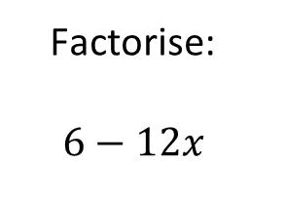
Question 13 – Factorising

Slide 27
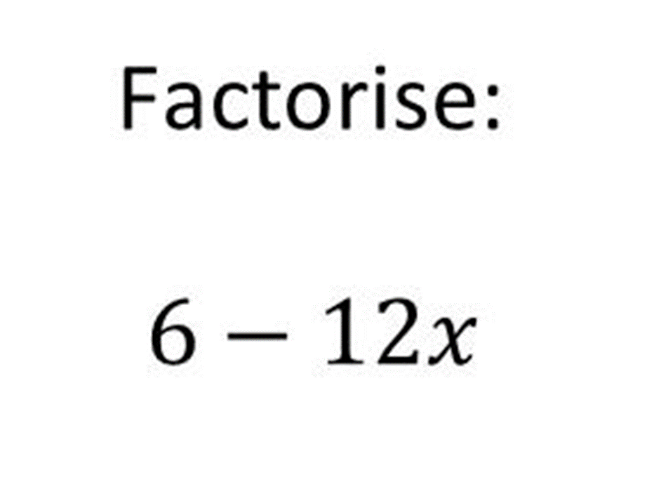
Answer 13 – Factorising
CORRECT ANSWER | CORRECT EXPLANATION
6(1 – 2x) | The HCF of 6 and 12x is 6, so we take this out as a factor to get 6(1- 2x).
COMMON MISTAKES | WHAT MIGHT BE YOUR MISTAKE
6(1 – 12x) | The student has not divided 12 by 6.
12(6 – x) | The student has not divided 6 by 12.
3(2 – 3x) | The student has factorised, but not fully.

