Slide 1
Integration
Area Under Curve and Line
Chapter 13
(Part 3 of 3)

Slide 2

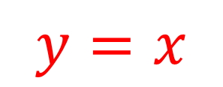

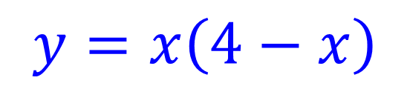

Find the area between the line and the curve?
$$y=x\left(4−x\right)$$
$$y$$
$$y=x$$
$$R$$
$$x$$

Slide 3


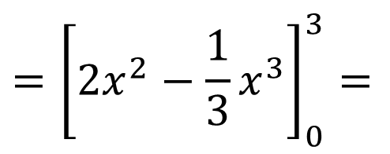
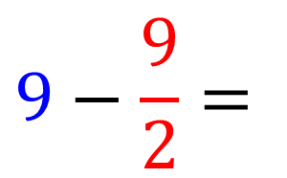

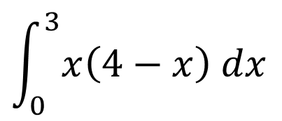


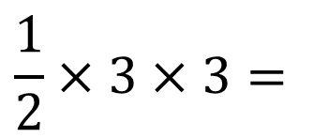





Find the area between the line and the curve?
Area under curve
$$y=x\left(4−x\right)$$
$$y=x$$
$$y$$
$$\int_{0}^{3}{x\left(4−x\right) dx}$$
$$={\left[2x^{2}−\frac{1}{3}x^{3}\right]}_{0}^{3}=$$
$$9$$
$$R$$
Area of triangle
$$\frac{1}{2}×3×3=$$
$$\frac{9}{2}$$
$$0$$
$$x$$
$$3$$
$$9−\frac{9}{2}=$$
$$\frac{9}{2}$$
Shaded area

Slide 4
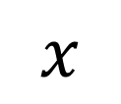
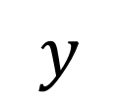
Areas between curves and lines
$$y$$
The generally way of
tackling these questions
is to calculate the area
under the curve and
subtract the area of
a common shape.
$$x$$

Slide 5
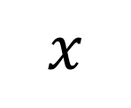
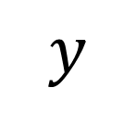
Area of the Curve
$$y$$
Area of Common Shape
$$x$$

Slide 6

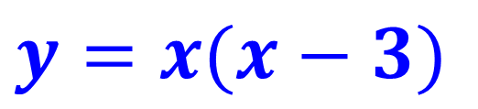
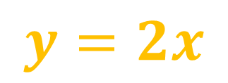



Find the area of the shaded section of the graph.
$$y=2x$$
$$y=x(x−3)$$
$$C$$
$$O$$
$$A$$
$$B$$

Slide 7
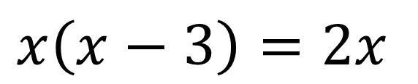

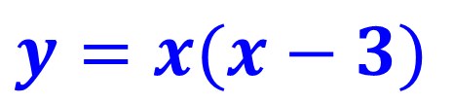
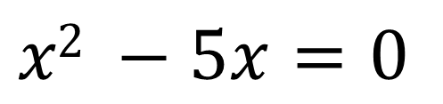


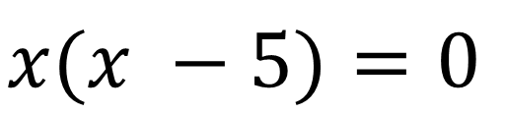

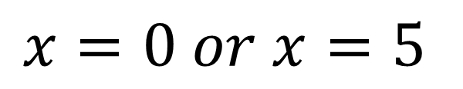

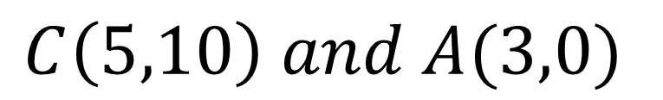
Find the area of the shaded section of the graph.
Points of intersection
$$y=x(x−3)$$
$$x\left(x−3\right)=2x$$
$$C$$
$$y=2x$$
$$x2 −5x=0$$
$$x(x −5)=0$$
$$x=0 or x=5$$
$$O$$
$$A$$
$$B$$
$$C\left(5,10\right) and A(3,0)$$

Slide 8
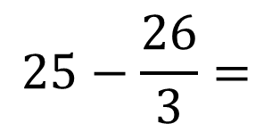
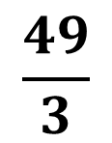





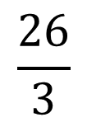

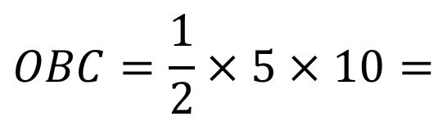

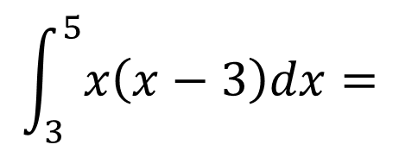
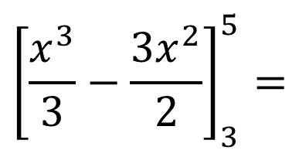
Find the area of the shaded section of the graph.
Area under the curve
$$y=x(x−3)$$
$$\int_{3}^{5}{x\left(x−3\right)dx}=$$
$${\left[\frac{x^{3}}{3}−\frac{{3x}^{2}}{2}\right]}_{3}^{5}=$$
$$\frac{26}{3}$$
$$C$$
$$y=2x$$
Area of triangle
$$OBC=\frac{1}{2}×5×10=$$
$$25$$
$$O$$
$$A$$
$$B$$
$$25−\frac{26}{3}=$$
$$\frac{49}{3}$$
Shaded area

Slide 9
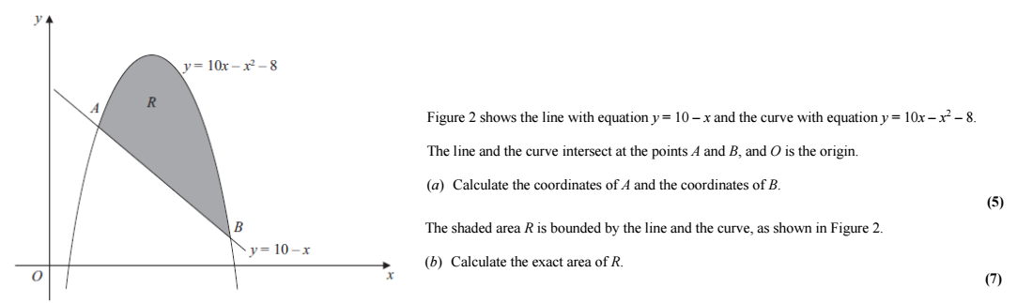




a)
Points of intersection
$$10−x=10x−x2−8$$
$$0=x2−11x+18$$
$$x=2 or x=9$$
$$A\left(2,8\right) and B(9,1)$$

Slide 10
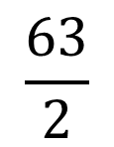
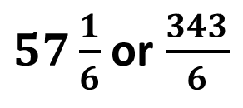
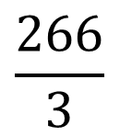
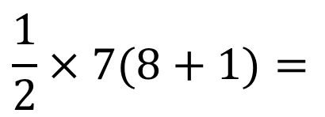
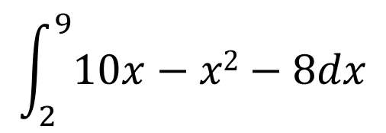
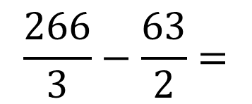
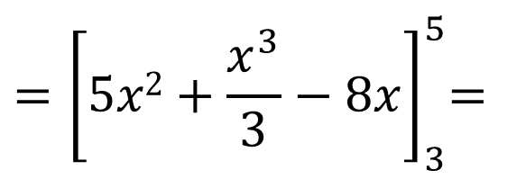
b)
Area under the curve
Area of trapezium
$$\int_{2}^{9}{10x−x2−8dx}$$
$$\frac{1}{2}×7(8+1)=$$
$$\frac{63}{2}$$
$${=\left[5x2+\frac{x^{3}}{3}−8x\right]}_{3}^{5}=$$
$$\frac{266}{3}$$
$$\frac{266}{3}−\frac{63}{2}=$$
Shaded area
$57\frac{1}{6}$ or $\frac{343}{6}$

