Slide 1
LO: Algebraic Fractions
(Adding and Subtracting)

Slide 2

What is the golden rule of adding
and subtracting fractions?
$$Make sure you have a$$
$$common denomiator$$

Slide 3
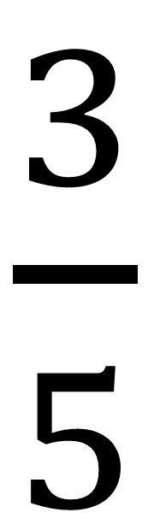
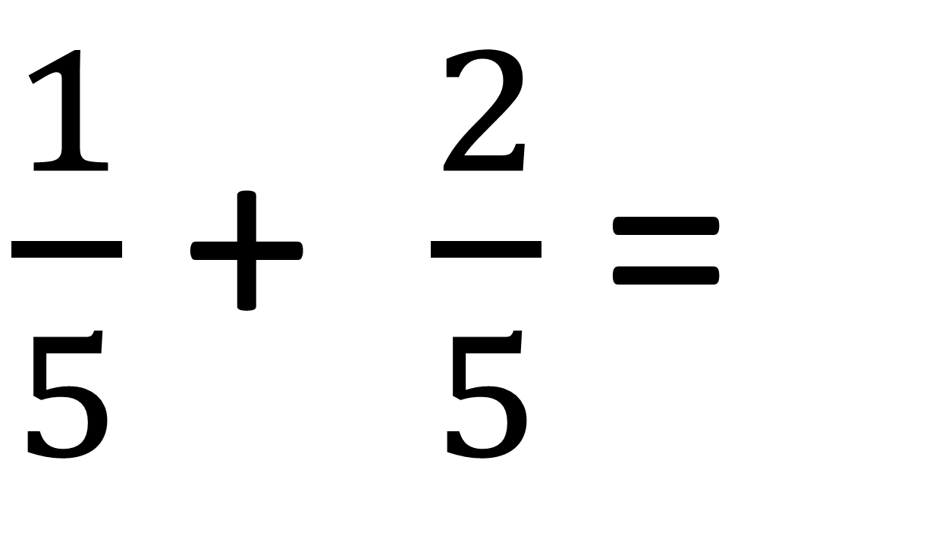
$\frac{1}{5}$ + $\frac{2}{5}$ =
$\frac{3}{5}$

Slide 4
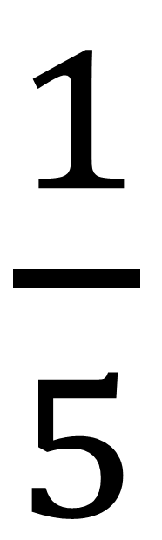
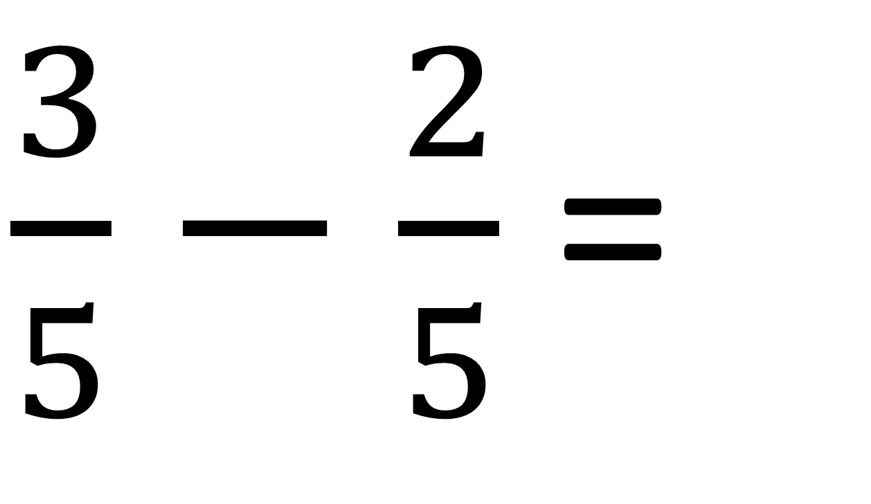
$\frac{3}{5}$ $−$ $\frac{2}{5}$ =
$\frac{1}{5}$

Slide 5
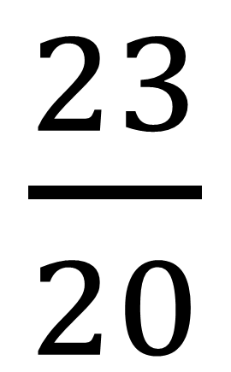
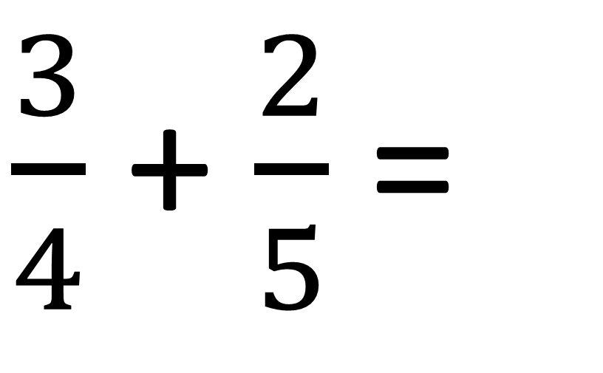
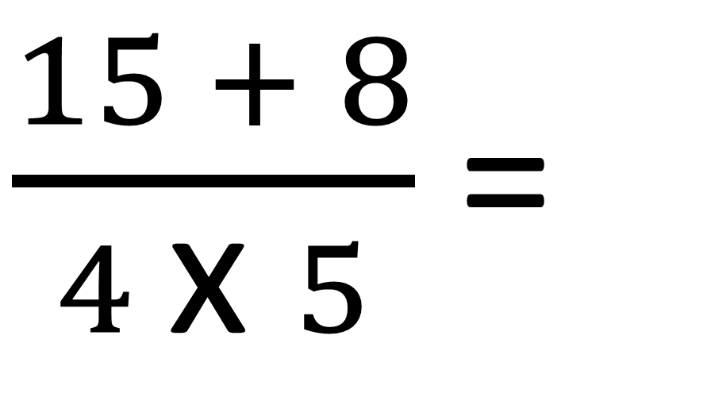
$\frac{3}{4}$ + $\frac{2}{5}$ =
$\frac{15 + 8}{4 \text{x} 5}$ =
$\frac{23}{20}$

Slide 6
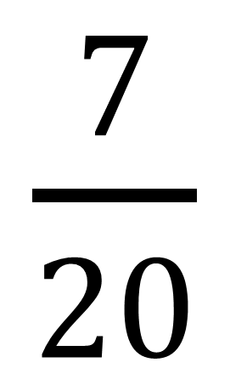
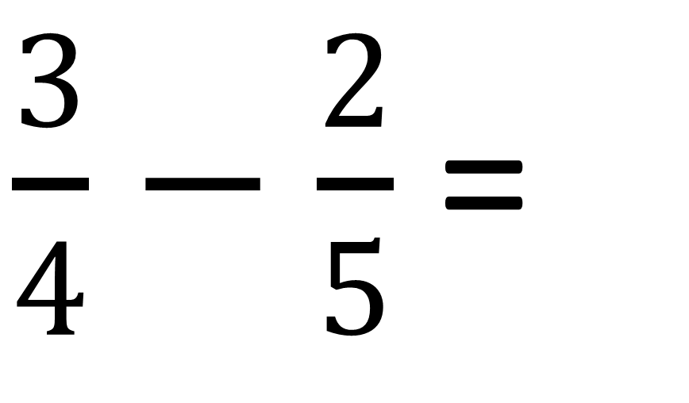
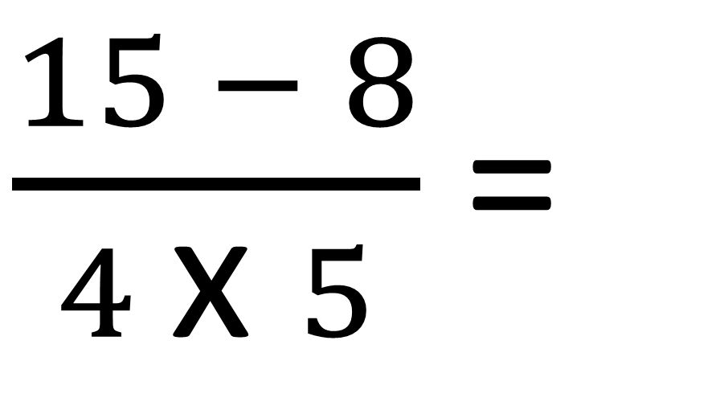
$\frac{3}{4}$ $−$ $\frac{2}{5}$ =
$\frac{15 − 8}{4 \text{x} 5}$ =
$\frac{7}{20}$

Slide 7




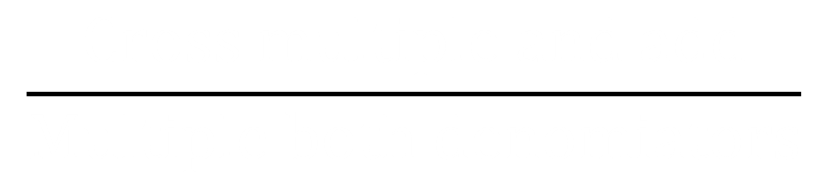

How would you teach someone
to add numerical fractions?
$$\frac{1}{2}$$
$$\frac{1}{3}$$
$$Cross multiple and add$$
$$+$$
=
$$\frac{Cross multiple and add}{Multiple both denomiators}$$
$$Multiple both denomiators$$

Slide 8
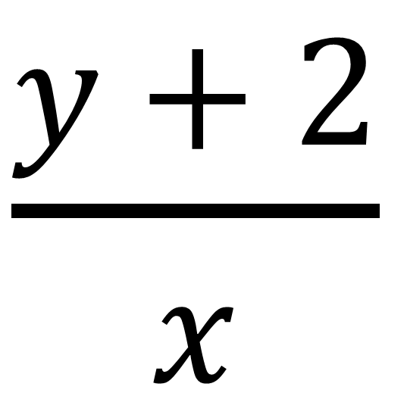
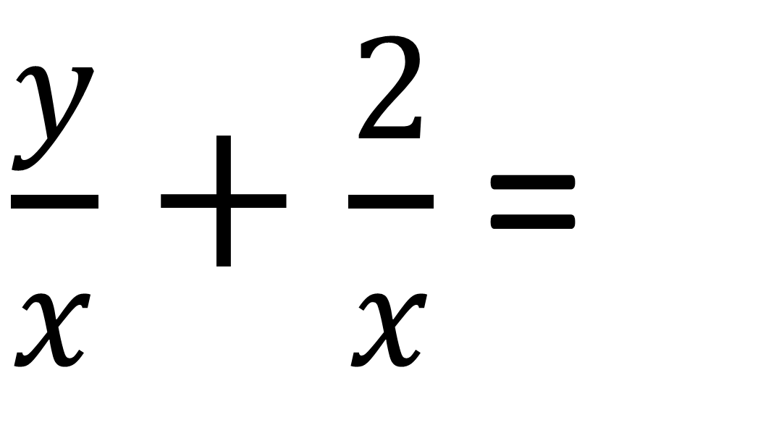
$\frac{y}{x}$ $+$ $\frac{2}{x}$ =
$\frac{y + 2}{x}$

Slide 9
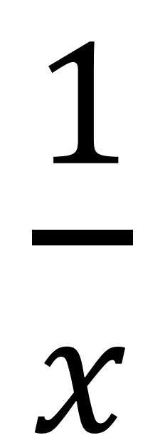
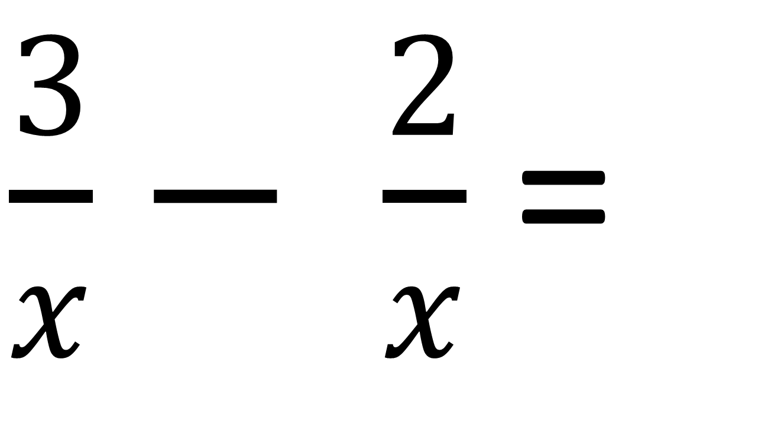
$\frac{3}{x}$ $−$ $\frac{2}{x}$ =
$\frac{1}{x}$

Slide 10
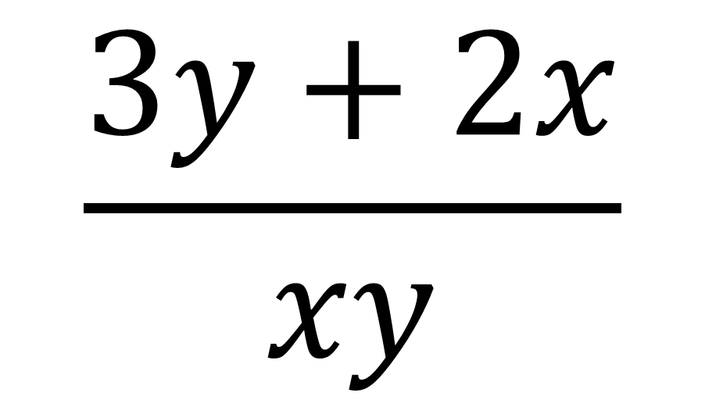
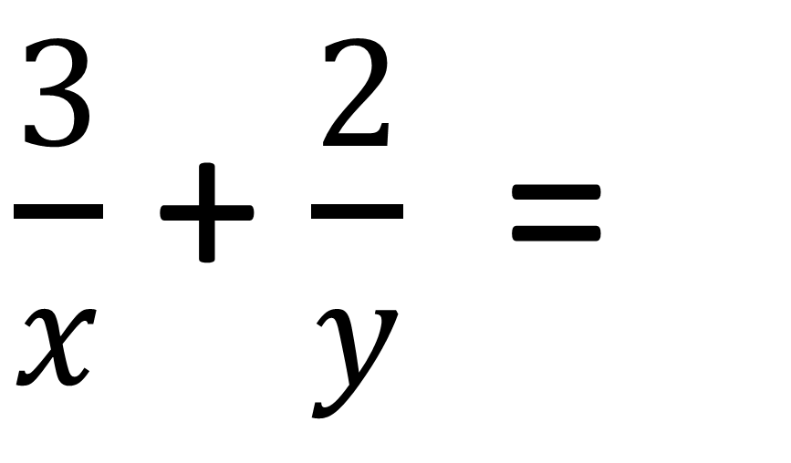
$\frac{3}{x}$ + $\frac{2}{y}$ =
$$\frac{3y+2x}{xy}$$

Slide 11
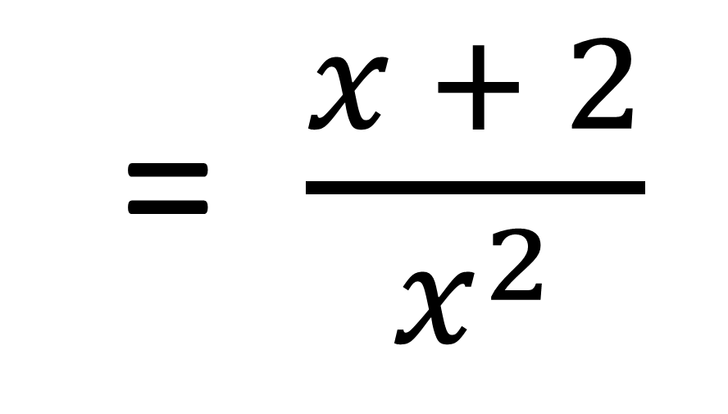
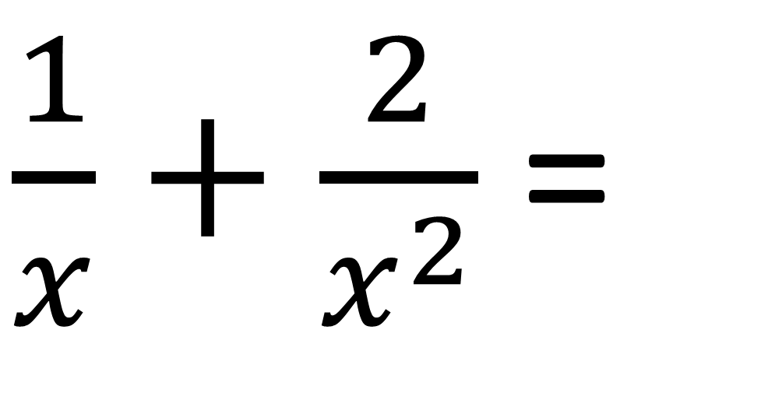
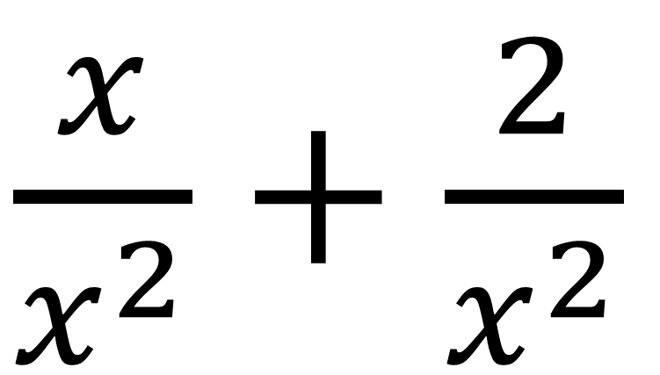
$\frac{1}{x}$ $+$ $\frac{2}{x^{2}}$ =
$\frac{x}{x^{2}}$ $+$ $\frac{2}{x^{2}}$
= $\frac{x + 2}{x^{2}}$

Slide 12
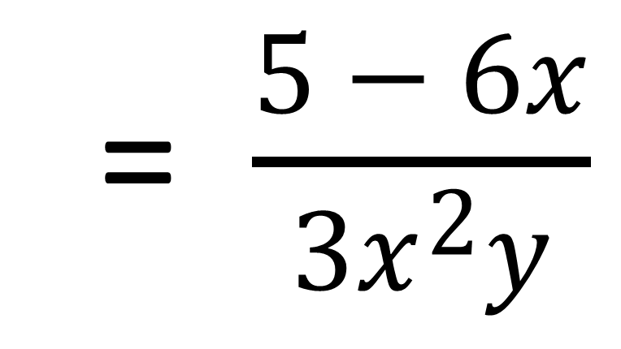
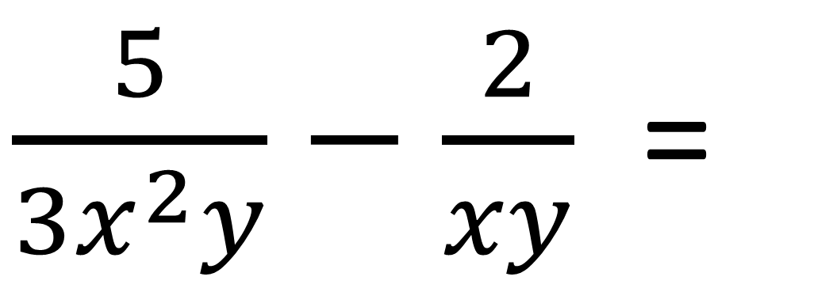
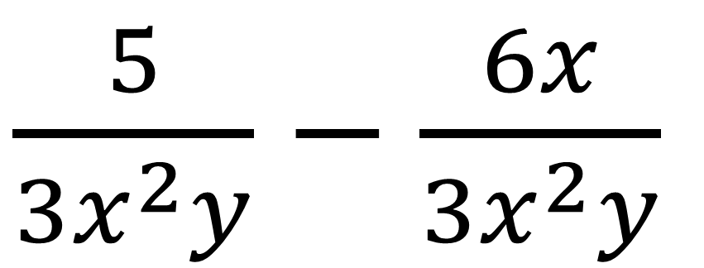
$\frac{5}{3x^{2}y}$ $−$ $\frac{2}{xy}$ =
$\frac{5}{{3x}^{2}y}$ $−$ $\frac{6x}{{3x}^{2}y}$
= $\frac{5 − 6x}{{3x}^{2}y}$

Slide 13
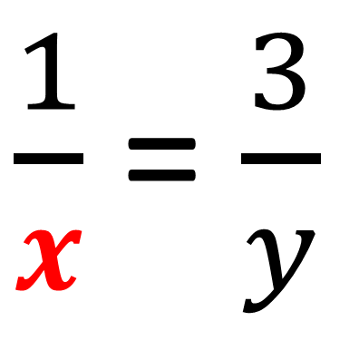
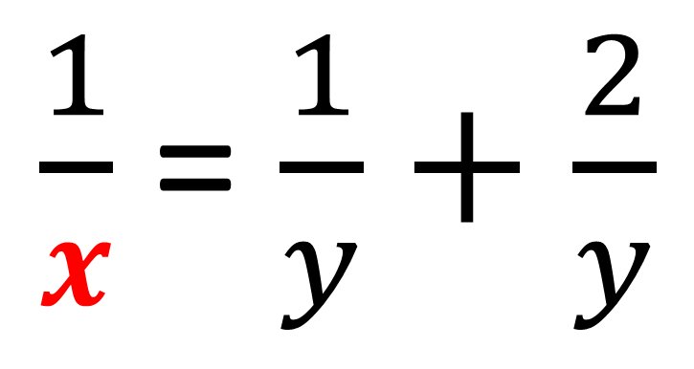
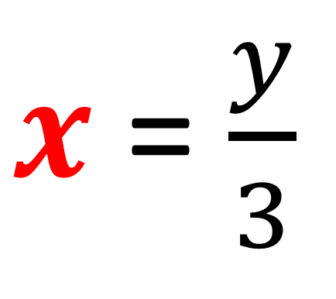
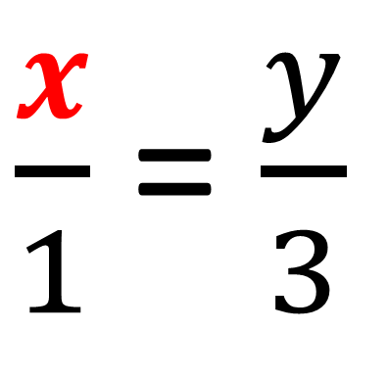
Make x the subject of the formula.
$\frac{1}{x}$ = $\frac{1}{y}+\frac{2}{y}$
$\frac{x}{1}$ = $\frac{y}{3}$
$\frac{1}{x}$ = $\frac{3}{y}$
$x$ = $\frac{y}{3}$

