Slide 1
Measure of Location and Spread
Quartiles and Percentiles
Chapter 2
(Part 2 of 4)

Slide 2


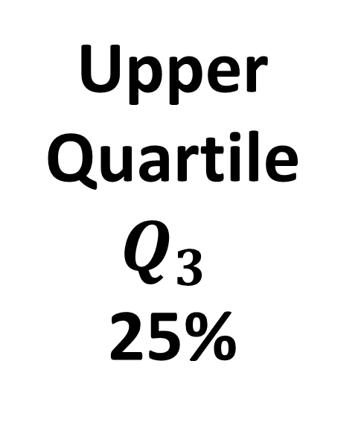
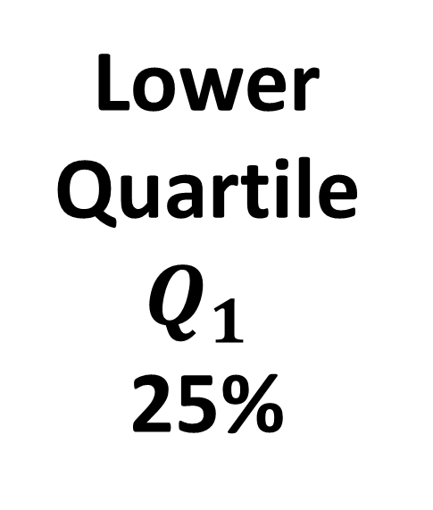
Quartiles
Interquartile Range
Min
$$Q_{1}$$
$$Q_{3}$$
Max
Bottom 25% of data
Middle 50% of data
Top 25% of data
Lower
Quartile
$$Q_{1}$$
25%
Upper
Quartile
$$Q_{3}$$
25%

Slide 3
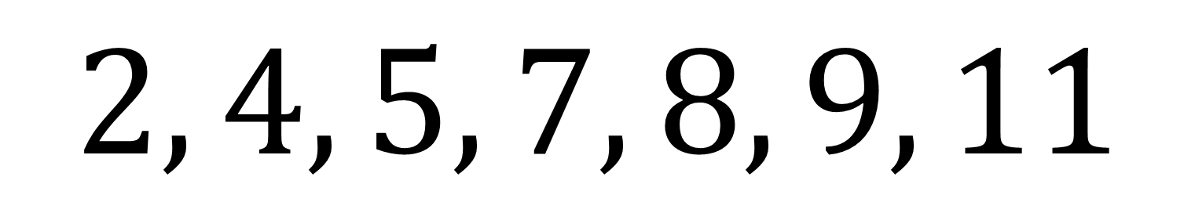
Quartiles – Listed Data
$$2, 4, 5, 7, 8, 9, 11$$
Q₁= 4
Q₃= 9
Median = 7

Slide 4
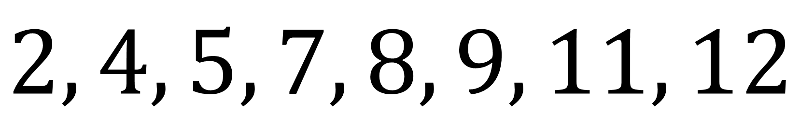
Quartiles – Listed Data
$$2, 4, 5, 7, 8, 9, 11, 12$$
Q₁= 4.5
Q₃= 10
Median = 8

Slide 5
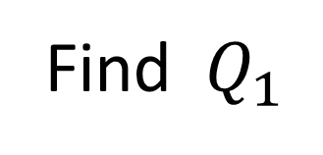
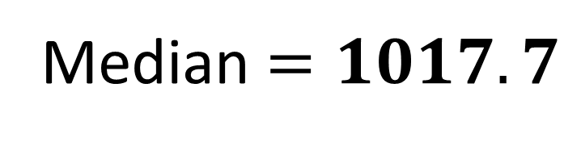
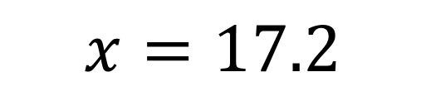
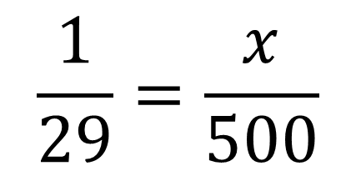
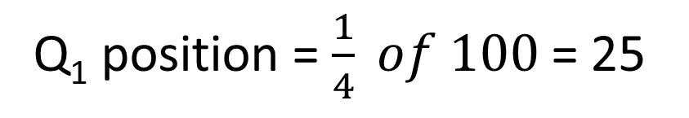
Quartiles – Tables
Age of relic (years) | Frequency
0-1000 | 24
1001-1500 | 29
1501-1700 | 12
1701-2000 | 35
 | 100
C.F.
24
53
65
100
Q₁ position = $\frac{1}{4} of 100$ = 25
Find${ Q}_{1}$
$$\frac{1}{29}=\frac{x}{500}$$
Median
500
1000.5
1500.5
x
$$x=17.2$$
24
53
1
Median $=1017.7$
25th item
29
Notes:
There’s a slip to print out here.

Slide 6
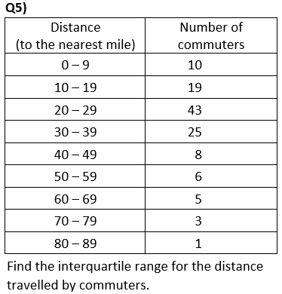
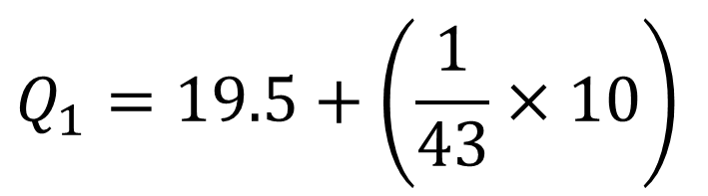

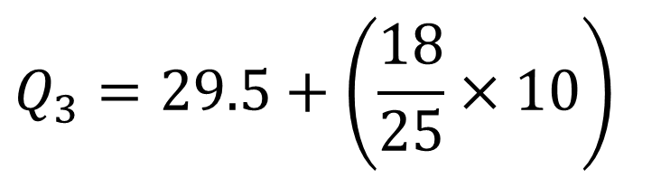

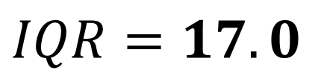
$$Q_{1}=19.5+\left(\frac{1}{43}×10\right)$$
$$Q_{1}=19.7$$
$$Q_{3}=29.5+\left(\frac{18}{25}×10\right)$$
$$Q_{3}=36.7$$
$$IQR=17.0$$

Slide 7
Percentiles
The LQ, median and UQ give you
25%, 50% and 75% respectively.
But we can have any percentage you like!

Slide 8
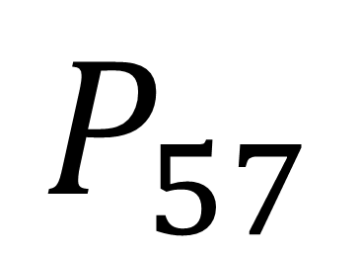
Notation
$$P_{57}$$
57th Percentile: 57%

Slide 9
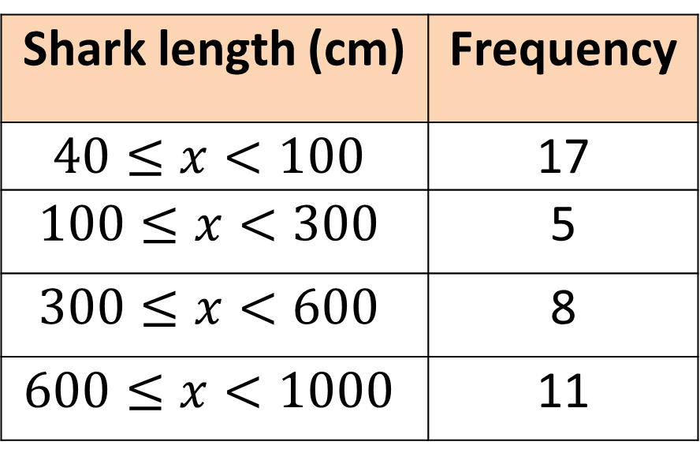
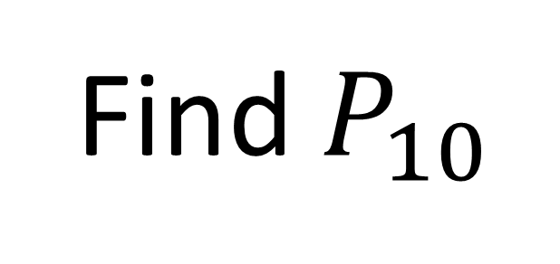
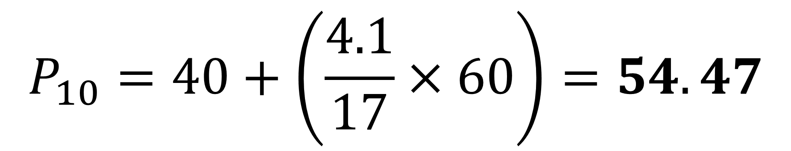
Find $P_{10}$
Shark length (cm) | Frequency
$$40≤x<100$$ | 17
$$100≤x<300$$ | 5
$$300≤x<600$$ | 8
$$600≤x<1000$$ | 11
C.F.
17
22
30
41
$$P_{10}=40+\left(\frac{4.1}{17}×60\right)=54.47$$
Notes:
There’s a slip to print out here.

