Slide 1
LO: Upper and Lower
Bounds

Slide 3
Round 3.55
to 1 decimal place.
3.6

Slide 4
Round 3.55
to 1 significant figure.
4

Slide 5
Round 3.55
to the nearest whole number.
4

Slide 6
Round 2.54
to 1 decimal place.
2.5

Slide 7
Round 3.44
to 1 significant figure.
3

Slide 8
Round 3.45
to the nearest whole number.
3

Slide 9
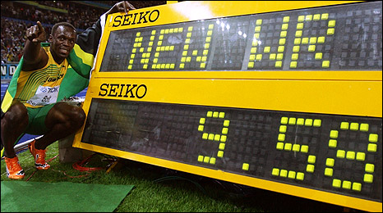
Is Usain Bolt as fast as they say he is?
https://www.youtube.com/watch?v=By1JQFxfLMM

Slide 10
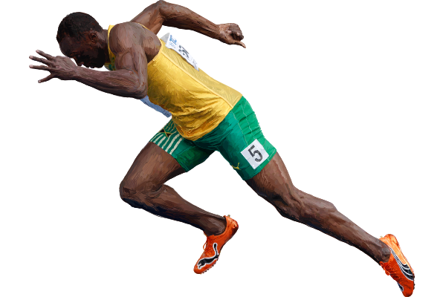
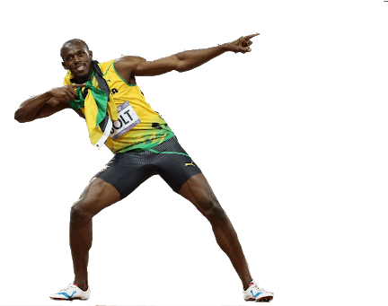
Fastest Time |  |  |  |  |  |  |  |  |  | secs
World Record Time |  |  |  |  |  |  |  |  | 9.58 | secs
Slowest Time |  |  |  |  |  |  |  |  |  | secs
9.575
9.585

Slide 11
Lower Bound
Upper Bound
9.575 ≤ time < 9.585
down to
and including
up to but
not including

Slide 12
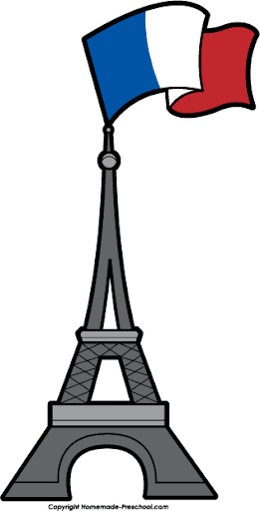
The height of the Eiffel Tower is 320 meters
to the nearest 10 meters.
The lowest height it could be is…
315
The highest height it could be is…..
325

Slide 13
20cm is rounded to the nearest cm
What are the lower and upper bounds?
1cm ÷ 2 = ± 0.5
19.5 ≤ l < 20.5

Slide 14
20cm is rounded to the nearest 5cm
What are the lower and upper bounds?
half the accuracy number
then add and subtract
i.e. 5cm ÷ 2 = ± 2.5
17.5 ≤ l < 22.5

Slide 15
20.6cm is rounded to the 1 decimal place
What are the lower and upper bounds?
1 decimal place = 0.1
0.1 ÷ 2 = ± 0.05
20.55 ≤ l < 20.65

Slide 16
20.63cm is rounded to the 2 decimal place
What are the lower and upper bounds?
2 decimal place = 0.01
0.01 ÷ 2 = ± 0.005
20.625 ≤ l < 20.635

Slide 17
20cm is rounded to the 1 significant figure
What are the lower and upper bounds?
1st significant number is 10
10 ÷ 2 = 5
15 ≤ l < 25

Slide 18
3400cm is rounded to the 2 significant figures
What are the lower and upper bounds?
2nd significant number is 100
100 ÷ 2 = 50
3350 ≤ l < 3450

